Slide 1

INTERMEDIATE PROGRAMMING LESSON
COLOR LINE FOLLOWER MY BLOCK WITH INPUTS: MOVE FOR DISTANCE

Slide 2
Lesson Objectives
Learn how to write a line follower that takes multiple inputs
Learn how to write a line follower that stops after a certain number of degrees
Practice making a useful My Block
Prerequisites: My Blocks with Inputs & Outputs, Data wires, Loops, Switches.
The code uses Blue Comment Blocks. Make sure you are running the most recent version of the EV3 Software. EV3Lessons has Quick Guides to help you.

Slide 3
My Block Line Follower with Inputs
Making a My Block out of your line follower reduces the length of your code and makes it reusable
Learning to write a line follower that takes multiple inputs (power, degrees and color) can be very useful
Every time you want a line follower that goes a different distance, you just need to change the input!

Slide 4
Tips to Succeed
You will need to know how to make a Simple Color Line Follower program and how to make a My Block with inputs
Since you will use your EV3 Color Sensor in Color Mode, you will not have to Calibrate your color sensor for this lesson
Check which ports you have your color sensor connected to and adjust the code as needed
You may have to adjust the speed or direction to work for your robot. Make sure that the the color sensor is in front of the wheels in the direction of travel.
Make sure you place the robot on the side of the line that you are following. The most common mistake is placing the robot on the wrong side of the line to begin with.

Slide 5
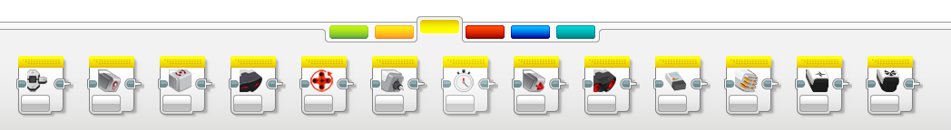
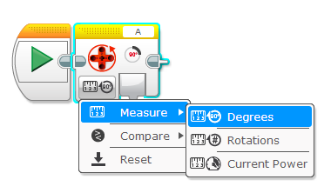
New Block
In this lesson, you will use the Sensor Block from the yellow tab for the first time.
We will use the Motor Rotation block. This is the rotation sensor.
The block has many useful modes.
In this lesson, we learn to use it in reset mode so that the value in the sensor will be set to 0.

Slide 6
Color Follower for Distance
STEP 1: Create a simple color line follower program
STEP 2:
A. Include a “reset the rotation” sensor block to delete any prior readings
B. Exit the line follower loop when the robot has moved certain degrees
STEP 3:
A. Create a My Block with the code in Step 2 with inputs for degrees, power and color.
B. Wire the inputs in the My Block
Challenge: Write a line follower My Block that follows a colored line and stops after moving a certain number of degrees. The line follower should take three inputs (degrees, power and color to follow).
Goal: Stop after 720 degrees

Slide 7
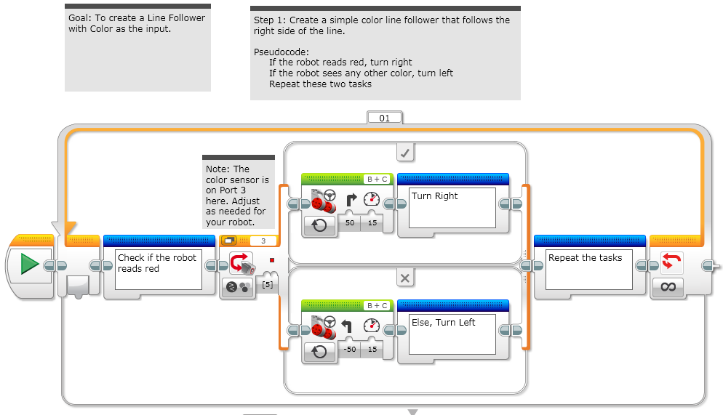
Step 1: Simple Color Line Follower

Slide 8
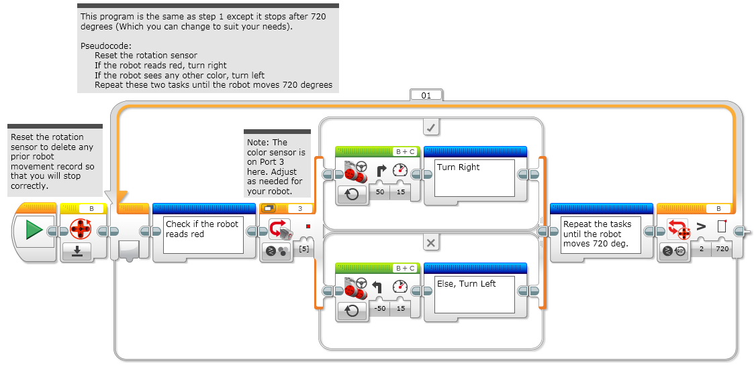
Step 2: Add Reset & Loop Exit

Slide 9
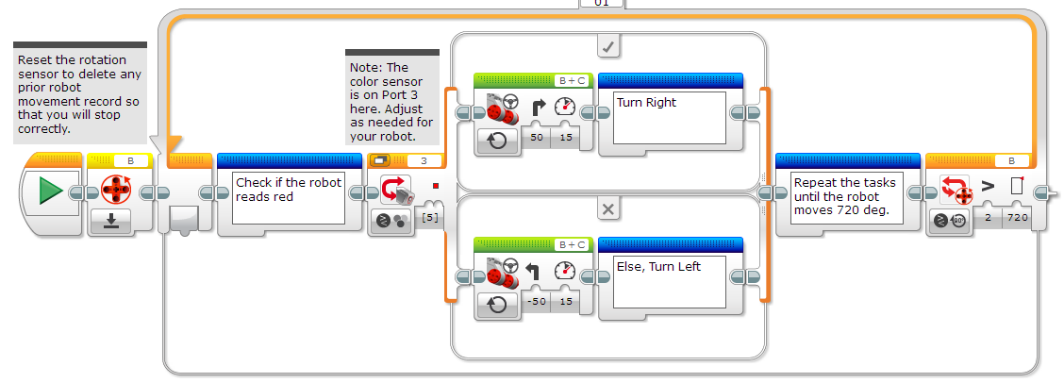
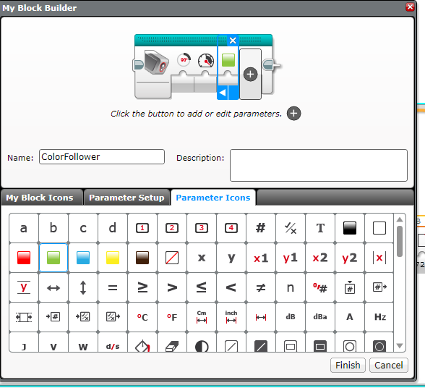
Step 3a: Create a My Block
Highlight all the blocks then go to My Block Builder
Add 3 inputs: one for power and one for color, and one for degrees
Refer to the My Blocks with Inputs & Outputs lesson if you need help setting up the My Block
A
B

Slide 10
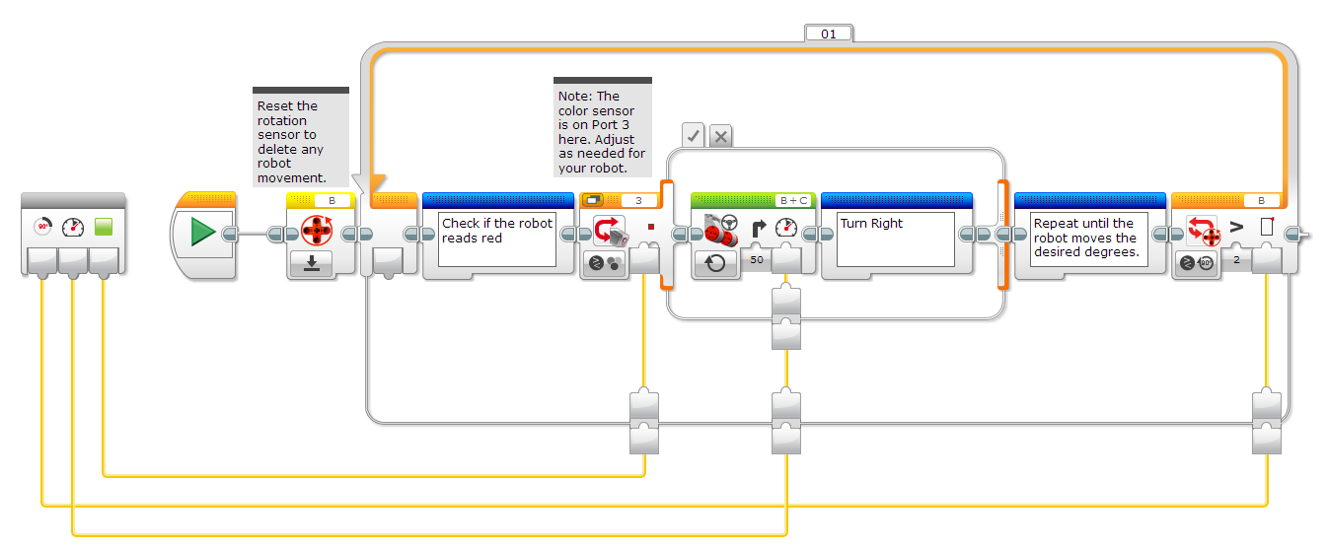
Step 3B: Wire the My Block
Color
Degrees
Power
C
The degrees input goes into loop exit condition
The power input goes into power input on the steering block
The color input goes into color input for the switch

Slide 11
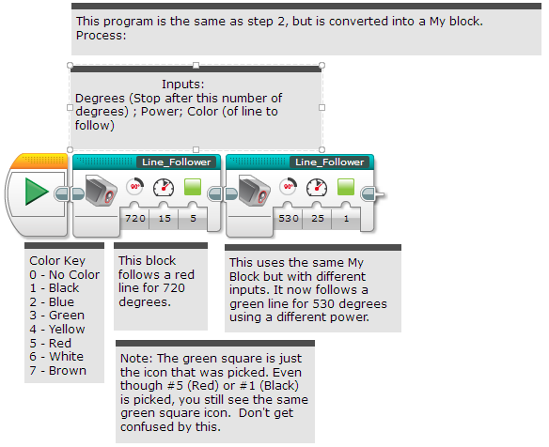
STEP 3C: Using the My Block
Now the My Block appears in the turquoise tab and the same My Block can be used again and again with new inputs (see left)
The first block alone solves the challenge of line following for 720 degrees.
The second block in this code is to show that the same block can be used with different inputs to follow a different line for a different distance.
If you want to learn smoother line followers, proceed to the proportional control lesson in Advanced.

Slide 12
Credits
This tutorial was created by Sanjay Seshan and Arvind Seshan
More lessons are available at www.ev3lessons.com
This work is licensed under a Creative Commons Attribution-NonCommercial-ShareAlike 4.0 International License.

