Slide 1

INTERMEDIATE PROGRAMMING LESSON
COLOR LINE FOLLOWER MY BLOCK WITH INPUTs: MOVE UNTIL BLACK

Slide 2
Lesson Objectives
Learn how to write a line follower that takes multiple inputs
Learn how to write a line follower that stops when it sees a another line
Practice making useful My Blocks
Prerequisites: My Blocks with Inputs & Outputs, Data Wires
The code uses Blue Comment Blocks. Make sure you are running the most recent version of the EV3 Software. EV3Lessons has Quick Guides to help you.

Slide 3
Tips to Succeed
You will need to know how to make a Simple Color Line Follower program and how to make a My Block with inputs
Since you will use your EV3 Color Sensor in Color Mode, you will not have to Calibrate your color sensor for this lesson
Check which ports you have your color sensor connected to the EV3 and adjust the code as needed
You may have to adjust the speed or direction to work for your robot. Make sure that the the color sensor is in front of the wheels in the direction of travel.
Make sure you place the robot on the side of the line that you are following. The most common mistake is placing the robot on the wrong side of the line to begin with.

Slide 4
Color Follower Until Color
Challenge: Create a line follower My Block that stops when it sees black
STEP 1:
Create a simple line follower
STEP 2:
Change the loop exit condition to “until black”
STEP 3:
A. Make a My Block with 3 inputs: Power, Color to line follow on, and Color to stop at
B. Wire the My Block

Slide 5
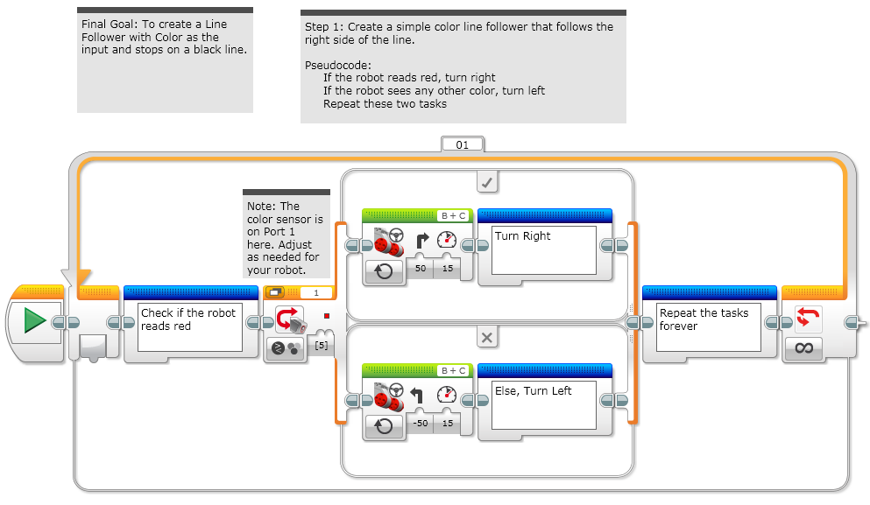
Step 1: Simple Line Follower

Slide 6
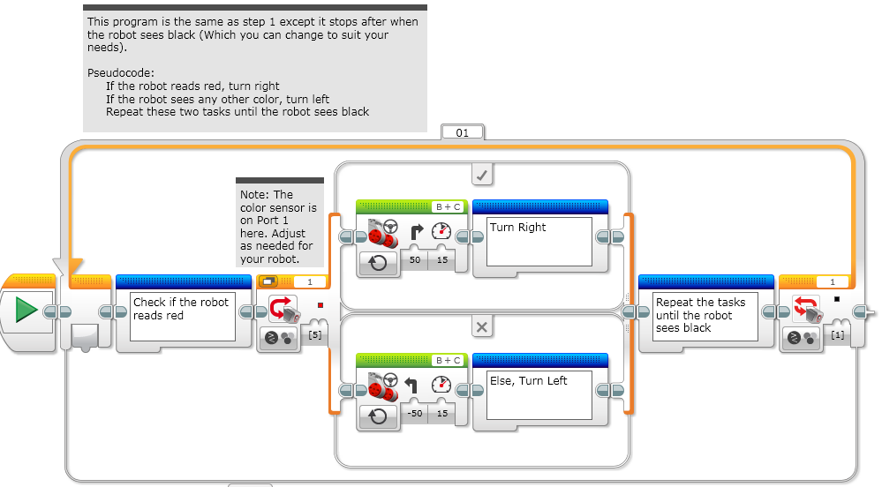
Step 2: Loop Exit Condition

Slide 7
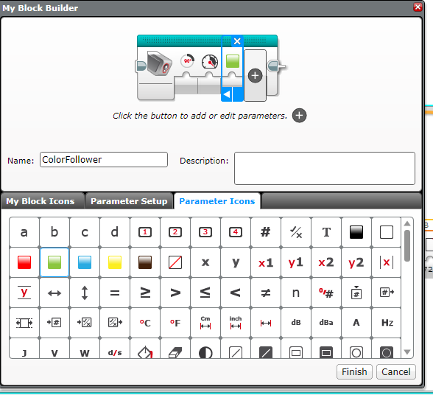
Step 3A: Create a My Block
Highlight all the blocks then go to My Block Builder
Add 3 inputs: one for power and one for color, and one for degrees
Refer to the My Blocks with Inputs & Outputs lesson if you need help setting up the My Block
A
B

Slide 8
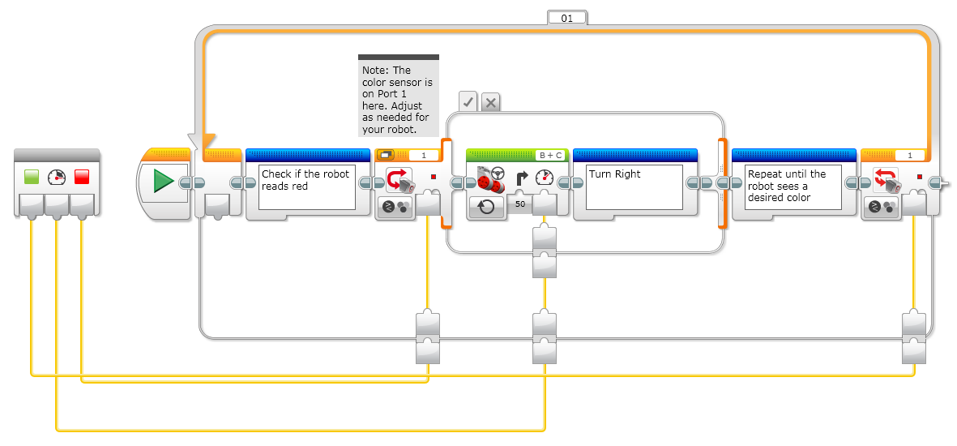
Step 3B: Wire the My Block
Color to line follow
Color to stop at
Power
C
The color to stop at goes into loop exit condition
The power input goes into power input on the steering block
The color input goes into color input for the switch

Slide 9
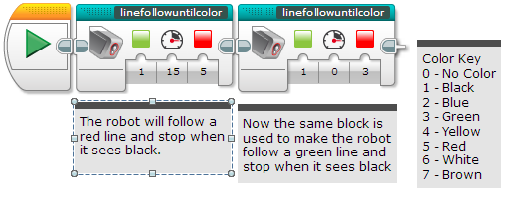
Step 3B: The My Block
Now the My Block appears in the turquoise tab and the same My Block can be used again and again with new inputs (see left)
The first block solves the challenge and follows a red line until it sees the robot sees black
The second block in this code is to show that the same block can be used with different inputs
If you want to learn smoother line followers, proceed to the proportional control lesson in Advanced.

Slide 10
Next Steps
We use a simple line follower in this lesson. You can combine these techniques with any line follower.
Learn how to create a proportional line follower for light or a smooth line follower for color → check out our Advanced: Proportional Line Follower lesson.

Slide 11
Credits
This tutorial was created by Sanjay Seshan and Arvind Seshan
More lessons are available at www.ev3lessons.com
This work is licensed under a Creative Commons Attribution-NonCommercial-ShareAlike 4.0 International License.

