Slide 1

INTERMEDIATE PROGRAMMING LESSON
DEBUGGING TECHNIQUES

Slide 2
Lesson Objectives
Learn the importance of debugging
Learn some techniques for debugging your code

Slide 3
Why Debug?
Debugging is a useful strategy to figure out where in your program something is going wrong or what went wrong
Once your code starts to become long or complicated (e.g. using sensors), it can become hard to figure out where in the program you are
The following slides show you some ways of knowing where you are in your program or knowing what values your sensors see
You will see that these techniques can be VERY USEFUL to any programmer.
Locate Error
Think of Solution
Fix Error
Re-Test Program
HURRAY!

Slide 4
Different Techniques
Play Selected vs. Button Press
Very similar techniques
Lets you try out smaller portions of code
Play Selected requires bluetooth
Button Press requires some care so you don’t jostle the robot when pressing the button
Light, Sound and Display
Very similar techniques
Light and Sound are used in the same way
Teams enjoy the sound more and it is easier to identify sometimes
Display Block comes in handy for knowing what block is played if your robot gets stuck and if you want to see the sensor values

Slide 5
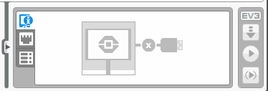
Play Selected
Play selected is useful for running small parts of the program
Use when you don’t want to wait for your robot to complete other parts of the program before getting to the part you want to see
If you don’t have bluetooth built in the computer, we recommend that you purchase a bluetooth dongle (US $10-15) because it makes this type of debugging easier
To use, highlight the parts of the program you want to run and pick the play button with the parentheses (>)

Slide 6
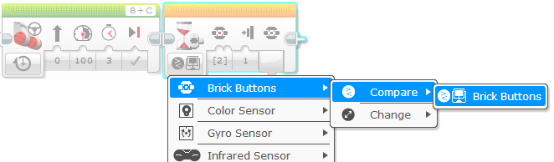
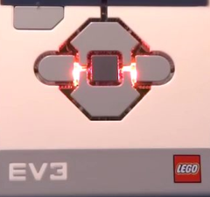
Wait For Button Press
To place a Wait for Button Press block in your program, place a wait block into your program
Go under brick buttons > compare > brick buttons, then choose which button needs to be pressed to continue the program
Place these wait for button presses every block or two close to where the robot is not working correctly
This can help you pinpoint which block is causing the robot to fail
The robot will stop and “wait for you to press the button”

Slide 7
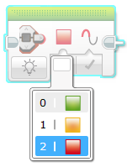
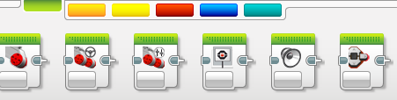
Visual Alerts: Brick Status Light
Place these blocks at critical steps in your program
You will then be able to visualize what block is playing and figure out where the error might be
Brick status light blocks can be used for warnings
Brick
Status
Light
block

Slide 8
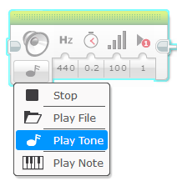
Sound Alerts: Sound Block
You can insert different sounds at intervals (about every 5 blocks or so, and then run the program again while listening for beeps.
Once you pick Play Tone, select Play Type and pick “play once”
These sounds can help you narrow down where in the program something is going wrong.
Sound
block

Slide 9
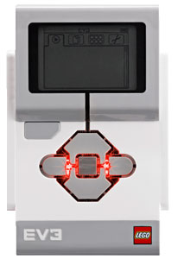
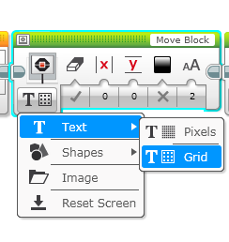
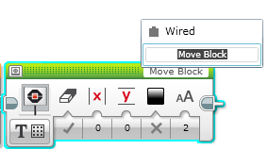
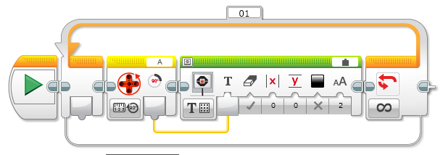
Print to Screen: Display Block
Showing which block is playing on your robot
Helps identify what block the robot is stuck on
Seeing the sensor readings – to see what the robot sees!
Move inches
Light-1 100

Slide 10
Sample Video on Next Slide
The video on the next slide shows some of the debugging techniques
Wait for button press
Sounds alerts
Brick lights
Sensor readings displayed on brick

Slide 11
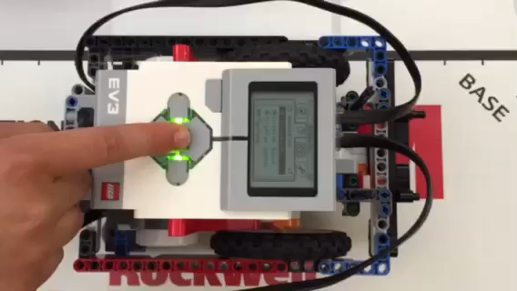
Sample Video – Click to Play

Slide 12


Other Methods
Recordings:
You can record your robot with a camera. Then watch the video and observe what went wrong
Comments:
You can also use “comments” to help debug – we add comments to remember what older values were entered into a block. We watch the robot and then adjust these values

Slide 13
CREDITS
This tutorial was created by Sanjay Seshan and Arvind
Author’s Email: team@droidsrobotics.org
This work is licensed under a Creative Commons Attribution-NonCommercial-ShareAlike 4.0 International License.

