Slide 1

INTERMEDIATE PROGRAMMING LESSON
Infrared sensor

Slide 2
Lesson Objectives
Learn how to use an Infrared Sensor
Learn to make a remote control system and a program that follows the beacon.
Learn to use the Infrared Sensor in all three major modes
Learn the limitations of the Infrared Sensor
Prerequisites: Switches, Loops, Compare blocks, and Math blocks

Slide 3
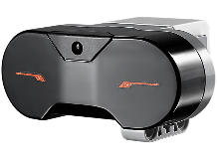
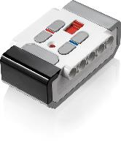
What does the Infrared Sensor do?
Measures proximity to beacon or object
Measures the angle of the beacon relative to the sensor
Measures which button is pressed on remote.
Beacon/remote can be set to 1 of 4 channels. Infrared sensor code must specify which channel to use. This allows you to use multiple remotes in the same room
Infrared Sensor
Beacon/Remote

Slide 4
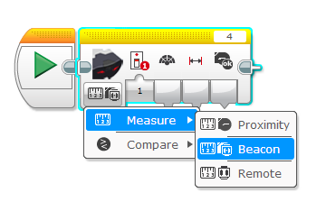
Three Modes
Works up to about 70cm away (or 100 proximity units)
Proximity Mode
Returns undefined unit type called proximity (not inches or centimeters)
Beacon Mode
Returns heading (angle) and distance to beacon. Heading measurement is not in degrees.
Remote Mode
Returns which button is pressed on the remote
We will use all three in this lesson
The Infrared Sensor block can be found in the yellow sensor tab

Slide 5
Challenges
To learn how to use the Infrared Sensor you will complete three challenges:
Challenge 1: Create a remote control for your robot that does a different action based on which button you press on the Remote
Challenge 2: Proportional Dog Follower: The robot should move to wherever the Beacon is using proximity and heading
Challenge 3: Test how accurate the Infrared Sensor is for measuring distances

Slide 6
Pseudocode/Hints
Challenge | Hint/Pseudocode
Remote Control | Run different actions based on which button(s) are pressed on channel 1
Proportional Dog Follower | If the robot is <15 proximity from the beacon move backward If the robot is >15 proximity from the beacon move forward Use proportional control to adjust the steering base on the “heading” of the beacon Note: Proportional Control is covered in an Advanced Lesson on EV3Lessons.com. Please refer to this lesson.
Accuracy of Proximity | Measure distance using ultrasonic and measure proximity using infrared (use Port View on brick). Compare measurements for different distances to different surfaces.

Slide 7
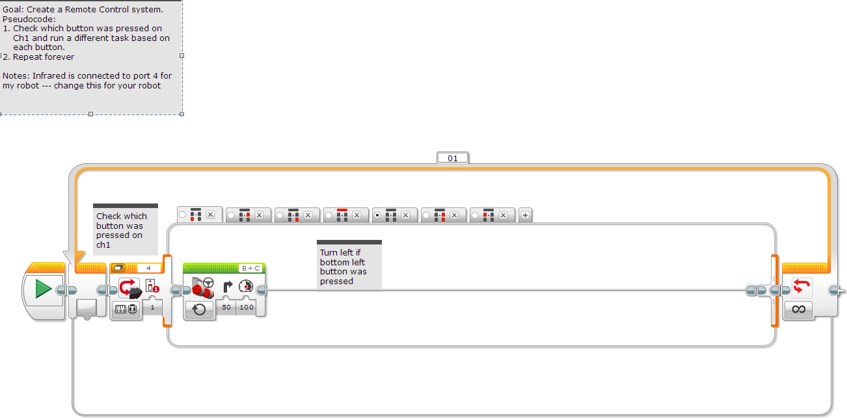
Solution: Remote Control
Make sure to set your remote to channel 1 using the slider button on remote.

Slide 8
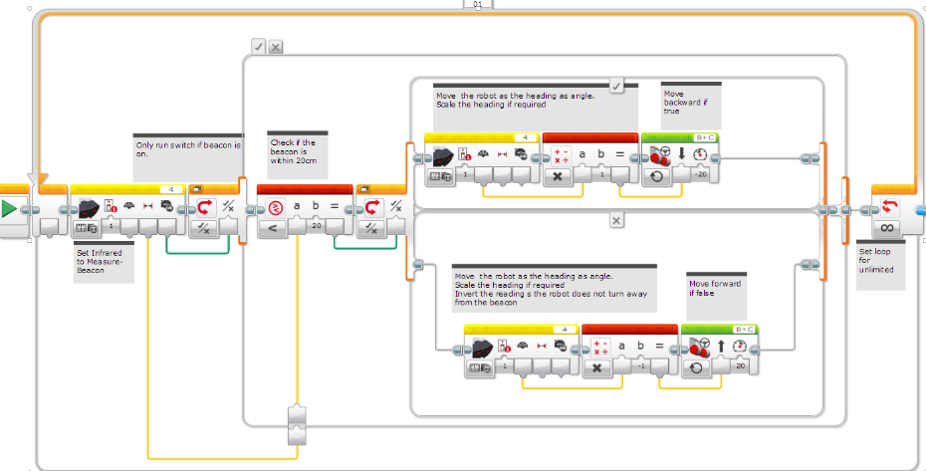
Solution: Dog Follower

Slide 9
Challenge 3: Compare Sensors
Surface | Actual Distance to Surface | Ultrasonic Measurement | Infrared Measurement
Aluminum Foil | 10CM
Wooden Table | 10CM
Black Paper | 10 CM
Glass | 10 CM
White Paper | 10 CM
Instructions:
Hold the each sensor 10CM away from the material and check the sensor readings on Port View
Pick reflective and non-reflective surfaces to try
Lesson:
The Infrared Sensor’s reading are based on the intensity of the reflective light. It will not be as accurate as an ultrasonic sensor in measuring how far away an object is. Try different distances next.

Slide 10
Discussion Guide
What modes does the Infrared sensor have?
Ans: Proximity, Beacon and Remote
Can the Infrared sensor measure distance?
Yes, but not accurately because it is based on the reflected light intensity. So, it is going to vary based on the material the object is made of.

Slide 11
Next Steps
Go to the Advanced Lesson on the Infrared Sensor (*coming soon)
Read the Advanced Lesson on Proportional Control.

Slide 12
Credits
This tutorial was created by Sanjay Seshan and Arvind Seshan
More lessons at www.ev3lessons.com
This work is licensed under a Creative Commons Attribution-NonCommercial-ShareAlike 4.0 International License.

