Slide 1

INTERMEDIATE PROGRAMMING LESSON
LOGIC OPERATIONS & DECISION MAKING

Slide 2
Lesson Objectives
Learn what the Logic Block does
Learn how to use the Logic Block
Prerequisites: Data Wires, Sensor Blocks

Slide 3

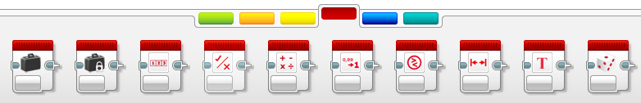
Logic Operations Block
The Logic Bock does a Logic operation on its inputs, and outputs the result
A Logic Block takes inputs that are True or False, and produces a True or False output
Logic values can be used as inputs into loop exists and switch conditions.
It is found in the Red Programming Pallet tab
Inputs
Mode
Output/Result

Slide 4
Different Modes in the Logic Block
Icon | Mode | Inputs | Output/Result
 | AND | A, B | True if both A and B are both true, otherwise the result is False
 | OR | A, B | True if either A or B (or both) is/are True. The result is False if both A and B are False
 | XOR | A, B | True only if one (and exactly one) of A and B is True The result is False if both A and B are True The result is False if both A and B are False
 | NOT | A | Outputs the opposite of what you input. The result is True if A is False The result is False if A is True
The icons are Venn Diagrams. The dark shaded areas identify what needs to happen for the block to output True.

Slide 5
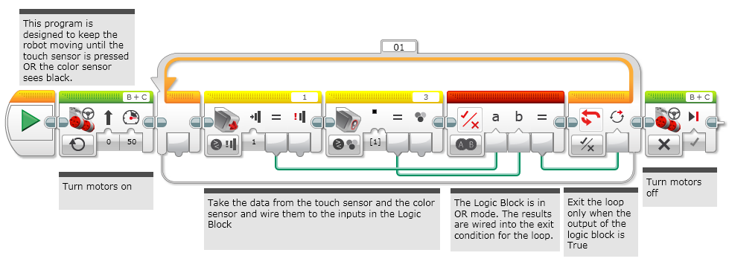
Logic Blocks in Three Easy Steps
CHALLENGE: Make your robot drive forward until EITHER the Touch Sensor is pressed or the Color Sensor detects black.
STEP 1: Turn the motors on
STEP 2: Add the Logic and Sensor Blocks
A. Use a Logic Block in the OR mode
B. Add the inputs: Take a color sensor and a touch sensor blocks and wire them into the Logic Block as inputs
STEP 3: Add a Loop and loop exit condition:
Place the Sensor and Logic Blocks in a loop
For the exit condition of the loop, select logic. Wire the result of the Logic Block into the exit condition
If the result of STEP 2 is True, you should exit the loop and stop the robot

Slide 6
Challenge Solution
STEP 1
STEP 2
STEP 3

Slide 7
Credits
This tutorial was written by Sanjay and Arvind Seshan
More lessons at www.ev3lessons.com
This work is licensed under a Creative Commons Attribution-NonCommercial-ShareAlike 4.0 International License.

