Slide 1

INTERMEDIATE PROGRAMMING LESSON
MOVE Distance My Block (Move_CM)

Slide 2
Lesson Objectives
Create a useful My Block
Learn why creating a My Block that takes measurements made with a ruler can be useful
Make a Move_CM My Block
Prerequisites: Moving Straight, Port View, My Blocks with Inputs and Outputs, Math Blocks, Data Wires

Slide 3
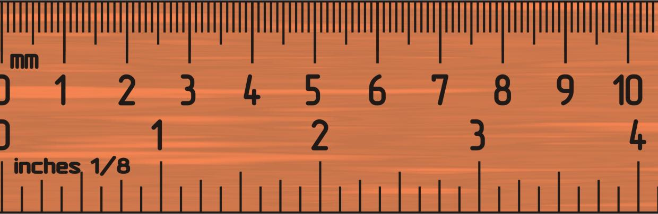
Why a Move Distance My Block?
Built-in move blocks will not take inputs (values) in centimeters or inches.
It is much easier to measure distance with a ruler than degrees or rotations.
If you change your robot design to have bigger or smaller wheels later on, you don’t have to re-measure every movement of your robot
Instead of changing distances in every single program you wrote, just go into your new Move Distance Block and change the value for how many inches/cm one motor rotation would take.

Slide 4
MOVE_CM IN THREE EASY STEPS
STEP 1: Determine how many motor degrees your robot moves in 1cm
STEP 1A: Wheel Measurement
STEP 1B: Program the robot to move 1cm
STEP 2: Add a Math Block to convert centimeters to degrees
STEP 3: Create a Move_CM My Block with 2 inputs (power and degrees)

Slide 5
Step 1A: How Many Degrees Does The Robot Move in 1 CM?
Method 1:
Look up the wheel size in mm printed on your tire and divide by 10 to convert to cm (because 1cm=10mm)
Multiply the answer in step 1 by π (3.1415…) to compute circumference
Divide 360 degrees by value from step 2. This computes degrees in 1cm since you travel one circumference in 1 rotation and 1 rotation is 360 degrees
Example calculation using the standard EV3 Edu 45544 set wheels:
EV3 EDU (45544) wheels are 56mm = 5.6cm in diameter
5.6cm × π = 17.6cm per rotation
360 degrees ÷ 17.6cm = 20.5 motor degrees per cm
Helpful chart with common LEGO wheels and their diameters.
http://wheels.sariel.pl/

Slide 6
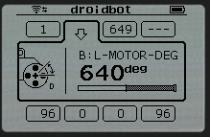
Step 1A: Alternative Method
Alternate Method: Use Port View to find the Motor Degrees value. Use this method if you cannot find the diameter value printed on your wheel.
Put your ruler next to your wheel/robot at 0 centimeters (whatever part of the robot you use to align with 0, you should use to use to measure distance in step 2)
Roll your robot forward any amount of centimeters, making sure your robot does not slip.
Take the degree reading you see on the screen for the motor sensor and divide by the amount of centimeters you moved.
The answer will be the number of degrees your robot's wheels turn in 1 centimeter.

Slide 7
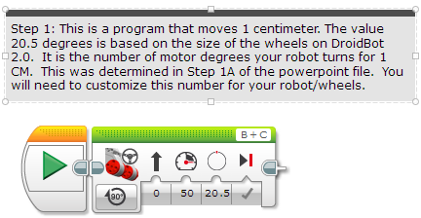
Step 1B: Program Move 1CM
Use the Motor Degrees value you obtained for your robot in slides 5 or 6

Slide 8
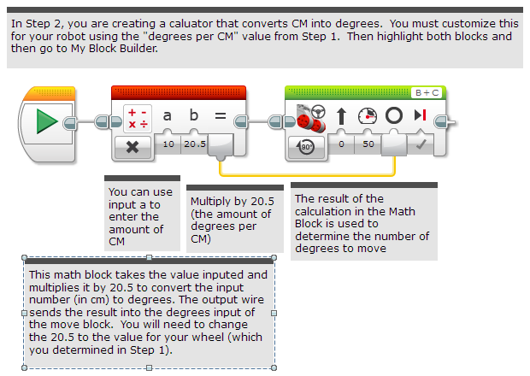
Step 2: Degree to CM Conversion
Create the Calculator that coverts degrees to centimeters

Slide 9
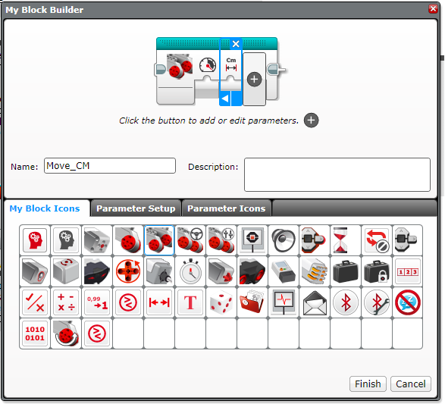
Step 3A: Setup the My Block
A. Highlight the two blocks in Step 2 and go to My Block Builder
B. Add two inputs: Power and Centimeters and complete the setup process.
If you need help in the My Block Builder, refer to the My Block with Inputs and Outputs Lesson in Intermediate
A
B

Slide 10
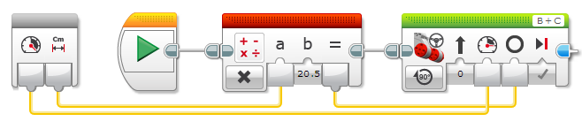
Step 3B: Wire the My BLOCK
C. Wire the inputs in the grey block. The centimeters input connects to the Math Block. The power goes into the Move Steering Block’s power input. The result of the Math Block is wired into the degrees input in the Move Steering Block.

Slide 11
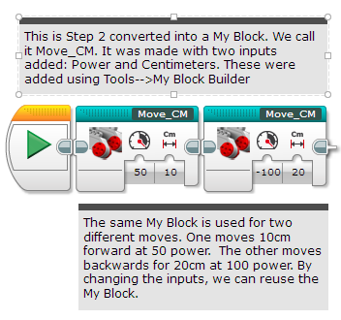
Step 3C: Completed Move_CM

Slide 12
Discussion
Why is a Move_CM My Block useful?
You can measure distances in centimeters and input this number into your block instead of programming in degrees or rotations
Will changing the inputs in one copy of Move_CM impact another copy of it?
No. That is exactly why a My Block is useful. You can use the same block multiple times, each time using a different number for power and centimeters (or any other parameter you set up).
Can you alter a My Block after it is made?
You can change any of the contents, but not the grey blocks (input and output parameters). If you need to make changes to the parameters, you must remake your My Block.

Slide 13
CREDITS
This tutorial was created by Sanjay Seshan and Arvind Seshan
More lessons are available at www.ev3lessons.com
This work is licensed under a Creative Commons Attribution-NonCommercial-ShareAlike 4.0 International License.

