Slide 1

INTERMEDIATE PROGRAMMING LESSON
Introduction to MY BLOCKs

Slide 2
Lesson Objectives
Learn how to make custom blocks in the EV3 Software (My Blocks)
Learn why a My Block is useful
Learn to construct a My Block with Inputs and Outputs (Parameters)
Note: The new features mentioned in this lesson are available in V.1.3 of both Home Edition and Education Edition. Update your software if you are not running this version.

Slide 3
What is a My Block?
A My Block is a combination of one or more blocks that you create that can be grouped into a single block
My Blocks are basically your own custom blocks
Once a My Block is created, you can use it in multiple programs
Just like any other block in EV3, My Blocks can have both inputs and outputs (parameters)
CM
The two blocks above are examples of My Blocks:
Move_Inches tells the robot to move the number of inches we input
Turn_Degrees tells the robot to turn the amount we input
These My Blocks will be taught in separate lessons.

Slide 4

When do You Use a My Block?
Whenever the robot is going to repeat an action inside your program
When code is repeated in a different program
Organize and simplify your code

Slide 5
Why Should You Bother?
Because of My Blocks, your missions will look like this…
Instead of this….
This makes your code easier to read and easier to modify!!!

Slide 6
What Makes a Useful My Block
Note: Making My Blocks with inputs and outputs can make them far more useful. However, you need to be careful not to make the My Block too complicated.
Question: Look at the list of three My Blocks below. Which ones do you think are useful for to use?
Move5CM (Moves the robot five centimeters)
MoveCM with a centimeter and power input
MoveCM with centimeter, power, angle, coast/brake, etc. inputs
Answer:
Move5CM may be used often, but you will be forced to make other My Blocks for other distances. This will not be fixable later.
MoveCM with centimeters and power as inputs is probably the best choice.
MoveCM with centimeters, power, angle, coast/brake, etc. might be most customizable, but some of the inputs might never be used.

Slide 7
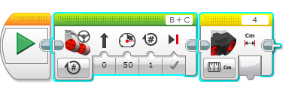
Step 1: Highlight Blocks
For this lesson, our goal is to move a desired amount of rotations at a desired power and return the ultrasonic value at the end
Step 1: Select the two blocks in the code that you want to turn into a My Block
Question: What would be the input(s) and output(s) for our My Block?
Answer: The inputs are power and rotations. The Output is distance measured by the ultrasonic sensor.

Slide 8
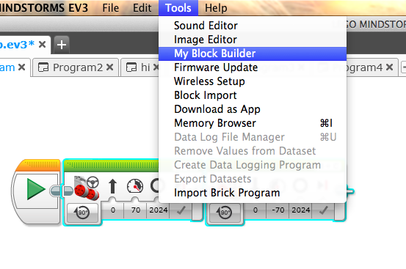
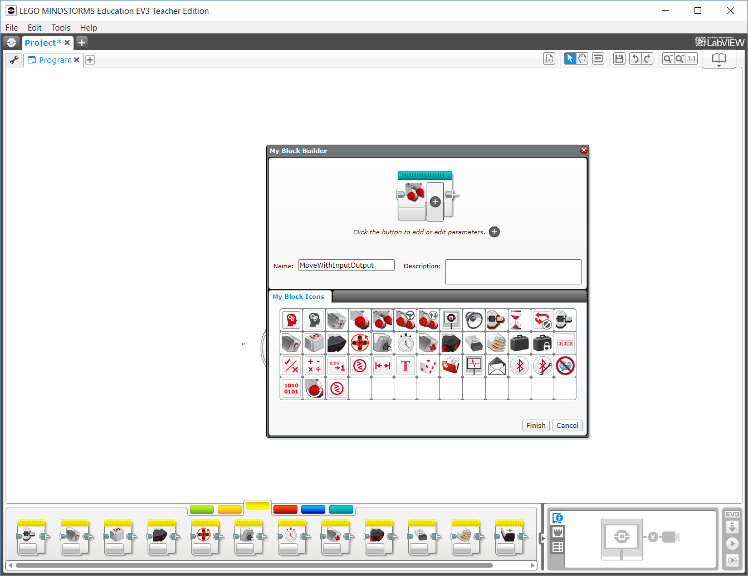
Step 2: Launch My Block Builder
A: Go to Tools → My Block Builder - If you encounter an error, view the next slide
B: Pick a My Block Name
C. Add a Description
D. Select an Icon for the whole My Block
A
B
Move Rotations and output Ultrasonic
C
D

Slide 9
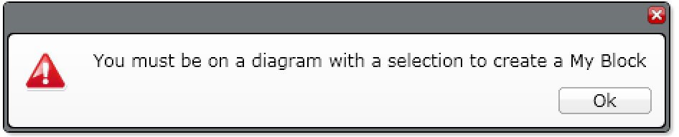
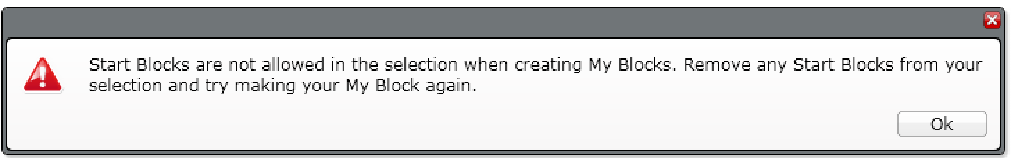
Common Error Messages
ERROR 1:
SOLUTION: You need to highlight the blocks before going into My Block Builder
ERROR 2:
SOLUTION: Un-highlight the start block before going into My Block Builder
If you continue to have trouble at this step, just select a single block in your program and create a My Block from it. You can edit and add more blocks to a My Block at any time. You can even change the inputs and outputs* of a My Block after creation.
* New for 2017

Slide 10
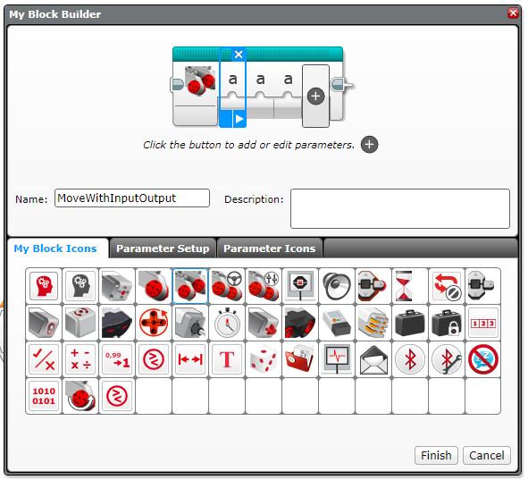
Step 3: Add Inputs/Outputs
A
A. We need to add two inputs and one output so we will click the + button three times
B. Go back to the first parameter
C. Go to Parameter Setup
Move Rotations and output Ultrasonic
B
C
Move Rotations and output Ultrasonic

Slide 11
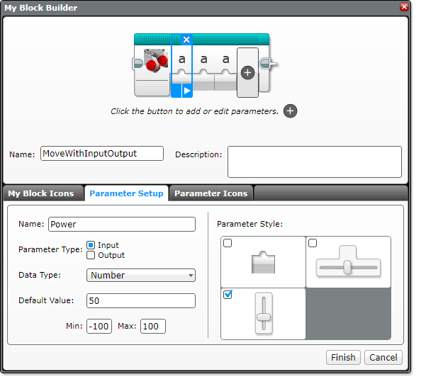
Step 4: Setup Parameter for Power
Move Rotations and output Ultrasonic
A. Pick a Name
A
E
B. Select Input
B
C. Power is a Number
C
D. Choose a default value
D
E. Choose button Style
Set min & max values (only available with slider)

Slide 12
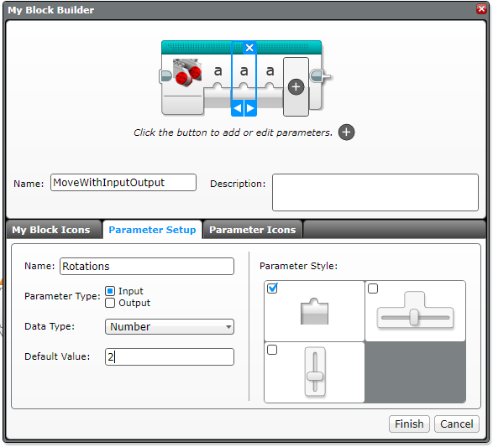
Step 5: Setup Parameter for Rotation
Now click on the second parameter
Move Rotations and output Ultrasonic
A
E
A. Pick a Name
B
B. Select Input
C
C. Rotation is a Number
D
D. Choose a default value
E. Choose button Style

Slide 13
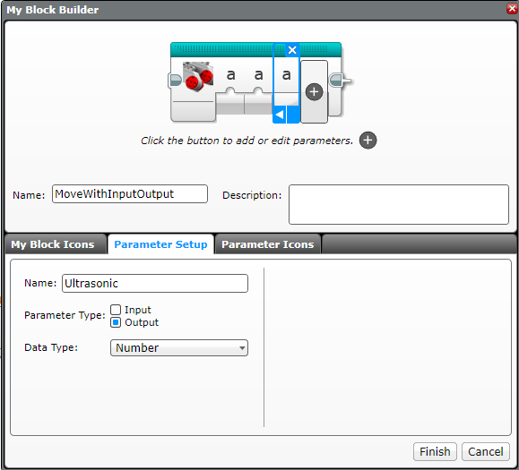
Step 6: Setup Parameter for Ultrasonic
Now click on the third parameter
Move Rotations and output Ultrasonic
A
A. Pick a Name
B
B. Select Output
C
C. Ultrasonic output is a Number

Slide 14
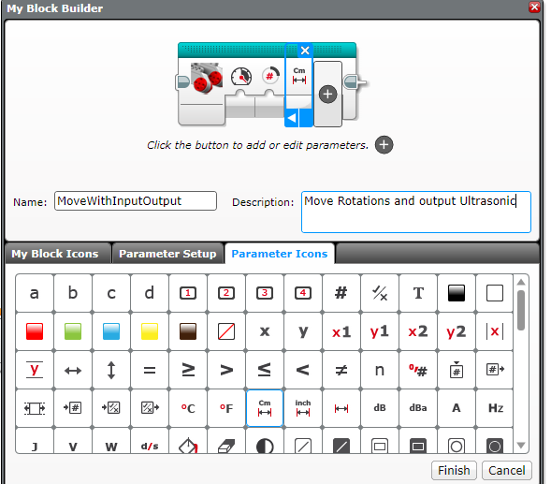
Step 7: Setup Parameter Icons
In this step, we will change the icons for the parameters from “a” to an image of your choice.
Click on a parameter
B. Click on the tab Parameter Icons if not already on this tab, and choose an icon
C. Repeat steps A and B for each parameter
D. Press Finish when you are done.
A
B
C

Slide 15
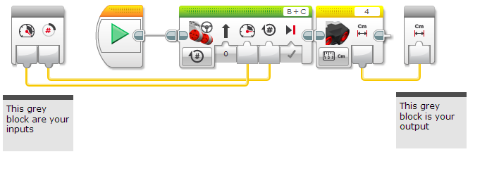
Step 8: Add Data Wires
When you click Finish (on previous slide) you will see this.
Wire up the My Block by dragging a data wire from each parameter to its corresponding slot on the move steering block and sensor block.
These grey blocks are our inputs/outputs (parameters) that were set up automatically by the My Block Builder

Slide 16
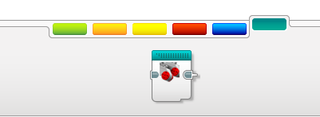
Where is the My Block?
Your My Block will appear in the turquoise tab. You can now use this block in any program.
Below, the same My Block is used twice. Once to move forward 2 rotations and then backwards 5 rotations.
Note: The same My Block can be used with different input values.

Slide 17
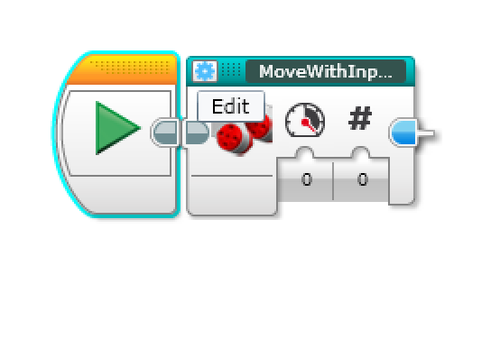
Editing Your Newly Created My Block
If you want to change anything in the My Block you just created, simply press on the “Edit” button on the top Left corner of the My Block*
You can change the name, add or delete parameters, etc.
* New for 2017

Slide 18
Credits
This tutorial was created by Sanjay Seshan and Arvind Seshan
More lessons are available at www.ev3lessons.com
This work is licensed under a Creative Commons Attribution-NonCommercial-ShareAlike 4.0 International License.

