Slide 1

INTERMEDIATE PROGRAMMING LESSON
TURNING My BLOCK

Slide 2
Lesson Objectives
Create a useful My Block
Learn to make a My Block that will take inputs based on measurements with a protractor
Make a Turning My Block
Prerequisites: Turning, My Blocks with Inputs and Outputs, Data Wires, Math Blocks, Port View

Slide 3
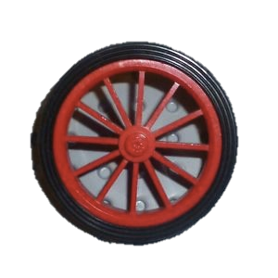
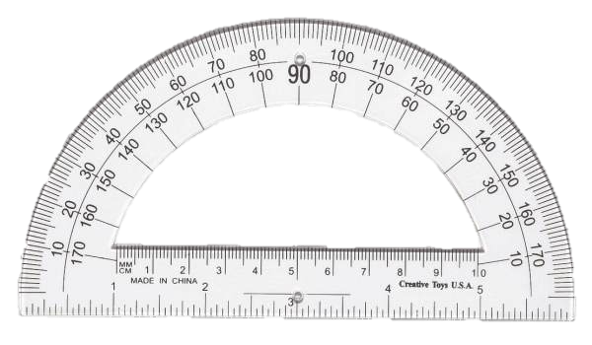
Rotation vs. Protactor Degrees
45 degree turn by the robot in the real world can be measured with a protractor. We call this protractor degrees.
You can use the EV3 to measure how much your wheel turns. We call this rotation degrees.
Just like Move_CM, you can also create a My Block for turns. In Move Centimeters, we had to figure out how much the robot wheels rotate for one CM.
To make a Turn Degrees My Block, you have to figure out how much your rotation sensor on the motor turns for one degree on a protractor.

Slide 4
Turn Degrees in 3 Easy Steps
STEP 1: How many rotation degrees does the robot turn for every 1 protractor degree?
STEP 1A: Rotation Sensor Measurement
STEP 1B: Program the robot to turn 1 protractor degree
STEP 2: Add a Math Block to convert protractor degrees to rotation degrees.
STEP 3: Create a Turn_Degrees My Block with 2 inputs (power and degrees)

Slide 5
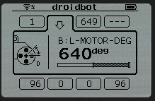
Step 1A: Measuring Rotation Sensor
Calculate how many motor degrees are in 1 protractor degree
Go to Port View and pick the rotation sensor on your motor
Hold one wheel in place and only turn the other wheel (Pivot Turn). Turn the robot any number of degrees you choose. Make sure the wheels don’t slip when you do this.
Look at the Motor Degree value and divide by the number of protractor degrees you turned.
This is the number of rotation degrees in 1 protractor degree.
An example using Droid Bot
Robot was turned 90 protractor degrees
Using Port View, the motor moved 330 degrees
330 motor degrees/90 protractor degrees = 3.7

Slide 6
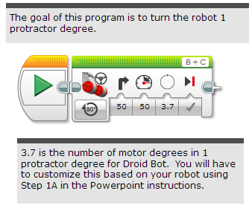
Step 1B: Turn the Robot 1 Degree

Slide 7
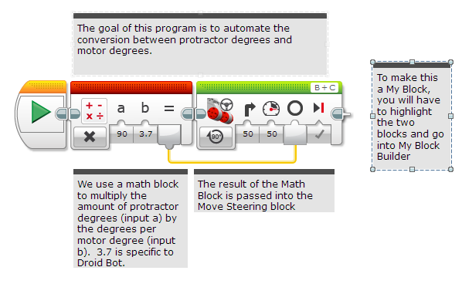
Step 2: Protractor to Motor Degree

Slide 8
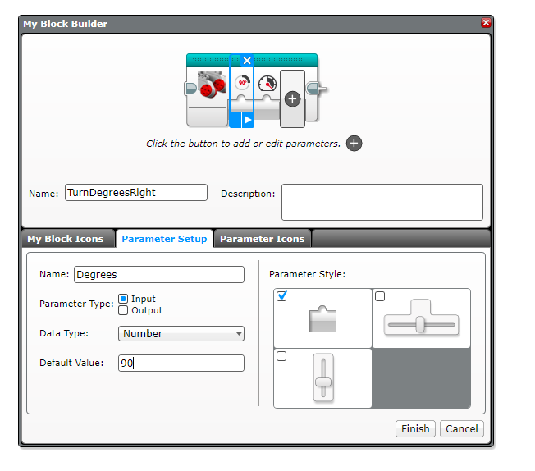
Step 3A: Set up My Block
A. Highlight the two blocks and go to My Block Builder
B. Create two inputs: one for degrees and one for power. Both inputs should be setup as numeric inputs
Refer to the My Blocks with Inputs & Outputs lesson if you need help setting up the My Block
A
B

Slide 9
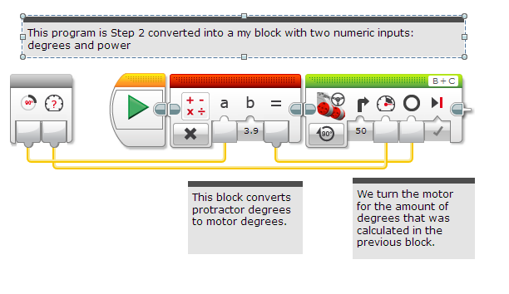
STEP 3A: Wire the Inputs
C. Wire the inputs in the grey block. The degrees input connects to the Math Block. The power goes into the Move Steering Block’s power input. The result of the Math Block is wired into the Move Steering Block’s degree input.

Slide 10
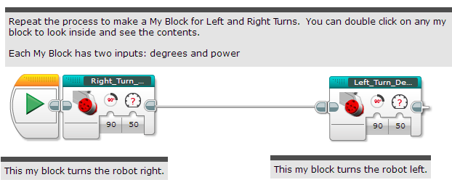
Step 3B: Turn_Degrees My BLock

Slide 11
STEP 3B: Inside Turn_degrees Right

Slide 12
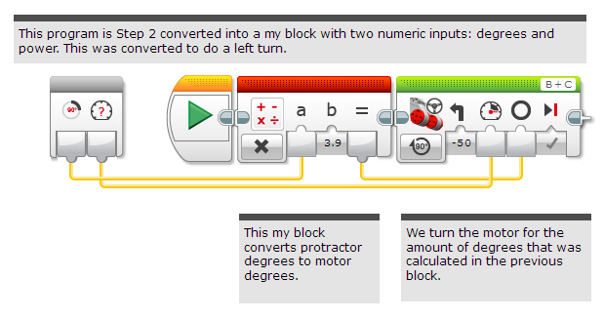
STEP 3B: Inside Turn_degrees left

Slide 13
Discussion
Why is a Turn_Degree My Block useful?
You can measure turns using a protractor and input this number into your turn block
Will changing the inputs in one copy of Turn_Degrees impact another copy of it?
No. That is exactly why a My Block is useful. You can use the same block multiple times, each time using a different number for power and degrees (or any other parameter you set up).
Can you alter a My Block after it is made?
You can change any of the contents, but not the grey blocks (input and output parameters). If you need to make changes to the parameters, you must remake your My Block.

Slide 14
Credits
This tutorial was created by Sanjay Seshan and Arvind Seshan
More lessons are available at www.ev3lessons.com
This work is licensed under a Creative Commons Attribution-NonCommercial-ShareAlike 4.0 International License.

