Slide 1

SIMPLE & OPTIMIZED ULTRASONIC WALL FOLLOW

Slide 2
Objectives
Learn how to use the ultrasonic sensor to follow walls
Learn how to optimize code
Prerequisites: Loops, Switches, Ultrasonic Sensor

Slide 3
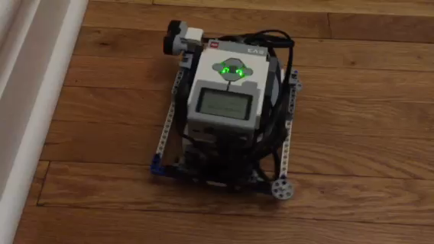
Challenge 1: Simple Wall Follow
Challenge: Can you write a program to have a robot follow the wall (always staying 15cm away from the wall) using an ultrasonic sensor?
STEP 1: In a Switch Block, turn Left or Right based on whether the robot is too close to the wall or too far from the wall
STEP 2: Repeat everything in a loop that runs forever (you can change the exit condition of the loop if you wish)
Play the video to see how the robot should move

Slide 4
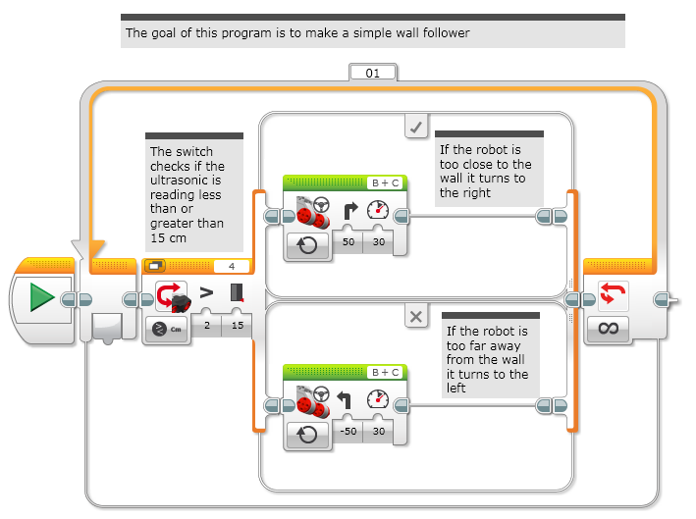
Challenge 1 Solution

Slide 5
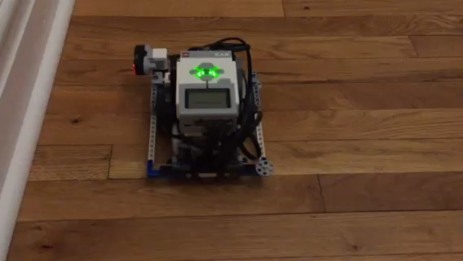
Challenge 2: Optimizing the Code
The code for the Simple Ultrasonic Wall Follow Challenge was slow and the robot wiggles back and forth a lot.
Challenge: For this next challenge, think about how you can improve the program so that the wall follower is smoother.
Hint: Change the angle of the turns
Play the video to see how the robot should move
Do you notice any differences?

Slide 6
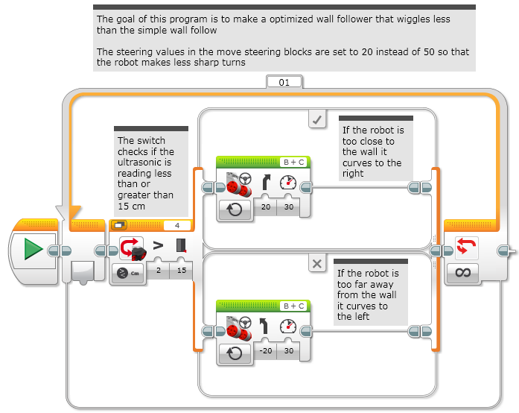
Challenge 2 Solution

Slide 7
Credits
This tutorial was created by Sanjay Seshan and Arvind Seshan
More lessons are available at www.ev3lessons.com
This work is licensed under a Creative Commons Attribution-NonCommercial-ShareAlike 4.0 International License.

