Slide 1

INTERMEDIATE PROGRAMMING LESSON
Variables

Slide 2
Objectives
Learn about different types of variables
Learn how to read and write to variables
Prerequisites: Data wires, Color Sensor, and Display Blocks, Wait blocks

Slide 3

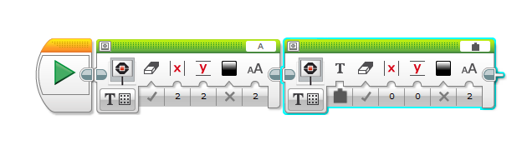
Additional Tool: Wired Display Blocks
Text to be displayed
Click on field to choose wired
Text supplied on a wire
Erase screen before display
Column to start display
Row to start display
Black or white text
Text size
0 – small font
1 – small bold font
2 – large font

Slide 4
Variables
What is a variable? Ans. A variable stores a value that you can use later in your program. Think of it like a notepad or a box that holds a value for you.
You can name the variable whatever you want
You can define the type of variable:
Numeric (Holds a number)
Logic (Holds True/False)
Text (Holds lines of text … “Hello World”)
Numeric Array (Holds a set of numbers … 1,2,3,10,55)
Logic Array (Holds a set of logic … True, True, False)
They can be used as either Inputs or Outputs so you can either….
Write – put a value into the variable
Read – retrieve the last value written to the variable

Slide 5
Why Variables?
Variables are an easy way to transfer data across code without too many data wires
You can also use variables to transfer data into a My Block without an input (eg. A variable for wheel size in Move Inches – You probably do not want this to be an input since it rarely changes. You may also use the value in other locations and want to change it just in one spot.)
Array variables can store multiple data items without needing several wires or variables
Having too many data wires or variables makes your code messy

Slide 6
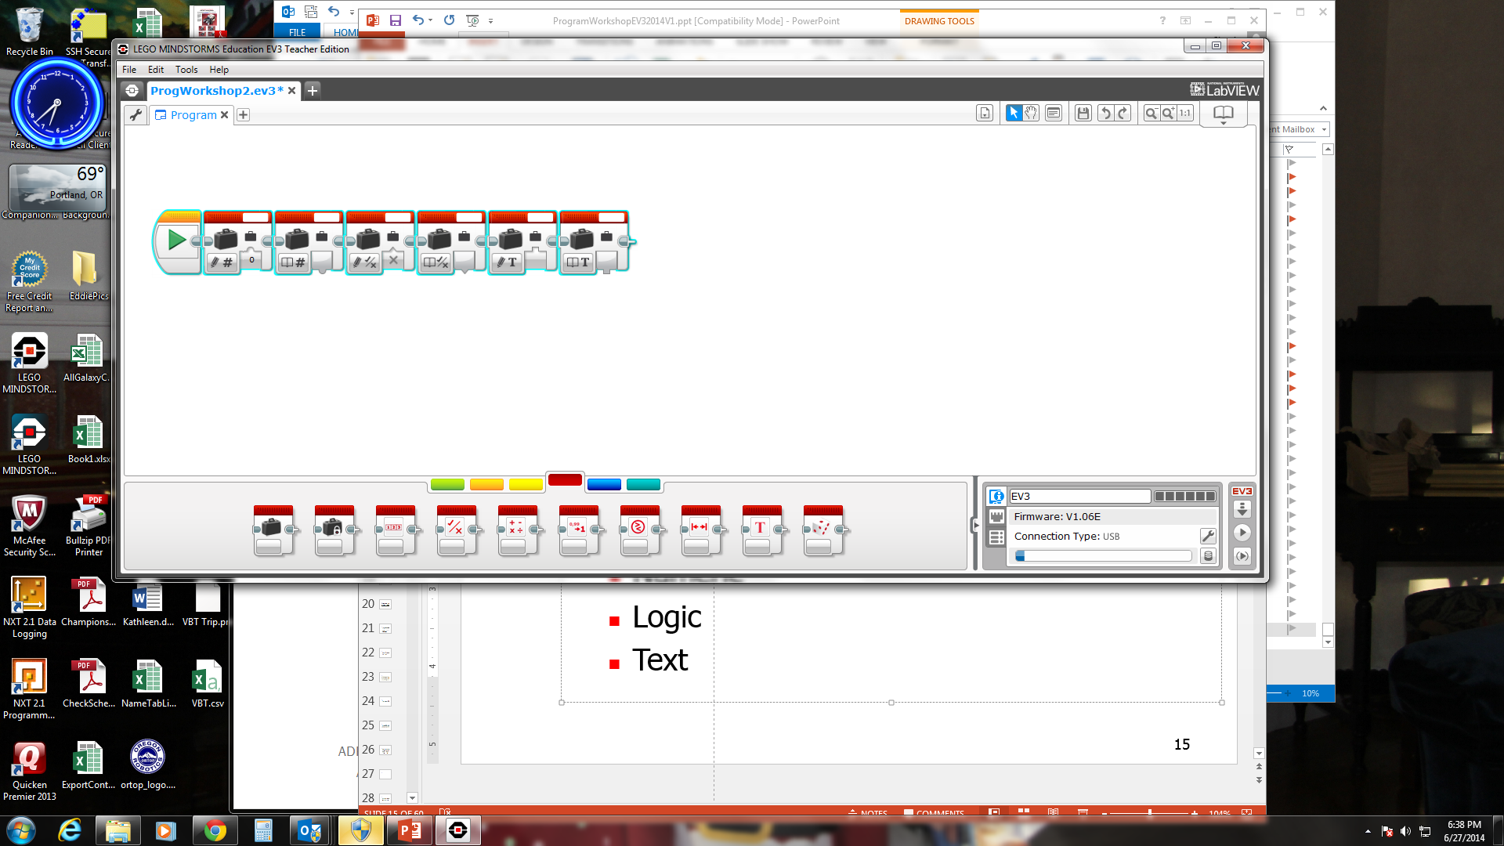
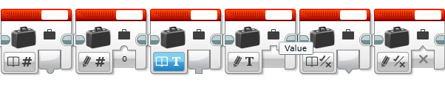
Variable Blocks
Numeric
Logic
Text
Write (Inputs) have a bump up
Read (Outputs) have a bump down
Use the key above to identify if the variables are Inputs or Outputs and if they are Numeric, Logic or Text
Read Numeric
Write Numeric
Read Text
Write Text
Read Logic
Write Logic
TIP: You can change the type of variable at the bottom-left part of the block.
When you display logic to the screen it will show 1 for True or 0 for False

Slide 7
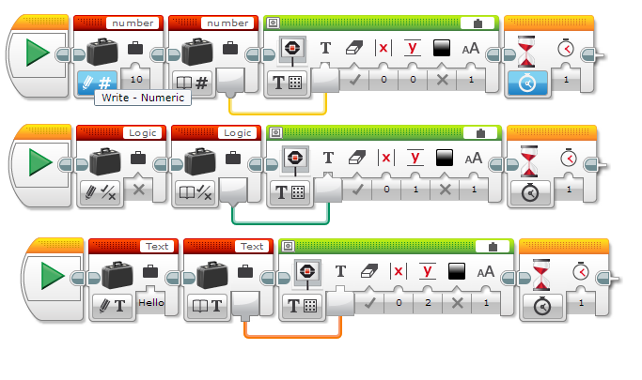
Outputs of Different Types of Variables
Write to the variable
Can you guess what each of these do?
Here we display the value of the variable to the screen
Numeric Variables:
This will display 10 on the screen
Logic Variables:
This will display 0 on the screen
Text Variables:
This will display Hello on the screen

Slide 8
Challenges
Challenge 1:
Can you make a program that displays the number of times that you have clicked the up button?
Challenge 2:
Can you write a program that counts the number of black lines you have crossed?
Challenge 2
FINISH
START

Slide 9
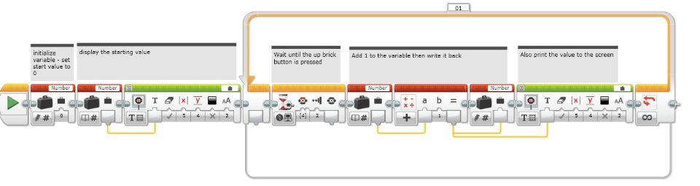
Challenge 1 Solution: Count Clicks

Slide 10
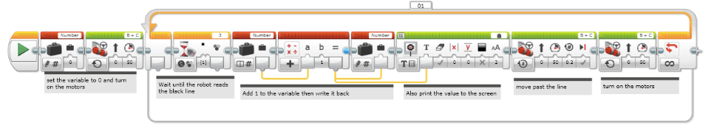
Challenge 2 Solution: Count the Lines

Slide 11
Next Steps
We use variables in the following lessons:
Advanced: Menu System
Advanced: Parallel Beam Synchronization

Slide 12
Credits
This tutorial was created by Sanjay Seshan and Arvind Seshan
More lessons at www.ev3lessons.com
This work is licensed under a Creative Commons Attribution-NonCommercial-ShareAlike 4.0 International License.

