Slide 1
INTRODUCTION TO HITECHNIC COLOR SENSOR

Slide 2


LESSON OBJECTIVES
Learn how to use the HiTechnic Color Sensor V.2
Learn how to configure your sensor
Learn how to position your sensor
Learn about the different modes the sensor uses

Slide 3
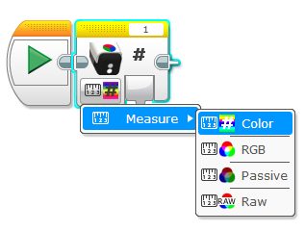
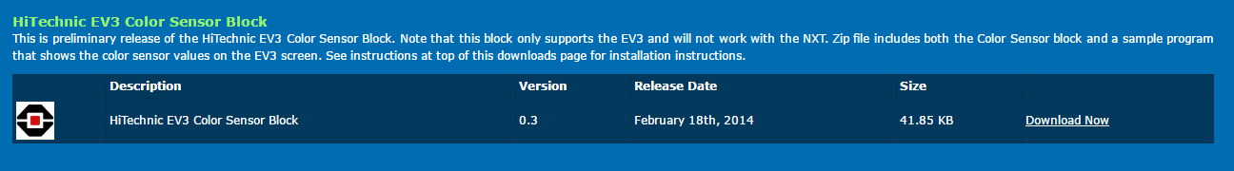
DOWNLOADING THE BLOCK
The EV3 Block for the sensor can be download from the manufacturer’s download page:
https://www.hitechnic.com/downloads
Add the block to your software.
If you do not know how to add a block to your software, complete the “Importing HiTechnic Blocks” lesson on EV3Lessons.com → Lessons → WRO

Slide 4
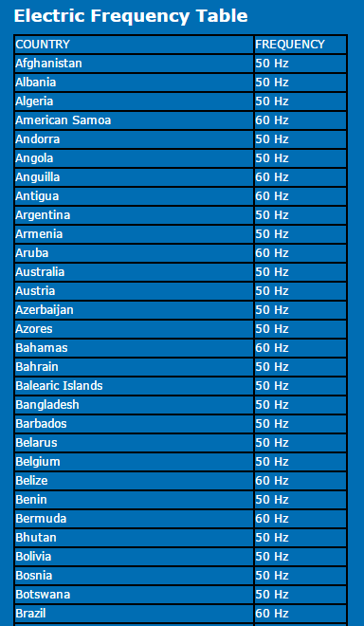
Configure for electricity Frequency – Part 1
There are two electric supply frequencies commonly used (50Hz and 60Hz).
The sensor is configured for 60Hz (US, Canada and other countries) by default
To check if you need to configure your sensor, consult the Electricity Frequency Table on this page: https://www.hitechnic.com/colorsensor
If you need to switch the frequency, you must have an NXT and NXT software installed

Slide 5
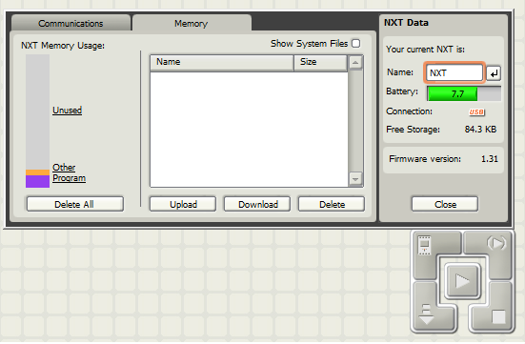
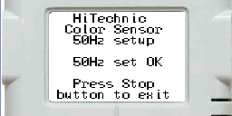
Configure for electricity Frequency - PART 2
Memory Tab
Download the Configuration Program for 50Hz (SetTo50Hz) from https://www.hitechnic.com/colorsensor
Start NXT Software
Connect an NXT Brick to your computer
In the NXT software
Create a New Program
Select the NXT Window button
Pick the Memory Tab
Pick Download and select the file to the download to the brick
Connect the HiTechnic Sensor to Port 1
Use the brick buttons to pick My Files → Software Files → SetTo50Hz file. Select the file to run the program. You should see the confirmation screen on the right
Disconnect your HiTechnic Color Sensor and use it on your EV3
Download
Nxt Window
Note: We confirmed these instructions. We also compared sensors set to 50Hz and 60Hz. We found that the frequency does make a difference in the readings depending upon room lighting.
Image Credit: HiTechnic.com

Slide 6
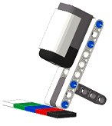
Position & ANGLE (From HiTECHNIC)
The Color Sensor V2 works best when it is positioned a little further away from the target
Approximately 4 LEGO studs distance (see image)
Ideally, the sensor must be placed at an angle. The angle prevents the direct reflection of the light from the LED from coming back into the sensor element (see image)

Slide 7
Four MODES
Color Mode
RGB Mode
Passive Mode
Raw Mode
Can recognize 18 colors
Outputs red, green, blue, and white values ranging from 0 to 255
Outputs red, green, blue, and white values that do not range from 0 to 255
Includes external light readings
Can be use to measure room and outdoor lighting
Outputs red, green, blue, and white values that do not range from 0 to 255
This mode provides the raw data that the sensor reads before being processed.

Slide 8
RGB Vs Passive ModeS
Comparing sensor readings in Passive Mode in two different lighting conditions reveals that in Passive Mode, the reading is impacted by ambient light
In RGB mode, the sensor measures and subtracts ambient light
 | RGB Mode Dim Lighting |  |  | RGB Mode Bright Lighting |  |  | Passive Mode Dim Lighting |  |  | Passive Mode Bright
LEGO Color | Red | Green | Blue | Red | Green | Blue | Red | Green | Blue | Red | Green | Blue
White | 123 | 123 | 102 | 121 | 122 | 101 | 72 | 61 | 39 | 785 | 1062 | 475
Red | 64 | 17 | 8 | 63 | 16 | 7 | 47 | 20 | 10 | 1034 | 543 | 185
Yellow | 110 | 80 | 13 | 114 | 83 | 13 | 58 | 40 | 14 | 1851 | 2122 | 392
Green | 14 | 32 | 19 | 10 | 28 | 17 | 11 | 19 | 11 | 183 | 575 | 226
Blue | 10 | 23 | 53 | 10 | 23 | 54 | 12 | 18 | 19 | 106 | 262 | 240
Black | 9 | 9 | 9 | 8 | 8 | 8 | 13 | 12 | 8 | 87 | 135 | 65
Brown | 21 | 12 | 9 | 20 | 12 | 8 | 21 | 16 | 9 | 324 | 309 | 137

Slide 9
MORE ABOUT RGB MODE
In RGB mode, the sensor measures and subtracts ambient light
However, there are limits to this “subtraction”. In very bright light, the sensor is overloaded (see passive values) and cannot subtract effectively. Resulting in unpredictable RGB mode readings
 | RGB Mode Dim Lighting |  |  | RGB Mode Bright Sun Light |  |  | Passive Mode Dim Lighting |  |  | Passive Mode Sun Light
LEGO Color | Red | Green | Blue | Red | Green | Blue | Red | Green | Blue | Red | Green | Blue
White | 123 | 123 | 102 | 0 | 0 | 126 | 72 | 61 | 39 | 37810 | 39305 | 32973
Red | 64 | 17 | 8 | 0 | 17 | 11 | 47 | 20 | 10 | 37692 | 25968 | 16953
Yellow | 110 | 80 | 13 | 0 | 0 | 33 | 58 | 40 | 14 | 37689 | 39317 | 25230
Green | 14 | 32 | 19 | 8 | 30 | 15 | 11 | 19 | 11 | 20046 | 31605 | 21915
Blue | 10 | 23 | 53 | 12 | 23 | 51 | 12 | 18 | 19 | 21447 | 30028 | 28308
Black | 9 | 9 | 9 | 3 | 6 | 7 | 13 | 12 | 8 | 16012 | 18125 | 13029
Brown | 21 | 12 | 9 | 18 | 12 | 9 | 21 | 16 | 9 | 25995 | 23004 | 15443

Slide 10
Raw vs. RGB Modes
By conducting tests, we found that the Raw Mode readings are processed through a linear equation to generate the RGB data.
Note that the different colors are scaled differently. White might show up as [120 red, 120 green, 120 blue] in RGB mode but as [285 red, 450 green, 300 blue] in Raw Mode

Slide 11

Lessons learned
Position: Follow manufacturer’s recommendations for angle and distance from target.
Configuring: If you live in an area that is 50Hz, you will have to configure your sensor using an NXT.
Color Mode: This mode can measure 18 colors.
Passive Mode: Does not subtract values for external light. This mode is useful to measure external lighting.
Raw vs. RGB: The data outputted from the RGB mode is derived from the Raw mode’s readings. The raw data is processed for the RGB mode.

Slide 12
Credits
This tutorial was created by Sanjay Seshan and Arvind Seshan
More lessons at www.ev3lessons.com
This work is licensed under a Creative Commons Attribution-NonCommercial-ShareAlike 4.0 International License.

