Slide 1
IMPORTING HITECHNIC BLOCKS

Slide 2
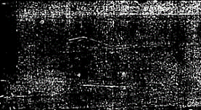
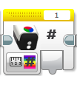
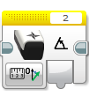
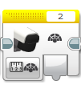

LESSON OBJECTIVES
Learn how to add the HiTechnic programming blocks for the Color Sensor, Compass Sensor and IRSeeker to your EV3 software

Slide 3
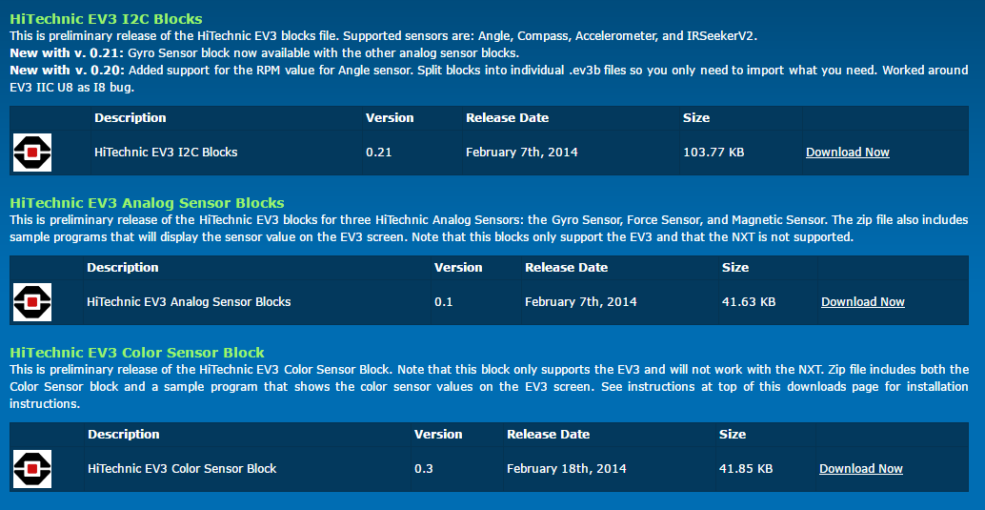
STEp 1: DOWNLOAD THE BLOCKS
The EV3 programming blocks for all HiTechnic Sensors permitted in WRO can be download from the manufacturer’s download page:
https://www.hitechnic.com/downloads
Exapand the .zip file

Slide 4
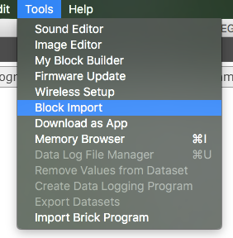
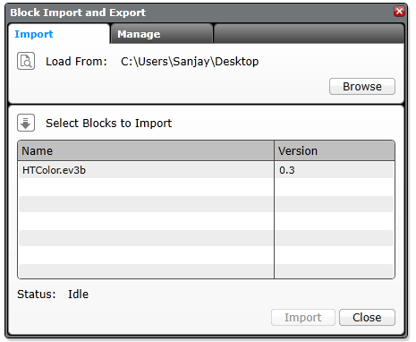
Step 2: Import BlockS
Open your EV3 software, add a project
Go to Tools → Block Import
Browse through your files and find the .ev3b file you downloaded in Step 1
Select the block and click Import
You will have to restart your software before using the block

Slide 5
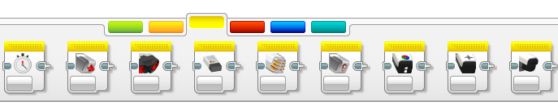
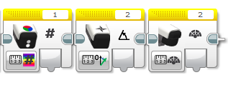
Step 3: USING The Blocks
The block(s) you imported will appear in the Yellow Sensor Pallet in the EV3 Programming Software
HiTechnic Color
HiTechnic Compass
HiTechnic IReeker

Slide 6
Credits
This tutorial was created by Sanjay Seshan and Arvind Seshan
More lessons at www.ev3lessons.com
This work is licensed under a Creative Commons Attribution-NonCommercial-ShareAlike 4.0 International License.

