Slide 1
Basic Line Follower
By Sanjay and Arvind Seshan

Slide 2
Lesson Objectives
Learn how humans and robots follow lines
Learn how to get a robot to follow a line using Colour Mode on the EV3 Colour Sensor
Learn how to follow a line until a sensor is activated
Learn how to follow a line for a particular distance
Learn how to combine sensors, loops and switches

Slide 3
Teacher Instructions
Slides 4-7 are animated. For students to better understand how a line follower works and how a human and a robot follow a line, we recommend that you play the animation
Give each student/team a copy of the worksheet.
Challenge 1 begins on slide 10 and Challenge 2 on Slide 13
Discussion Guide is on Slide 16
More advanced students might be interested in other line followers on EV3Lessons.com

Slide 4

Follow the Middle
Humans want to follow the line in the middle.
Let’s have the robot do the same thing using the Colour Sensor
What type of questions can we ask using this sensor
Are you on line or not?

Slide 5
If we are on black, keep going straight
If we are on white, turn left to get back to the line
Seems to work fine here…

Slide 6
If we are on black, keep going straight
If we are on white, turn left to get back to the line
OH NO… my robot is running away….
When the robot leaves the left side of the line, the program no longer works!

Slide 7
Line Following: Robot Style
Why could the Human follow the middle?:
They can see ahead.
They can see the whole line and its surroundings
They see both sides and which side they left
Why can’t the Robot do the same thing?:
Can’t tell right or left side of the line
How do we make sure the robot always veers off on the SAME SIDE of the line?
Instead of the middle, could the robot follow the “edge”?
So now the robot will fall off only the same side.
We will now show you how this works!

Slide 8
Line Following at the Edges
Left side line following
Right side line following
If on black, turn left.
If on white turn right.
If on black, turn right.
If on white turn left.
The robot has to choose which way to turn when the colour sensor sees a different colour.
The answer depends on what side of the line you are following!

Slide 9
The Correct Side of the Line
✗
✔
✔

Slide 10
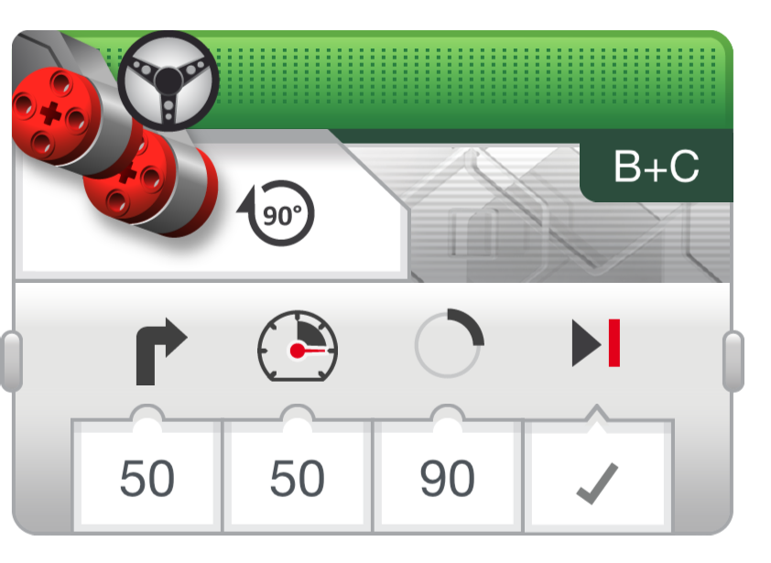
Line Follower Challenge 1
Step 1: Write a program that follows the RIGHT edge of a line.
Hints: If your sensor sees black, turn right. If your sensor sees white, turn left. Use loops and switches!
Step 2: Try it out on different lines.
Did your line follower work the same on straight and curved lines?
Step 3: If not, instead of turn Steering = 50, try smaller values.
Is it better on the curved lines now?
B
B
C
C

Slide 11
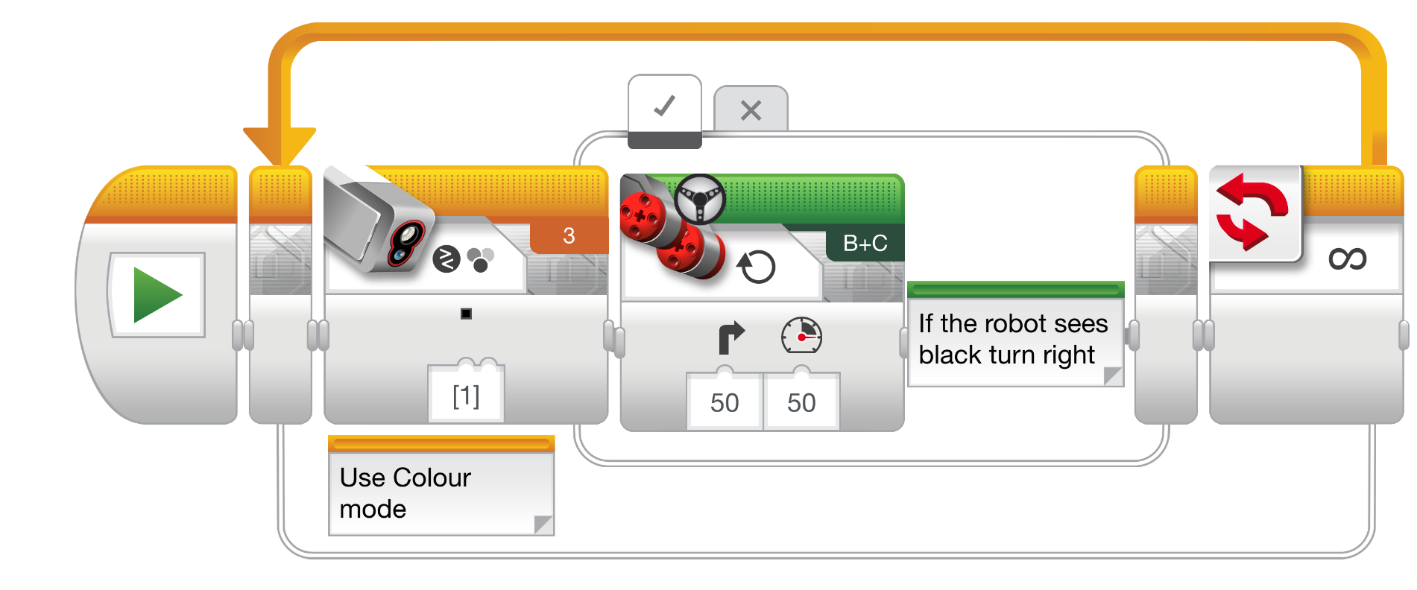
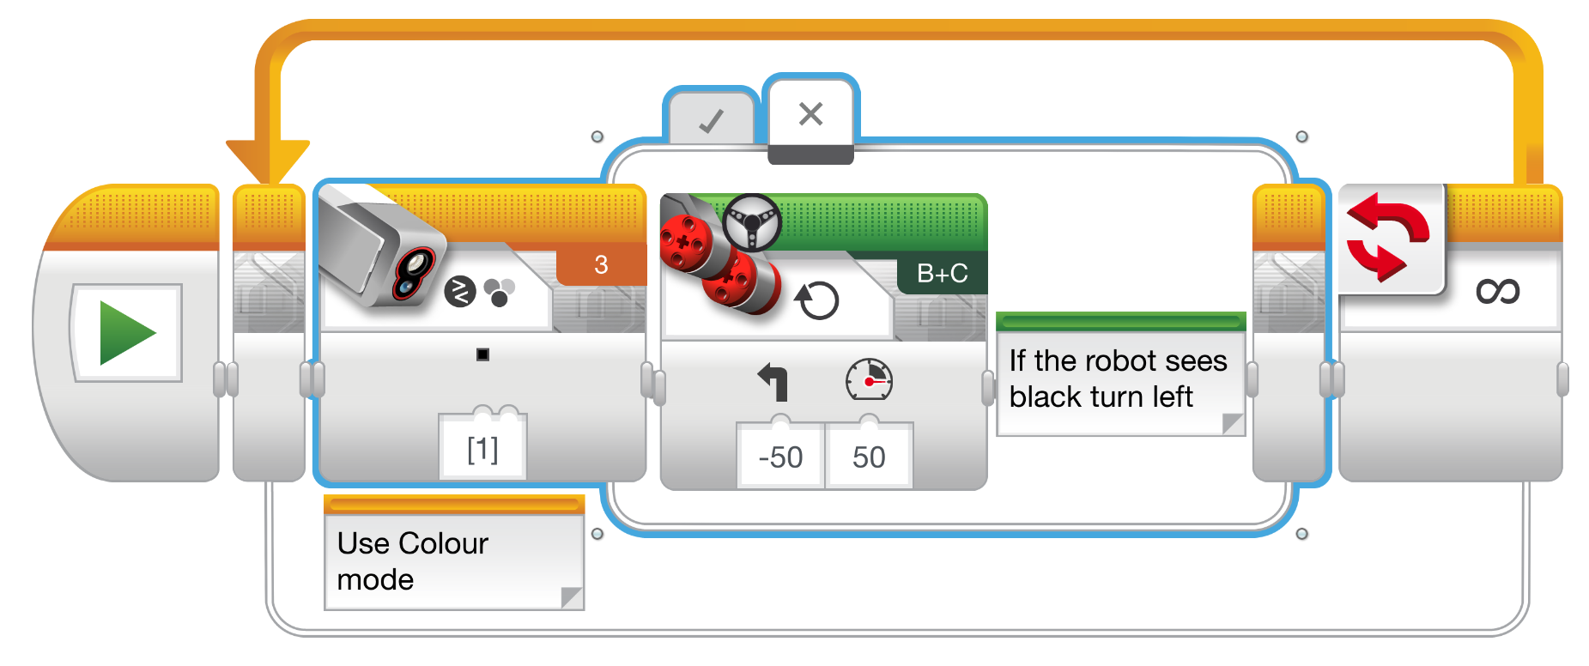
Challenge 1 Solution
Q. Does this program follow the Right or Left side of a line?
A. The robot is following the Right Side of the line.
Notes:
Right side

Slide 12
Challenge 1 Solution (Cont.)
Q. This line follower goes forever. How do we make this stop?
A. Change the end condition on the loop.
Notes:
Right side

Slide 13
Line Follower Challenge 2
Part 1: Make a line follower that stops when you press the touch sensor
Part 2: Make a line follower that stops after it travels a particular distance

Slide 14
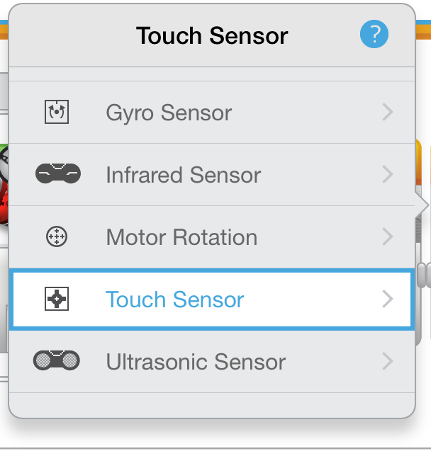
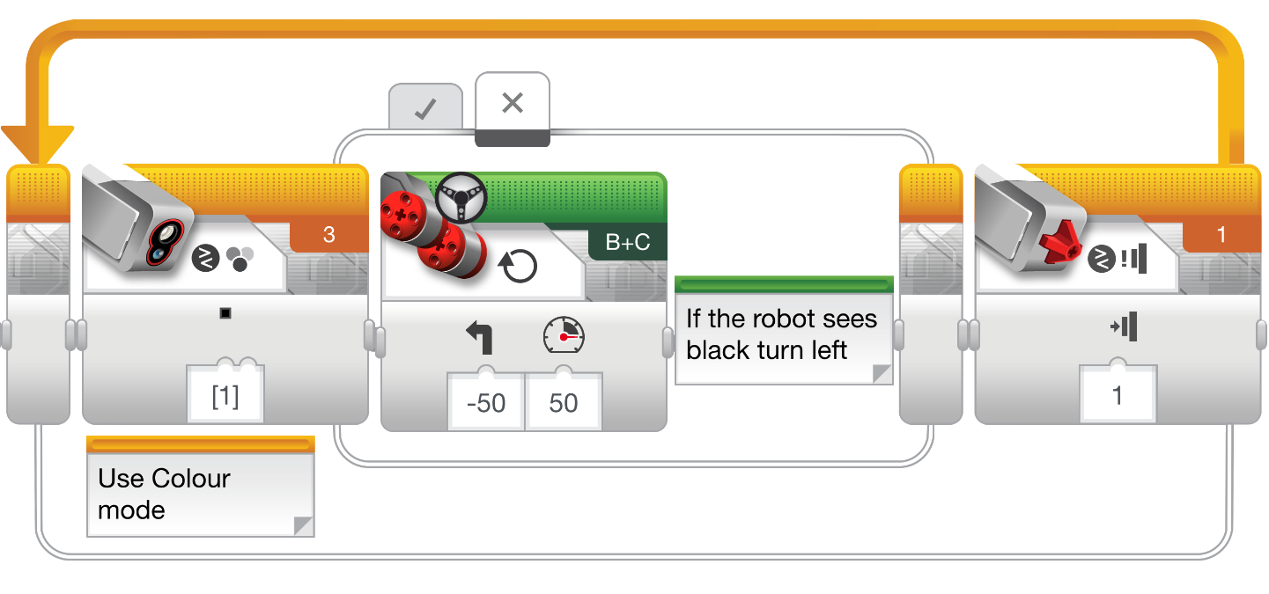
Challenge 2 Solution (Touch)

Slide 15
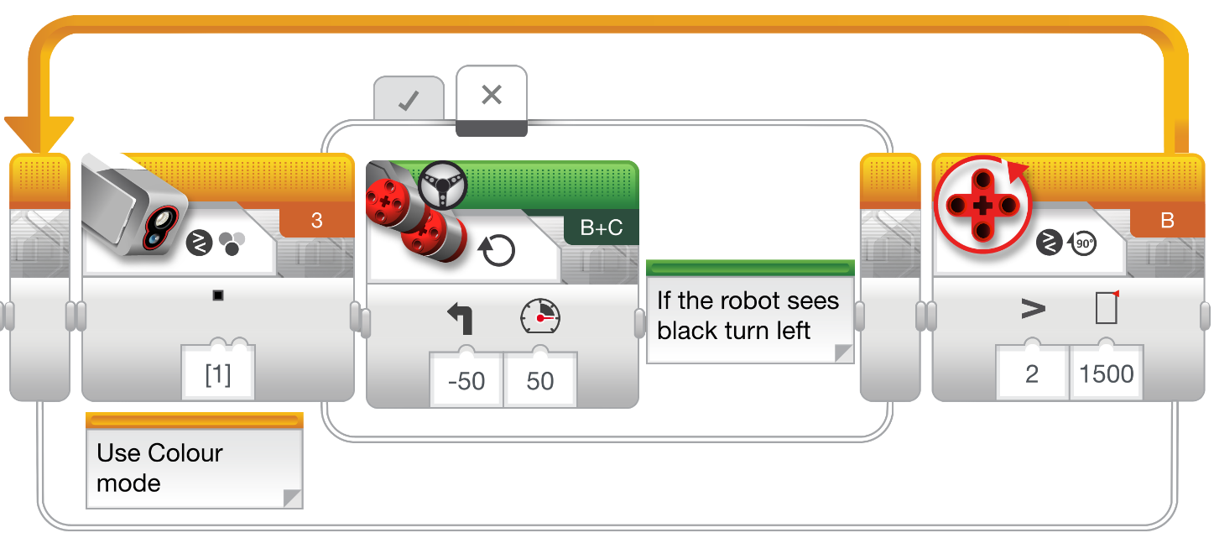
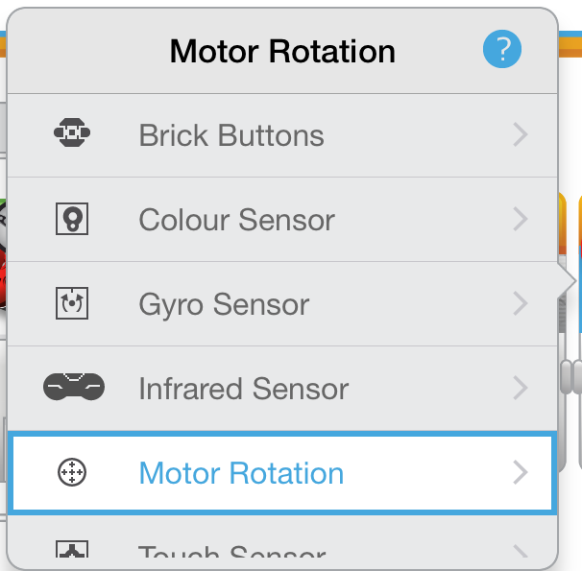
Challenge 2 Solution (Distance)
Note: You cannot add any block before the line follower (end after distance mode) because there is no rotation reset block

Slide 16
Discussion Guide
Why is it important for the robot to follow the same side of the line?
The robot only knows to check if it is on or off the line.
This is a basic line follower. What are some things that were not good about this line follower? Do you think the line follower can be improved?
It wiggles a lot. Smoother line followers are described in the Advanced lessons
What sensor measures how far you have travelled?
The rotation sensor used in Challenge 2 solution measures how much the wheels have turned
How would you write a line follower that will stop when it sees a line? Or another colour?
Change the loop exit condition to use the colour sensor.

Slide 17
Credits
This tutorial was created by Sanjay Seshan and Arvind Seshan
More lessons are available at www.ev3lessons.com
This work is licensed under a Creative Commons Attribution-NonCommercial-ShareAlike 4.0 International License.

