Slide 1
CONNECTING A BRICK
By Sanjay and Arvind Seshan

Slide 2
Lesson Objectives
Learn how to connect a brick to the App

Slide 3
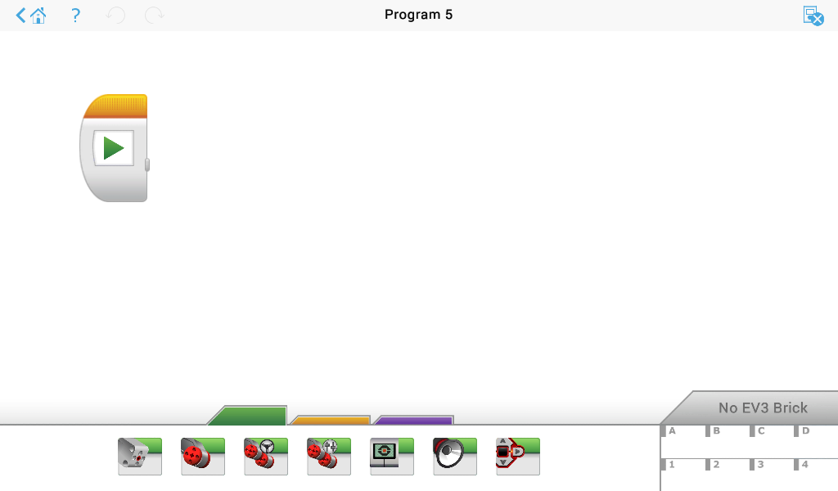
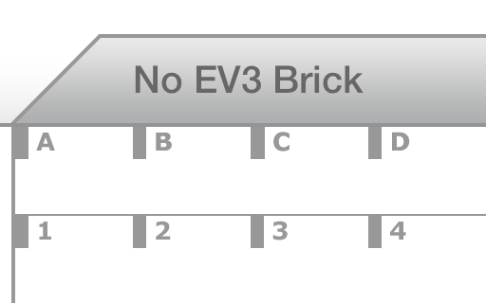
Tap on “No EV3 Brick” in App
Tap on “No EV3 Brick”

Slide 4
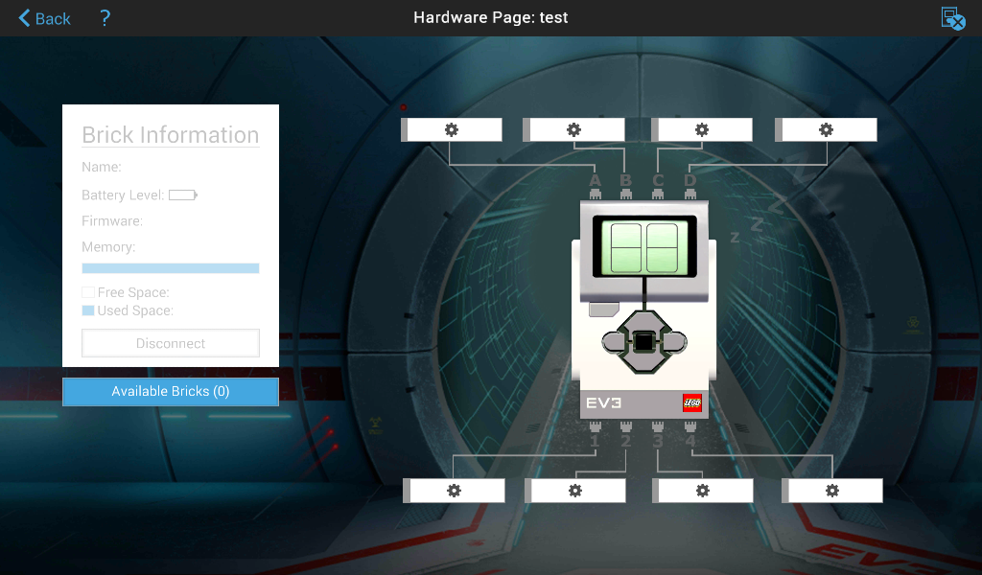
Click on Available Bricks

Slide 5
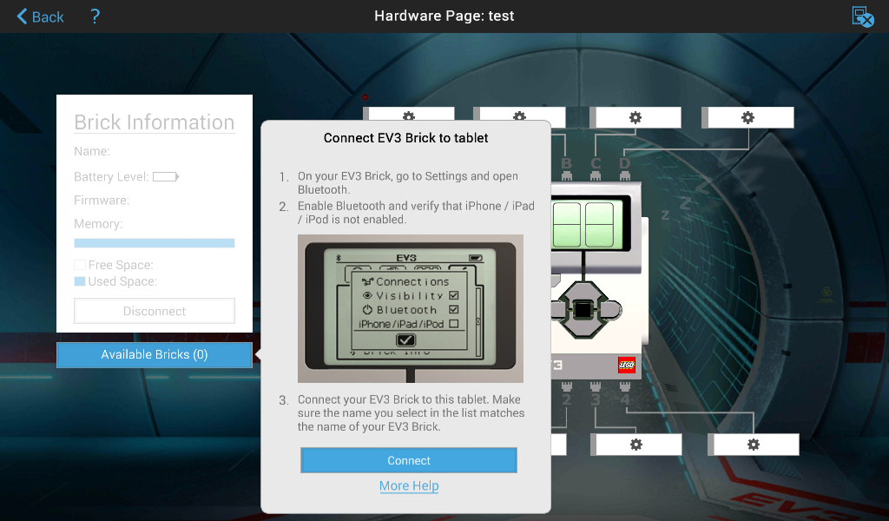
Turn on Brick and Follow Instructions on Pop-Up Screen in App

Slide 6
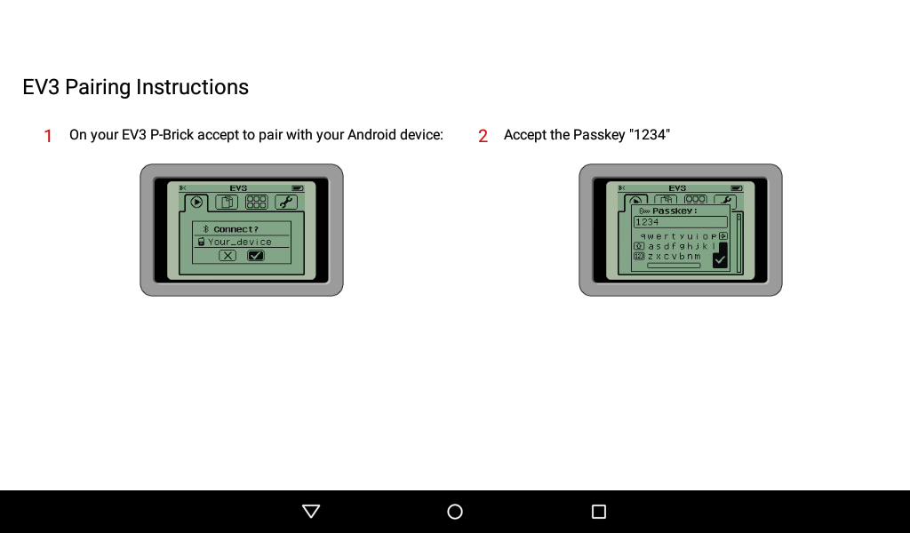
Pair the EV3 with the Tablet

Slide 7
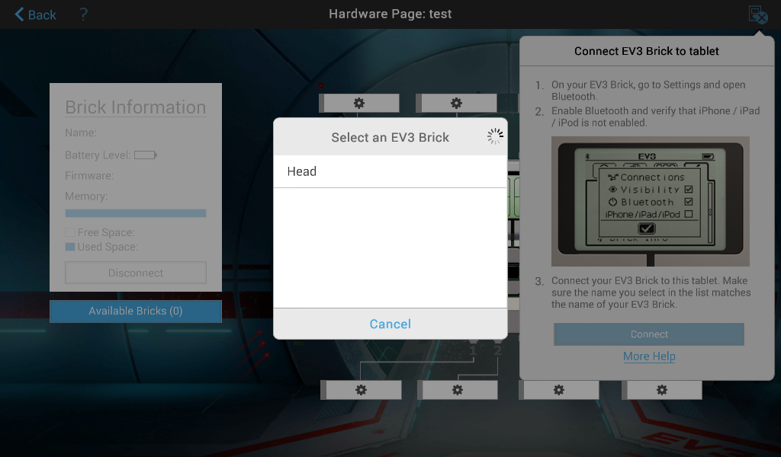
Connect to the Brick (Match the Name)

Slide 8
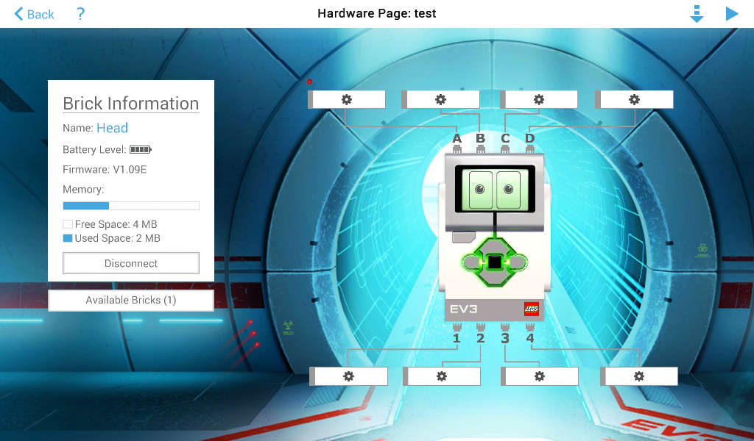
There is Now 1 Available Brick

Slide 9
Credits
This tutorial was created by Sanjay Seshan and Arvind Seshan
More lessons are available at www.ev3lessons.com
This work is licensed under a Creative Commons Attribution-NonCommercial-ShareAlike 4.0 International License.

