Slide 1
INTRODUCTION TO THE EV3 BRICK and SoFTWARE
By Sanjay and Arvind Seshan

Slide 2
Lesson Objectives
Learn how the EV3 brick operates
Learn about the main components of the EV3 Programmer App
Learn how to create a new program, play/download it, rename it and share it

Slide 3
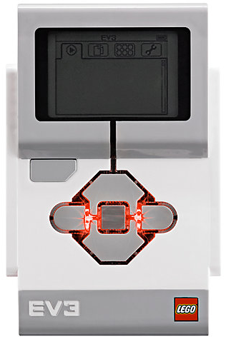
The “Brick” Buttons
1 = Back Undo Stop Program Turn robot off
2 = Centre Button Select options Run Program Turn robot on
3 = L, R, Up, Down Navigate menus
1
3
3
2
3
3

Slide 4
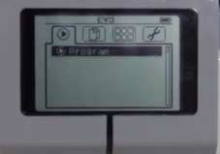
The “Brick” Screen
Tabs on Screen
Run Recent Find programs you ran recently
2. File Navigation Find all programs by project
3. Brick Apps Port views
4. Settings Bluetooth, Wifi, Volume
1
2
3
4

Slide 5
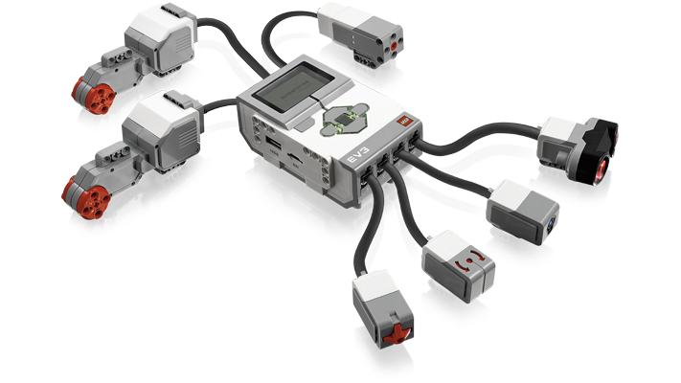
Ports, Sensors, Motors
Ports A, B, C, D = Motors
Default setup assumes Right Motor in C, Left Motor in B
B
Default setup
Front
C
Ports 1, 2, 3, 4 = Sensors

Slide 6
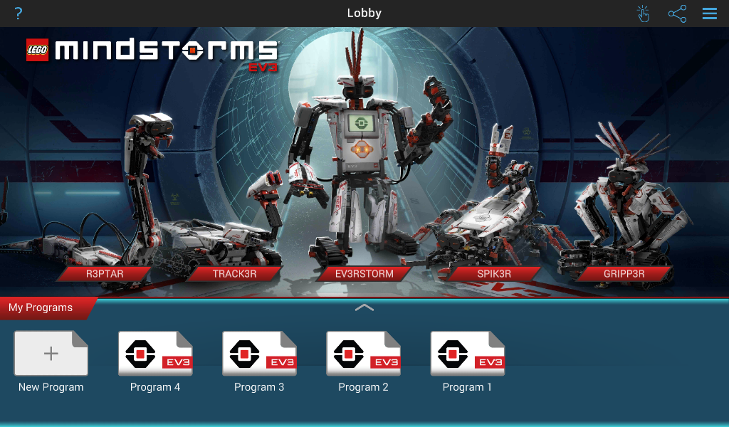
EV3 Programmer App
Open New Program
Open Saved Program

Slide 7
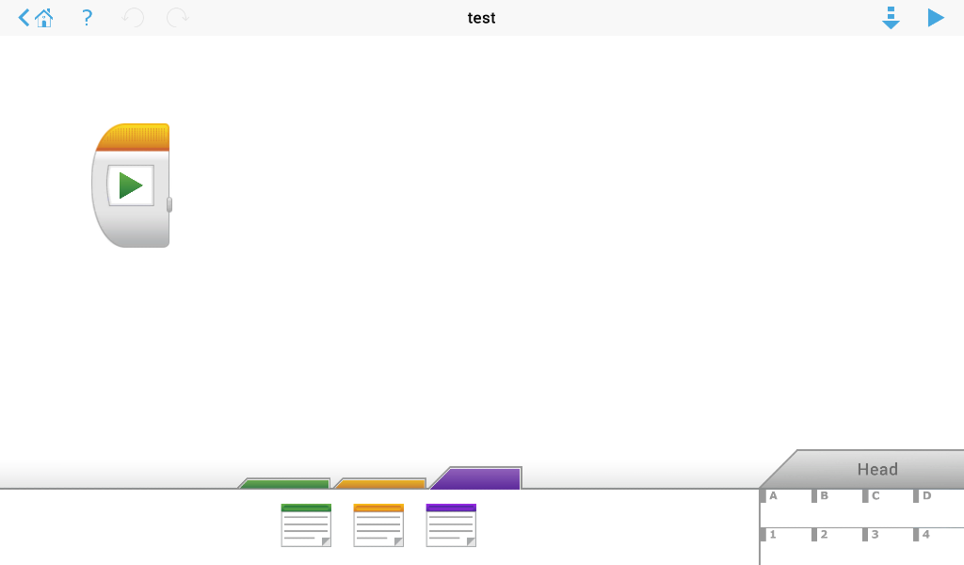
Programming Environment
Download &
Play
Programming Canvas
Programming Blocks in
3 Colored Palettes
Brick Status

Slide 8
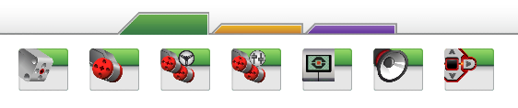
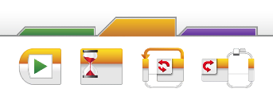
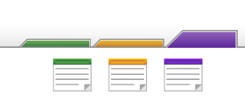
Available Blocks
ACTION BLOCKS
Move, Large & Medium Motor, Display…
FLOW BLOCKS
Start, Wait, Loop, Switch, Loop
Comments:
Green, Orange, and Purple

Slide 9
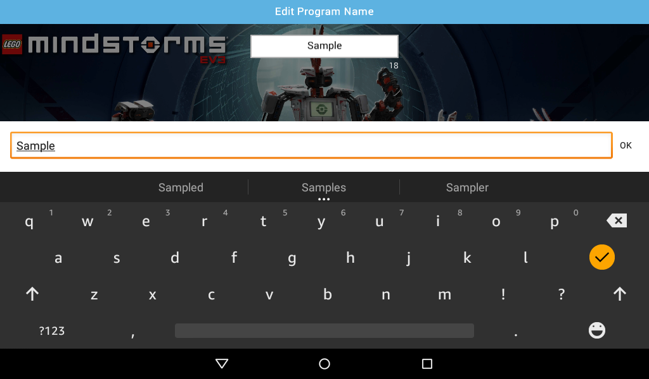
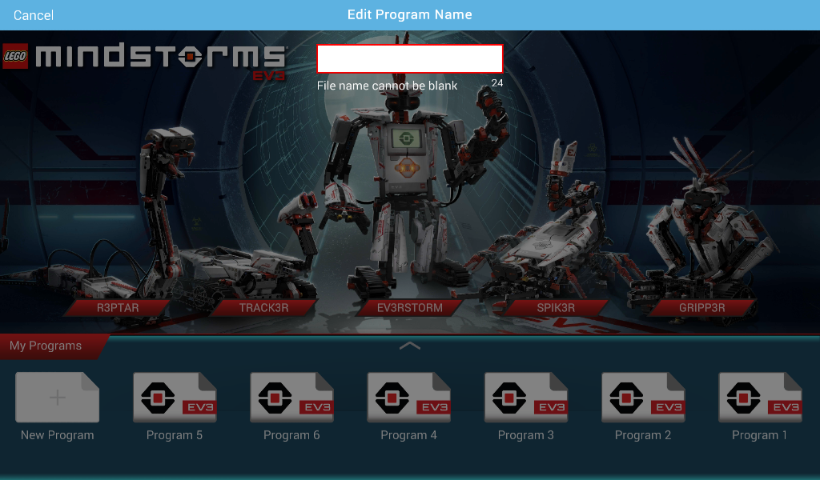
Changing the Name of a Program
Click lightly on the default name (e.g. Program 5)
A keyboard will show up to change the name to whatever you want

Slide 10
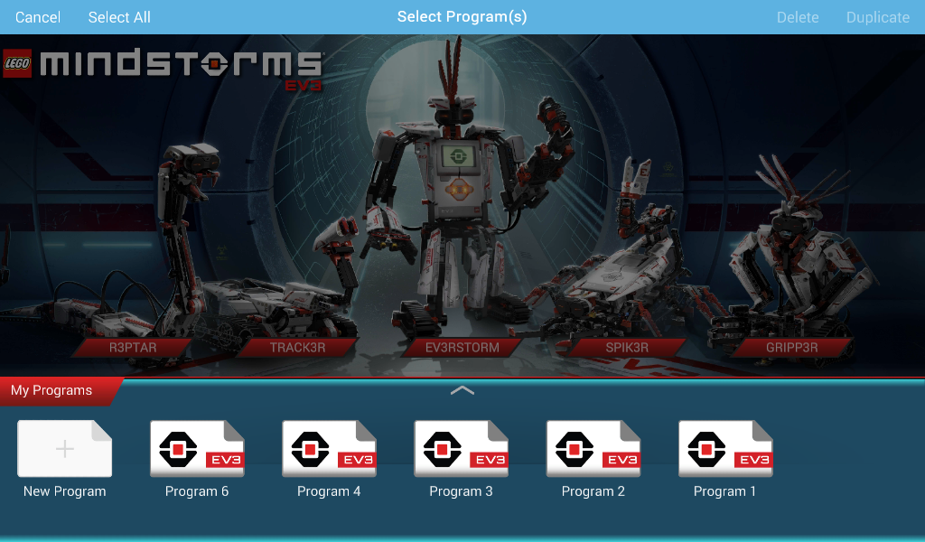
Deleting or Duplicating Programs
Click on the first “finger” icon on the top right in the lobby
Select the program you want to delete/duplicate and hit the appropriate button

Slide 11
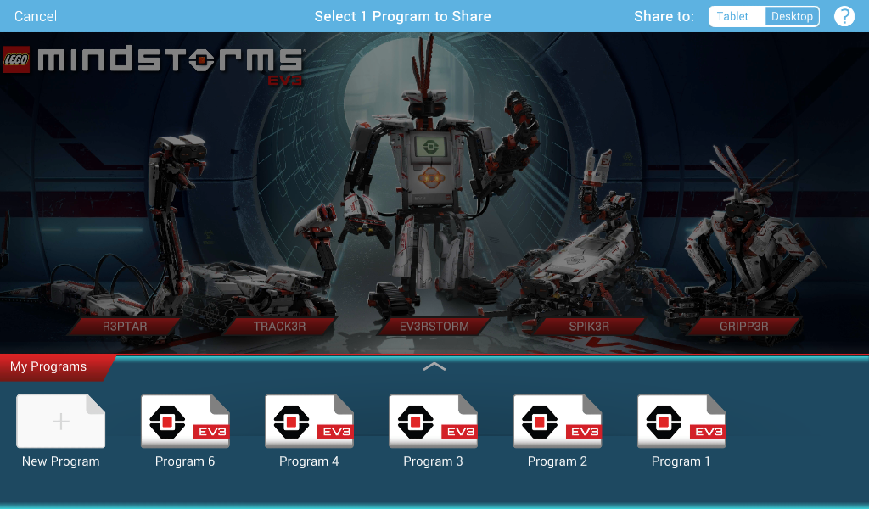
Sharing the File
Click on second icon in top right and then select Share to Tablet or Share to Desktop
Sharing to Tablet saves the file as .ev3m and it can be opened by on tablet running the Programmer App
Sharing to Desktop saves the file as a .ev3 and can be opened with the EV3 software on a computer

Slide 12
CREDITS
This tutorial was created by Sanjay Seshan and Arvind Seshan
More lessons are available at www.ev3lessons.com
This work is licensed under a Creative Commons Attribution-NonCommercial-ShareAlike 4.0 International License.

