Slide 1
Ultrasonic sensor
By Sanjay and Arvind Seshan

Slide 2
Lesson Objectives
Learn about the Ultrasonic Sensor
Learn how to use Wait Until Ultrasonic Block
Learn the difference between the Wait Until Ultrasonic Block and the Ultrasonic Block

Slide 3
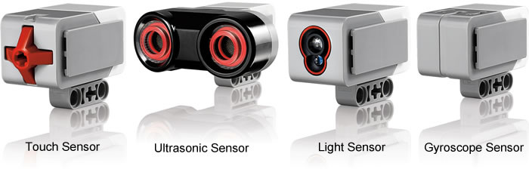
What is a sensor?
A sensor lets an EV3 program measure and collect data about is surroundings
The EV3 sensors include:
Colour – measures color and darkness
Gyro – measures rotation of robot
Ultrasonic – measures distance to nearby surfaces
Touch – measures contact with surface
Infrared – measures IR remote’s signals
Image from: http://www.ucalgary.ca/IOSTEM/files/IOSTEM/media_crop/44/public/sensors.jpg

Slide 4
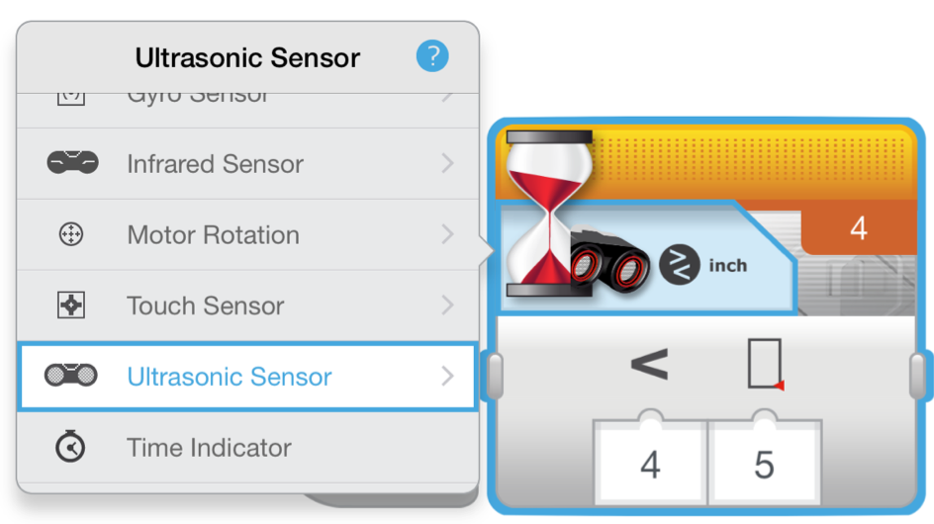
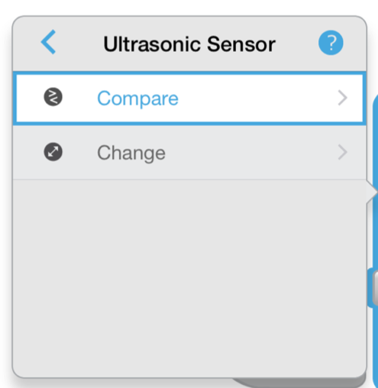
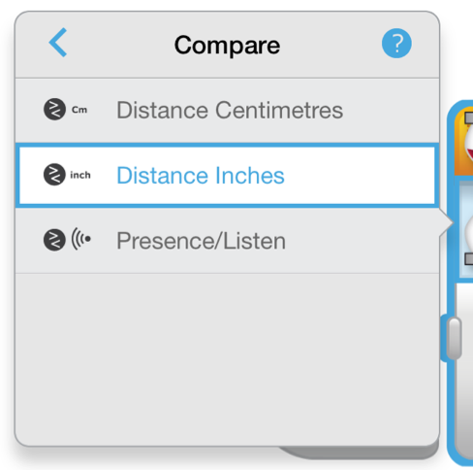
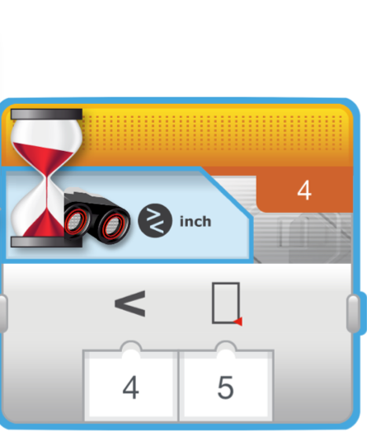
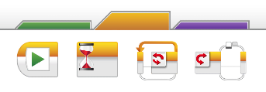
Ultrasonic Challenge 1
Challenge: Make the robot move until it is 5 inches away from the wall.
Step 1: Make a new program
Step 2: Set move to “on”
Step 3: Set wait block to use the Ultrasonic
Step 4: Set move block to “off”
Animated slide

Slide 5
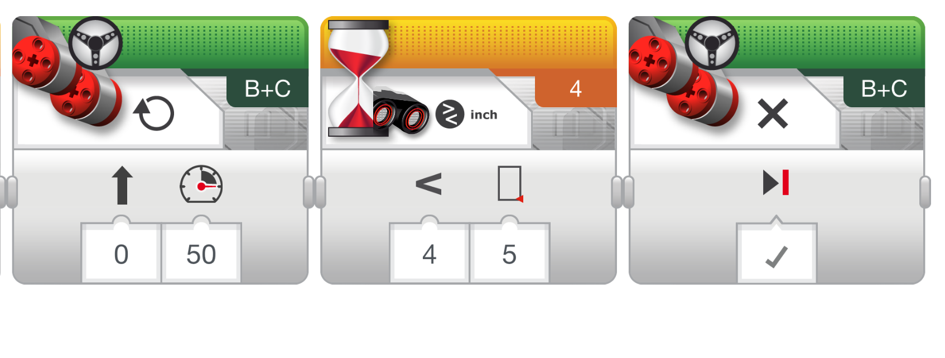
Challenge 1 Solution

Slide 6
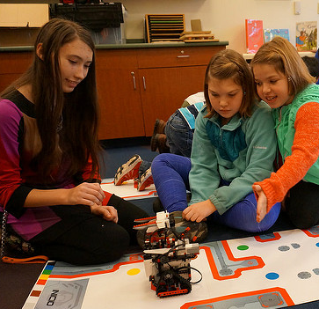
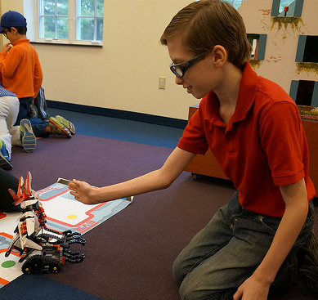
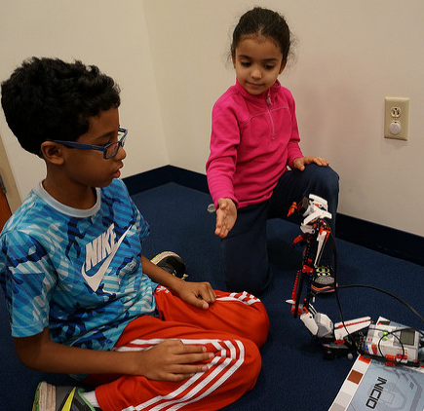
CHALLENGE 2: Use The Force To Control Your Robot!

Slide 7
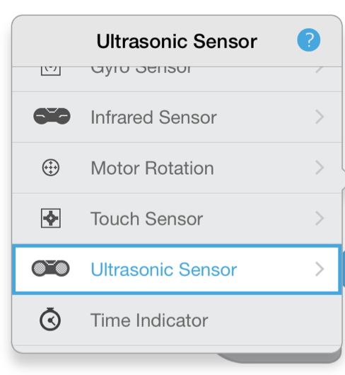
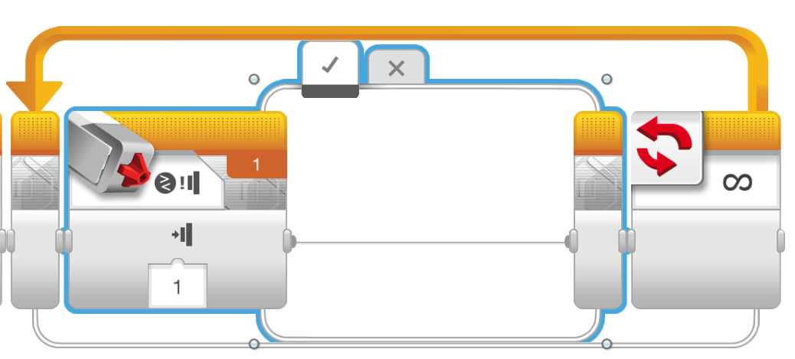
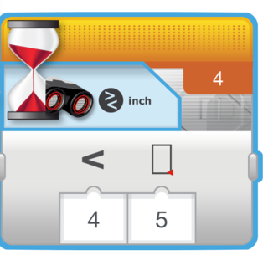
Challenge 2: Pseudocode
If the robot is closer than 5 inches away from your hand move backward, otherwise move forward.
Step 1: Drag a loop from the orange tab
Step 2: Drag switch inside loop
Step 3: Set switch to Ultrasonic
Step 4: Set move steering block to ON and place in TRUE
Step 4: Set move steering block to OFF and place in FALSE
Animated slide

Slide 8
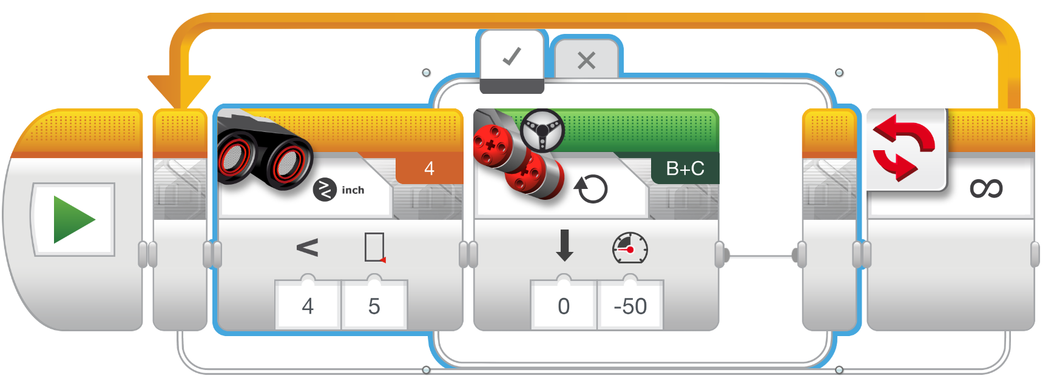
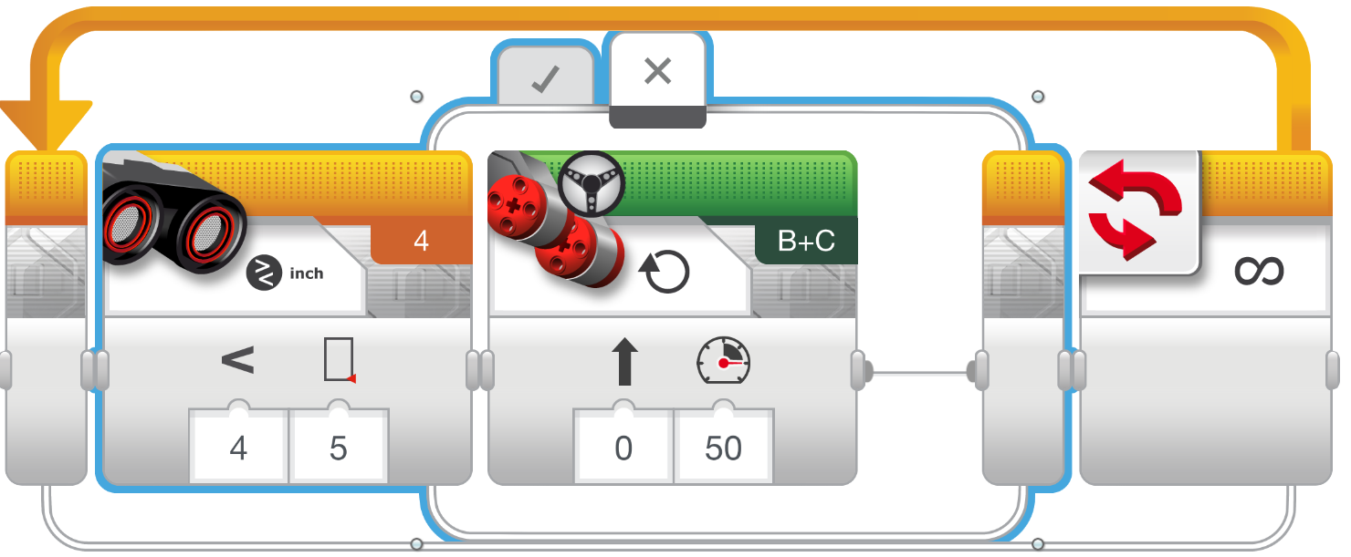
Challenge 2 Solution
Animated slide

Slide 9
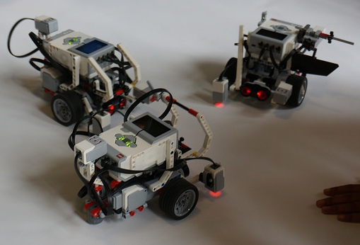
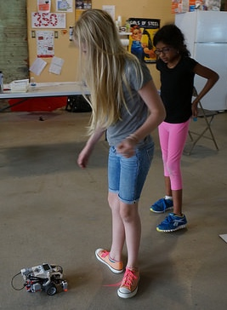
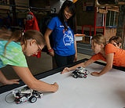
Robots Can Follow You & Even Dance with this code!

Slide 10
CREDITS
This tutorial was created by Sanjay Seshan and Arvind
More lessons are available at www.ev3lessons.com
This work is licensed under a Creative Commons Attribution-NonCommercial-ShareAlike 4.0 International License.

