Slide 1
EV3 & Swift: Getting STARTED

Slide 2
Objectives
Learn how to install Swift Playgrounds on your iPad
Learn how to pair the App with your EV3

Slide 3
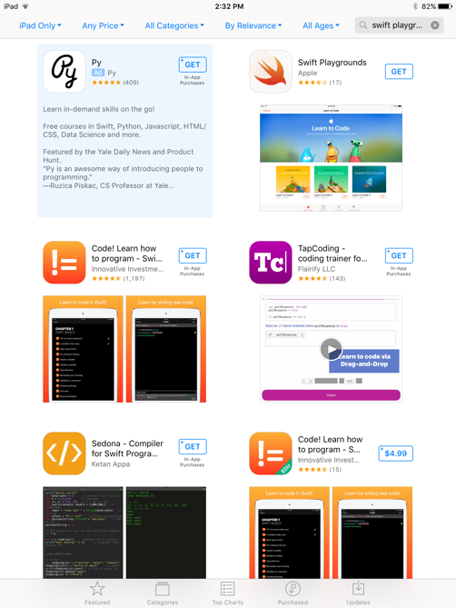
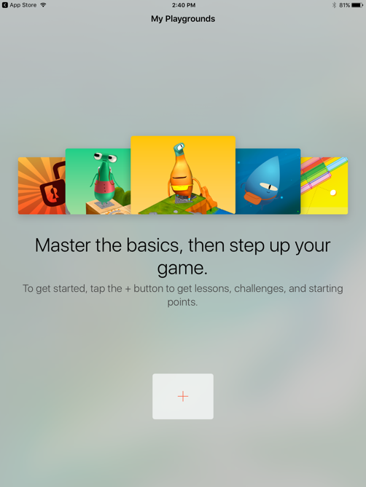
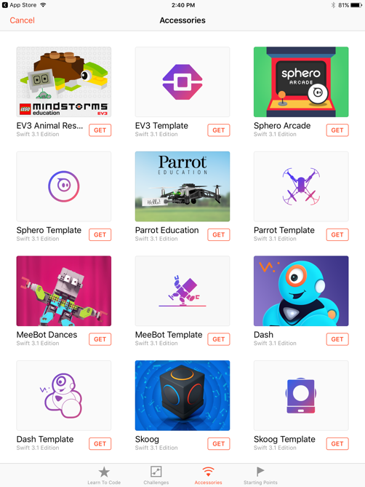
Installing Swift Playgrounds
Install the Swift Playgounds App from the App Store
Launch the App
And click on the ”+”
Install “EV3 Animal Rescue” and “EV3 Template”

Slide 4
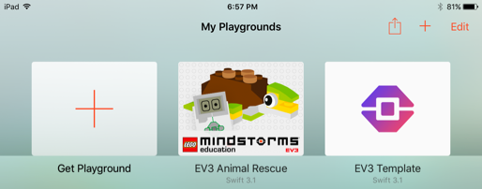
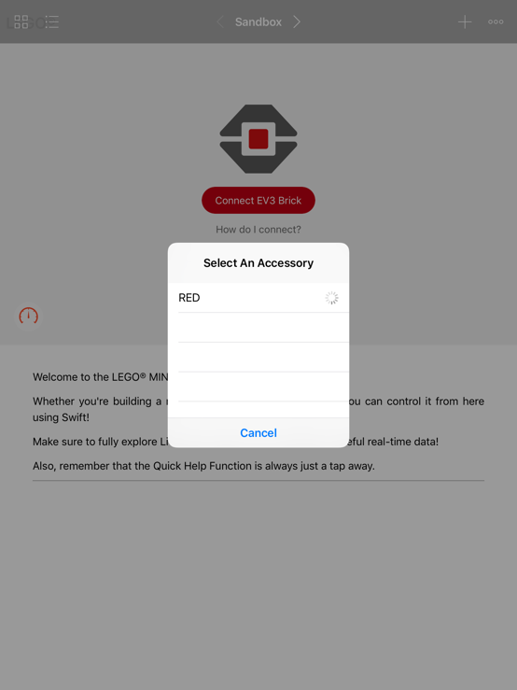
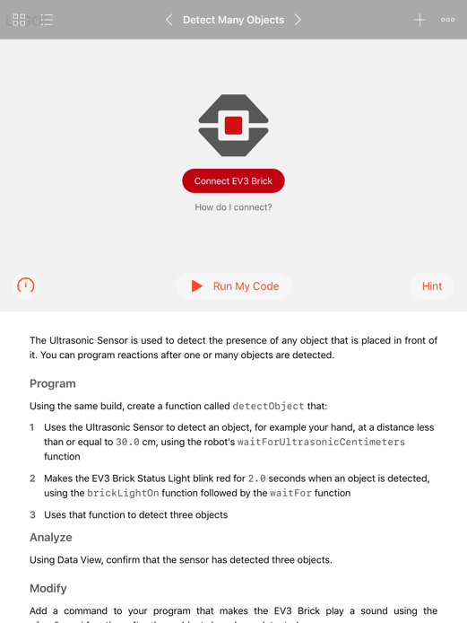
Pair with your EV3 – Part 1
In the Settings Tab on the Brick, select Bluetooth and then make sure that Visibility, iPhone/iPad and Bluetooth are all set
In either EV3 Playground, click on “Connect EV3 Brick”
Select EV3 brick you want to pair to

Slide 5
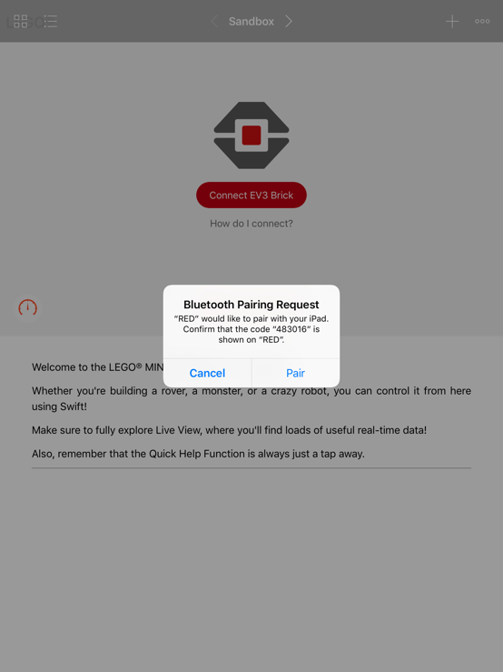
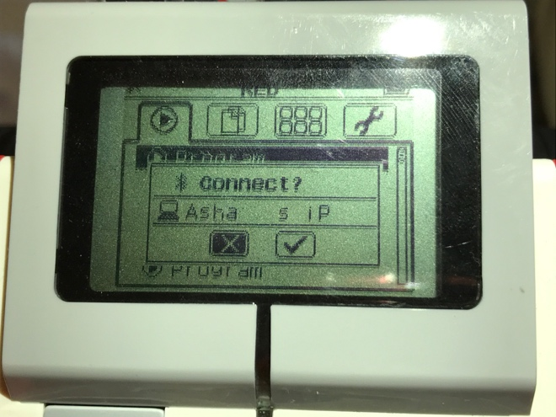
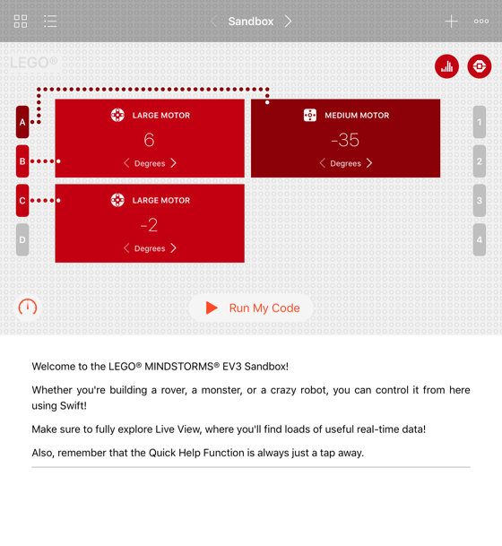
Pair with your EV3 – Part 2
Click on “Pair”. (Note the number indicated on the iPad does not appear on the EV3 brick.)
Select the “check mark” to connect to your iPad
You will see a welcome screen showing EV3 motors & sensors. Attaching motors & sensors or moving them should update the screen in real-time.

Slide 6
Credits
This lesson was created by Sanjay and Arvind Seshan
More lessons are available at www.ev3lessons.com
This work is licensed under a Creative Commons Attribution-NonCommercial-ShareAlike 4.0 International License.

