Slide 1


INTERMEDIATE PROGRAMMING Lesson
Move Distance My Block (Move_Inches)
By: Droids Robotics

Slide 2
Lesson Objectives
Create a useful My Block
Learn why creating a My Block that takes measurements made with a ruler can be useful
Practice creating a My Block with Inputs and Outputs

Slide 3
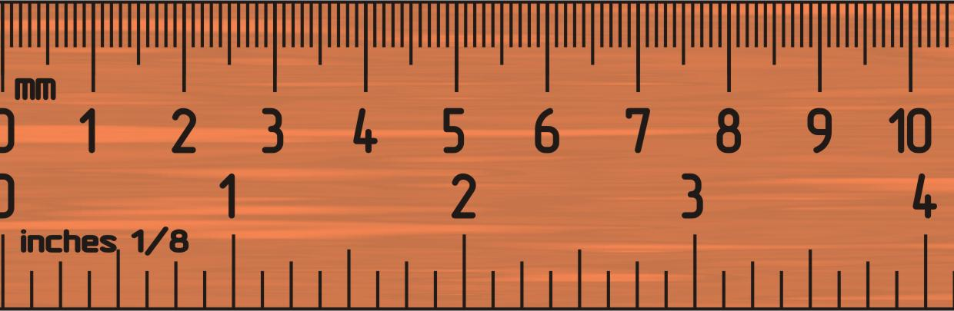
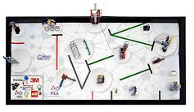
Why IS A Move DISTANCE My Block a Good IDEA
Built-in move blocks will not take inputs (values) in centimeters or inches.
Much easier to measure distance with a ruler than degrees or rotations.
If you change your robot design to have bigger or smaller wheels late in the season you don’t have to re-measure every movement of your robot
Instead of changing distances in every single program you wrote, just go into your cool Move Distance Block and change the value for how many inches/cm one motor rotation would take.

Slide 4
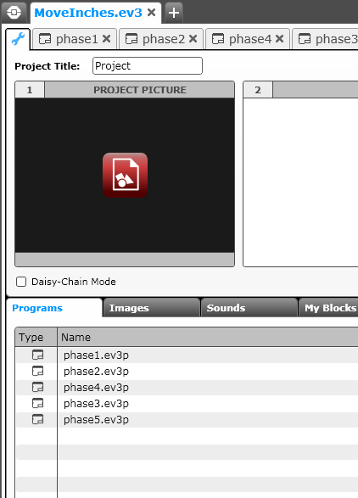
My blocks with inputs and outputs (Move InChes)
The next few slides and the corresponding code file teaches you how to make a specific Move Distance My Block called Move Inches.
You can easily convert the code to use CM.
In the code file, start at PHASE 1.
There is also a corresponding worksheet as well as an automatic calculator that will help you in this lesson.

Slide 5
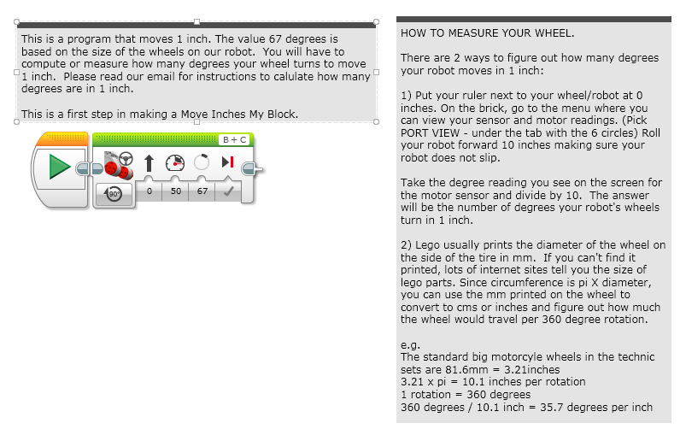
PHASE 1: MEASURE WHEELS

Slide 6
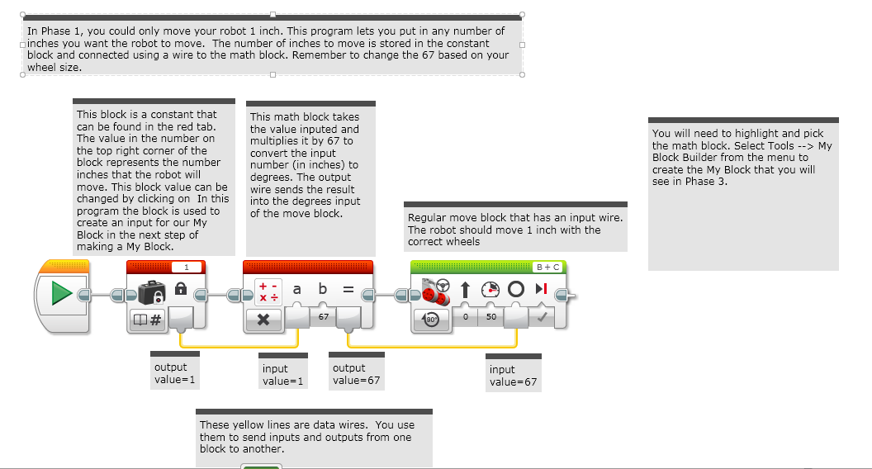
PHASE 2: Making aN INCHES TO DEGREES My Block

Slide 7
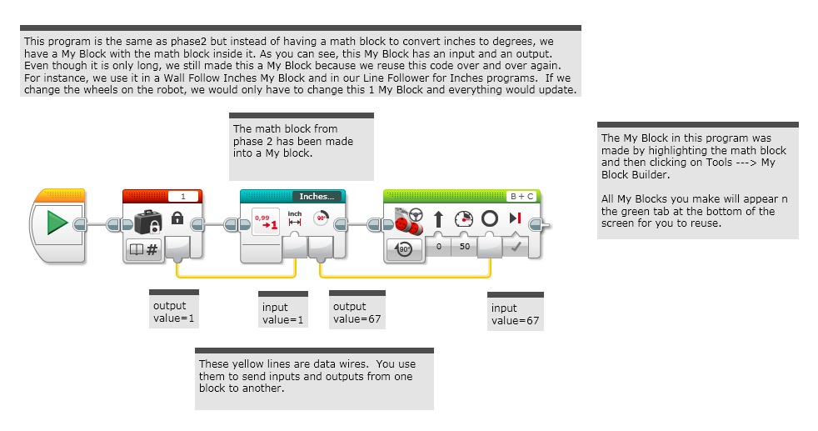
PHASE 3: Using the INCHES TO DEGREES MY BLOCK

Slide 8
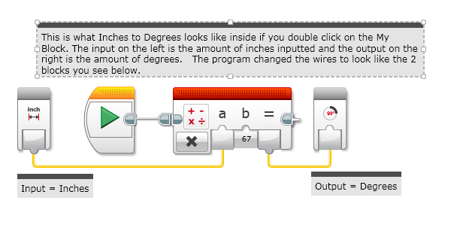
A LOOK INSIDE INCHES to DEGREES

Slide 9
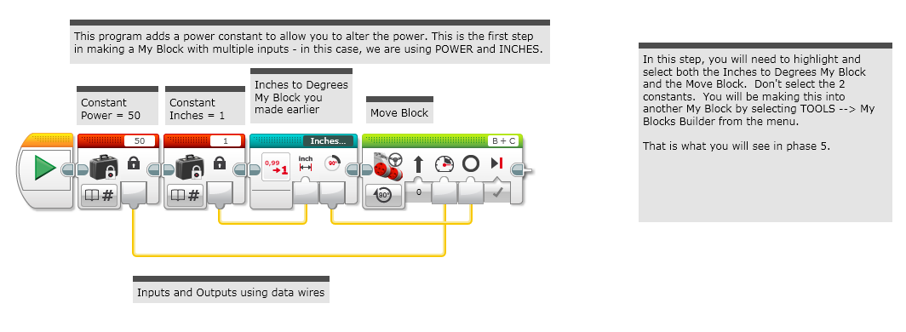
PHASE 4: ADDING INPUTS

Slide 10
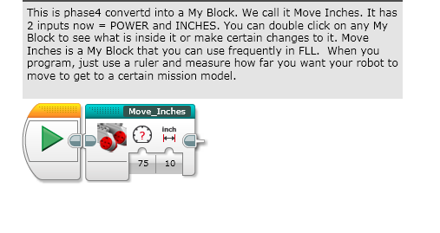
PHASE 5: COMPLETED Move InChes MY BLOCK

Slide 11
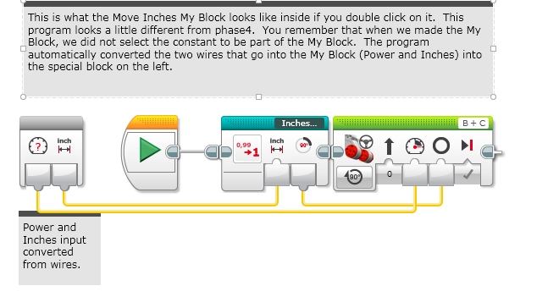
A LOOK INSIDE Move InChes

Slide 12
CREDITS
This tutorial was created by Sanjay Seshan and Arvind Seshan from Droids Robotics.
More lessons are available at www.ev3lessons.com
Author’s Email: team@droidsrobotics.org
This work is licensed under a Creative Commons Attribution-NonCommercial-ShareAlike 4.0 International License.

