Slide 1

BEGINNER PROGRAMMING LESSON
Final Challenges

Slide 2
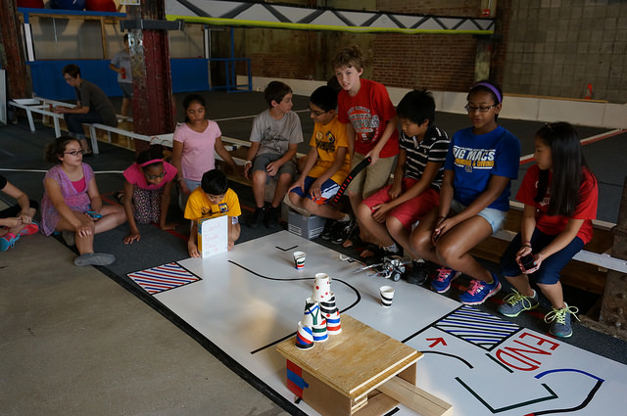
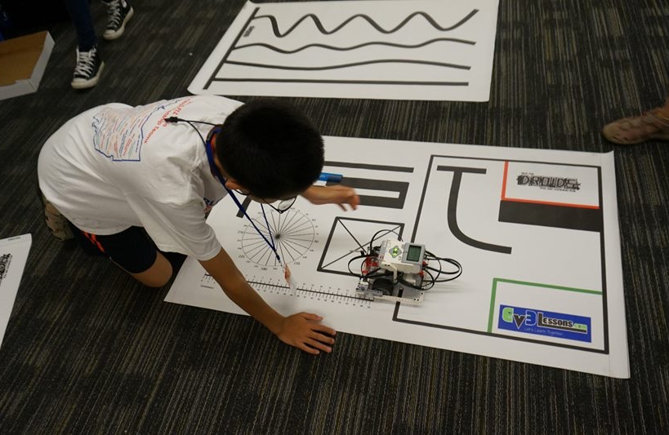
TEACHER INSTRUCTIONS
You can set up any challenge you want using colored electric tape on a white board (available at home improvement/hardware stores). You can also use large white poster paper on a hard floor.
Note that the electric tape colors do not match LEGO’s colors. So your sensors may have trouble reading those colors.
You can also use old FIRST LEGO League Mats for practice. They are sometimes available on eBay or other teams.

Slide 3
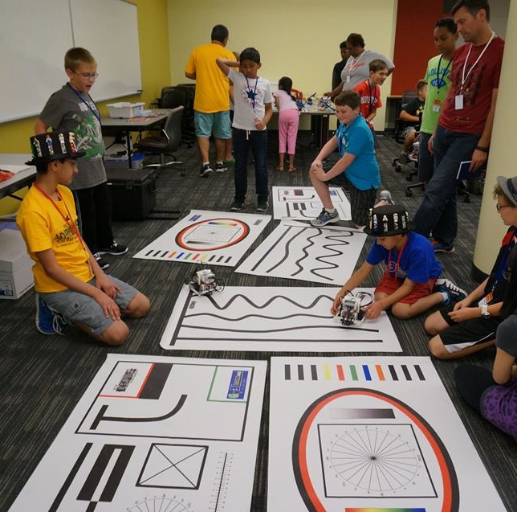
Challenges in this Lesson
The following slides have a few examples of challenges that incorporate the Beginner Lessons.
Solutions are not provided. Students should use everything they have discovered in the Beginner Lessons series to solve the missions
Image on the right features EV3Lessons.com’s training mats. These are not for sale, but the designs are given away free to anyone who donates to the site.

Slide 4
Maze 1: MOVING STRAIGHT AND TURNING PRACTICE
END
Go out of base
Turn left into the passage
Turn right
Turn right and head to the END
BASE/ START

Slide 5

MAZE 2: SENSOR USAGE PRACTICE
Solid North Wall
END
Go out of base
Go up to the North wall and touch it.
Back up turn and navigate through the passage
Go to the “do not touch this wall”. Don’t touch it.
Turn and go to the West wall.
Turn and head to the END!
USE 2-3 SENSORS!
BASE/ START
Do Not Touch this.
Light box that falls over.

Slide 6
STOP ON THE LINE
Program your robot to move forward and then stop exactly at the 3rd line.
You must use a loop and a sensor!
What sensor will you use?

Slide 7
CREDITS
This tutorial was created by Sanjay Seshan and Arvind Seshan
More lessons are available at www.ev3lessons.com
This work is licensed under a Creative Commons Attribution-NonCommercial-ShareAlike 4.0 International License.

