Slide 1






Slide 2
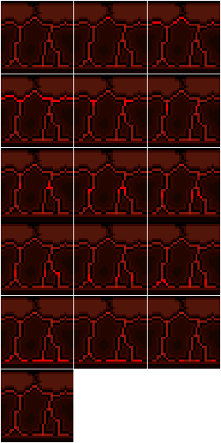
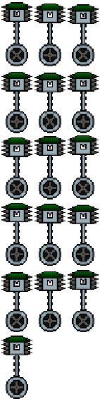
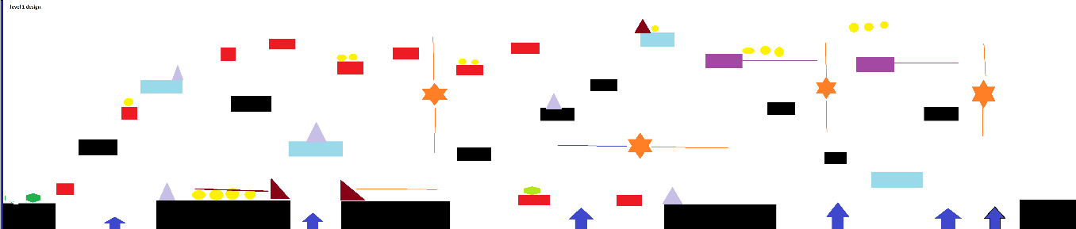
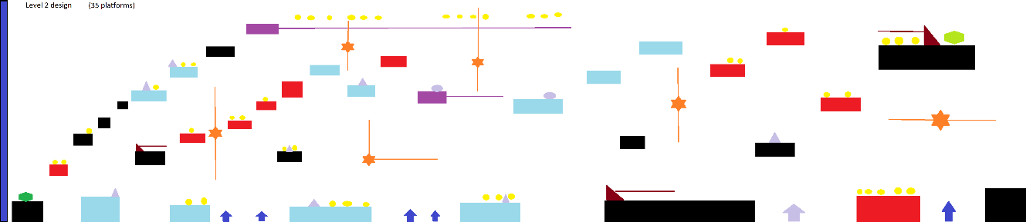
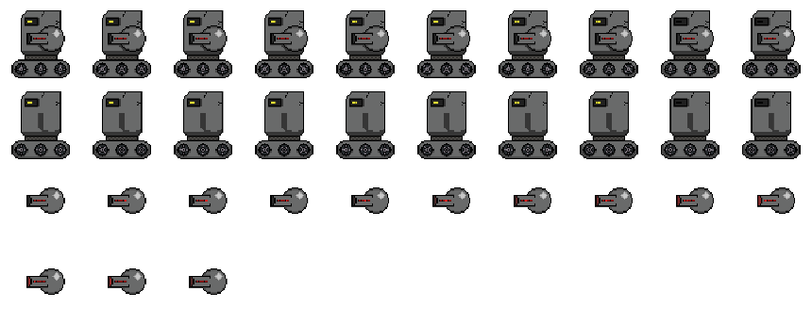
Introduction: The Project Team
Kenny Melville
[B00323186]
Alistair Walker
[b00305911]
Steven O’neill
[B00339826]
Kenny Melville
[B00323186]
Alistair Walker
[b00305911]
Steven O’neill
[B00339826]
Lead Programmer
Lead Games Designer & Audio Designer
Lead Artist
Notes:
[Name, Banner ID, Role]
[Mention the title of the game we are working on]

Slide 3
Features, Genre, Target Audience
[Talk about the genre the game is]
[Uniqueness of the game – what sets it apart from other games]
[Mention it is a Single Player game]
[Talk about the Target Audience and where the Influence for the game came from]
[Influences behind the game]
Notes:
[Talk about the genre the game is]
[Uniqueness of the game – what sets it apart from other games]
[Mention it is a Single Player game]
[Talk about the Target Audience and where the Influence for the game came from]
[Influences behind the game]

Slide 4
Story
[Brief summary of the plot of the game]
[Mention the main character and the main antagonist]
[Main characters goal in the story]
Notes:
[Brief summary of the plot of the game]
[Mention the main character and the main antagonist]
[Main characters goal in the story]

Slide 5
Setting and Environment
[Where the game takes place]
[The environments and world the player will be going through]
Notes:
[Where the game takes place]
[The environments and world the player will be going through]

Slide 6
Gameplay and Mechanics
[Talk about the core objectives of the game]
[Mention the player (controls and mechanics, enemies (behaviour and types), pickups and hazards]
[Mention the goal of each level]
Notes:
[Talk about the core objectives of the game]
[Mention the player (controls and mechanics, enemies (behaviour and types), pickups and hazards]
[Mention the goal of each level]

Slide 7
Level Design
[Show image of level concept for Volcanic level]
[Discuss level design approach]
[Discuss immersive aspects of the level related to the principles of level design – refer to lecture slides]
Notes:
[Show image of level concept for Volcanic level]
[Discuss level design approach]
[Discuss immersive aspects of the level related to the principles of level design – refer to lecture slides]

Slide 8
Artwork of the game
[Display images of the various block, enemy and player images]
[Talk about the style of artwork; why we choose to make 2D sprites, how they were made and what they were influenced by]
[Discuss software used – aseprite – visuals of images on the slide]
Notes:
[Display images of the various block, enemy and player images]
[Talk about the style of artwork; why we choose to make 2D sprites, how they were made and what they were influenced by]
[Discuss software used – aseprite – visuals of images on the slide]

Slide 9
Audio Production for the game
[Discuss audio – how it was created (e.g. via Audacity) – multiple sounds per level?
[Samples of the sounds]
[Discuss ease of use of the software? – how easy to integrate with Unity?]
Notes:
[Discuss audio – how it was created (e.g. via Audacity) – multiple sounds per level?
[Samples of the sounds]
[Discuss ease of use of the software? – how easy to integrate with Unity?]

Slide 10
Development Approach for Project
[Talk about the Development Model we have gone with (Agile Model); why did we choose that specific model, what were the benefits and mention a practical example of how the Agile approach was useful]
Notes:
[Talk about the Development Model we have gone with (Agile Model); why did we choose that specific model, what were the benefits and mention a practical example of how the Agile approach was useful]

Slide 11
Project Management and Version Control
[Talk about the use of GitHub and version control – how you found using it and how beneficial was it for file sharing and project communication]
Notes:
[Talk about the use of GitHub and version control – how you found using it and how beneficial was it for file sharing and project communication]

Slide 12
Game Engine and Development Language
[Talk about the Game Engine we choose to go with (why we choose it over Unreal Engine 4, GameMaker etc. – why Unity was beneficial from a game development perspective)
[What programming language we used for creating the game – C#]
[Show snippets of code used for the game]
Notes:
[Talk about the Game Engine we choose to go with (why we choose it over Unreal Engine 4, GameMaker etc. – why Unity was beneficial from a game development perspective)
[What programming language we used for creating the game – C#]
[Show snippets of code used for the game]

Slide 13
Pedagogical Outcomes
[Talk about what the team has learnt during the course of the project]
Notes:
[Talk about what the team has learnt during the course of the project]

Slide 14
Game Demo
[Show a demo of the game in play]
Notes:
[Show a demo of the game in play]

Slide 15
Any Questions?
[Answer questions]
Notes:
[Answer questions]

