Slide 1
Hard pass
Or how to protect your passwords
Lizzi Dimitri Sousa Claudio Da Silva Bruno

Slide 2
Vos mots de passe ne sont pas en sécurité!
“In 2016, billions of accounts were leaked to internet from LinkedIn, Tumblr, MySpace, Last.FM, Yahoo!, VK.com and Gmail” http://thehackernews.com/2017/03/gmail-yahoo-password-hack.html
Demo: https://haveibeenpwned.com/
“LastPass Leaking Passwords Via Chrome Extension” https://www.darknet.org.uk/2017/03/lastpass-chrome-extension-leaking-passwords/

Slide 3
Un bon mot de passe
Unique
Complexe
Non reutilisée
Non previsible
Pas de pattern global
Riche set de characters
Longue
Secrete
Stockee nulle part
N’existe que dans votre tête
Notes:
To have all three is impossible
Give an example for each pair
Ours aims at complying with all three

Slide 4
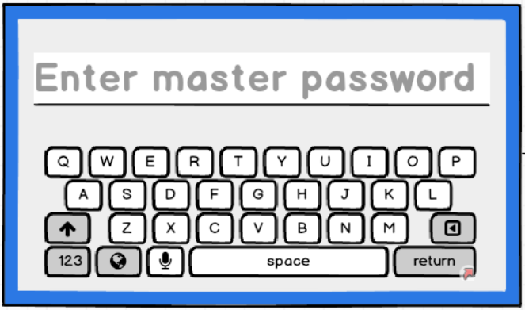
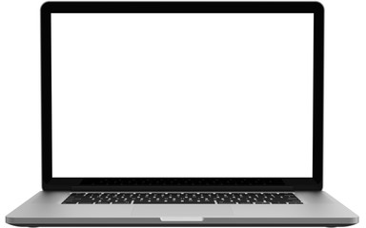
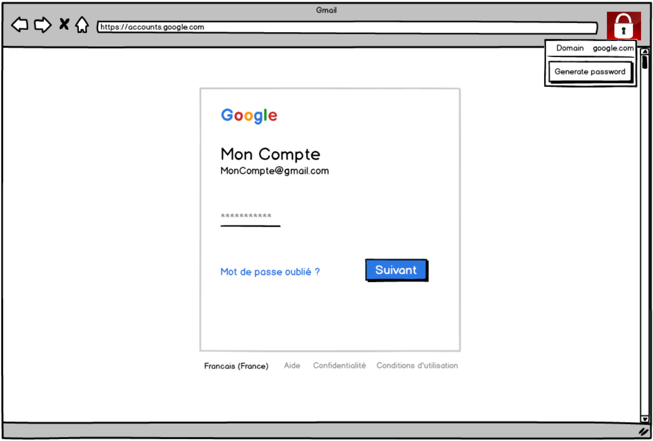
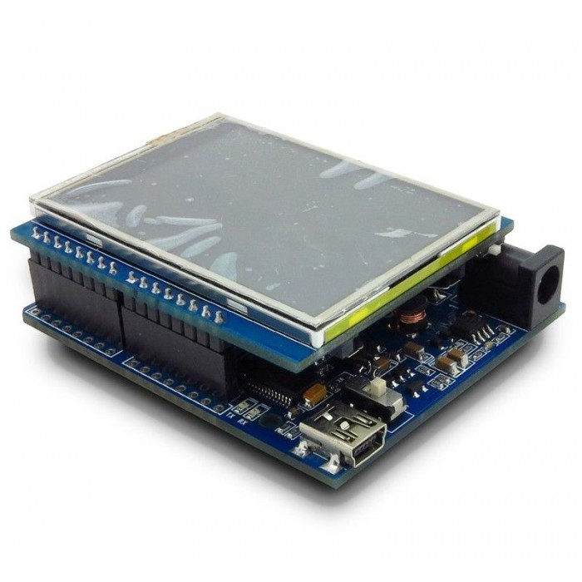
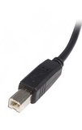
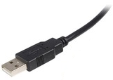
Notre proposition: architecture
DO ARCHITECTURE DIAGRAM HERE AND EXPLAIN

Slide 5
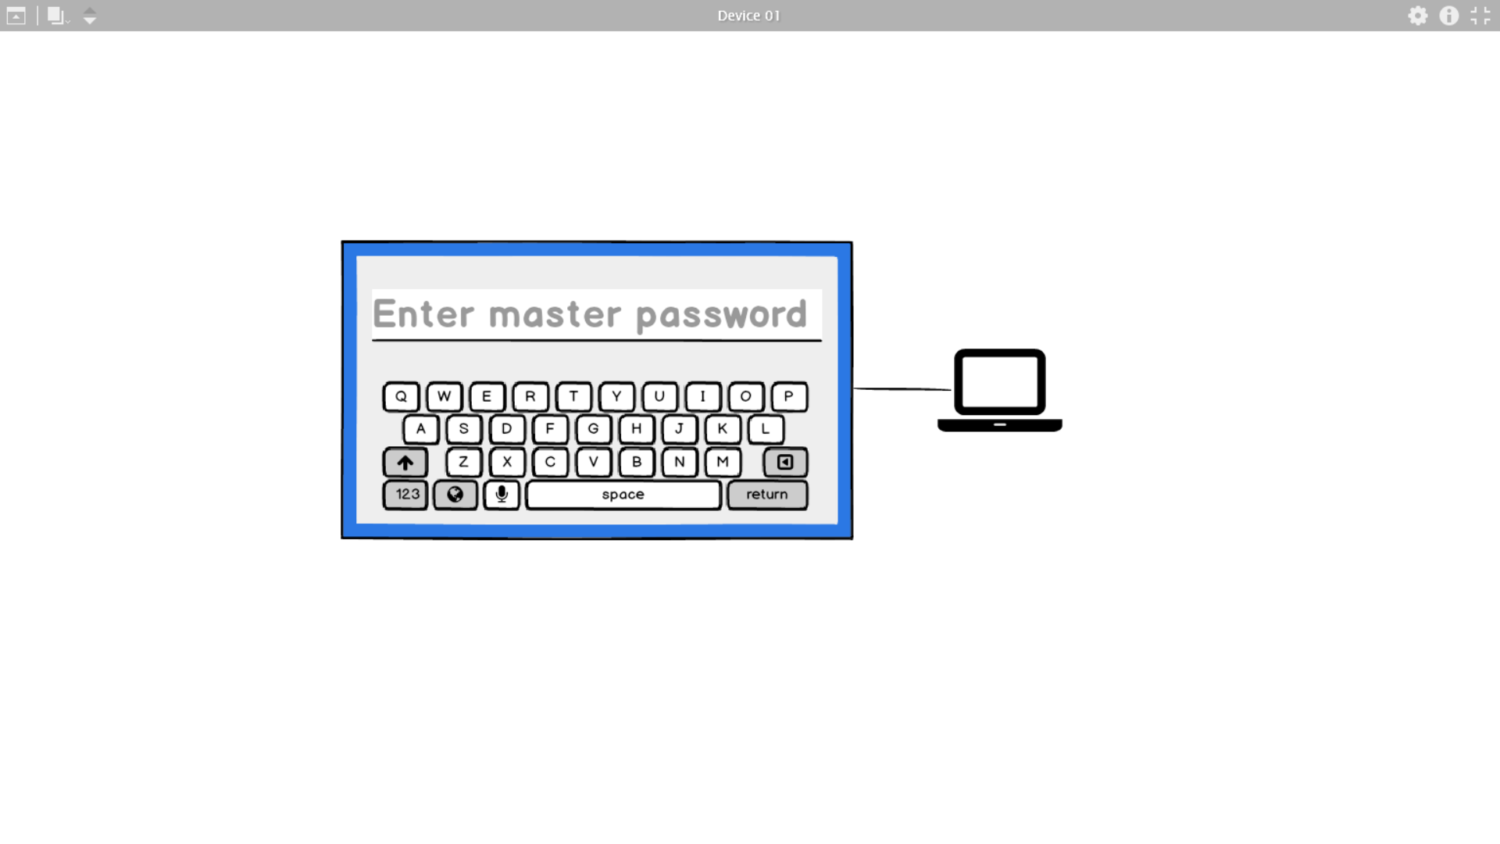

Slide 6
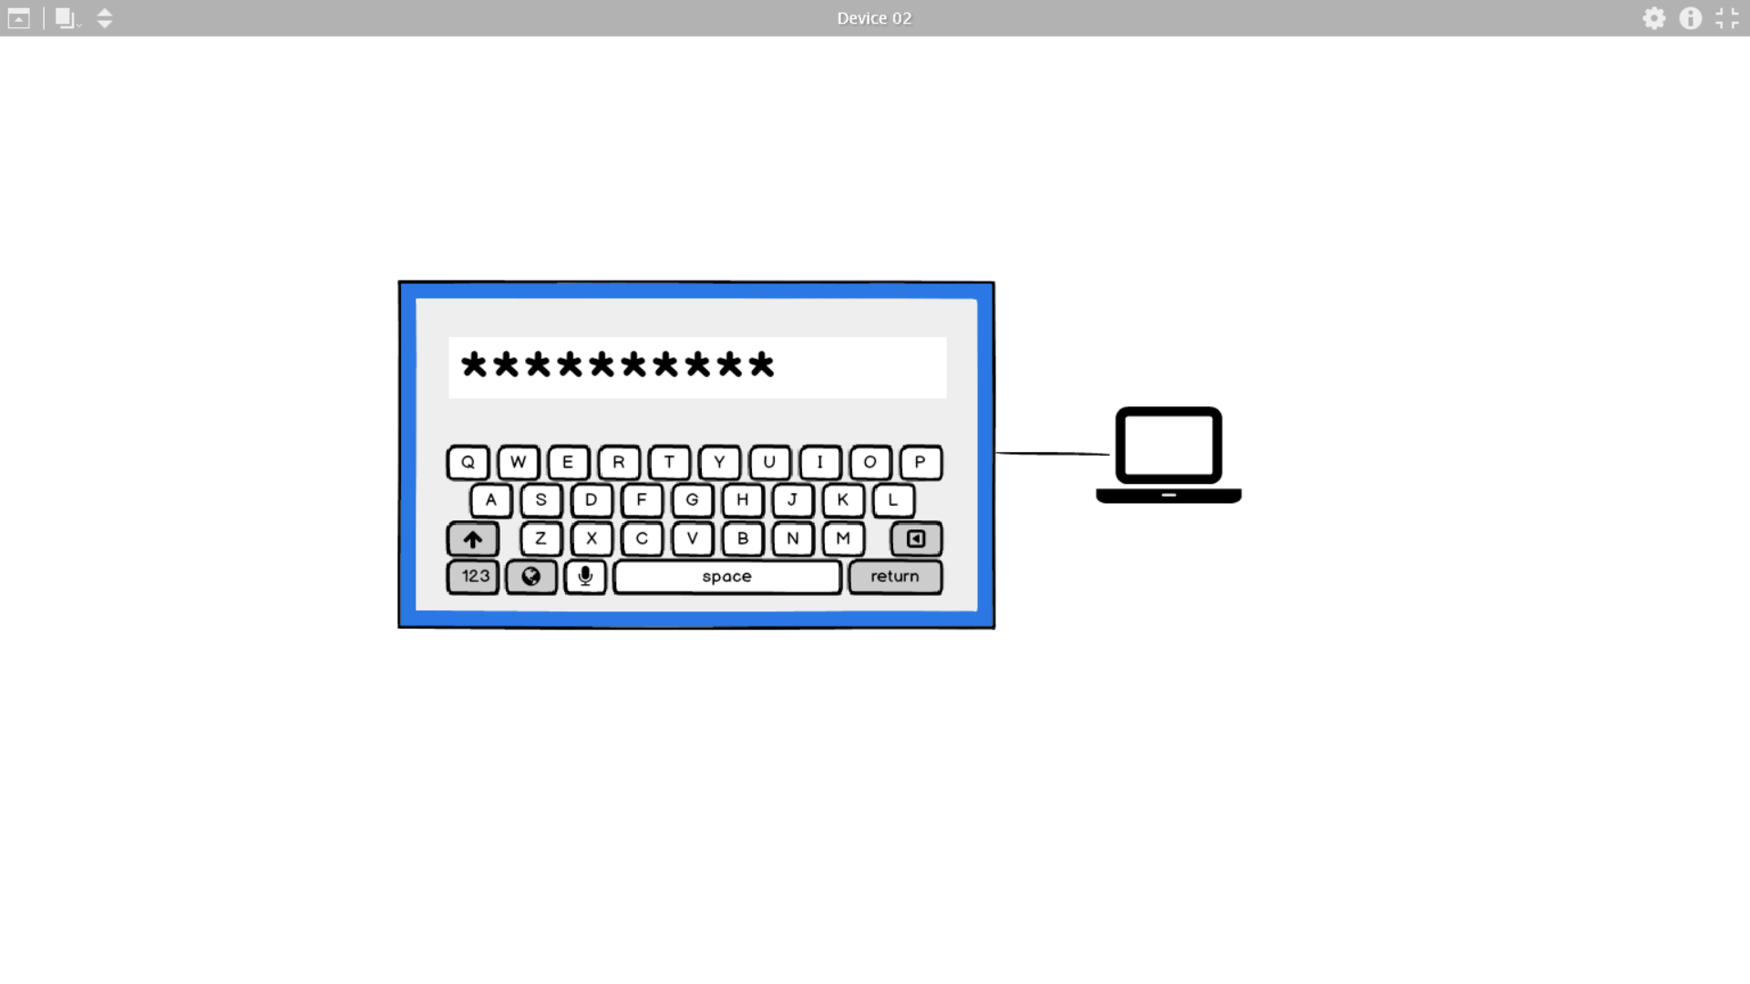

Slide 7
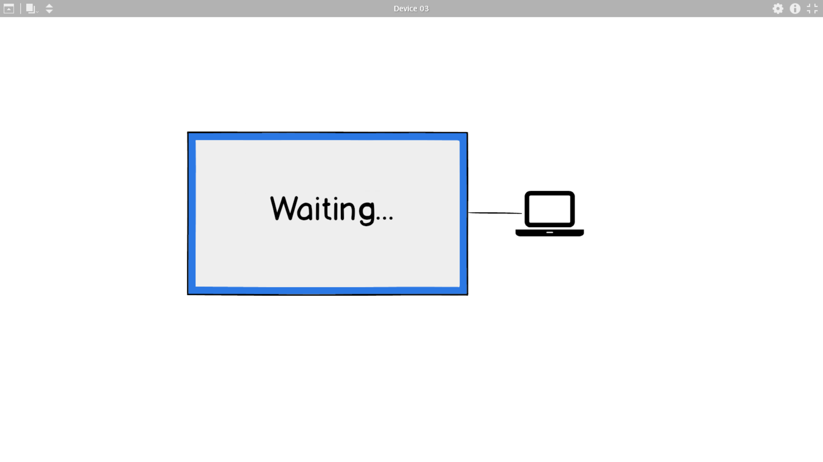

Slide 8
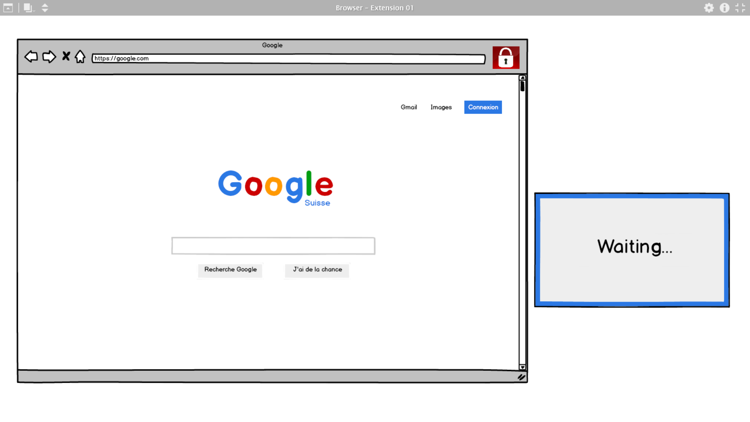

Slide 9
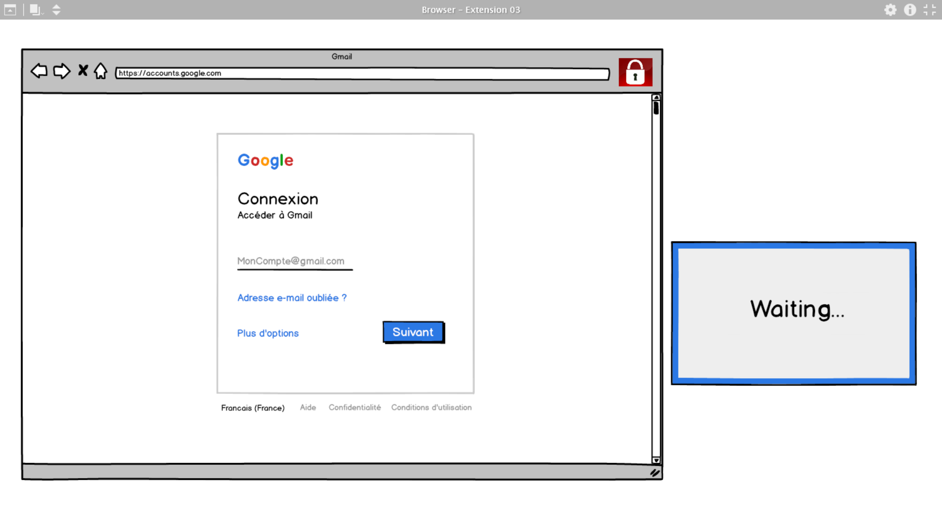

Slide 10
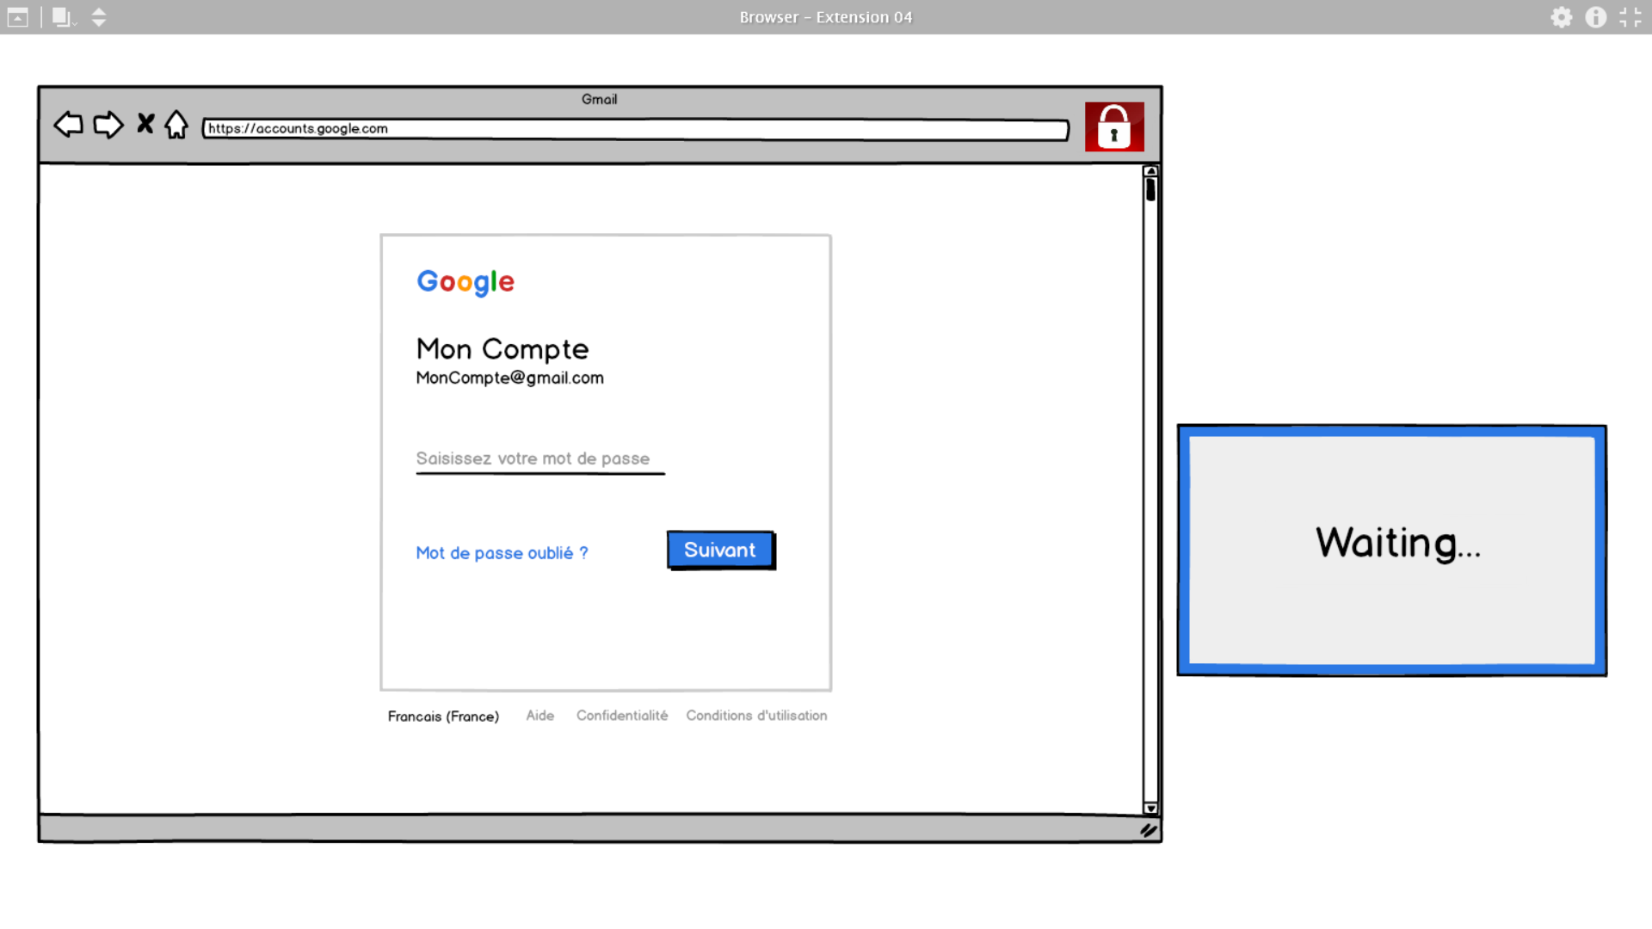

Slide 11
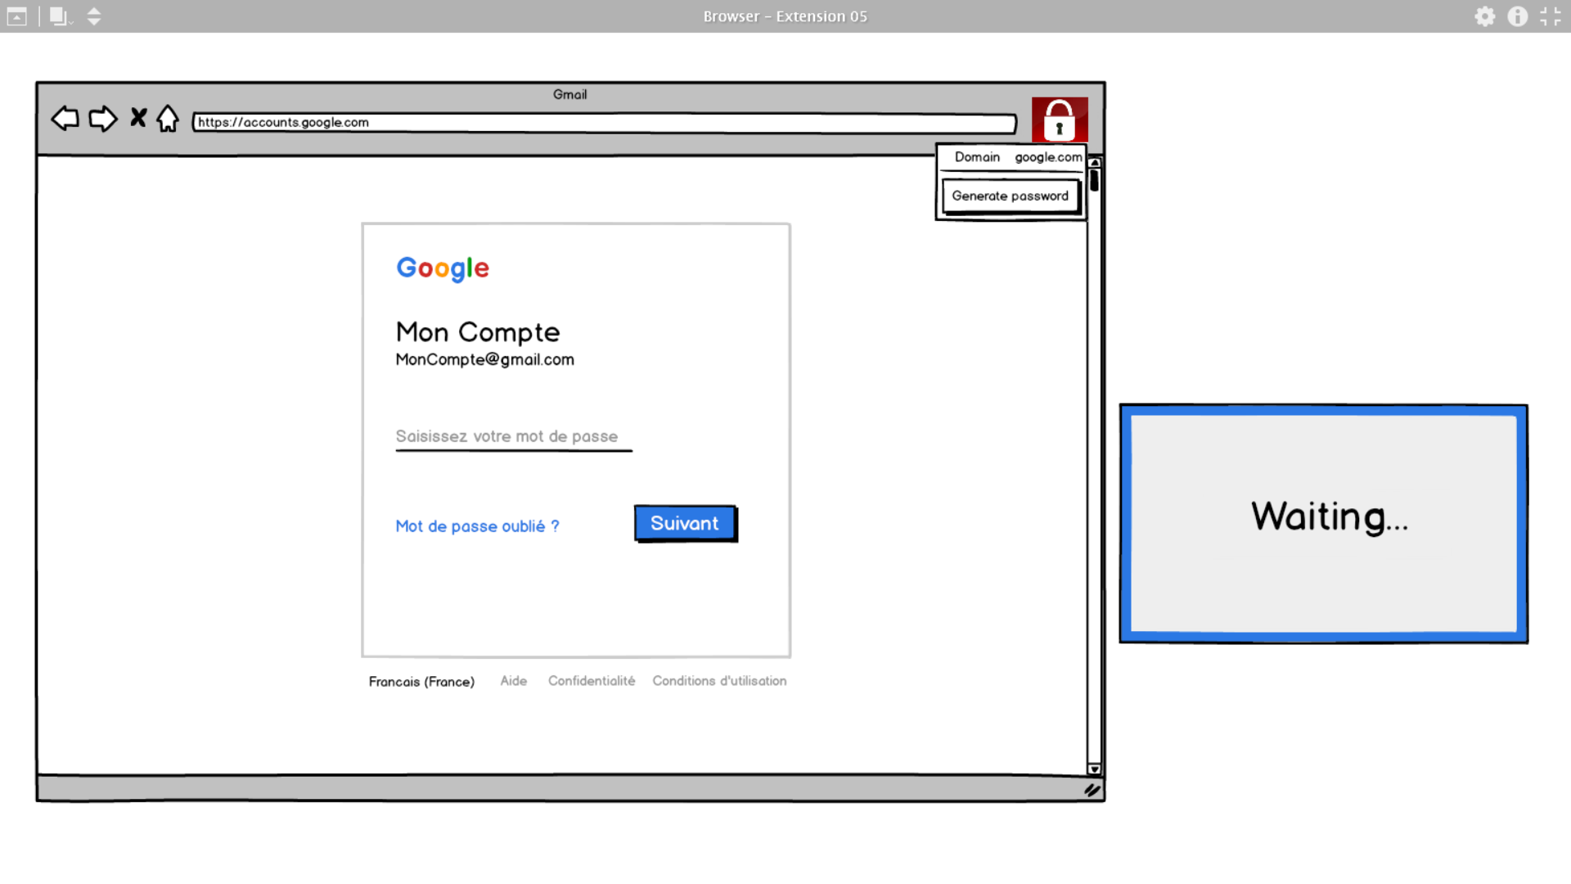

Slide 12
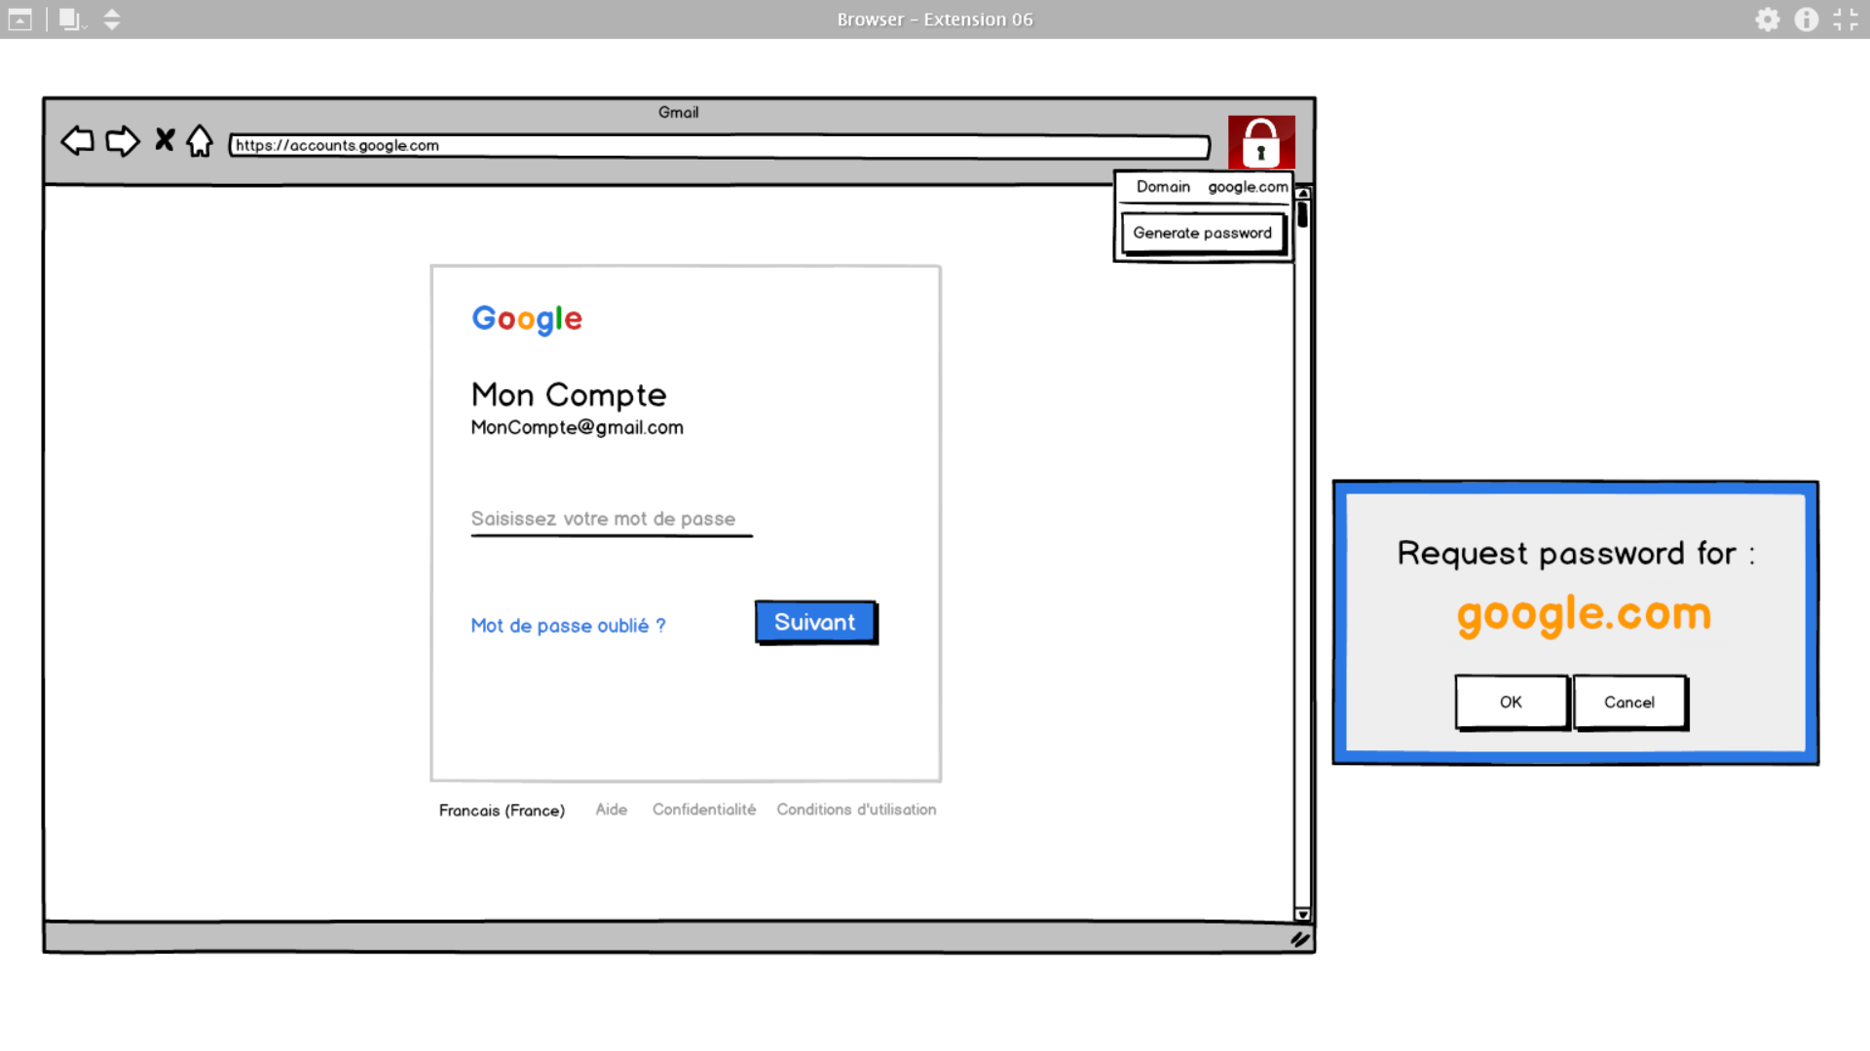

Slide 13
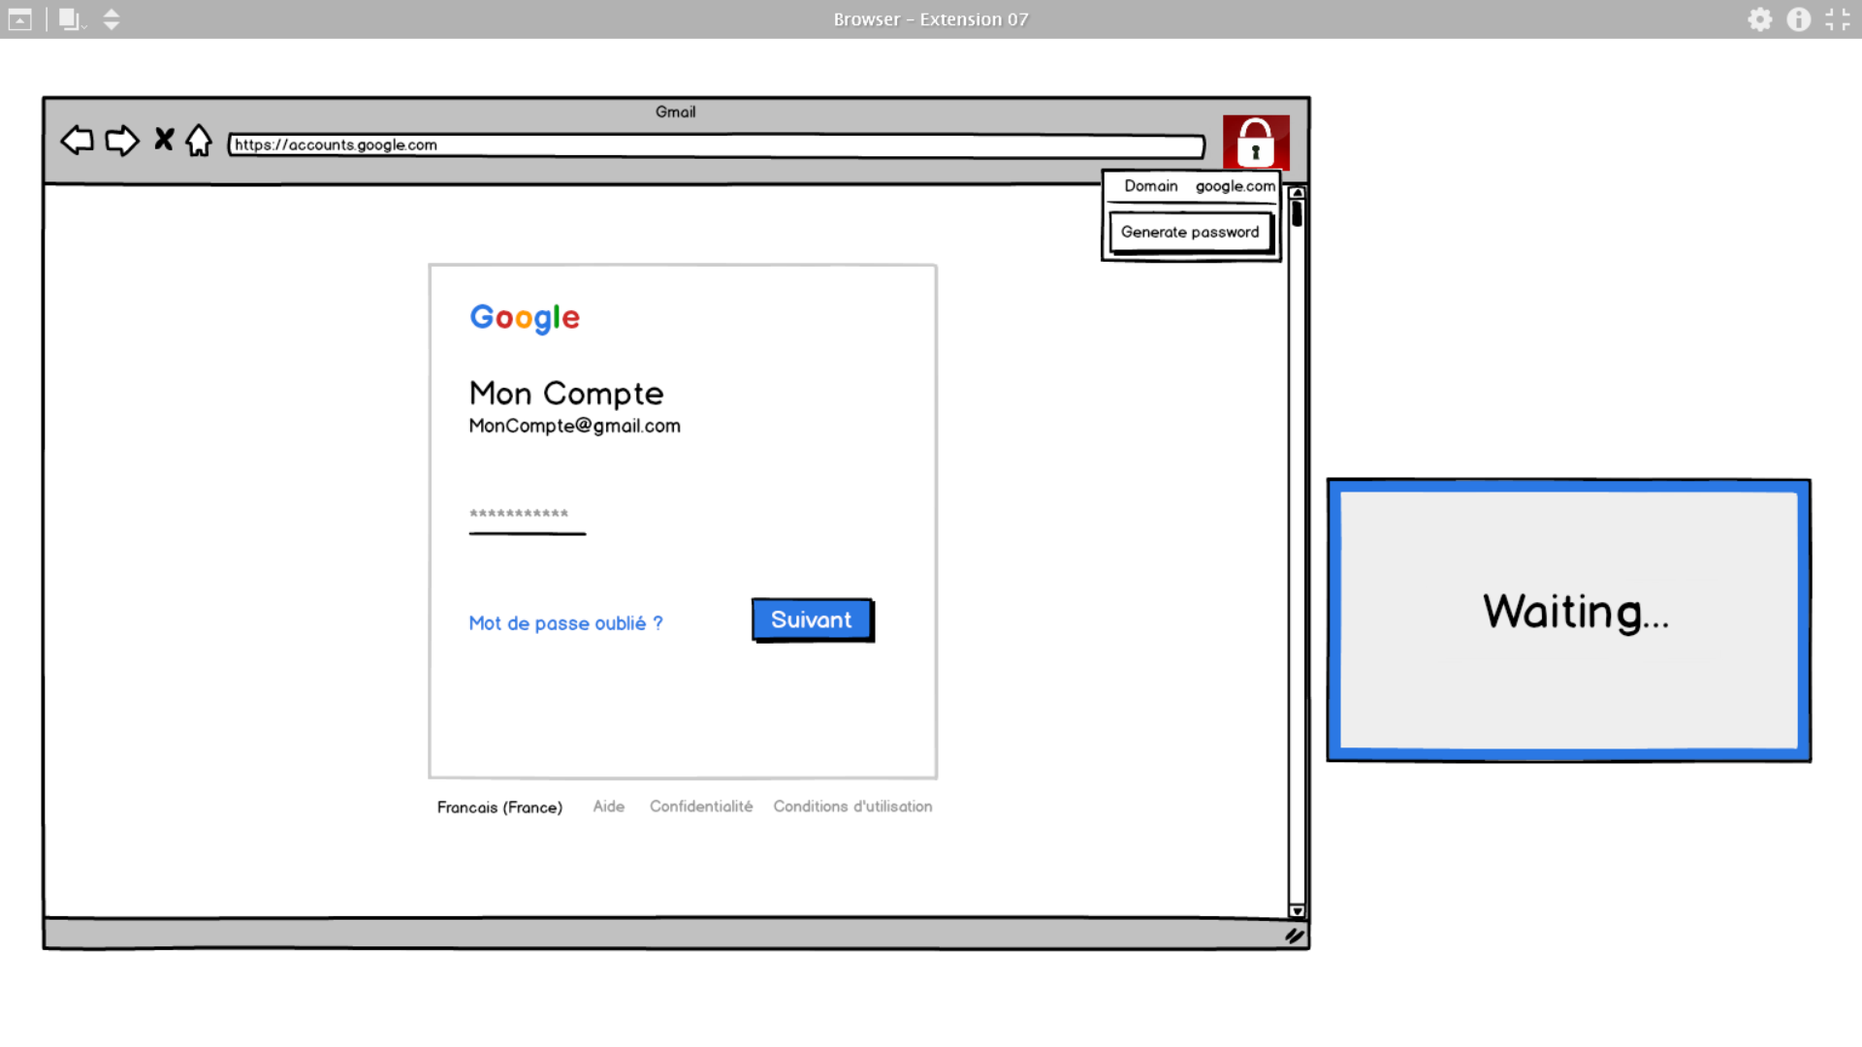

Slide 14
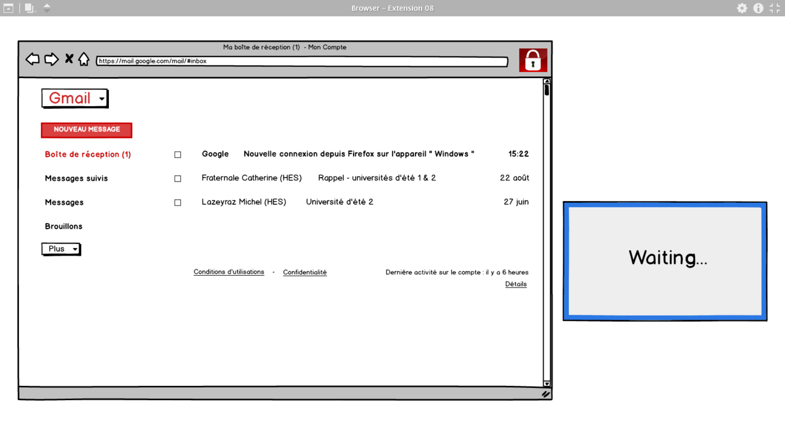

Slide 15
Q & A

