Slide 1


DA 204o: Data Science in Practice
Course Project Proposal
Auto-Insight: Predicting Ownership, Usage, Price and Insights from Indian Car Listings
Team Data Pack
Binayak Chakraborty, binayakc@iisc.ac.in
Supratim Dey, supratimdey@iisc.ac.in
Rohit Agarwal, rohitagarwal@iisc.ac.in
Rituparno Chatterjee, rituparnoc@iisc.ac.in
Image source: Internet

Slide 2
Data Science Canvas |  |  | Project: | Auto-Insight: Predicting Ownership, Usage, Price and Insights from Indian Car Listings
 |  |  | Team: | Team Data Pack
Problem Statement |  |  |  | Execution & Evaluation |  | Data Collection & Preparation
Business Case & Value Added Provide data-driven insights into the Indian used-car market. Identify what factors most influence resale price Help buyers & sellers make informed decisions and get fair prices. Build reusable ML pipelines. | Model Selection Regression models for price prediction (Linear Regression, Random Forest, XGBoost, LightGBM , AdaBoost, Decision tree, Weighted Ensemble) | Model Requirements Numerical and categorical feature handling. Minimal missing values or well-defined imputation logic. Sufficient distribution of target values (price). | Skills Data wrangling, EDA, and cleaning. Understanding of regression and ML modeling. Feature engineering Model evaluation using metrics (MAE, RMSE, R²). Visualizationskills. | Model Evaluation Regression: MAE, RMSE, R². Compare models against baseline (mean/median predictor). Monitor prediction stability across car segments (brand, fuel type, age). | Data Storytelling Present insights using clear and intuitive visualizations: Price vs. mileage Price vs. year Brand-wise median price Feature importance graph Tailor communication for non-technical audience. | Data Selection & Cleansing Drop duplicates and invalid entries. Standardize units Handle missing values using median/mode imputation. Remove extreme outliers Convert text columns into numeric features using parsing & encoding. | Data Collection Primary dataset from Kaggle.
 |  | Software & Libraries Python (Pandas, NumPy) Scikit-learn Matplotlib, Seaborn Streamlit Google Colab / Jupyter Notebook GitHub for collaboration
Data Landscape Available: Kaggle car dataset — 140K rows, 12 fields. Includes: Brand, Model name, year, price, km driven, fuel, transmission, owner. Brand category mapping
Data Landscape Available: Kaggle car dataset — 140K rows, 12 fields. Includes: Brand, Model name, year, price, km driven, fuel, transmission, owner. Brand category mapping |  | Software & Libraries Python (Pandas, NumPy) Scikit-learn Matplotlib, Seaborn Streamlit Google Colab / Jupyter Notebook GitHub for collaboration |  |  |  | Data Integration Merge processed features into a dataframe. Create derived features (brand, age of car, mileage per year). Ensure consistency between numerical conversions and categorical encoding. | Explorative Data Analysis Identify distributions of numerical fields (price, km driven, year). Detect patterns, correlations, and feature relationships. Visualize: heatmaps, boxplots, scatterplots,. Identify outliers and unusual data clusters. Assess which features are likely strongest predictors.

Slide 3

Problem Definition
Background of the problem
    This project combines Exploratory Data Analysis (EDA) and Machine Learning (ML) to uncover patterns in vehicle attributes and build predictive models. Through EDA, we aim to understand key trends in pricing, usage, and ownership. Using ML, we will predict price and data driven insights for cars buyers.
Why is it important?
    Reveals what truly affects a car’s value and resale potential.
    Helps standardize pricing using data-driven models.
    Supports smarter buying and selling decisions.
Objectives of the project
    The main objective of this project is to explore different Machine Learning techniques to predict price of cars based on different features. We will explore different model design hypotheses and assess our models’ performance.
How can Data Science solve the problem?
    Analyze trends in pricing, usage, and ownership.
    Predict key outcomes like resale price and ownership type using machine learning.

Slide 4
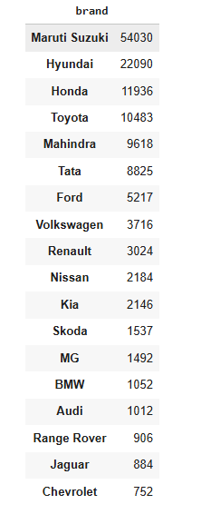
Data Collection and Preparation
Data source(s) (where it's from, how it was collected)
Kaggle (https://www.kaggle.com/datasets/milapgohil/car-dataset)
Description of the data (features, size, format)
Features: Rows = 140K, Columns = 12 (String = 8, Int = 3, Bool = 1)
Size: 11 MB
Format: .csv
Fields:
Brand, Model name, Year, Price, KM Driven, Fuel Type, Transmission, Owner etc.
Any preprocessing steps required
Data cleaning: Remove duplicates & adjust extreme outliers.

Slide 5
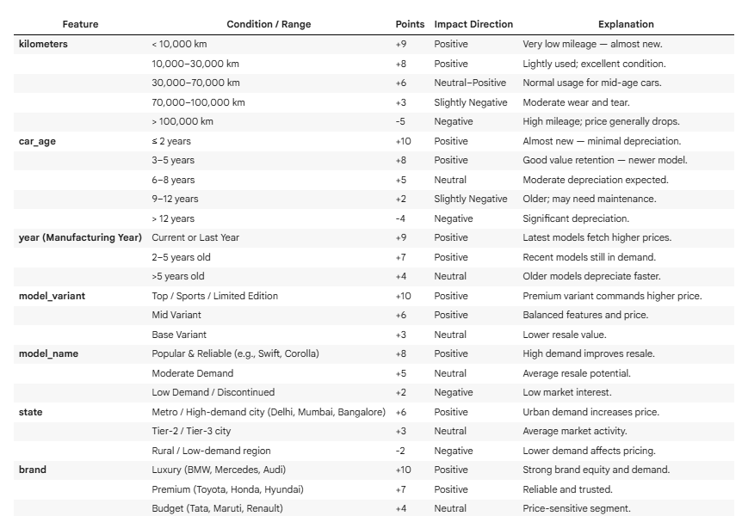
Data Collection and Preparation
Feature Engineering
Car Age , Kilometer Driven , Manufacturing year , Model Variant , Model Name , State, Brand , Car type, Owner , transmission , fuel type.
> We tried creating a new feature out of the above by providing the impact “Car_Points”

Slide 6
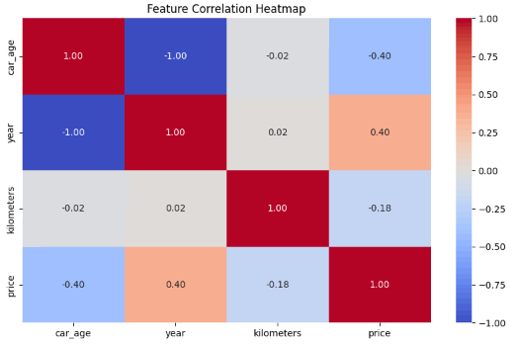
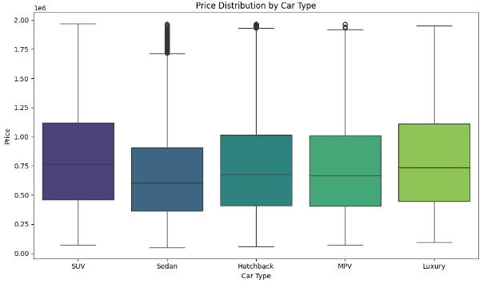
EDA

Slide 7
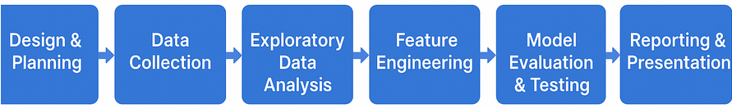
Implementation Plan
Design and Plan
Completion of Plan (1st Milestone : 25th Oct)
EDA
Data Cleansing (3rd Milestone : 10th Nov)
Data Modelling & Evaluation
Building the model and testing ( 4th Milestone : 20th Nov)
Streamlit Dashboard & Report generation
Final Testing ( 5th Milestone : 30th Nov)
Data Collection
Evaluate the Data source(2nd Milestone : 1st Nov)
Project phases (data collection, model building, testing)
Timeline and milestones
Resources required
Human resources:
2 members for Data Cleaning & EDA
2 members for Model Training & Validation
Technical resources:
  Google Colab / Jupyter Notebook
  Python libraries: Pandas, NumPy, Scikit-learn, Matplotlib
Collaboration tools:
  GitHub / Google Drive for version management

Slide 8
Proposed Methodology
ML methods used & it’s justification
  Linear Regression :Baseline model for interpretability
  Random Forest Regressor: Handles non-linear relationships and provides feature importance
  XGBoost: Gradient boosting for high accuracy and efficiency.
  LightGBM: Optimized for large datasets and faster training.
  AdaBoost: Improves weak learners through boosting.
  Decision Tree: Simple and interpretable model for quick insights.
  Weighted Ensemble: Combines strengths of multiple models for better performance.
Tools / technologies used
    Pandas – Data loading, cleaning, preprocessing
    NumPy – Numerical computation
    Matplotlib & Seaborn – Exploratory data analysis & visualization
    Scikit-learn – ML model building, tuning, cross-validation
    Google Colab – Development, training environment
    Python
    Streamlit

Slide 9
Challenges and Risks
Potential risks or challenges
  Data Quality Issues
  Bias in Data
  Overfitting / Underfitting
  Model accuracy / performance
How you plan to mitigate them
  Clean and Validate Data: Use techniques like missing value imputation, outlier detection (e.g., boxplots), and consistency checks during EDA.
  Address Bias: Perform exploratory data analysis (e.g., distribution plots, group-wise statistics) to detect imbalance.
  Monitor Model Performance: Evaluate models with metrics like RMSE, MAE, R2 score for regression.

Slide 10

Final Learnings I
Using Car Points as the Feature containing price per kms
Model Name | R2 | MAE | RMSE
XGBRegressor | 0.998584138 | 8442.74 | 15607.16
Random Forrest | 0.903 | 84830.91 | 129170.99
However when we tried to generate a car price like below , it generated values which are way behind actuals ( courtesy Spiny)
Brand | Model Name | Model Variant | Car Type | Transmission | Fuel Type | Year | KMs | Price generated (Rs)
Tata | Nexon | Nexon | SUV | Manual | Petrol | 2017 | 115000 | 44000
Maruti Suzuki | Alto | Z | Hatchback | Manual | Petrol | 2007 | 150000 | 56000
Hundai | I10 | Sportzs | Hatchback | Manual | Petrol | 2011 | 90000 | 60000

Slide 11
Final Learnings - II
So we revaluated the features and hyper tuned
Model Name | R2 | MAE | RMSE
RandomForest | 0.286 | 289497.575 | 350470.397
XGBoost | 0.293 | 288154.934 | 348752.493
LightGBM | 0.292 | 288464.150 | 349108.866
AdaBoost | 0.290 | 288897.920 | 349401.420
Linear Regression | 0.267 | 292440.433 | 355010.491
DecisionTree | -0.435 | 389166.599 | 496791.116
Weighted Ensemble | 0.153 | 308612.964 | 381806.962
Now it generated values which are close to the actuals ( courtesy Spiny)
Brand | Model Name | Model Variant | Car Type | Transmission | Fuel Type | Year | KMs | Price generated (Rs)
Tata | Nexon | Nexon | SUV | Manual | Petrol | 2017 | 115000 | 677590
Maruti Suzuki | Alto | Z | Hatchback | Manual | Petrol | 2007 | 150000 | 511980
Hundai | I10 | Sportzs | Hatchback | Manual | Petrol | 2011 | 90000 | 521226

Slide 12
Role and Responsibilities
Binayak Chakraborty:
  Data Model Training & Validation
Supratim Dey:
  Data Model Training & Validation, Streamlit Dashboard
Rohit Agarwal:
  Data Cleaning / EDA
Rituparno Chatterjee:
  Data Cleaning / EDA
Note: More than one student may be responsible to handle an activity, e.g., Model development.

Slide 13
Future Enhancements
Enable user-uploaded datasets
Integration with real-time APIs (e.g., Cars24).
Integrate Neural Networks

Slide 14
Demo & QnA

