Slide 1

Pun-GAN
Generative Adversarial Network for Pun Generation
IE-643 Deep Learning : Project Mid-Term Review
Speakers: Chesta Pahuja (19i190008)
Saurav Raj (170110062)
Fall’2020

Slide 2
Presentation Outline
Introduction
2. Work Done Before Mid-Term Review
3. Mid-Term Evaluation- Comments
4. Work done after Mid-Term review
5. Results
6. Future Work
7. References

Slide 3
Introduction
What? - Homographic pun- A clever and amusing use of a word with two meanings.
Example: A dog having puppies on the sidewalk is considered to be littering.
Task - Pun-Generation, given a pair of word senses (a polyseme)
Why? - Computational creativity– A key step towards building an intelligent
natural language generation system
- Fun application of Natural Language Processing research
- Can be used to develop linguistic skills in children
- Witty and humorous content for social media

Slide 4
Till Midsem
Literature Riview
Studied 3 related papers along with the given paper. 1. A constrained neural language model (Mou et al., 2015) 2. A neural approach to pun generation (Yu et al., 2018) 3. Word sense disambiguation using a bidirectional LSTM ( Luo et al., 2018)
Problems considered and their solution approach given in the paper
Traditional sentence generators lack flexibility and creativity- - Adoption of Constrained neural network in an unsupervised learning mode
Same word has 2 senses, exact sense of a word only depends upon the context of given sentence - Go beyond “Bag of words” technique and adopt sequence modelling
lack of large-scale pun corpus for training - Use of Reinforcement learning in an adversarial manner for generator and discriminator.

Slide 5
STATUS OF WORK BEFORE MIDSEM
Implementing the model from scratch in: Coding Language- Python, Framework –PyTorch
Model | Methodology | Status
1. Dataset pre processing Generator- Wikipedia corpus | Corpus lowercased, tokenized, replaced numeric characters by #, polysemes in corpus replaced by labelled sense. | ✓
2. Dataset pre processing Discriminator- SemCor(Google WSD dataset), Wikipedia corpus | Embedding, dictionary, cleaned context, Built vocab, etc. | ✓
3. Word Sense Disambiguation Model | Single layer Bi-Directional LSTM, Training Settings: SGD, Loss function: | ✓
3. Generator | Forward Model and backward model :- 1 LSTM encoder, 1 LSTM decoder, Hidden -128, Embeddings 300 Working on Joint Model with Joint Beam Search Algorithm | ✗
Coding done by: Chesta Pahuja

Slide 6
EXPERIMENTAL SETTING
Programming Language- Python Framework- TensorFlow | Generator(Pun Generation Model) | Discriminator (Word Sense Disambiguation Model)
Type of Learning | Unsupervised | Semi-Supervised
Training Dataset | Generic English Wikipedia corpus- Tagged with a unsupervised WSD tool (2595K sentence) | 1. Labelled dataset - SemCor 3.0 -226K sense annotations 2. Unlabelled- English Wikipedia corpus 3. Puns generated from the generator
Evaluation Dataset | SemEval 2017 task 7 -1274 human written puns- annotated with two word senses Word senses are extracted as input to the model
Model Specifications | Se2seq- Forward, Backward– Encoder Decoder – LSTM, Joint Beam Search Decoding |  | Bi-Directional LSTM
Pre-training Optimizer Batch Size Adversarial training | Pre-trained for 5 epochs Optimizer- SGD 32 Trained every 1 step |  | Pre trained for 4 epochs Optimizer-SGD 32 Trained every 5 steps

Slide 7
MID TERM REVIEW- Comments
Understanding of the paper and previous work was very well depicted
Initial experiments were not presented
- The code from the official paper is based on older versions of Tensorflow, Python and linux
and can only be run on GPU. Thus, no experiments could be performed
For future work:
-The proposal of using gloss words in Word Sense Disambiguation model was discouraged,
because of the complexity in implementation, and time constraints
- Alternative approach suggested – To implement simpler components for solving different
tasks, to be completed before final evaluations
-Involvement of both the members in code preparation was encouraged

Slide 8
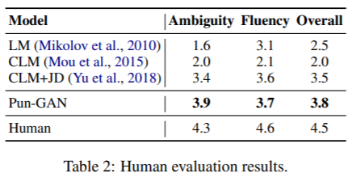
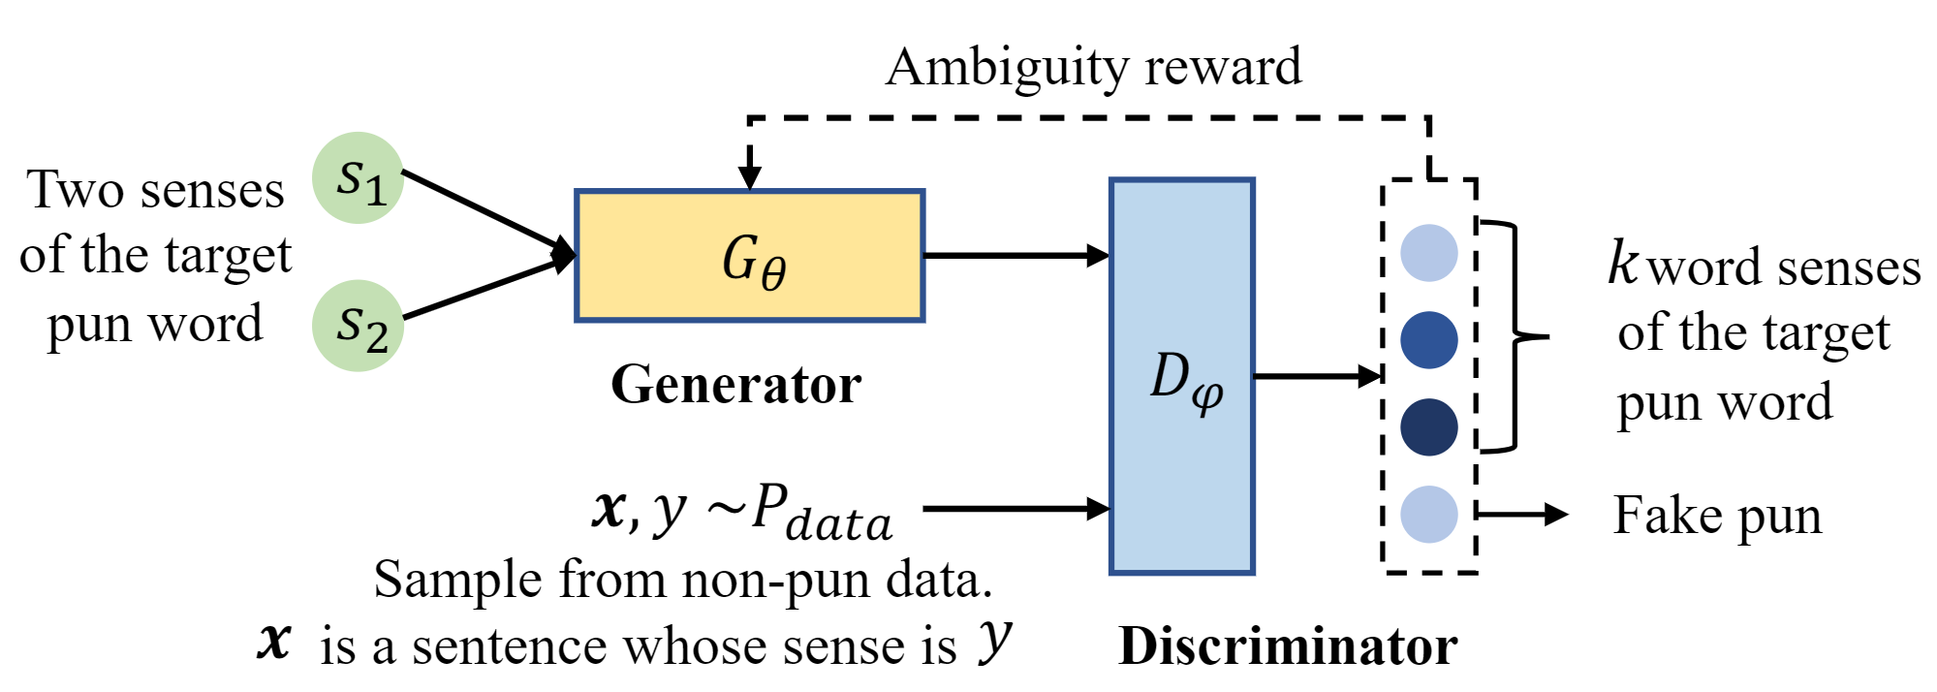
MODEL ARCHITECTURE IMPLEMENTATION FROM SCRATCH
Pun-GAN

Slide 9
Dataset Preprocessing- CLM +JD
SEM-EVAL2017 –TASK-7 with WIKIPEDIA Corpus
Sem Eval 2017 Task-7 Pun-Detection dataset of Homographic puns
Contains several short contexts, jokes, slogans, aphorisms (1294)
The dataset contains sentences, each sentence has exactly one pun-word
Approach:
Conversion of raw data to CSV files for pre-processing and extracting pun words from the sentences and the sense keys(annotated)
Writing a program to convert the sense keys to intended sense using wordnet synsets
Using the extracted data for further pre-processing Wikipedia corpus

Slide 10
Sem Eval + Wikipedia Corpus
A major component involved in implementing the model was to pre-process Wikipedia dumps keeping in mind the model architecture and the task
Approach:
Extracted Wikipedia text from 30 pages, and cleaned the text. Libraries used- NLTK for tokenization.
Text cleaned, tokenized into sentences, sentences tokenized to words
Disambiguated and sense tagged the corpus using pywsd
The pun words extracted from the Sem-Eval dataset were converted into pseudo-words and the Wikipedia corpus was modified to replace the pseudo words according to their respective sense in the corpus
Vocabulary built with word2index and index2word mappings and counting rare words
Total words in vocabulary- 30,000. (Rare words with less than 3 occurences were excluded and were also replaced by <unk> token in the text

Slide 11
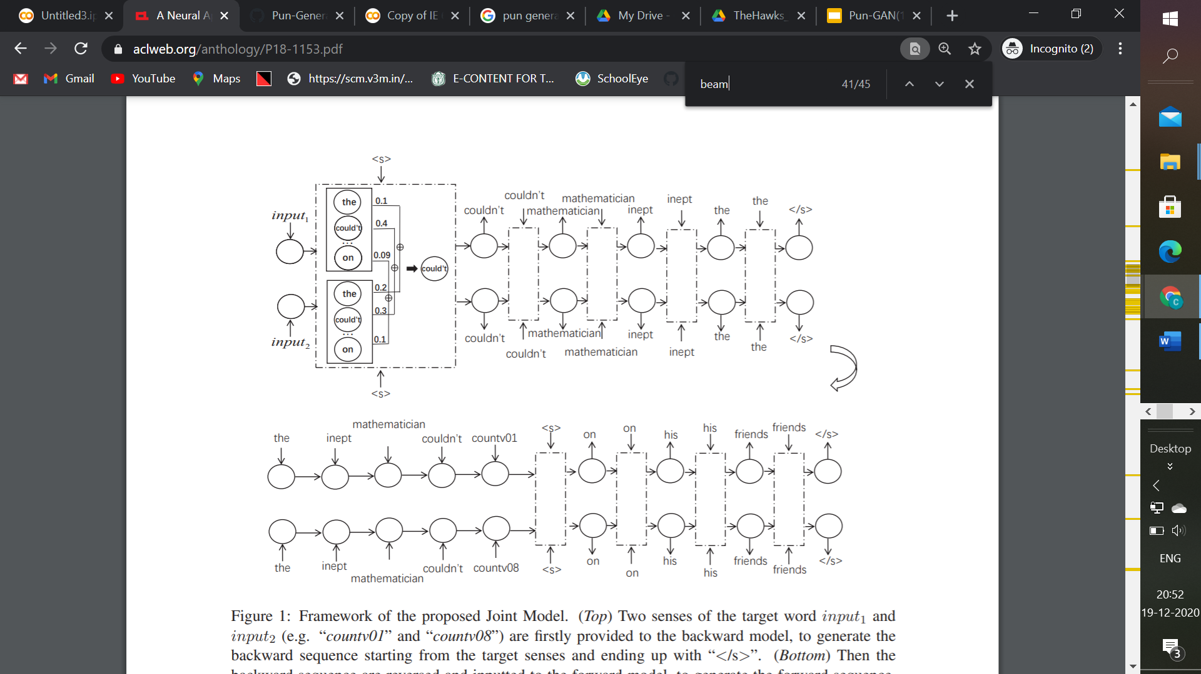
Constrained Language Model + Jointly Decoding

Slide 12
CLM + JD Implementation and Training settings
Backward Encoder-Decoder Architecture- Given 2 words, generate a backward sequence of words
Implemented the Joint Beam Search for the backward model, as proposed in the paper
Forward Encoder-Decoder Architecture- Given a sequence, generates forward sequence
Training Settings:
Device- GPU
RNN cell – LSTM with 1 hidden layer for both encoder and decoder frameworks, hidden size -128
Input- A word- Output- Backward and forward sequences containing the word
Dataset- Unlabelled Wikipedia Corpus –Optimizer- SGD
Epochs – 200 Learning rate schedule – 0.1 for the first epoch , decreasing by factor 0.1 every 30 epochs
Beam width =5
During training, only one unlabeled word is fed as input, to generate a sequence containing the word
During inference, Joint Decoding is used to generate pun-like sentences

Slide 13
WORD SENSE DISAMBIGUATION
Initially worked on replicating the existing GPU based code for pun-GAN
Data preprocessing- SemCor Data-Set
Mainly involved in implementing the discriminator model
Solved the problem of ambiguous words having 2 sense/meaning eg. The bank has water in it and it has fishes – Sense: River Bank The commercial banks are used for finance – Sense: Commercial Banking
Given 1 word with 2 sentences having 2 different senses, it can tell the sense of word used in each sentence.
Based on Basic NLP technique of sentence similarity and dissimilarity using NLTK library

Slide 14
Continued..
Implemented Synonyms creator using WordNet to detect similar words
Use of word stemming and Lemmatization
Used self made small data set for training as well as testing the model.

Slide 15
Word Sense Disambiguation Model
The Model has 4 parts 1. Stopwords 2. SynonymsCreator 3. FilterSentence 4. SimilarityCheck 4. Main

Slide 16
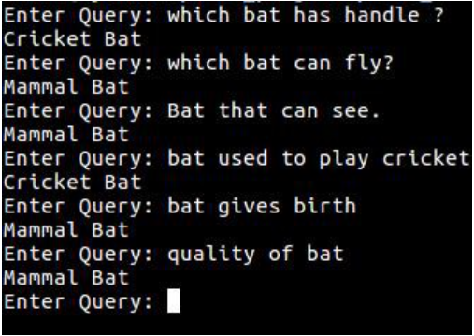
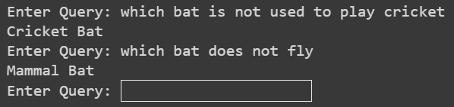
RESULTS (WSD)
During training, the model works as expected. Disambiguates the pun word correctly.
Examples of correctly classified outputs
Failed to handle negation sentences.

Slide 17


RESULTS
During training, the model works as expected. Generates sentences include a word.
Example of sequence from the backward model using ‘statue’ as input:
Forward Model:

Slide 18
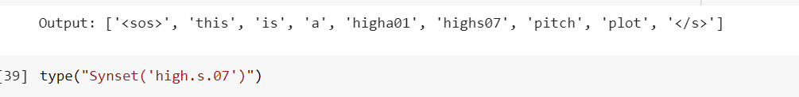
RESULTS AND CONCLUSION
Pairs of Synset IDs from SemEval2017: “high”
Synset('high.s.07’) : (literal meaning) being at or having a relatively great or specific elevation or upward extension (sometimes used in combinations like `knee-high’)
Synset('high.a.01’): greater than normal in degree or intensity or amount
Pseudo words input to the backward model: highs07, higha01.
Output sequence(concatenated):
Generated sequences are short, further training would improve the quality of puns (using large corpus for training)

Slide 19
Future Work
Although, the core idea of the paper was to implement adversarial learning, because of time constraints, only one component is implemented to the core, which fits the purpose, but can be further improved using adversarial learning.
Implementation of gloss words in Word Sense Disambiguation Model would further improve the disambiguation model and the quality of puns generated

Slide 20
References: Original paper :- https://arxiv.org/abs/1910.10950 Others: https://arxiv.org/pdf/1904.06828.pdf https://arxiv.org/abs/1512.06612 https://www.aclweb.org/anthology/P18-1153.pdf https://www.researchgate.net/publication/220356042_The_Construction_of_a_Pun_Generator_for_Language_Skills_Development/link/09e415112f7cbd67f0000000/download Blogs and Repositories : https://towardsdatascience.com/illustrated-guide-to-recurrent-neural-networks-79e5eb8049c9 https://towardsdatascience.com/illustrated-guide-to-lstms-and-gru-s-a-step-by-step-explanation-44e9eb85bf21 https://towardsdatascience.com/illustrated-guide-to-recurrent-neural-networks-79e5eb8049c9 https://iamtrask.github.io/2015/11/15/anyone-can-code-lstm/ https://machinelearningmastery.com/gentle-introduction-long-short-term-memory-networks-experts/ http://colah.github.io/posts/2015-08-Understanding-LSTMs/ https://towardsdatascience.com/using-deep-learning-to-generate-puns-f000c76026c9 Some images taken from blogs have been re-developed by me for clarity. https://stanford.edu/~shervine/teaching/cs-230/cheatsheet-recurrent-neural-networks https://stanford.edu/~shervine/teaching/cs-230/cheatsheet-recurrent-neural-networks

