Slide 1
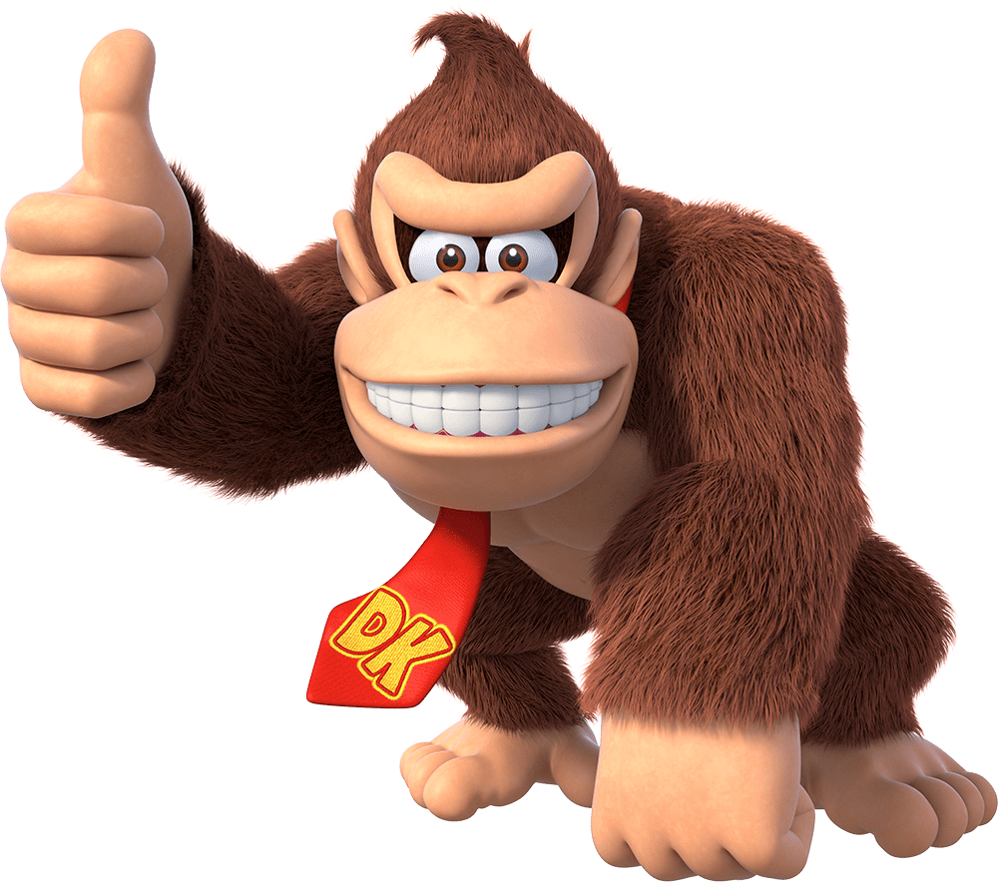
MONKEY TIME: INFO AND FORMAT

Slide 2
DATASET V0.1
WHERE IS IT:
‘{cnpl-drmanhattan}\Student Folders\Bianca_Wang\updated_retrieved’
WHAT DOES IT CONTAIN:
405 session files labelled ‘Joker_20XX_XX_XX_Run-0XX.pkl’
Each contains preprocessed neural and behavioral data for one session on one day, along with metadata and trial data
Multiple sessions can be from the same day, but should only happen if both target styles are present on the same day
HOW TO OPEN ONE:
feats = pickle.load(filepath)

Slide 3
SESSION FILE CONTENTS
Each ‘Joker…XX.pkl’ file contains a dict with the following keys:
METADATA:
‘Date’ ,‘Run’, ‘Target Style’
TRIAL DATA:
‘TrialNumber’, ‘TrialIndex’, ‘TrialCount’, ‘TargetPos’
TIMESERIES DATA:
‘FingerAnglesTIMRL’, ‘NeuralFeature’

Slide 4
METADATA
‘Date’ (str): Session date
‘Run’ (str): ‘Run-0XX’, session run No. (probably not needed)
‘Target Style’ (float): indicates how targets were presented either 29.0 (random targets) or 34.0 (center out)

Slide 5
TRIAL DATA
‘TrialNumber’ (int64 np.ndarray): Mx1 array, M = # of trials incl. for this session. Contains trial id’s of incl. trials (not necessarily continuous – some trials maybe be removed)
‘TrialIndex’ (int64 np.ndarray): Mx1, start indices of each trial in timeseries data
‘TrialCount’ (int64 np.ndarray): Mx1, length of each trial in the timeseriesdata. Note: TrialIndex[i] + TrialCount[i] in most cases should equal TrialIndex[i+1].
‘TargetPos’ (float32 np.ndarray): Mx5, for each trial, gives the target position for ‘5’ fingers – only indices [1 3] are relevant (IDX and MRS)

Slide 6
TIMESERIES DATA
‘FingerAnglesTIMRL’ (float64 np.ndarray): Nx4 array, N= # of 32ms bins in this session. Finger kinematics averaged into 32ms bins, each row contains:
[IDX_position, MRS_position, IDX_velocity, MRS_velocity]
‘NeuralFeature’ (float 64 np.ndarray): Nx96 array, spiking-band power averaged into 32ms bins for all 96 channels.

Slide 7
CHANGES COMING
Keys will have different, more general names and follow the same scheme – no spaces, no ‘FingerAnglesTIMRL’
Target Style will be either an int or a string
Target Positions for non-existent fingers will be removed
Threshold Crossing/Firing Rate (Spiking Rate) will be included as an additional neural feature
Maybe: Include which signal processing unit was used for recording (should be Cerebus for the majority)
Maybe: If we can define a scalar metric for signal quality, include that

