Slide 1
Milestone 4: Presenting Your Findings

Slide 2
CLIENT:
SportsStats: Sports analysis firm partnering with local news and elite personal trainers to provide interesting insights to help their partners.

Slide 3
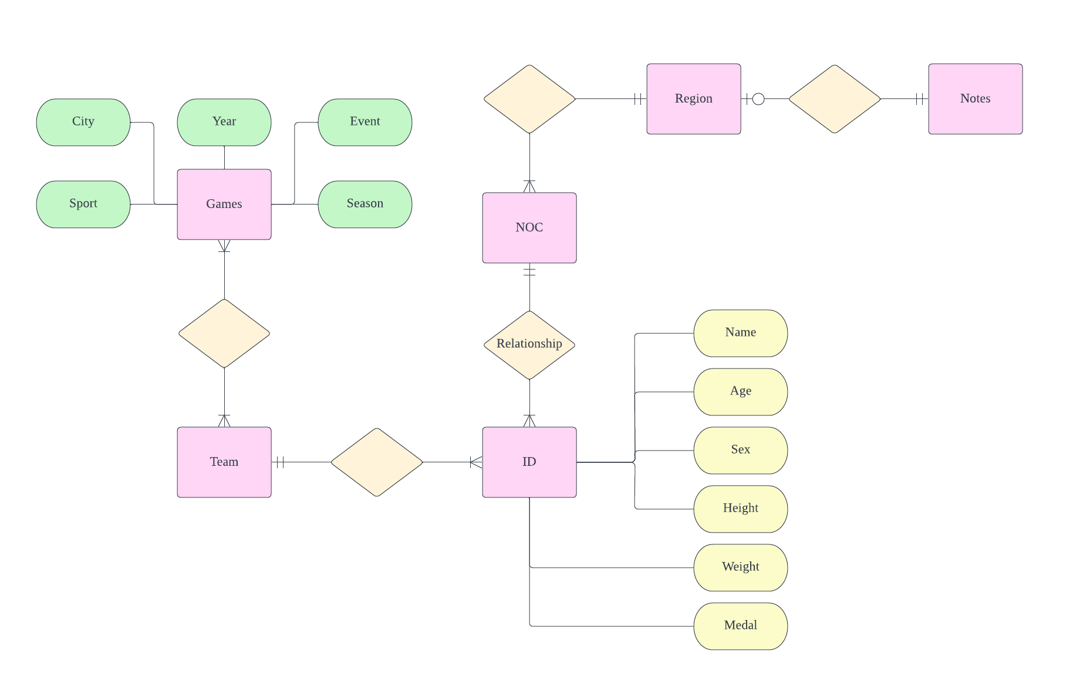
Entity Relationship Diagram (ERD)

Slide 4
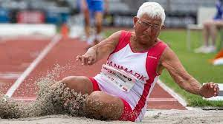
Main Questions
Question 1.
How does the age of an athlete affect his/her performance in the competitions?
Hypothesis.
Athletes’ performance declines with age. Athletes’ physical strength and agility generally decreases as they grow older.

Slide 5
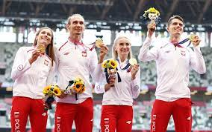
Main Questions
Question 2.
How has the male-to-female athletes ratio changed over the years?
Hypothesis.
The male-to-female athletes ratio increases with time. As male dominance increases, female athletes become more discouraged from partaking in games overall.

Slide 6
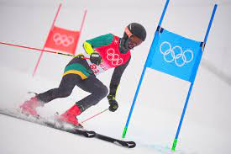
Main Questions
Question 3.
Is the performance of a nation in the Summer Olympics correlated to that in the Winter Olympics?
Hypothesis.
There is a correlation between the performance in the Summer and Winter Olympics. Athletes who are used to the summer weather conditions might not be accustomed to the winter weather conditions and vice-versa.

Slide 7
Approach to Questions
Question 1.
Compute the Pearson Correlation Coefficient, to determine whether there is a linear correlation between the performance of the athletes and their age.
Question 2.
Visualization using a histogram, to illustrate the change in the male-to-female athletes ration over the years.
Question 3.
Compute the Pearson Correlation Coefficient, to determine whether there is a linear correlation between the performance of athletes in the Summer and Winter Olympics.

Slide 8
Initial Findings – Male vs Female
There are huge differences between the male and female athletes in terms of age, height and weight.
Male athletes are generally older than female athletes.
The age gap between the male and female athletes is smaller in the Winter Olympics (1.5 years) compared to that in the Summer Olympics (2.8 years).

Slide 9
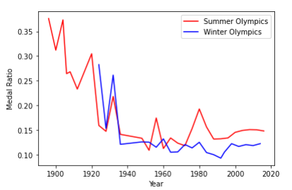
Initial Findings – Medal Ratio
We see that the medal ratio fluctuated greatly between the Summer and Winter Olympics, especially from 1920 to 1980.
Eventually, the medal ratio stabilized.

Slide 10
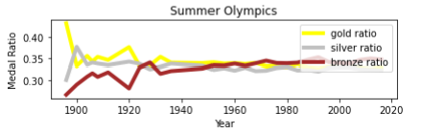
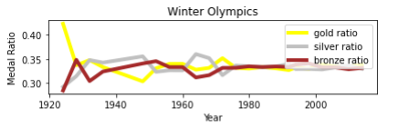
Initial Findings – Medal Ratio
We see that the relative percentages of gold, silver and bronze medals have also stabilized, as the years progress.

Slide 11
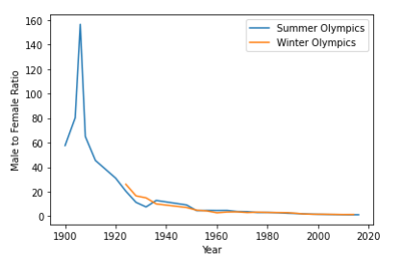
Initial Findings – Male-Female Ratio
From 1900 to 1910, the male-to-female athletes ratio increased significantly, for the Summer Olympics.
From 1910 onwards, the male-to-female athletes ratio decreased generally, which disproves the initial hypothesis.

Slide 12
Final Findings #1
The Pearson Correlation Coefficient between the total number of medals in the Summer and Winter Olympics from 1924 to 2016, is 0.94, which is considered to be highly positive.
A coefficient of +0.94 indicates that there is a strong linear relationship between the overall performance of athletes in the Summer Olympics and Winter Olympics.

Slide 13
Final Findings #2
Standard deviation of Summer Olympics medal count: 475.323015441357
Standard deviation of Winter Olympics medal count: 152.56899942903493
This indicates that in the period from 1924 to 2016, there is a much more significant variation in athletes’ performance in the Summer Olympics compared to the Winter Olympics, year-on-year.

Slide 14
Conclusion
Question 1.
The older the athlete, the lower the probability of him/her winning a medal. This indicates declining performance with age.
Hypothesis proven.
Question 2.
The male-to-female athlete ratio decreases generally over the years. More females are partaking in the Olympics, year-on-year.
Hypothesis disproved.
Question 3.
There is a linear correlation between athletes’ performance in the Summer Olympics and the Winter Olympics.
Hypothesis proven.

Slide 15
Recommendations
The athletes and their sports crew (e.g., physiotherapists/coaches) need to take more care of the physical states of the athletes as they grow older. Perhaps the Olympics committee can consider segregating competitions into different tiers based on age group.
Since the weather conditions affect the performance of athletes significantly, it is advisable that the coaches conduct trainings for their athletes in varying environmental conditions. This could maximize athlete performance in the Summer and Winter Olympics.

Slide 16
CREDITS
Special thanks to all the people who made and released these awesome resources for free:
Presentation template by SlidesCarnival
Photographs by Unsplash

