Slide 1
An introduction to SCMI
SUSE Labs - Hardware Enablement - Taipei Team
Chester Lin

Slide 2
System Control and Management Interface
What is SCMI?
Standard SW interfaces
Common protocols/APIs that SCMI clients can follow.
Resource Mgmt
HW Abstraction
Power domains, clocks, reset domains, sensors, voltage domains, power capping, pin control
SCMI clients don’t need to know sophisticated hardware knowledge.
ARM SCMI
Platform Security
Driver details can be secured in the SCMI server side.

Slide 3
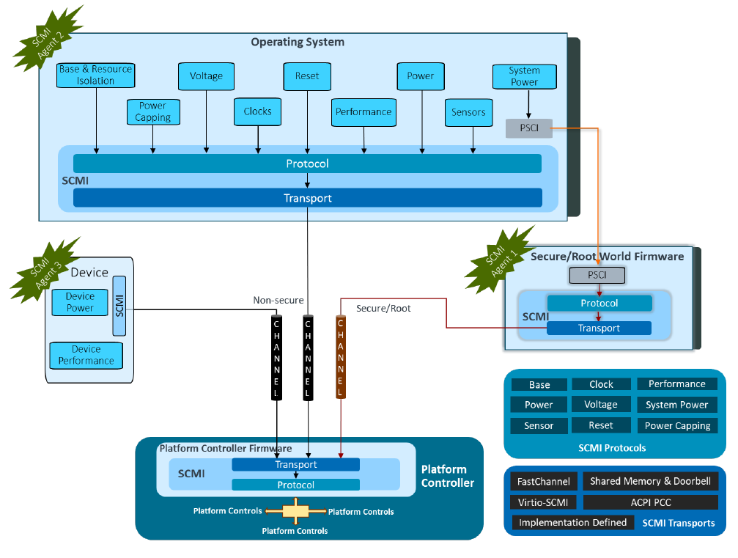
System Control and Management Interface
Overview
* Image source:
Arm SCMI Platform Design Document Ver 3.1
(Doc# DEN0056D)
(Non-Confidential)

Slide 4
Protocols supported in SCMI
Base
Discovers platform information. Such as protocol version, vendor name, supported protocols, set device/protocol permissions and agent configuration reset.
Power Domain Management
Put device/domain to different power saving sates.
Clock Management
Get/Set clocks, clock rate change notification.
Sensor Management
Sensor readings, events and settings.
Reset Domain Management
Device/Domain reset handling and notifications.
Voltage Domain Management
Mode[ON/OFF] config, voltage level config.
Power Capping and Monitoring
Set power caps and monitor power consumptions.
Pin Control
Pin config set/get, pin function select.
NEW in SCMI v3.1
NEW in SCMI v3.2
NEW in SCMI v3.0

Slide 5
Transports
Shared Memory based Transport
  FIX ME
ACPI-baed Transport
  Based on ACPI Platform Communication Channel (PCC, type 3)
Shared Memory or MMIO based Transport for FastChannels
Virtio-SCMI

Slide 6
SCMI Communication
How SCMI agents communicate with the SCMI server in platform firmware?

Slide 7
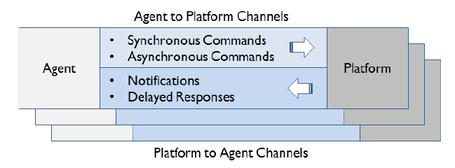
Channels
* Image source:
Arm SCMI Platform Design Document Ver 3.2
(Doc# DEN0056D)
(Non-Confidential)
Agent to Platform (A2P)
  Synchronous & Asynchronous
Platform to Agent (P2A)
  Delayed response
    e.g. clock-rate set complete, reset complete ...
  Notifications
    System power events [shutdown, power-up, suspend, cold/warn reset.. etc]
FastChannel [FIX ME . Trace Code]
  Unidirectional for decreasing command latency. (Async Mode only)
  No message header required but it’s only available for Perf & PowerCap protocols.

Slide 8
SCMI client-server connections
Client to server that handles by Trusted OS
Normal World
Secure World
EL0
Operating System
Trusted OS [e.g. OPTEE]
EL1
Runtime services for SCMI server
SCP Firmware
(@BL2)
SCMI drivers
(power, clk, reset, .. )
SCMI protocols
EL2
SCMI Transports
shmem
EL3
EL3 Firmware (e.g. TF-A)
SMC
Handler
SMC Calls
(SMCCC)

Slide 9
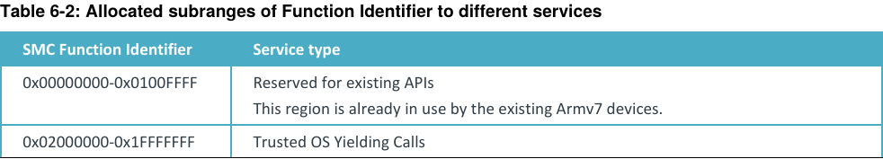
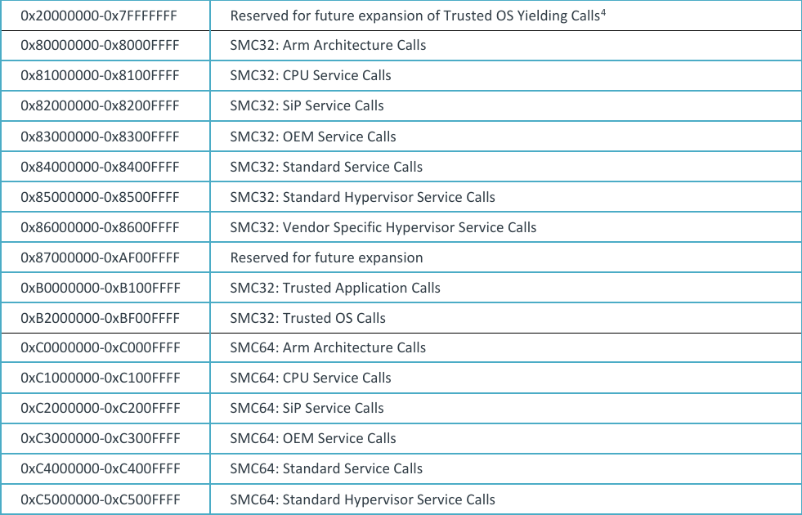
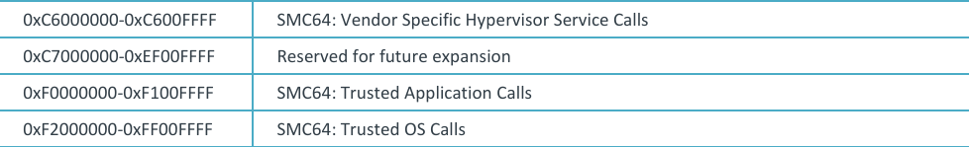
SMC / HVC calls
* Doc: ARM DEN 0028E - SMC Calling Convention v1.4
SMC Calling Convention (SMCCC)
Bits | Description
31 | 1’b = Fast Calls (atomic) 0’b = Yield Calls (non-blocking)
30 | 0’b = SMC32/HVC32, 1’b = SMC64/HVC64
29:24 | Service call ranges. 0: Arm arch, 1: CPU 2: SiP 3: OEM 4: Standard 5: Stand hypervisor 6: Vendor-specific Hypervisor 7-47: Reserved 48-49: Trusted App 50-63: Trusted OS
23:17 | 0 for fast calls.
16 | A hint bit to denote SVE live state (since SMCCC v.3)
15:0 | Function Identifiers

Slide 10
SCMI client-server connections
Client to server that handles by EL3 firmware
Normal World
Secure World
EL0
Operating System
EL1
SCP Firmware
(@BL2)
SCMI drivers
(power, clk, reset, .. )
SCMI protocols
EL2
SCMI Transports
shmem
EL3 Firmware (e.g. TF-A)
EL3
SMC
Handler
Runtime services for SCMI server
SMC Calls

Slide 11
SCMI client-server connections
SCMI sessions go through hypervisor
Normal World
Secure World
EL0
Operating System
EL1
SCMI Stack
HVC Calls
EL2
Hypervisor
EL3 Firmware (e.g. TF-A)
EL3
SMC
Handler
SMC Calls

Slide 12
SCMI client-server connections
SCMI sessions via virtio
Normal World
Secure World
EL0
VM0
VM1: Operating System
EL1
SCMI Server
SCMI Protocols
SCMi
Transport
Virtio Trans.
SCMI Virtio Transport
EL2
Hypervisor
EL3

Slide 13
SCMI Stack in Linux kernel

Slide 14
SCMI stack in Linux kernel
Core
Subsystems
SysPower
(scmi_power_controll.c)
Clock
(clk-scmi.c)
Sensor
(scmi-hwmon.c)
PowerCap
(scmi-powercap.c)
Reset
(reset-scmi.c)
Common drivers
PwrDomain
(scmi_pm_domain.c)
Performance
(scmi-cpufreq.c)
Sensor
(scmi_iio.c)
Voltage (scmi-regulator.c)
In subsys
folders
bus.c
driver.c
power.c
clock.c
sensors.c
powercap.c
reset.c
Protocols
notify.c
msg.c
scmi_pm_domain.c
perf.c
base.c
voltage.c
(/drivers/firmware/arm_scmi/)
shmem.c
mailbox.c
Transports
virtio.c
virtio.c
optee.c
(/drivers/firmware/arm_scmi/)

Slide 15
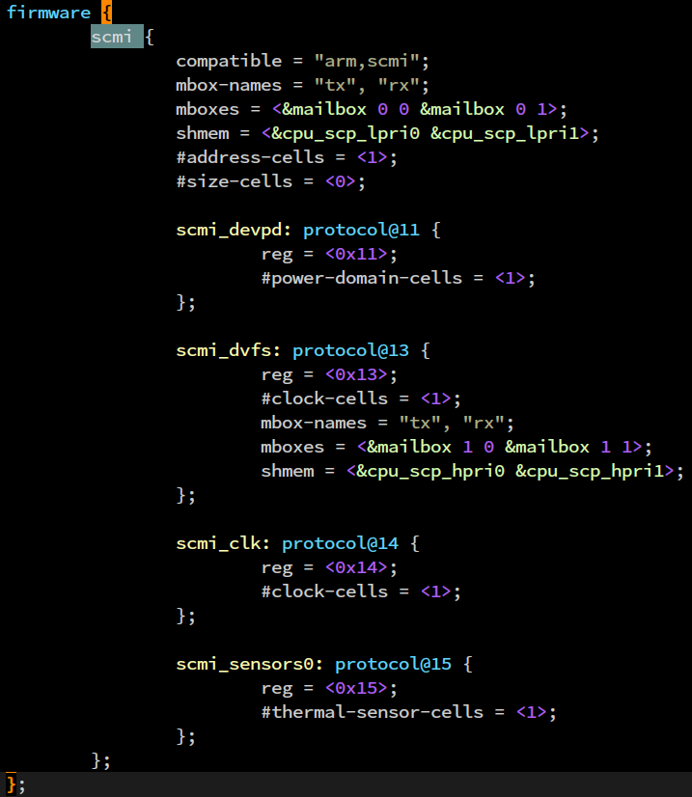
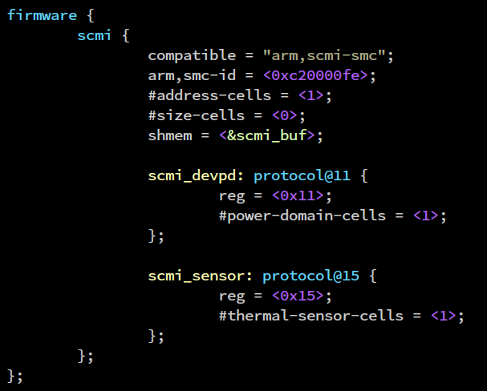
Devicetree examples
1
ARM Juno
From upstream kernel
&mailbox {
compatible = "arm,mhu-doorbell", "arm,primecell";
#mbox-cells = <2>;
};
2
I.MX8ULP
0xC2000000-0xC200FFFF:
SMC64
SiP Service Calls
dt-binding schema:
devicetree/bindings/firmware/arm,scmi.yaml

Slide 16
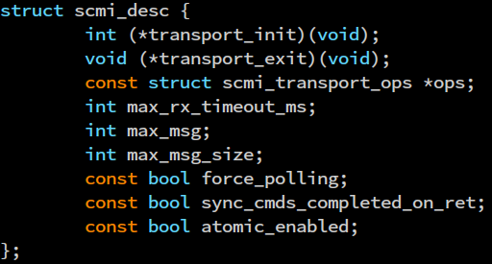
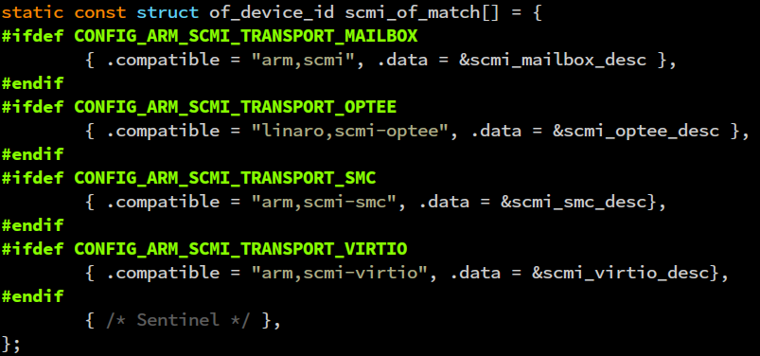
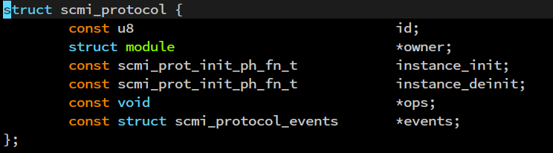
SCMI bus/core init in Linux kernel
Core
Protocol driver init
3
1
IDR:scmi_protocols
firmware {
scmi {
compatible = "arm,scmi-smc";
arm,smc-id = <0xc20000fe>;
….
}
}
scmi_bus_init()
scmi_driver_init()
….
….
….
….
platform_driver_register(
&scmi_driver)
scmi_probe()
2
(*ID array of struct scmi_protocol)
0x10: scmi_base
0x11: scmi_power
….
0x14: scmi_clock
….
0x15 scmi_powercap
scmi_base_register()
scmi_clock_register()
scmi_power_register()
….
….
scmi_powecap_register()
4
DT
5

Slide 17
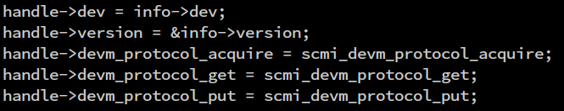
SCMI-based driver register/probe in Linux kernel
Scmi
Protocl
bus
SCMI-based subsys driver
(clk, reset, pd, perf .. etc)
SCMI bus driver
SCMI core: scmi_probe()
notifiers register
scmi_handle/channel/transport setup
scmi_driver_register()
scmi_device_request_notifier()
F
If the prot_id is not in IDR active_protocols yet.
T
If the prot_id is in IDR active_protocols.
Parsing
DT
Save prot_ids in IDR active_protocols
scmi_create_protocol_devices()
F
If the device is registered.
T
If the device is not yet
registered.
__scmi_device_create()
IDR:scmi_protocols
driver_register()
struct scmi_device initialize
(*ID array of struct scmi_protocol)
0x10: scmi_base
0x11: scmi_power
….
0x14: scmi_clock
….
0x15 scmi_powercap
BUS_NOTIFY_
BIND_DRIVER
device_register()
Call registered driver probe()
scmi_bus_notifier()
call_driver_probe()
handle_devm_protocol_get()→
…. →
pi->proto->instance_init()
scmi_set_handle()→
scmi_device_link_add()

Slide 18
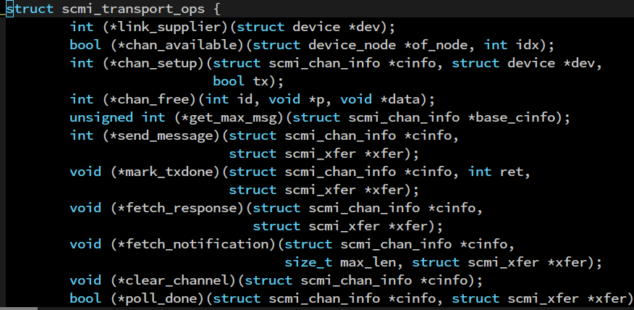
SCMI message handling in Linux kernel
sync
common
async
ops
flag
SCMI subsys driver
SCMI protocol driver
SCMI Core
SCMI Transport
scmi_xxx_proto_ops
e.g. clk_ops->rate_get()
registered proto ops
e.g. scmi_clock_rate_get()
do_xfer() [*sync/poll]
send_message() op
e.g. smc_send_message()
info→desc→ops→send_message()
poll_done() op
e.g. mailbox_poll_done()
scmi_wait_for_message_response()
IDR:scmi_protocols
0x10: scmi_base
0x11: scmi_power
….
0x14: scmi_clock
…
mark_txdone() op
e.g. virtio_mark_txdone()
scmi_wait_for_reply()
Info->desc->ops->mark_txdone()
fetch_response() op
e.g. scmi_optee_fetch_response()
do_xfer_with_response()
[*async: delayed response]
fetch_notification() op
e.g. mailbox_fetch_notification()
Wait xfer→async_done until timeout
scmi_rx_callback()
[*async: delayed resp / notification ]
When rx-data is present,
call scmi_rx_callback()
[*channel-specific handling]
scmi_handle_response
Complete flags:
xfer→done, xfer->async_done
scmi_handle_notification

Slide 19
MISC Topics

Slide 20
SCMI-based Platforms
stm32mpu
Juno ARM dev board
SynQuacer (TF-A <-> SCP)
Rockchip rk3588/356x
NXP I.MX8ULP
NXP S32G
?

Slide 21




Limitations
Must be concise
Limited channel capacity to exchange messages.
Common ops only
Complicated operations is not preferred.
E.g. Get/Set parent clocks via the SCMI clock protocol.
Less plat code upstreaming
Only a few plat implementations get upstreamed.
Need more protocols
battery, thermal, pwm, ... etc.

