Slide 1
OpenBMC
An open framework of embedded Linux in server management
Chester Lin
SUSE Labs – TPE Office

Slide 2
Agenda
Introduction of BMC
Why OpenBMC?
The build framework
Services
Kernel & Device Tree
Firmware management and security
Notes:
BMC has been developed since 90’s, which is used for computer system management, especially servers.

Slide 3
What’s BMC?
Baseboard Management Controller
A monitoring and control unit inside the sever board.
  Compute Node / Storage System / IPC / ...
  Sensor monitoring and thermal control
  Power Management
    Power control / Power Consumption / Power Capping
  Remote Management
    IKVM / Virtual Media
  Hardware / Firmware Inventory
    Part number, serial number, revision, …
Notes:
BMC has been developed since 90’s, which is used for computer system management, especially servers.

Slide 4
What’s BMC?
A monitoring and control unit inside the sever board
  Critical event alerts, logging & fail-overs
    Fan fail, PSU fail, system overheat ...
  Storage management.
    Disk Status & hot-plug, RAID configuration, ...
  Device hot-plug
    Compute Node / CPU / Memory / PCI-E devices, ...
  Firmware Management
    Firmware Update: UEFI/ME/LAN/FPGA/CPLD, ...
    UEFI configurations such as BootOrder, ...

Slide 5
Hardware connections of BMC
DIMM
VGA Core
/ Video
Engine
PCH
(I2C)
Host
CPUs
(LPC/eSPI
PECI/P2A)
FRU
(I2C)
USB
Root
HUB
Console
(UART)
Dedicated
NIC
(MII)
SAS Ctrl
Share
NICs
(RMII / NCSI)
Flash
(SPI/eMMC)
BMC
Chip
NVME-SSD
Other
BMCs
(ICMB)
LED
GPU
CPLD
/FPGA
Chassis
(GPIO/I2C)
PMIC
(I2C)
PSUs
(PMBus)
FAN
PWM
(hwmon)
Voltage
Sensors
(ADC)
Temp
Sensors
(I2C)

Slide 6



Software stack of BMC
A Linux-based embedded system.
Uses lots of open source packages.
  Linux Kernel, U-Boot, GCC tool-chain, GLIBC, busybox, Third-Party Authentication, crypto and security-related applications [e.g, OpenSSL], Dynamic DNS, NTP, .. etc.
Multiple management interfaces are provided.
  IPMI
    Adopted by server industries.
    Multiple channels: LAN, KCS/BT, UART, I2C, ...
  CLI / SNMP / SSH
  Redfish (Managed by DMTF)
    The successor of IPMI
    Higher security implementations.
    RESTful Framework
    Scalable API design.

Slide 7
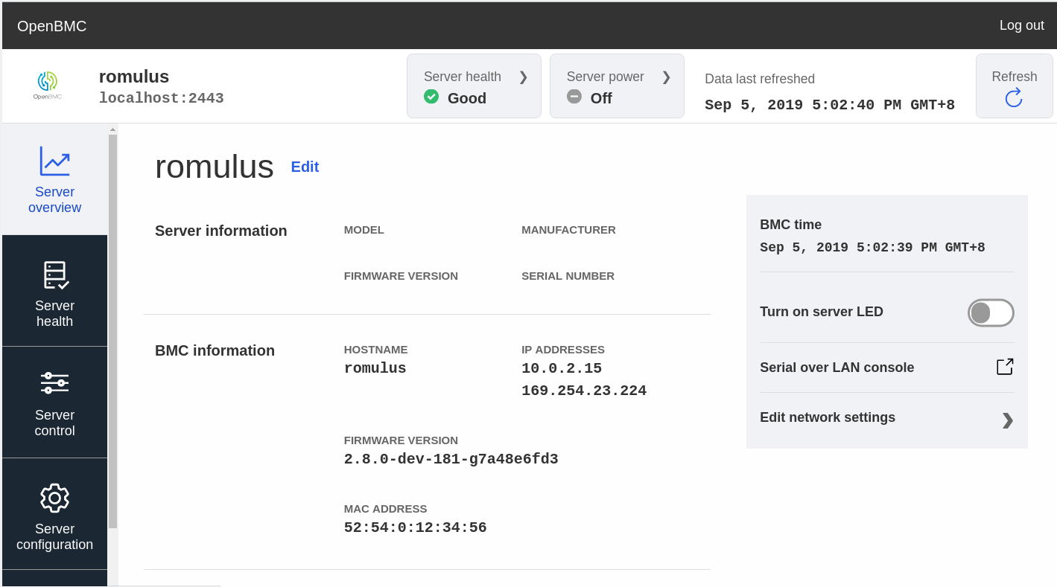
Software stack of BMC
WEB-UI

Slide 8

Why OpenBMC?
Eliminates the difficulties of maintaining proprietary BSPs. [Close → Open]
Source codes can be mainly managed by upstream.
Managed by Linux Foundation.
Traditional
OpenBMC
Linux
kernel
Boot
Loader
SoC
Codes
Boot
Loader
Linux
kernel
SoC
Codes
OSS
Package
Chip
Vendor
BSP
OSS
Package
Server’s
device-tree/
drivers
FW
Vendor
BSP
OpenBMC
OSS
Package
FW
Vendor
BSP
OSS
Package
Server
Vendor
BSP
OSS
Package
OSS
Package
Server
Vendor
BSP
Notes:
n Traditional ways, some code changes are made in downstreams, which can not be reivewed seriously and eventually cause a lot of issue such as security vulnerabilities.
By choosing OpenBMC, all changes such as cpu codes, drivers or device trees need to be merged into upstreams. This can improve code quality and codes can be easily reviewed and managed by upstream.
OpenBMC is a open source project under Linux Foundation.

Slide 9




Why OpenBMC?
Provides a reference framework based on Yocto.
  Unifies interfaces so that the management software can work across different vendors’ BMC firmware instances.
Brand-A
Whitebox
Brand-B
*Icon source: https://freeicons.io

Slide 10
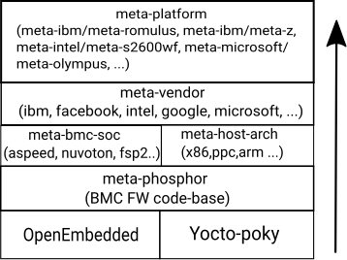
OpenBMC - Software Framework
OpenEmbedded Core
Yocko-Poky
  BitBake
Meta layers

Slide 11
Build System
BitBake: An automation build tool based on Python3.
Fetch
Pkg1-code
from SCM
Bit
Bake
meta-A
recipe-pkg1
Pkg2-code
from local
recipe-pkg2
configs,
Scripts,
Patches
Pkg1
Build
Pkg1
Pkg2
Install
Target
Image

Slide 12
File Tree Examples
meta-ibm/meta-romulus/
……………….
├── recipes-kernel
│ └── linux
│ ├── linux-aspeed
│ │ └── romulus.cfg
│ └── linux-aspeed_%.bbappend
├── recipes-phosphor
│ ├── chassis
……………….
│ │ ├── vrm-control
│ │ │ ├── vrm-control@.service
│ │ │ ├── vrm-control.sh
│ │ │ └── vrm.sh
│ │ └── vrm-control.bb
……………….
│ ├── sensors
│ │ ├── phosphor-hwmon
│ │ │ └── obmc
│ │ │ └── hwmon
│ │ │ ├── ahb
│ │ │ │ └── apb
│ │ │ │ ├── bus@1e78a000
│ │ │ │ │ └── i2c-bus@440
│ │ │ │ │ └── w83773g@4c.conf
│ │ │ │ └── pwm-tacho-controller@1e786000.conf
IBM / Romulus
  recipes
  .bb
  .bbappend
Notes:
Each recipe represents a software package.
A recipe needs a .bb file to define variable and scripts so that bitbake can understand how to build this package.
.bbappend is used to overwrite the recipe defined in previous layers.

Slide 13
File Tree Examples
LCONF_VERSION = "8"
BBPATH = "${TOPDIR}"
BBFILES ?= ""
BBLAYERS ?= " \
##OEROOT##/meta \
##OEROOT##/meta-openembedded/meta-oe \
##OEROOT##/meta-openembedded/meta-networking \
##OEROOT##/meta-openembedded/meta-perl \
##OEROOT##/meta-openembedded/meta-python \
##OEROOT##/meta-phosphor \
##OEROOT##/meta-aspeed \
##OEROOT##/meta-openpower \
##OEROOT##/meta-ibm \
##OEROOT##/meta-ibm/meta-romulus \
"
IBM/Romulus
meta-ibm/meta-romulus/
├── conf
│ ├── bblayers.conf.sample
│ ├── conf-notes.txt
│ ├── distro
│ │ └── openbmc-romulus.conf
│ ├── layer.conf
│ ├── local.conf.sample
│ └── machine
│ └── romulus.conf
KMACHINE = "aspeed"
KERNEL_DEVICETREE = "${KMACHINE}-bmc-opp-${MACHINE}.dtb"
UBOOT_MACHINE = "ast_g5_ncsi_config"
PREFERRED_PROVIDER_virtual/p9-vcs-workaround = ''
require conf/machine/include/ast2500.inc
require conf/machine/include/obmc-bsp-common.inc
require conf/machine/include/openpower.inc
require conf/machine/include/p9.inc

Slide 14
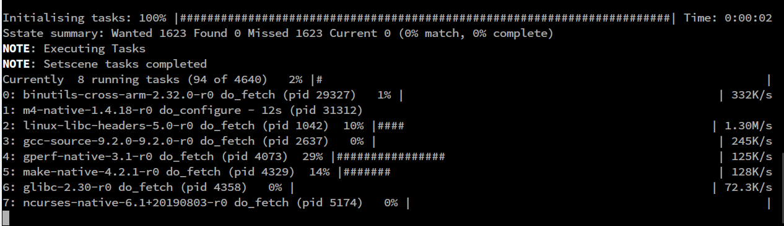
Build a target
Set TEMPLATECONF
  export TEMPLATECONF=meta-ibm/meta-romulus/conf
  . openbmc-env
  Workdir: openbmc/build/
Run BitBake
  bitbake obmc-phosphor-image
Output files and binaries
  build/tmp/deploy/images/romulus

Slide 15
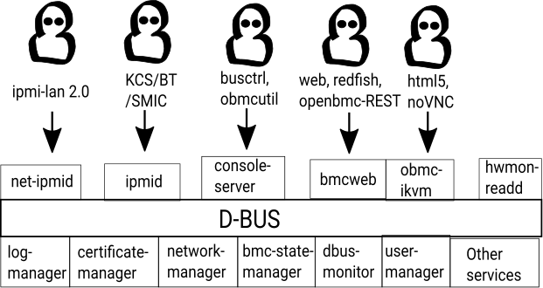
Running services in OpenBMC
Notes:
All OpenBMC services running on D-BUS.
Most of data exchanges happen on D-BUS.
Some services has to deal with user requests
Some services running internally and they are responsible for dealing with specific tasks, suc as user management, logging, hwmon reading, network management… , etc.

Slide 16
Service - IPMI daemon
D
B
U
S
Host
(ipmi driver)
KCS/BT
IPMI daemon
(ipmid / net-ipmid)
Remote
Clients
(ipmitool)
RMCP+
LAN/RMCP+
SOL
(ipmitool)
LAN/RMCP+

Slide 17
Service - HTTPS applications
config
D
B
U
S
Angular.js
Event
monitor
crow
phorsphor-webui
Web UI
IKVM
sensor
VirtualMedia
ikvm
bmcweb
User
mgmt
….
Notes:
bmcweb is a http server which is originally developed and used in OpenPower platforms.

Slide 18
Service - OpenBMC REST
curl -k -X GET https://${bmc}:${bmcport}/xyz/openbmc_project/network/eth0/enumerate
"data": {
"/xyz/openbmc_project/network/eth0": {
"AutoNeg": false,
"DHCPEnabled": true,
"DomainName": [],
"IPv6AcceptRA": false,
"InterfaceName": "eth0",
"LinkLocalAutoConf": "xyz.openbmc_project.Network.EthernetInterface.LinkLocalConf.both",
"MACAddress": "52:54:0:12:34:56",
"NTPServers": [],
"Nameservers": [],
"Speed": 0
},
"/xyz/openbmc_project/network/eth0/ipv4/49e97e86": {
"Address": "10.0.2.15",
"Gateway": "",
"Origin": "xyz.openbmc_project.Network.IP.AddressOrigin.DHCP",
"PrefixLength": 24,
"Type": "xyz.openbmc_project.Network.IP.Protocol.IPv4"
},
"/xyz/openbmc_project/network/eth0/ipv6/ff024971": {
"Address": "fe80::5054:ff:fe12:3456",
"Gateway": "",
"Origin":
"xyz.openbmc_project.Network.IP.AddressOrigin.LinkLocal",
"PrefixLength": 64,
"Type": "xyz.openbmc_project.Network.IP.Protocol.IPv6"
}
},
"message": "200 OK",
"status": "ok"

Slide 19
YAML
Two major types of yaml files in OpenBMC
  Defines schematics of services and objects
    Properties, methods and parameters, returns, enumerations, errors, ...
  Interface descriptors
    *.interface.yaml
  Error descriptors
    *.errors.yaml, *.metadata.yaml

Slide 20
YAML Example – Watchdog Interface
description: >
Implement the watchdog function.
methods:
- name: ResetTimeRemaining
description: >
Resets the time remaining to the configured interval. ....
parameters:
- name: EnableWatchdog
type: boolean
description: >
If true the watchdog will be enabled when the reset is performed.
errors:
- xyz.openbmc_project.Common.Error.InternalFailure
properties:
……….
- name: Enabled
type: boolean
description: >
The watchdog is enabled or not.
default: false
- name: ExpireAction
type: enum[self.Action]
description: >
The action the watchdog should perform when it expires.
default: 'HardReset'
- name: Interval
type: uint64
description: >
Time interval to arm the watchdog,
in milli-second.
default: 30000
- name: TimeRemaining
type: uint64
description: >
Time remaining before timeout, ……
……….
enumerations:
- name: Action
description: >
The type of action to perform.
values:
- name: 'None'
description: >
Do nothing.
- name: 'HardReset'
description: >
Perform a reset of the system.
- name: 'PowerOff'
description: >
Perform a power off of the system.
- name: 'PowerCycle'
description: >
Perform a power cycle of the system.

Slide 21
YAML – Common Errors
Common.errors.yaml
Common.metadata.yaml
- name: Timeout
description: Operation timed out.
- name: InternalFailure
description: The operation failed internally.
- name: InvalidArgument
description: Invalid argument was given.
- name: InsufficientPermission
description: Insufficient permission to perform operation
- name: NotAllowed
description: The operation is not allowed
- name: NoCACertificate
description: Server's CA certificate has not been provided.
- name: Timeout
meta:
- str: "TIMEOUT_IN_MSEC=%llu"
type: uint64
- name: InvalidArgument
meta:
- str: "ARGUMENT_NAME=%s"
type: string
- str: "ARGUMENT_VALUE=%s"
type: string
- name: InternalFailure
level: ERR
- name: InsufficientPermission
level: INFO
- name: NotAllowed
level: INFO
meta:
- str: "REASON=%s"
type: string
- name: NoCACertificate
level: ERR

Slide 22
Service LIB
.yaml
FuncA/
Server.cpp
& hpp
Method
Properties
Properties
Service1
Method
Properties
Parameters
Method
FuncB/
Server.cpp
& hpp
Parameters
Parameters
Parameters
Enumeration
Parameters
Enumeration
Parameters
Service2
Parameters
libphosphor_
dbus.so.0
Parameters
signals
Parameters
Parameters
signals
Parameters
FuncC/
Server.cpp
& hpp
Parameters
Errors
Service
3
Errors
…..
….
Types of properties / parameters:
byte
int16/32
array []
string
boolean
dict [,]
uint16/32
path
…..

Slide 23
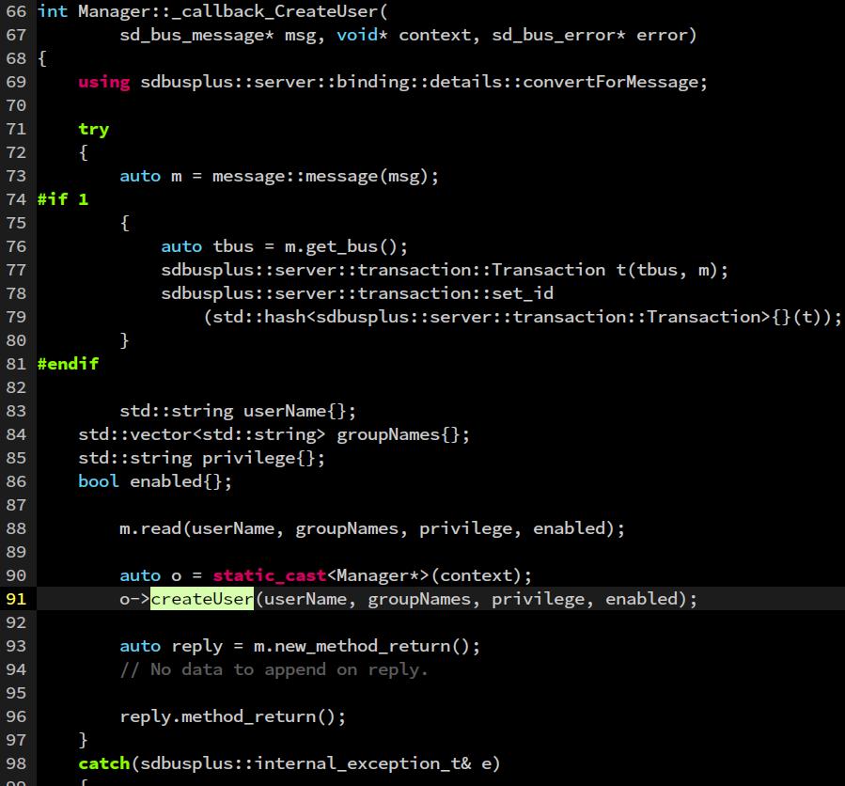
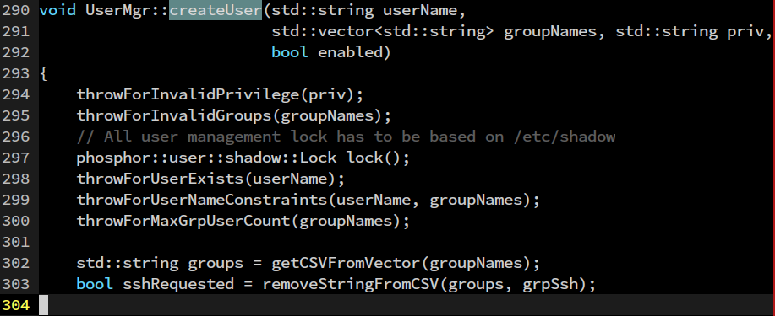
Service Construction
phosphor-dbus-interfaces/../User/Manager.interface.yaml
- name: CreateUser
description: >
…………..
parameters:
- name: UserName
type: string
- name: GroupNames
type: array[string]
- name: Privilege
type: string
- name: Enabled
type: boolean
……………………...
build/../User/Manager/server.cpp
sdbus++
phosphor-user-manager/user_mgr.hpp

Slide 24
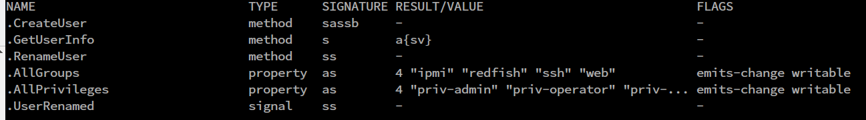
The calls from clients
static constexpr const char* createUserMethod = "CreateUser";
……..
ipmi_ret_t UserAccess::setUserName(const uint8_t userId,
const char* userNameInChar)
{..
……..
try
{
// Create new user
auto method = bus.new_method_call(
getUserServiceName().c_str(), userMgrObjBasePath,
userMgrInterface, createUserMethod);
method.append(newUser.c_str(), availableGroups, "", false);
auto reply = bus.call(method);
}
catch (const sdbusplus::exception::SdBusError& e)
……..
}
phosphor-host-ipmid/user_channel/user_mgmt.cpp
# busctl introspect xyz.openbmc_project.User.Manager /xyz/openbmc_project/user xyz.openbmc_project.User.Manager

Slide 25
Sensor
Based on Linux hwmon
D
B
U
S
Server.cpp
WEB
.config files under
/etc/default/obmc/hwmon
Interface
[Value]
REST
Load parameters, such as
sysfs-path, hwmon-names,
indexes, intervals, thresholds,
gpio settings… etc.
Update
Sensor
Interfaces(..);
Server.cpp
Phosphor-
hwmon-readd
IPMI
Interface
[Warning]
Console
……….
Server.cpp
Hwmons
(temp, fan, in,
curr, power)
……….
Interface
[threshold]

Slide 26
Sensor Example
Fan RPM Reading in IBM Romulus (OpenPower)
recipes-phosphor/sensors/
phosphor-hwmon_%.bbappend
openbmc/meta-ibm/meta-romulus/
recipes-phosphor/sensors/phosphor-hwmon/obmc/ahb/apb/pwm-tacho-controller@1e786000.conf
etc/default/obmc/hwmon/ahb/apb/pwm-tacho-controller@1e786000.conf
BitBake
LABEL_fan9 = "fan0"
LABEL_fan11 = "fan1"
LABEL_fan13 = "fan2"
PWM_TARGET_fan9 = "1"
PWM_TARGET_fan11 = "2"
PWM_TARGET_fan13 = "1"
LABEL_fan9 = "fan0"
LABEL_fan11 = "fan1"
LABEL_fan13 = "fan2"
PWM_TARGET_fan9 = "1"
PWM_TARGET_fan11 = "2"
PWM_TARGET_fan13 = "1"
Install
read config
/sys/devices/platform/ahb/ahb:apb/
1e786000.pwm-tacho-controller/
hwmon/hwmon0:
fan9_input
fan11_input
fan13_input
Phosphor-
hwmon-readd
find
Read
Kernel-src:
drivers/hwmon/aspeed-pwm-tacho.c

Slide 27
Kernel Device Tree
aspeed-bmc-opp-romulus.dts
&pwm_tacho {
status = "okay";
pinctrl-names = "default";
pinctrl-0 = <&pinctrl_pwm0_default &pinctrl_pwm1_default>;
fan@0 {
reg = <0x00>;
aspeed,fan-tach-ch = /bits/ 8 <0x08>;
};
fan@1 {
reg = <0x00>;
aspeed,fan-tach-ch = /bits/ 8 <0x09>;
};
fan@2 {
reg = <0x01>;
aspeed,fan-tach-ch = /bits/ 8 <0x0a>;
};
fan@3 {
reg = <0x01>;
aspeed,fan-tach-ch = /bits/ 8 <0x0b>;
};
fan@4 {
reg = <0x00>;
aspeed,fan-tach-ch = /bits/ 8 <0x0c>;
};
fan@5 {
reg = <0x00>;
aspeed,fan-tach-ch = /bits/ 8 <0x0d>;
};
fan@6 {
reg = <0x01>;
aspeed,fan-tach-ch = /bits/ 8 <0x0e>;
};
};
LABEL_fan9 = "fan0"
LABEL_fan11 = "fan1"
LABEL_fan13 = "fan2"
PWM_TARGET_fan9 = "1"
PWM_TARGET_fan11 = "2"
PWM_TARGET_fan13 = "1"
fan[1-*]_input: Fan input value.
Unit: revolution/min (RPM)
RO

Slide 28
SW/FW Information & Update
REST Interface
  /xyz/openbmc_project/software/<id>
  Multiple software instances.
Update channels
  Network
    Scp the image to tmp/images/
    OpenBMC REST APIs
      File Upload
      TFTP Download
  InBand
    LPC (Low Pin Count)
    I2C
    P2A (PCI-TO-AHB MMIO)
  Redfish

Slide 29
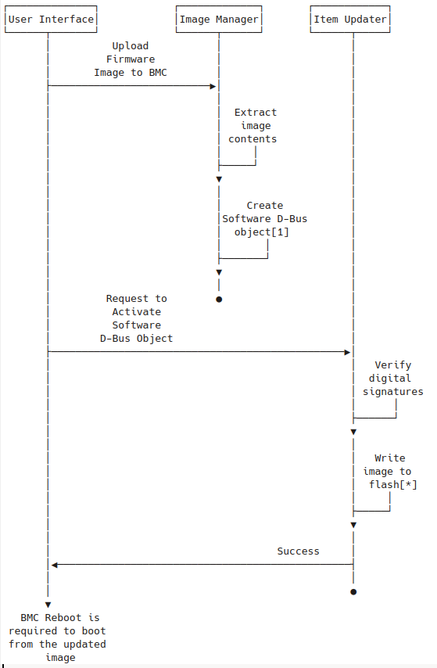
Firmware Update Flow
openbmc/phosphor-bmc-code-mgmt
BMCFW: RSA+SHA256
*Source:
openbmc docs

Slide 30
Linux Kernel & U-Boot
ASPEED is currently the most popular BMC CPU vendor adopted by OpenBMC.
Most ASPEED drivers are merged into upstream in recent years. [keyword: aspeed ]
  Kernel:
    clk, edac, gpio, drm, hwmon, i2c, iio, mtd, media, pinctrl, rtc, tty, usb_gadget, kcs for ipmi, ethernet/faraday/ftgmac100, …...
  U-Boot
    /arch/arm/mach-aspeed, board/aspeed, drivers/clk/aspeed, drivers/pinctrl/aspeed,
Different platforms need different device-trees.
  /arch/arm/boot/dts/openbmc-flash-layout.dtsi
  /arch/arm/boot/dts/aspeed-bmc-*.dts
    e.g, opp (OpenPower), arm, facebook-specific, … etc.

Slide 31
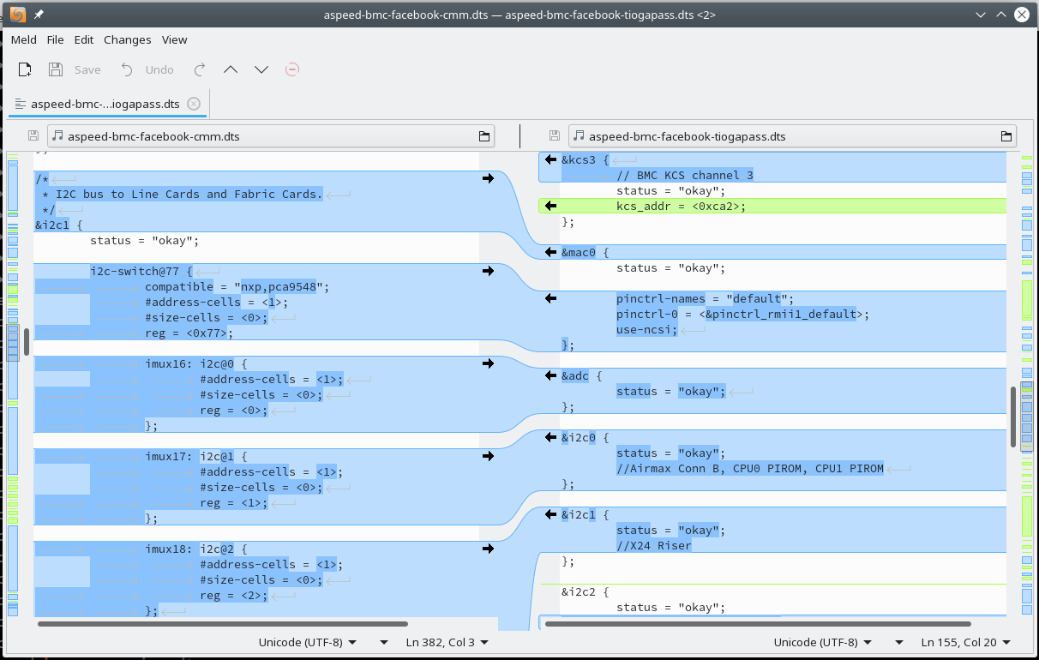
Devicetree

Slide 32
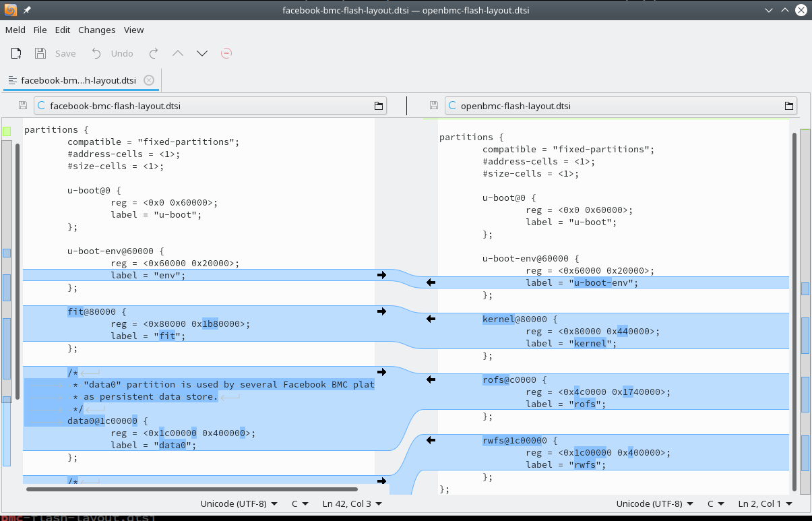
Devicetree

Slide 33
Firmware Security
Signed firmware validation while updating.
  Implements sign (RSA+SHA256) and verify based on OpenSSL
User Management
  Using Linux PAM instead of running auth-check on D-BUS.
  Support LDAP Auth (Kerberos?)
  Distinguished roles and privileges
    Group roles: ssh, ipmi, redfish web
    Privileges: admin, operator, user, callback

Slide 34
Firmware Security
Certificate Manager
  Phosphor-certificate-manager
    manages all certificates that openBMC might needs, such as https, LDAP.
TLS is enabled in network sessions.
  HTTPS(WEB), RESTful (OpenBMC REST/Redfish)
  IKVM / Virtual Media
  IPMI-RAKP, IPMI Serial-Over-LAN
Security Response Team
  https://github.com/openbmc/docs/blob/master/security/obmc-security-response-team.md

Slide 35
Package repo
GitHub: https://github.com/openbmc
  Most of public repositories are under this project.
    https://github.com/openbmc/openbmc
    https://github.com/openbmc/bmcweb
    https://github.com/openbmc/linux
    https://github.com/openbmc/phosphor-dbus-interfaces
    …..
  Major languages: C++14, C, BitBake, Shell and Python
  Other branches:
    Facebook: https://github.com/facebook/openbmc
    AMI: https://github.com/ami-megarac/MORF-OpenBMC
    OpenBMC CI: https://openpower.xyz/

Slide 36
Market Opportunities for SUSE
Unify firmware update framework based on OpenBMC APIs or Redfish APIs through In-Band and Out-Band channels.
  UEFI, PSU FW, SAS controller FW, NIC controller FW, FPGA, ...
Integrates OpenBMC interfaces with SUSE manager to have more detailed management on hardware and firmware resources.
  Hardware & firmware status monitoring and failover functions.
  Scalability of firmware deployment.
  Device management [e.g, Hotplug]

Slide 37
u-bmc
Another BMC FW infrastructure based on u-root
  Use gRPC instead of IPMI
    Protobuf: https://developers.google.com/protocol-buffers/
  U-root implements Linux userspace bsed on Golang.
  Support QEMU simulation.
  https://github.com/u-root/u-bmc

Slide 38
Thank You

