Slide 1
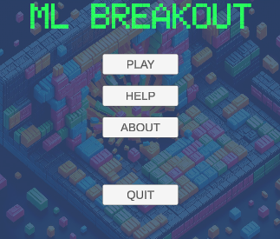
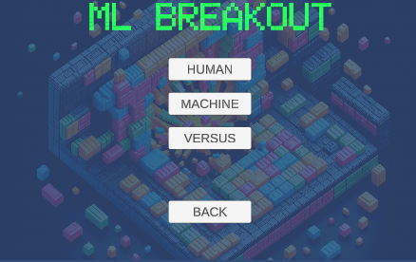
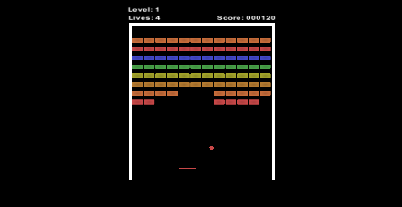
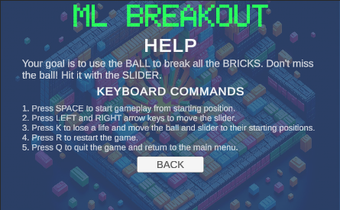
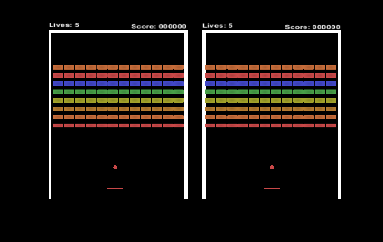
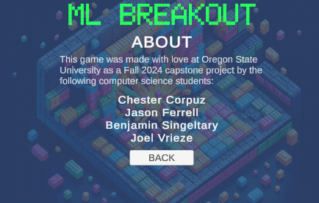
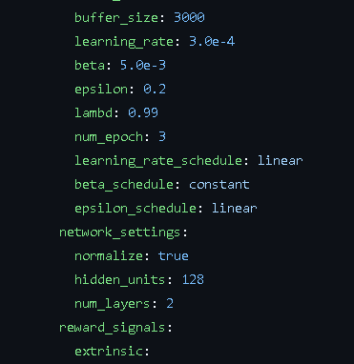
Machine learning breakout
Chester Corpuz corpuzc@oregonstate.edu
Jason Ferrell ferrelja@oregonstate.edu
Ben Singeltary singeltb@oregonstate.edu
Joel Vrieze vriezej@oregonstate.edu
https://github.com/chesterrc/ML-Breakout
A clone of Atari’s Breakout developed with Unity and trained using ML-Agents
Training with ML-Agents
ML-Agents: A Unity package used for training game agents. We used the tool’s reinforcement learning/proximate policy optimization (PPO) capabilities to train an agent, the game’s paddle. (ML-Agents can also use imitation/behavioral cloning)
We used observations of the ball’s position to define rewards for the paddle agent based on:
Paddle position/proximity to ball
Paddle striking the ball
Destroying a brick
Destroying all of a level’s bricks
Missing the ball
We set hyperparameters in the related YAML config for:
Number of simulation steps
How quickly the policy can evolve in simulation (epsilon)
Breakout
For this project, the team developed a brick-breaking game similar to Atari’s 1976 hit arcade game, Breakout. We used Unity for design and scripting, and the game features a player vs. CPU mode, trained with Unity’s ML-Agent package and associated Python/PyTorch toolkit.

