Slide 1
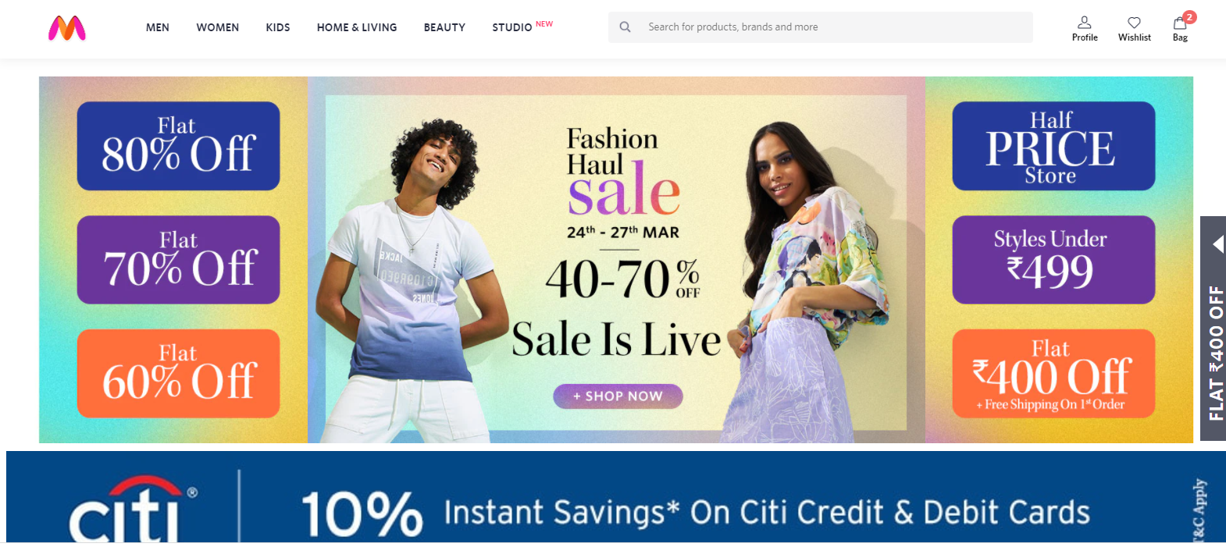
MYNTRA
About the Project-
Myntra is a one stop shop for all your fashion and lifestyle needs. Being India's largest e-commerce store for fashion and lifestyle products. In this project, I will make a look-alike clone of the Myntra Website.

Slide 2
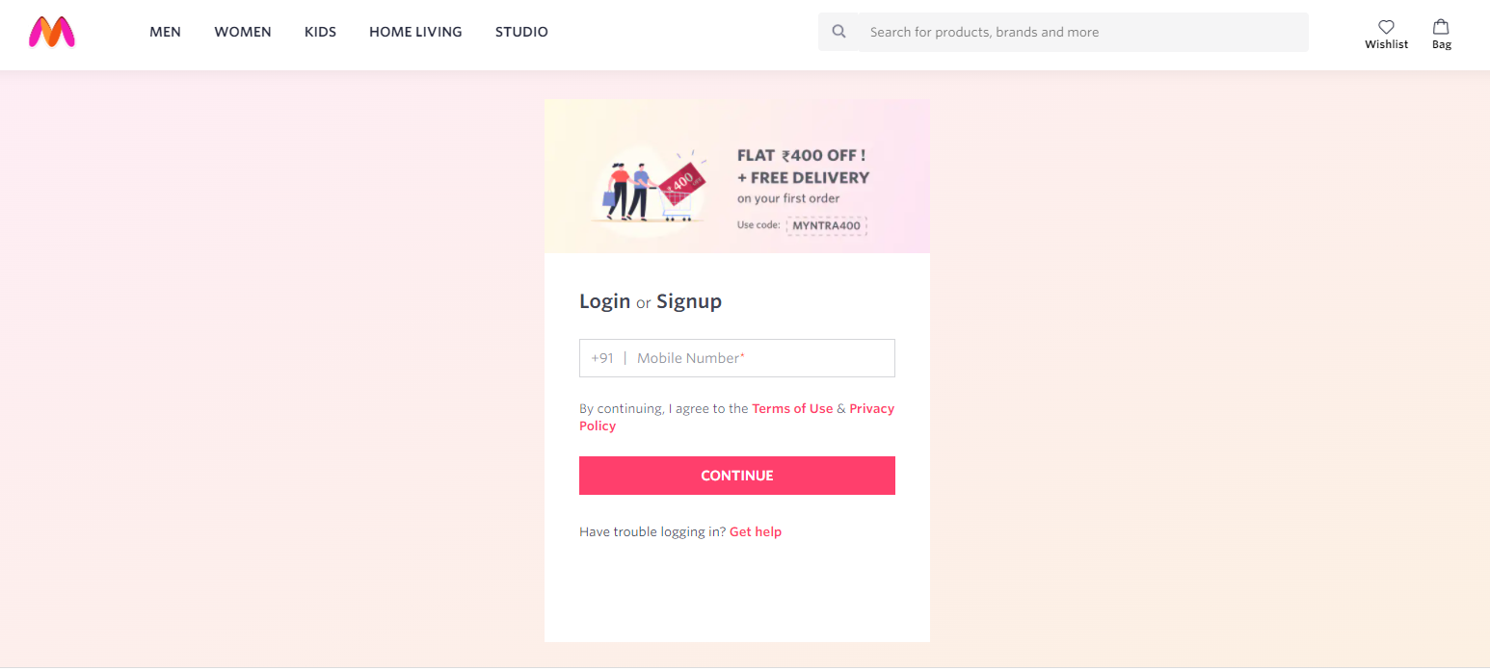
Login Page
Input field
Button
Container

Slide 3
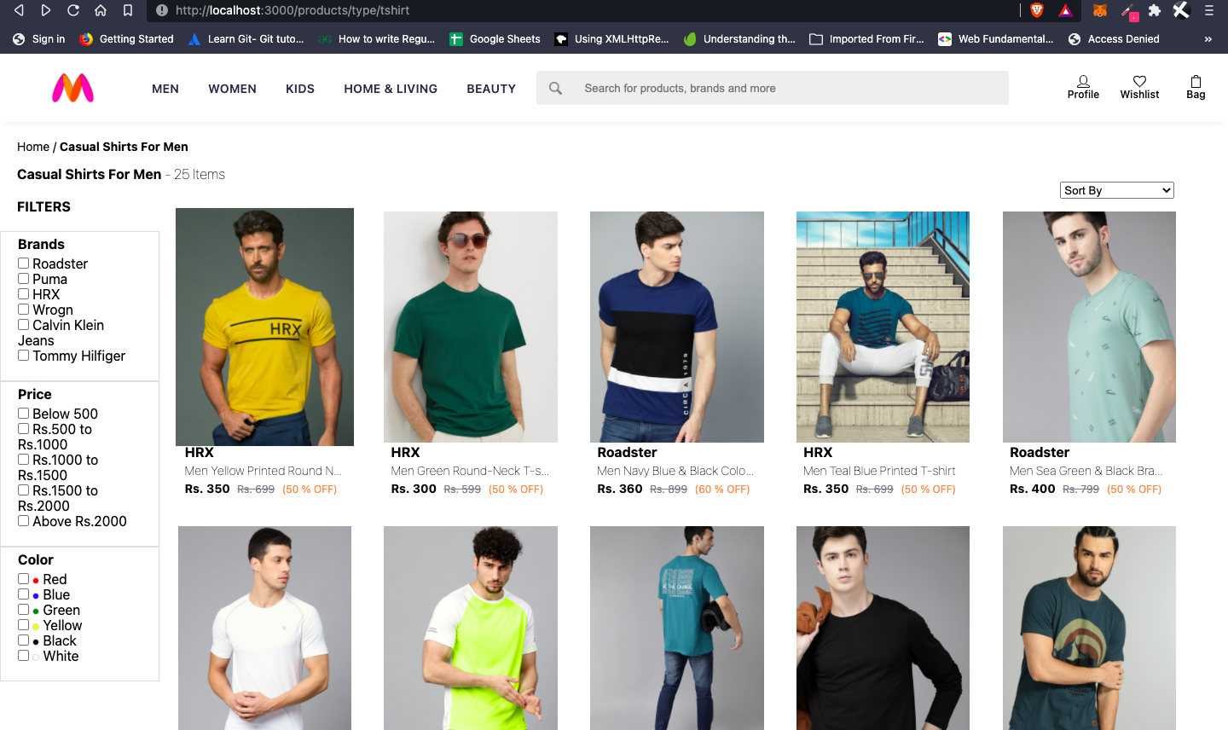
Product List
Header
Search bar
List of products
Features
Wishlist
Bag
Footer

Slide 4
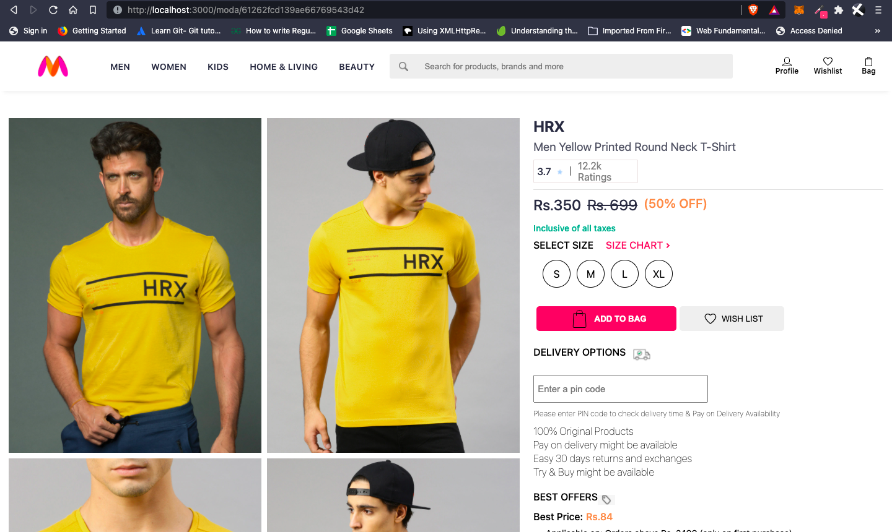
PRODUCT DESCRIPTION
BRAND , PRODUCT NAME , PRICE ,
DISCOUNT% (IF ANY) , SIZE CHART ,
DELIVERY OPTIONS , PRODUCT
DETAILS , SIZE & FIT , MATERIAL & CARE ,
SPECIFICATIONS , RATINGS , CUSTOMER REVIEWS
PAYMENT
Payment modes –Gpay, Paytm, UPI
Cash on delivery

Slide 5
Technologies
To manage Backend
Nodejs
Expressjs
MongoDB
To manage the database
Mongodb database
To display the functionalities
CSS
HTML
JavaScript

