Slide 1

Transition to College for Gender and Sexual Minority Youth
Christina Sun
With Alexandria Hurtt, Michal Kurlaender, Kairo Weber, and Baiyu Zhou
Jan 5, 2026
LGBTQ+ Policy Lab, Vanderbilt University
Note: This research was supported by the College Futures Foundation and conducted in partnership with the California Student Aid Commission. The authors are also grateful for ongoing support from the Stuart Foundation to the California Education Lab. The California Education Lab at the University of California, Davis and Policy Analysis for California Education are also thankful for research dissemination support from the Bill & Melinda Gates Foundation. The findings and conclusions here are those of the authors alone and do not necessarily reflect the positions or policies of the funders or of the California Student Aid Commission.

Slide 2
INTRODUCTION

Slide 3
Overview
Data: large survey of California high school seniors
Analysis: mixed methods
Focus: gender and sexual minority students.
We examine:
Identities
High school experiences
Concerns about college

Slide 4
Motivation
Schools shape students’ perceptions of college and future educational attainment (Lynn et al., 2010; Uwah et al., 2008)
The high school to college transition is crucial for young adults (Luh et al., 2023)
Limited evidence regarding LGBTQ+ students
Research tends to consider the community as a whole
The transgender and non-binary experience has been overlooked in education research (Glavinic, 2010; Goldberg & Kuvalanka, 2018; Marine, 2017).
Notes:
Research tends to consider the LGBTQ+ community as whole rather than examine subgroup differences based on sexual orientation or gender identity
From Feldman (2022): “This practice creates the problematic ideology that supporting gay and lesbian students looks the same as supporting transgender students. In addition, this practice assumes that various sexual minority groups face the same difficulties and have the same needs.”
The transgender and non-binary experience has been overlooked in education research (Glavinic, 2010; Goldberg & Kuvalanka, 2018; Marine, 2017).

Slide 5
Preview of Results
Diverse labels for identities
LGBTQ+ students have
Significantly less positive high school experiences
Significantly higher levels of worry about college
Transgender students have higher levels of concern about discrimination than other gender diverse students

Slide 6
BACKGROUND & METHODOLOGY

Slide 7
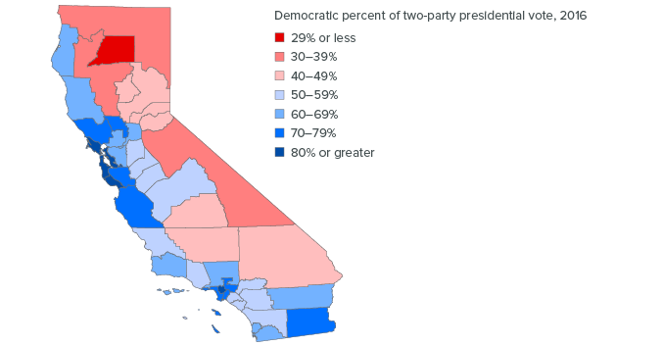
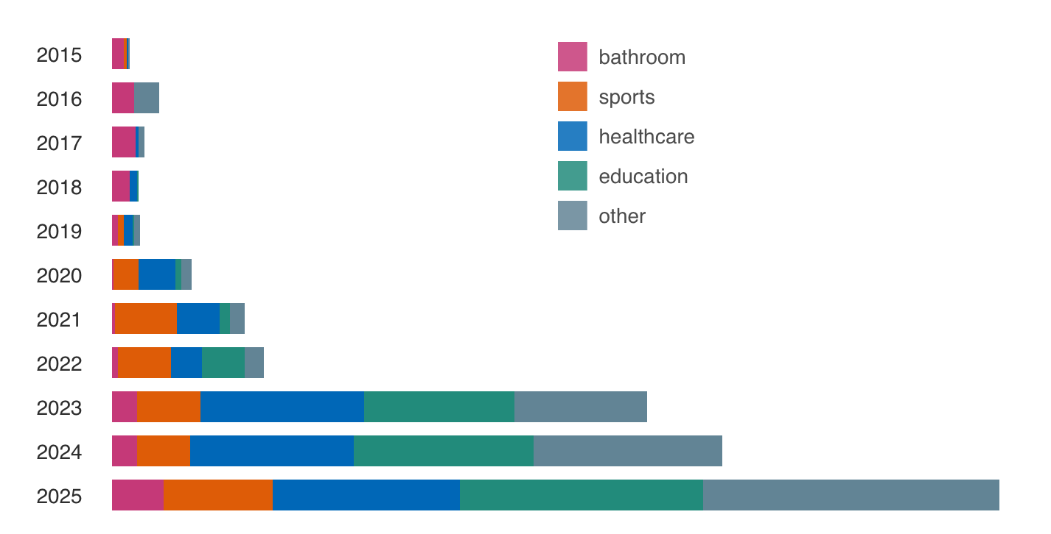
Social and Political Context
Number of anti-trans bills in the US
California
Diverse political leanings
Rise of anti-trans hate groups
Sources: Trans Legislation Tracker (translegislation.com) and Public Policy Institute of California

Slide 8
Methodology
Web survey in partnership with California Student Aid Commission (CSAC), May 2023
Distributed by email to all high school seniors in California
Main purpose of survey: experiences navigating financial aid
We included questions on
HS social and academic experiences
Concerns about college
SOGI items

Slide 9
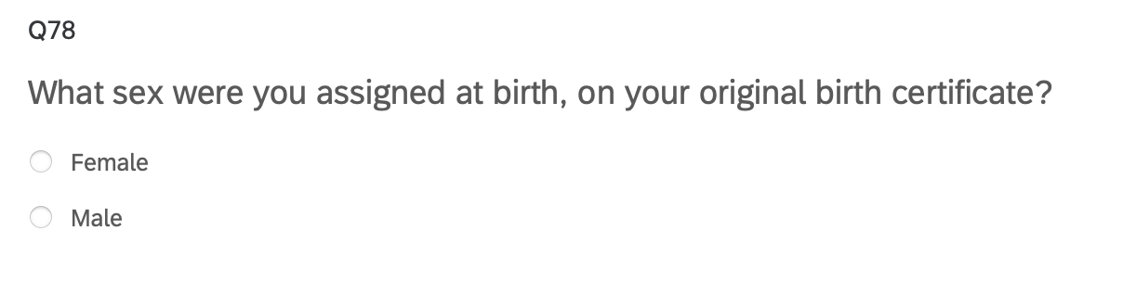
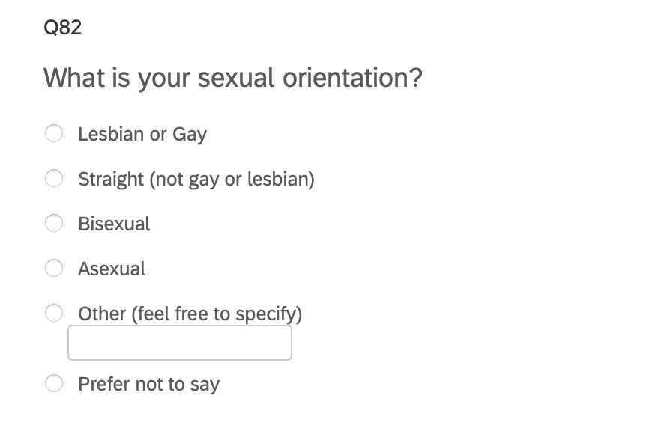
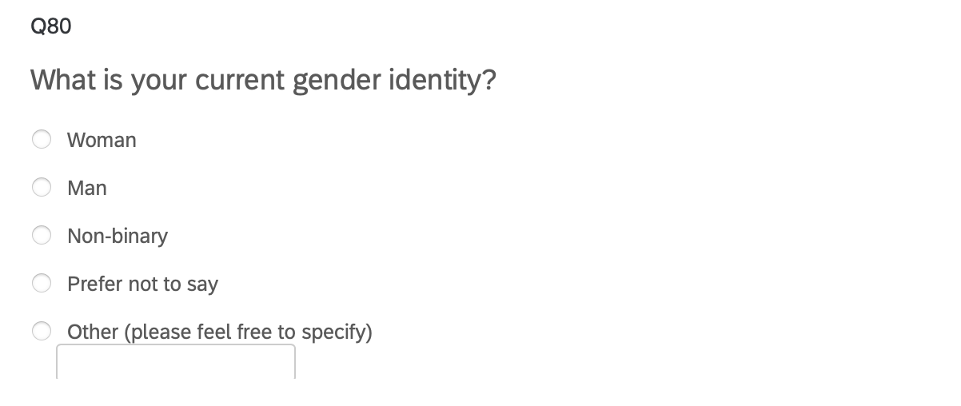
SOGI Items
Gender Sexual Orientation
Based on Williams Institute recommendations

Slide 10
Sample by LGBTQ+ Status
9230 college-bound HS seniors
1828 LGBTQ+ (19.8%)
417 non-cisgender (4.5%)
1782 non-heterosexual (19.3%)

Slide 11
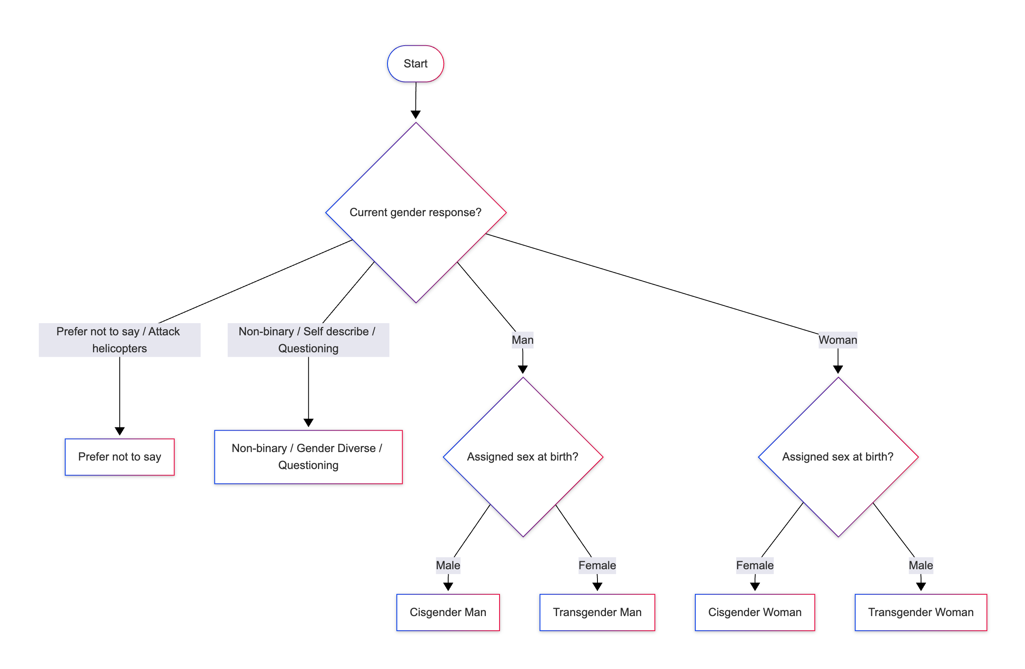
Classification of Gender Identity

Slide 12
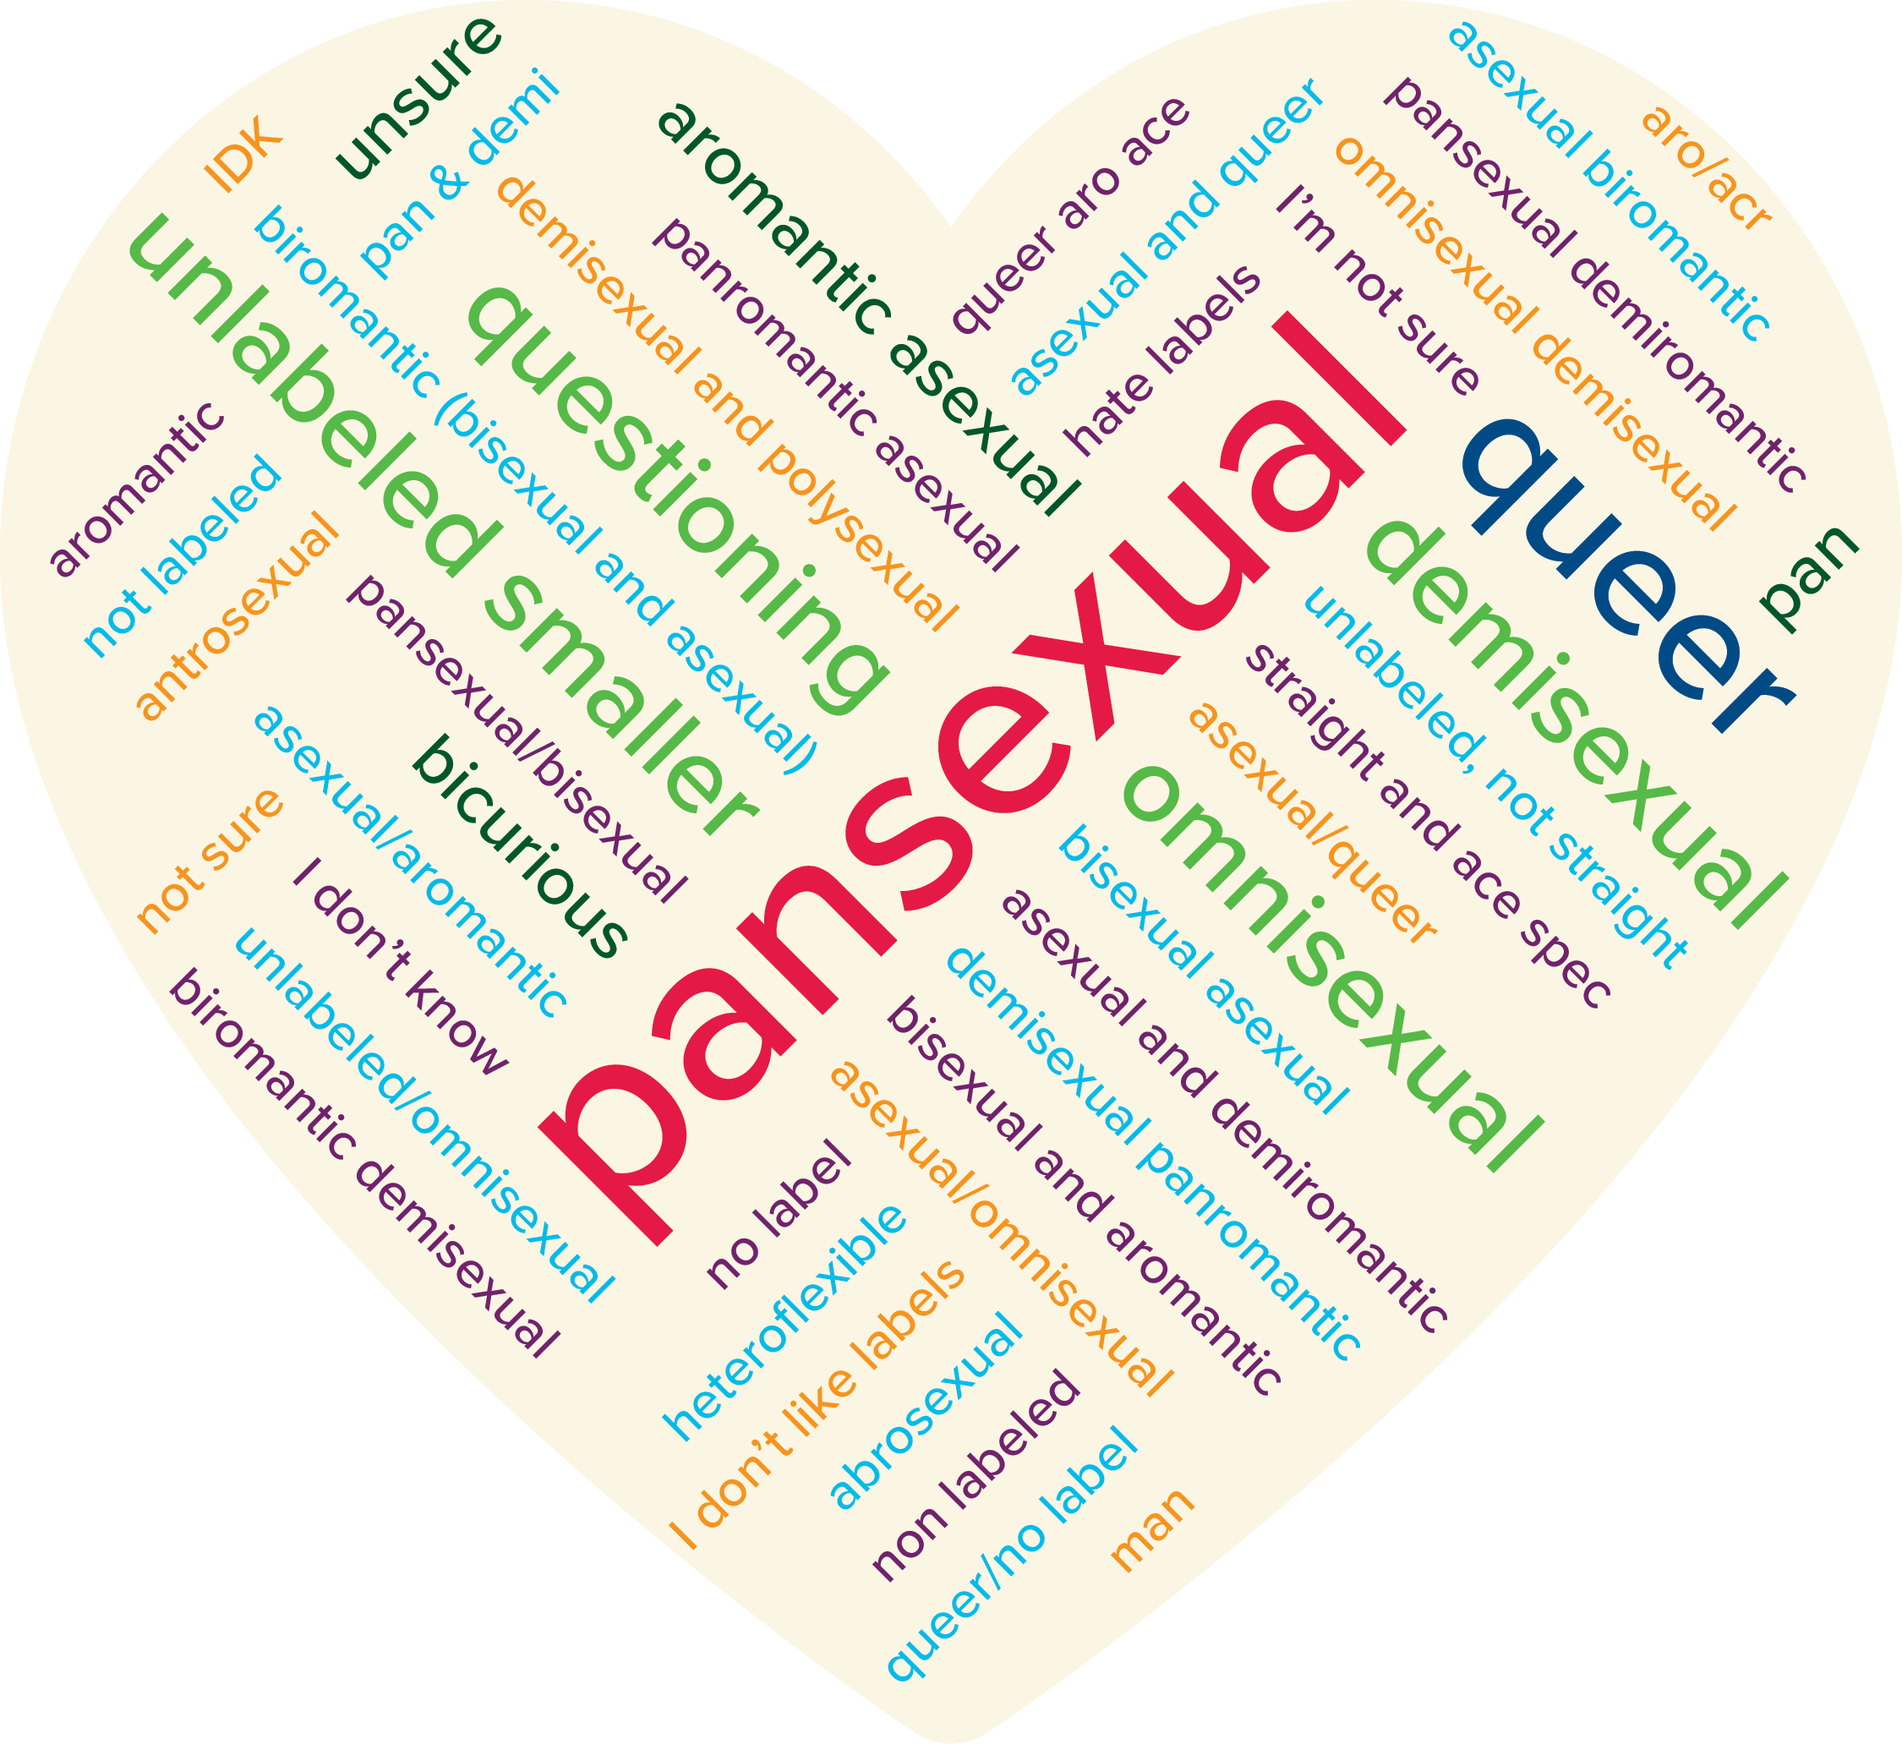
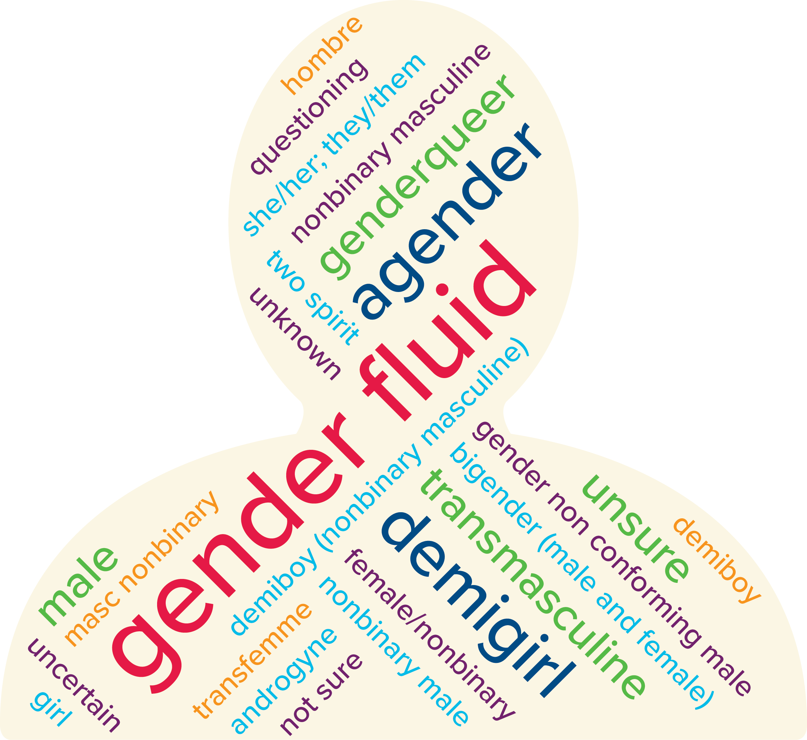
Gender and Sexuality Diversity
Notes:
Visual representation of how respondents identify

Slide 13
HIGH SCHOOL EXPERIENCE

Slide 14
LGBTQ+ Students More Likely to Experience Bullying

Slide 15
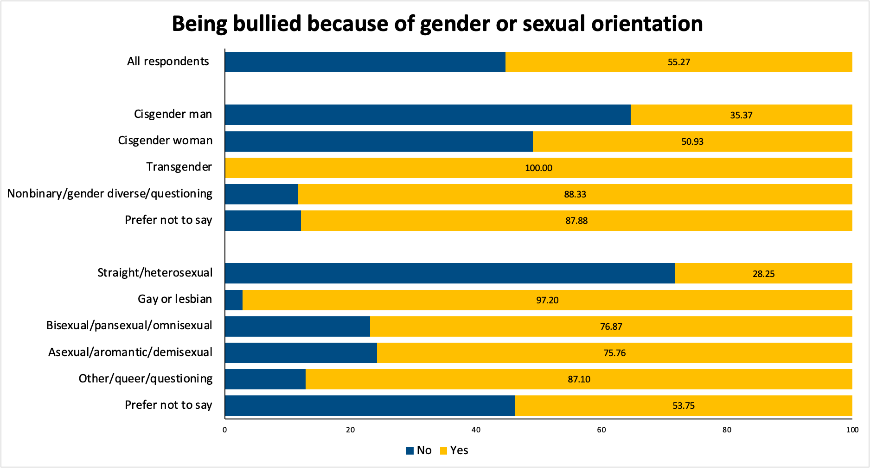
Reasons Bullied: Gender and Sexual Orientation

Slide 16
High School Experience Index
We construct an index from HS experience items
6 items, range [-2, 2]
Alpha > 0.7
Index range [-12, 12]
Lower value = more negative experience
How do you rate your high school academic performance (Poor to Excellent, 5 pt Likert)
How do you rate your high school social experience (Very Negative to Very Positive, 5 pt Likert)
Teachers and staff at my high school care about my future (same as above)
I belong in my high school community (Strongly Disagree to Strongly Agree, 5 pt Likert)
I received good advising from high school about college (same as above)
I feel prepared for college (same as above)

Slide 17
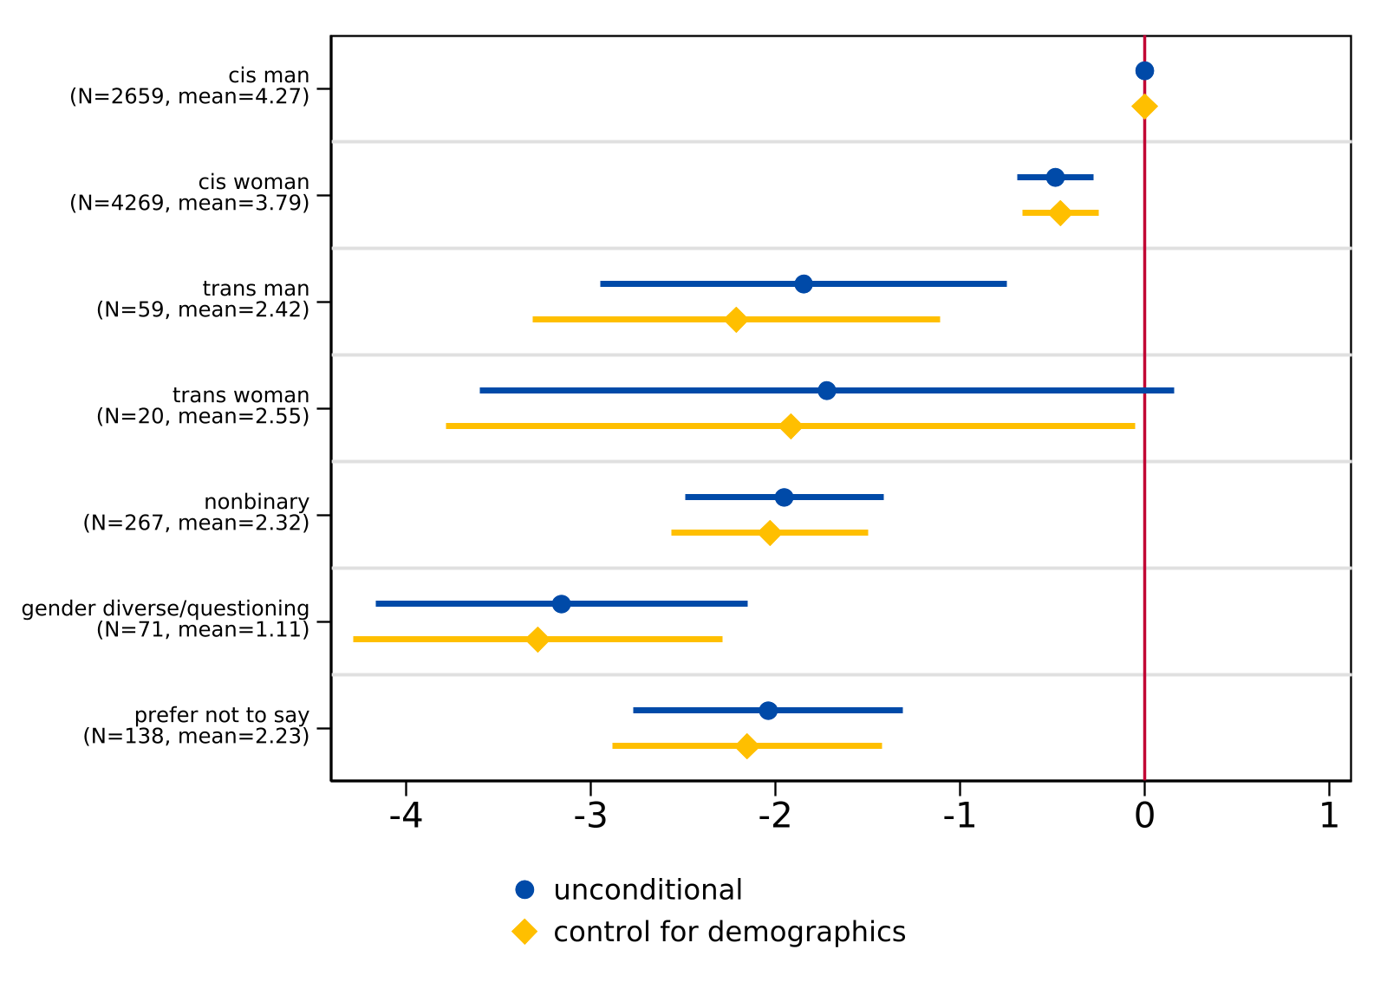
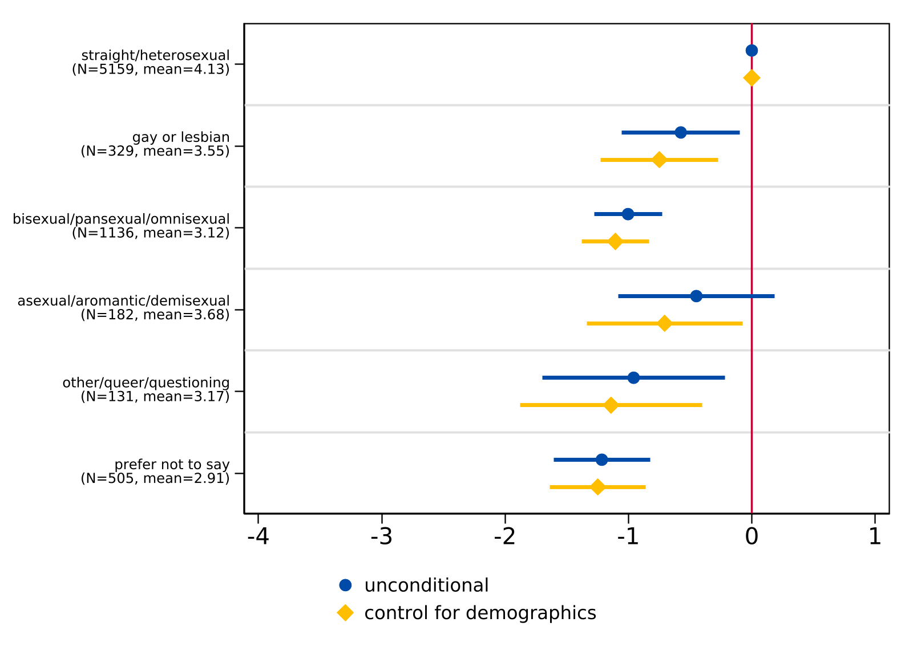
Disparities in HS Experience: Regression Analysis

Slide 18
WORRIES ABOUT COLLEGE

Slide 19
Survey Items: College Concerns
How worried are you about… (4 pt Likert)
Affording tuition and fees
Living expenses
Performing well academically
Balancing work obligations
Balancing family obligations
Finding community
Living away from home
Having adequate support for emotional and mental health needs
Discrimination based on gender
Discrimination based on sexual orientation
Discrimination based on race
Discrimination based on religion

Slide 20
Principal Components Analysis (PCA)
Explore dimensionality of worries
Create 3 worry indices using principal components
General Worries (32.03%)
Worries about Discrimination (13.79%)
Worries about financial burdens (10.26%)
Higher values = more worried

Slide 21
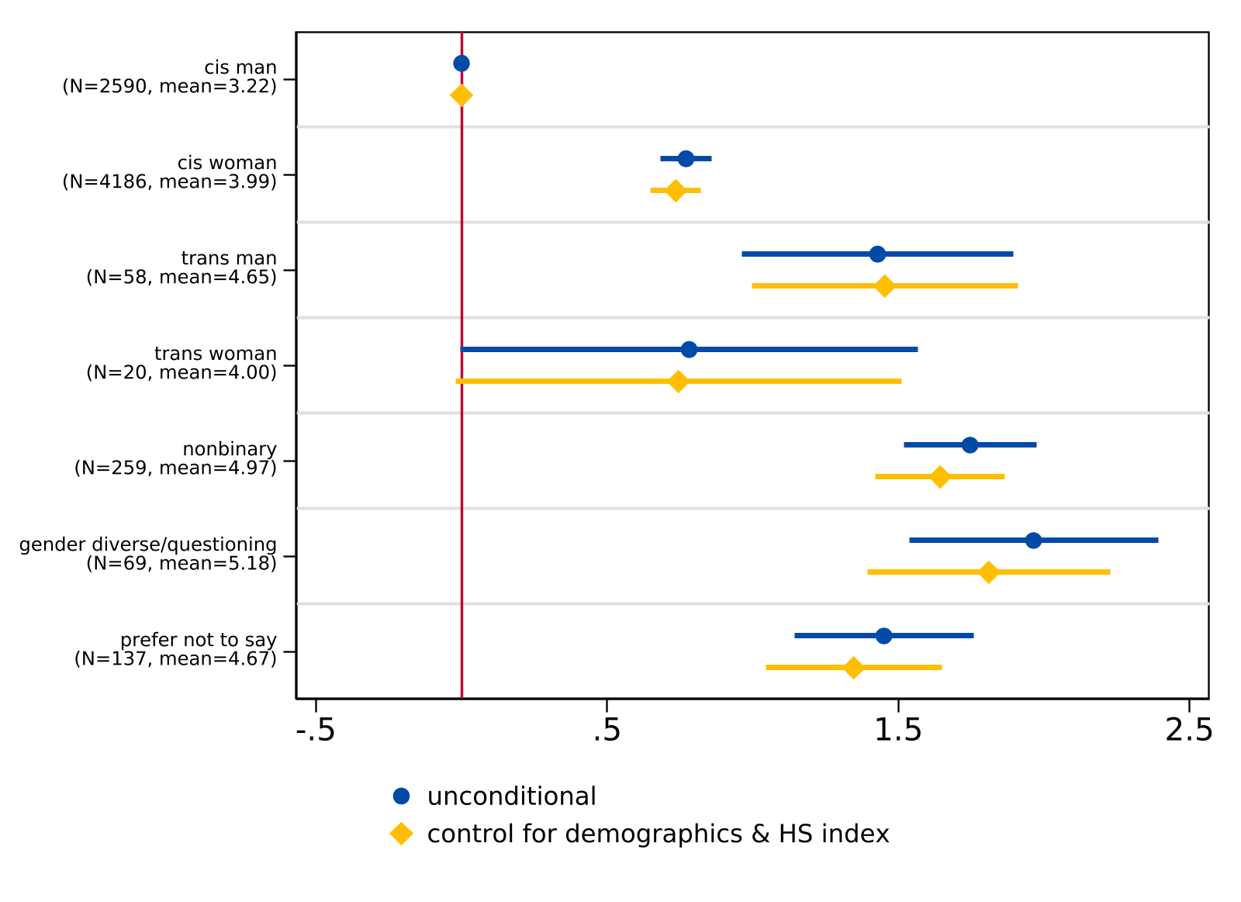
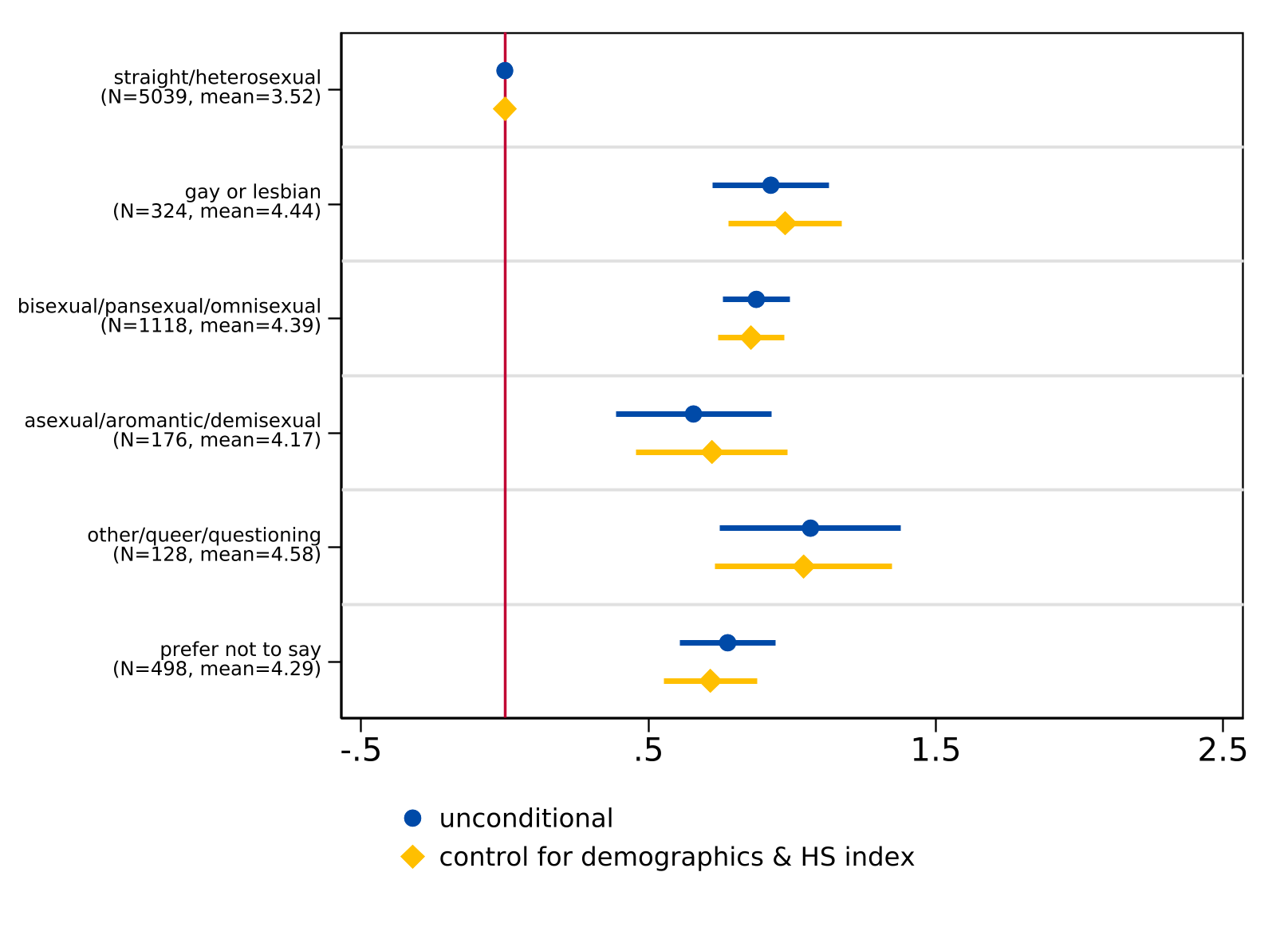
General Worries: Regression Analysis

Slide 22
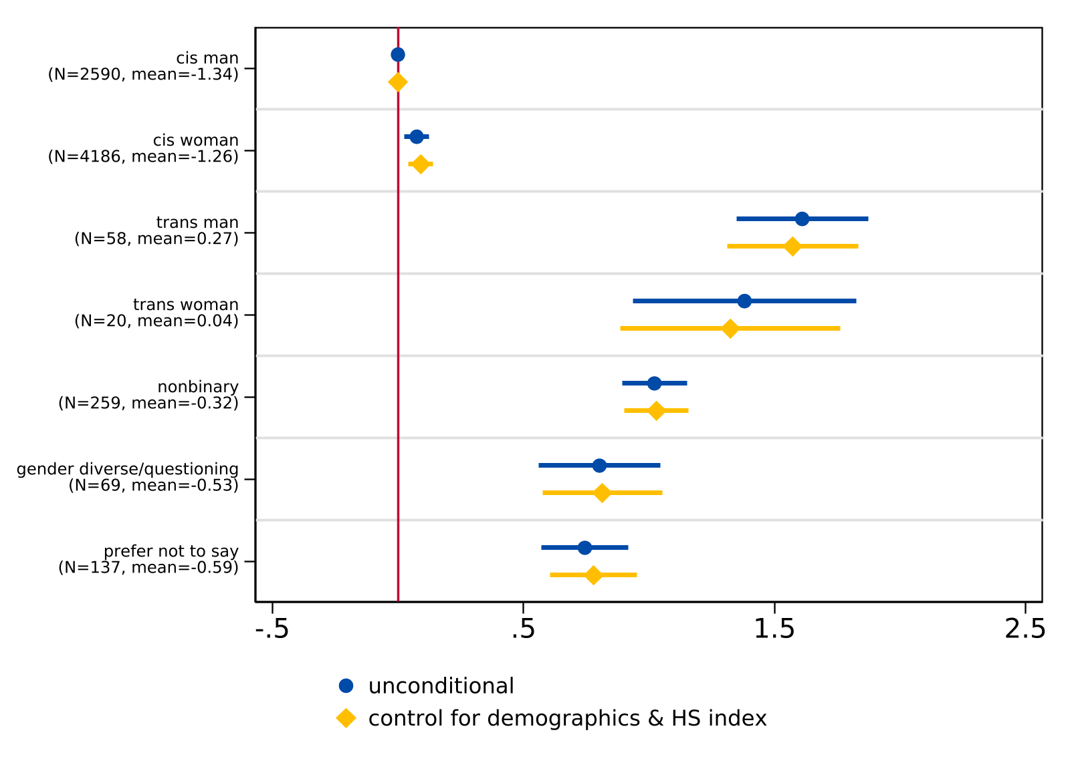
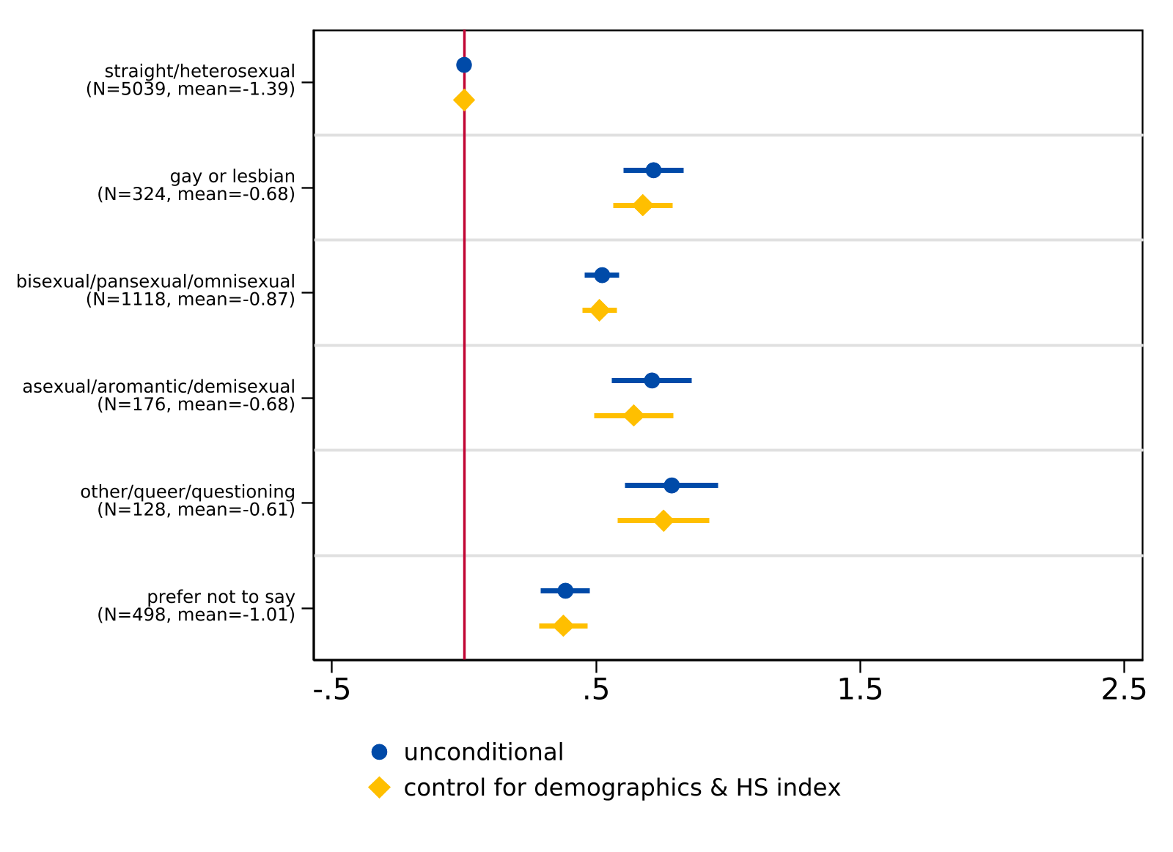
Worries about Discrimination: Regression Analysis

Slide 23
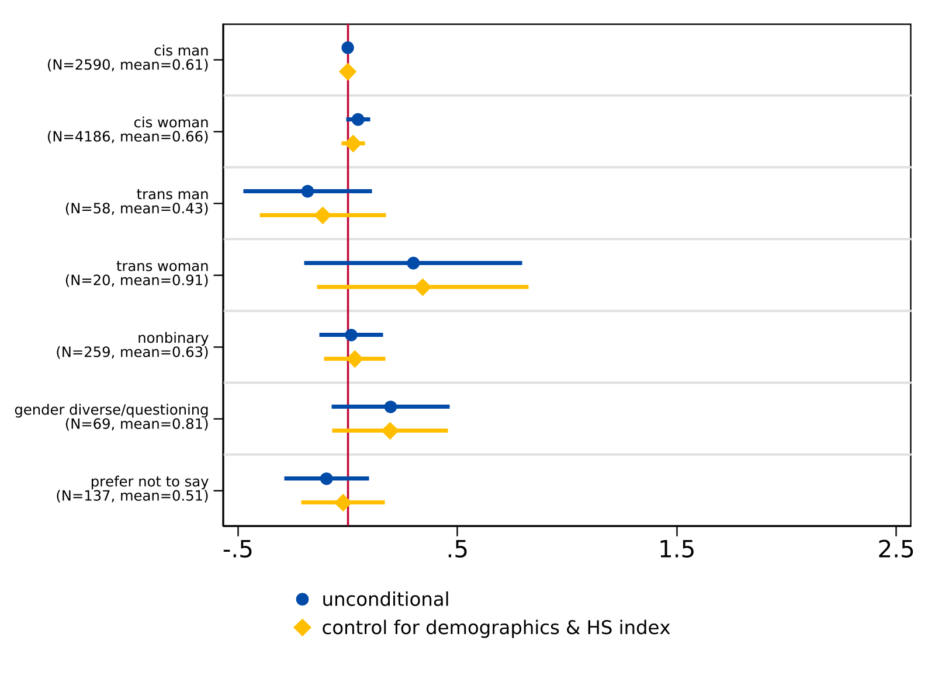
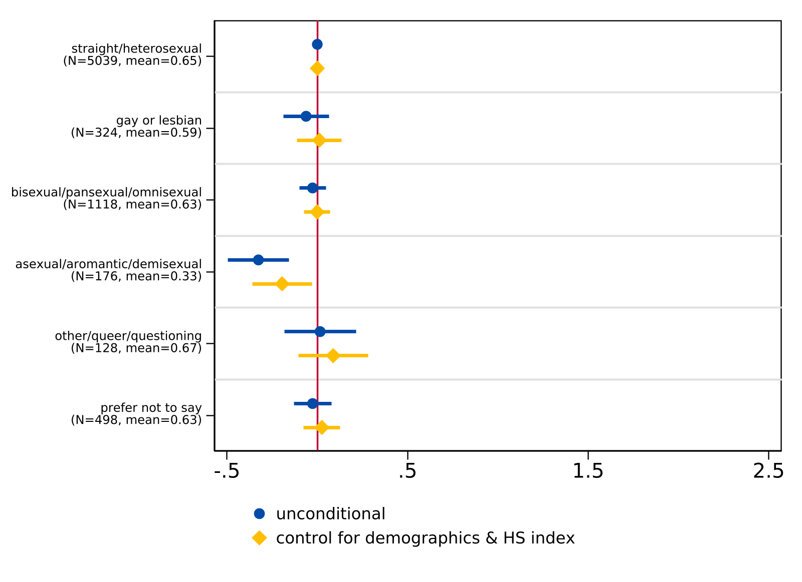
Worries about Financial Burdens: Regression Analysis

Slide 24
WHAT STUDENTS SAY
CW: SUICIDE

Slide 25
Open-Ended Items
What are you most excited about in college?
What do you think is the biggest challenge you’ll face in college?

Slide 26
Fears of Discrimination
“Transphobia”
“Political and social conflicts. I could die from hate crimes, but it's more likely that I end up killing myself. I struggle a lot with being trans and if not able to transition in college, I'm going to give up on everything. The political climate in Taiwan could reach a tipping point while I am in college. If that happens, I am likely going to drop everything to help my family.”
“lack of community due to discrimination”
“I think the biggest challenge will be standing up for myself.”
“Coming out to people around me.”

Slide 27
Excitement about College
“Being able to build a community for myself where I truly feel that I belong.”
“I'm excited to be myself. I live in a house of five. I'm the youngest of my three siblings, meaning I've had to share a room with my 23 year old sister since I was born. I've never had privacy and I never felt like I could be myself. To use broad terms, I could never properly express myself as a gay, trans teen. I can't wait to make new friends and enjoy my new found independence. “I’m [excited] about moving from home and working to establish my independence.”
“Getting out of my small area bubble and living on my own as my own person.”
“Finding likeminded people with similar interests and finding people who have the same sexual orientation”
Creating a healthy social circle, increased responsibility and freedom, and learning about specific subjects that interest me.

Slide 28

Acknowledgements & Dissemination
California Education Lab
Elizabeth Friedmann
Sherrie Reed
Paco Martorell
Scott Carrell
California Student Aid Commission
Marlene Garcia
Jessica Moldoff
Ryan Fuller
This paper will be released as part of Getting Down to Facts III
This research was supported by the College Futures Foundation and conducted in partnership with the California Student Aid Commission. The authors are also grateful for ongoing support from the Stuart Foundation to the California Education Lab. The California Education Lab at the University of California, Davis and Policy Analysis for California Education are also thankful for research dissemination support from the Bill & Melinda Gates Foundation. The findings and conclusions here are those of the authors alone and do not necessarily reflect the positions or policies of the funders or of the California Student Aid Commission.

Slide 29
FUTURE LGBTQ+ RESEARCH AGENDA

Slide 30
Research Agenda & Ideas
Gender Affirming Care & outcomes
Pre- vs. post-puberty medical transition and differential outcomes
Effects of gender affirming surgeries
Discrimination & disparities
Sorting in college majors and occupations
Effects of anticipated discrimination (lab experiment)
Social Context & Stereotype Change
Peer effects of LGBTQ+ students (contact hypothesis)
Beliefs and social norms about anti-trans sentiments

Slide 31
QUESTIONS & COMMENTS

Slide 32



THANK YOU
Appreciate your comments and feedback!
christinasun.net
ucsun@ucdavis.edu

Slide 33
APPENDIX

Slide 34
Survey Items: High School Experience
How do you rate your high school academic performance (Poor to Excellent, 5 pt Likert)
How do you rate your high school social experience (Very Negative to Very Positive, 5 pt Likert)
Teachers and staff at my high school care about my future (same as above)
I belong in my high school community (Strongly Disagree to Strongly Agree, 5 pt Likert)
I received good advising from high school about college (same as above)
I feel prepared for college (same as above)

Slide 35
Survey Items: College Concerns
How worried are you about… (5 pt Likert)
Affording tuition and fees
Living expenses
Performing well academically
Balancing work obligations
Balancing family obligations
Finding community
Living away from home
Having adequate support for emotional and mental health needs
Discrimination based on gender
Discrimination based on sexual orientation
Discrimination based on race
Discrimination based on religion

Slide 36
PCA Analysis: 3 Dimensions of Worries
Create 3 worry indices using principal components
General Worries (32.03%)
Range: [0, 10.23]
Worries about Discrimination (13.79%)
Range: [-3.83, 5.12]
Worries about financial burdens (10.26%)
Range: [-3.64, 3.65]

Slide 37
Sample Characteristics
 |  | Survey Respondents |  | Statewide
 |  | N | Percent | N | Percent
Total |  | 10,221 | - | 488936 | -
Race/ethnicity
 | American Indian/Alaskan Native/Pacific Islander | 247 | 2.42 | 2349 | 0.48
 | Black/African American | 559 | 5.47 | 23852 | 4.88
 | Hispanic/Latinx | 4066 | 39.78 | 272323 | 55.70
 | Filipino | 244 | 2.39 | 13231 | 2.71
 | Asian | 1163 | 11.38 | 46278 | 9.47
 | Other | 198 | 1.94 | 17435 | 3.57
 | White/Non-Hispanic | 1553 | 15.19 | 103787 | 21.23
 | Not reported | 2191 | 21.44 | 7576 | 1.55
Gender
 | Cis woman | 4503 | 44.06 | Female | 48
 | Cis man | 2864 | 28.02 | Male | 51.5
 | Non-binary/Gender variant | 418 | 4.09 | Non-binary | < 0.5
 | Unsure/prefer not to say | 191 | 1.87
 | Not reported | 2245 | 21.96
Parent level of education
 | Did not complete high school | 1467 | 14.35
 | High school diploma | 1708 | 16.71
 | Some college, no college degree | 1023 | 10.01
 | Associate degree | 474 | 4.64
 | Bachelor's degree | 1394 | 13.64
 | Graduate/professional degree | 1485 | 14.53
 | Don't know | 447 | 4.37
 | Not reported | 2223 | 21.75
Compared to all 12th graders enrolled in California public high schools, our sample:
Overrepresents American Indian/Alaskan Native/Pacific Islanders
Overrepresents Black/African Americans
Underrepresents Hispanic/Latinx students
The state only includes 3 categories for the gender identity information it collects:
Male
Female
Non-binary

Slide 38
Data
Raw sample: 10,221 complete responses
Response rate of 3.5%
Analytic sample: 9,230 college-bound HS seniors
7,522 reported gender identity
7,481 reported sexual orientation
1,828 LGBTQ+ students (excluding Prefer Not to Say)
417 non-cisgender
1,782 non-heterosexual

Slide 39
Classification of Gender Identity
Assigned Sex at Birth | Current Gender | Gender Identity Classification
Male | Man | Cisgender Man
Female | Woman | Cisgender Woman
Male | Woman | (Binary) Transgender Woman
Female | Man | (Binary) Transgender Man
Any | Non-binary/Self Describe/Questioning | Non-binary/Gender Diverse/Questioning
Any | Prefer not to say/Attack helicopters | Prefer not to say

Slide 40
Classification of Sexual Orientation
Sexual Orientation | Sexual Orientation Classification
Lesbian or Gay | Gay/Lesbian
Straight (not gay or lesbian) | Heterosexual
Bisexual/Self described pansexual | Bisexual/Pansexual
Asexual/Self described asexual/demisexual/aromantic | Asexual/Demisexual/Aromantic
Self described other non-heterosexual orientations/questioning | Other/Queer/Questioning
Prefer not to say/Attack helicopters | Prefer not to say

Slide 41
Self Rating of High School Social Experience

Slide 42
Belonging in High School

Slide 43
Worried about Discrimination on Gender

Slide 44
Worried about Discrimination on Sexual orientation

Slide 45
Worried about Finding Community

Slide 46
Worried about Adequate Support

Slide 47
Queer Identity by Parent Education: Gender

Slide 48
Queer Identity by Parent Education: Sexual Orientation

Slide 49
Most Gender Diverse Students Also Identify as Non-Heterosexual

Slide 50
EDUCATIONAL ASPIRATIONS

Slide 51
LGBTQ+ Students Have Higher Educational Aspirations

Slide 52
Intended College Majors

Slide 53
Limitations
We cannot do subgroup analysis for every single identity
Have to combine some gender/sexual orientation categories due to cell size issues
We follow a particular classification method and definitions for gender/sexual identities
E.g. Is transgender an umbrella term or a specific subgroup?

