Slide 1

The Transition to College for Gender and Sexual Minority Youth
Christina Sun
With Alexandria Hurtt, Michal Kurlaender, Kairo Weber, and Baiyu Zhou
University of California, Davis
AERA 2025, Denver, CO
Note: This research was supported by the College Futures Foundation and conducted in partnership with the California Student Aid Commission. The authors are also grateful for ongoing support from the Stuart Foundation to the California Education Lab. The California Education Lab at the University of California, Davis and Policy Analysis for California Education are also thankful for research dissemination support from the Bill & Melinda Gates Foundation. The findings and conclusions here are those of the authors alone and do not necessarily reflect the positions or policies of the funders or of the California Student Aid Commission.

Slide 2
Acknowledgements
California Student Aid Commission
Marlene Garcia
Jessica Moldoff
Ryan Fuller
California Department of Education
California Education Lab
Elizabeth Friedmann
Sherrie Reed
Paco Martorell
Scott Carrell

Slide 3
Outline
Introduction
Method
Data
Findings & Discussion

Slide 4
Introduction

Slide 5
Motivation
Transition to college crucial for youth (Luh et al., 2023)
LGBTQ+ youth face significant barriers (Sanlo 2004; Sansone 2019)
Sparse data on LGBTQ+ youth
Narrow/small samples
Lack of detail/nuance

Slide 6
This Study
Large-scale survey of HS seniors in CA
Detailed descriptions
Gender
Sexual Orientation
Rich data
HS experience
Aspirations
Challenges/Obstacles

Slide 7
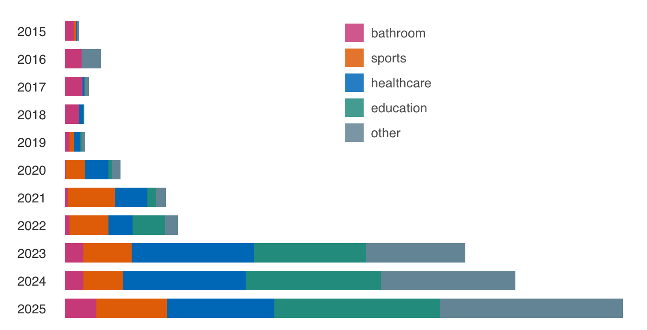
National Context
Number of anti-trans bills in the US
COVID-19 Pandemic
Remote education in HS
Rising backlash to LGBTQ+ people
Sources: Trans Legislation Tracker (translegislation.com)

Slide 8
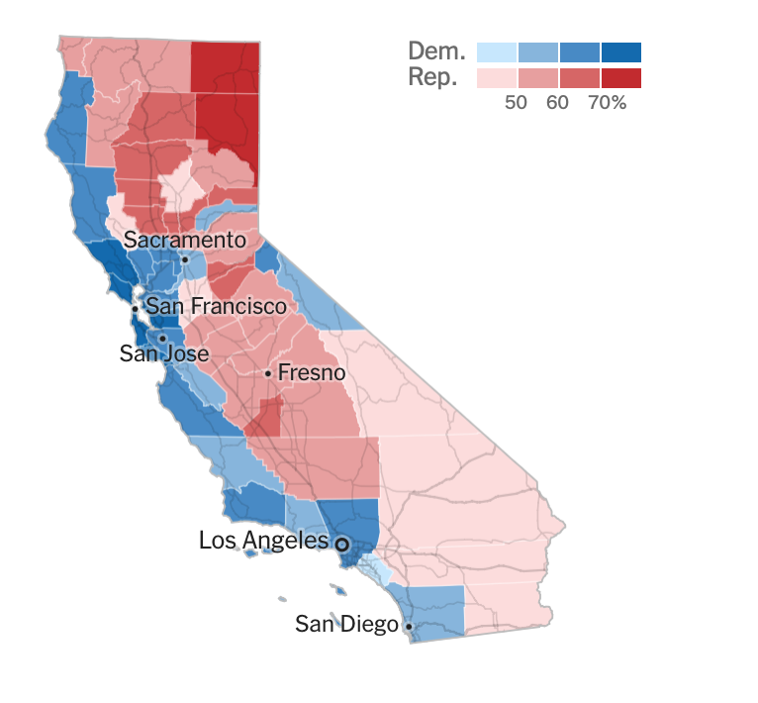
State Context: California
2024 Presidential vote shares in California
Diverse political leanings & demographics
AB 469 mandates FAFSA or CADAA
Class of 2023 is 1st cohort
Sources: The New York Times

Slide 9
Method

Slide 10
Survey Methodology
Internet based survey
May 2023
Partnership with California Student Aid Commission
Distribution via email to all HS seniors in CA who submitted
Free Application for Federal Student Aid (FAFSA)
California Dream Act Application (CADAA)

Slide 11
Survey Questions
Likert-scale questions
HS experience
College plans
Concerns
Open-ended questions
Perceived challenges
Excitements
Demographics

Slide 12
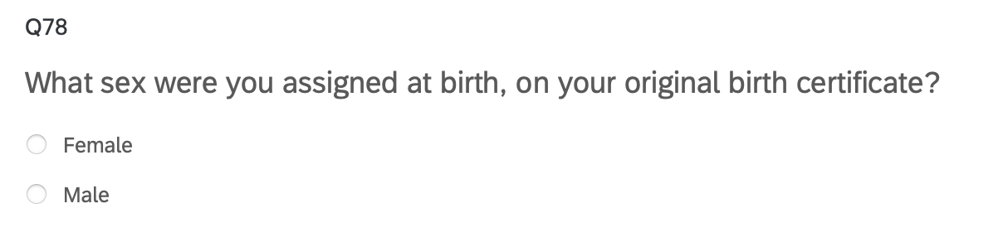
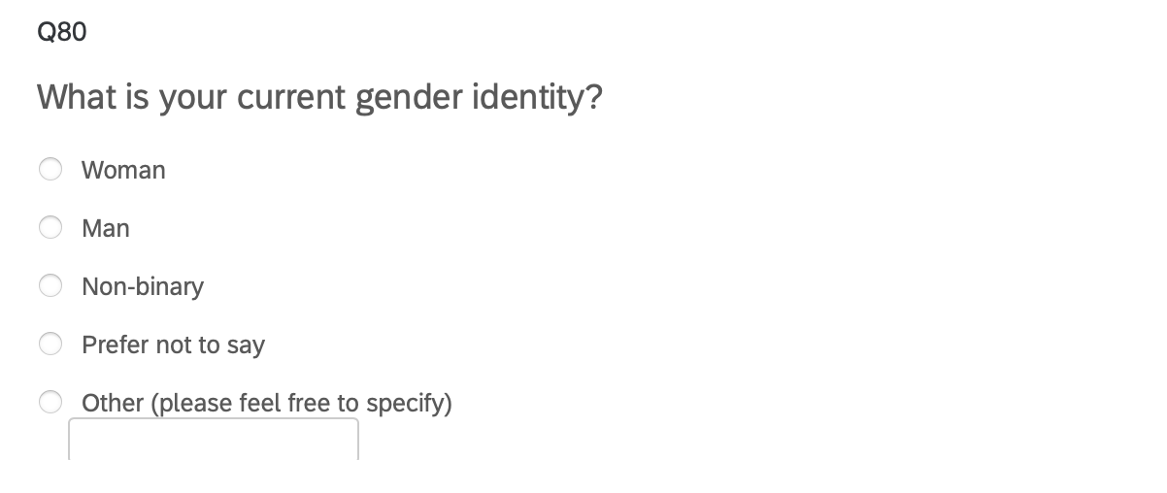
Gender Identity
Two-step approach (Williams Institute)
High sensitivity & specificity
Increased reliability & accuracy
Step 1: Sex assigned at birth
Step 2: Current gender

Slide 13
Gender Identity
Assigned Sex at Birth | Current Gender | Gender Identity Classification
Male | Man | Cisgender Man
Female | Woman | Cisgender Woman
Male | Woman | Transgender Woman
Female | Man | Transgender Man
Any | Non-binary/Self Describe/Questioning | Non-binary/Gender Diverse/Questioning
Any | Prefer not to say/Attack helicopters | Prefer not to say

Slide 14
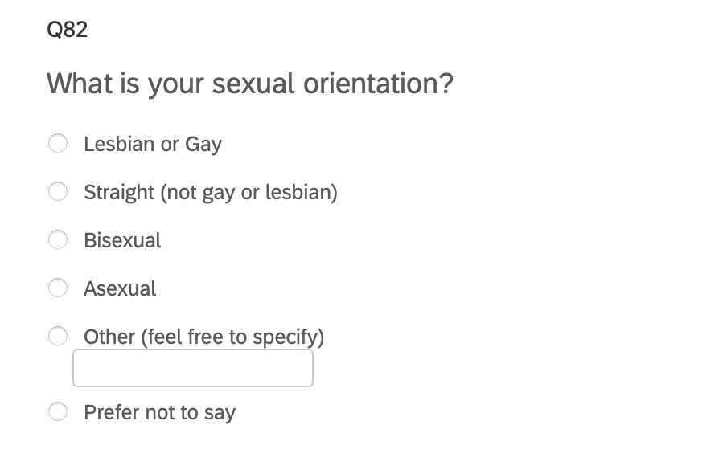
Sexual Orientation

Slide 15
Data

Slide 16
Sample Characteristics
 |  | Survey Respondents |  | Statewide
 |  | N | Percent | N | Percent
Total |  | 10,221 | - | 488,936 | -
Race/ethnicity
 | American Indian/Alaskan Native/Pacific Islander | 247 | 2.42 | 2,349 | 0.48
 | Black/African American | 559 | 5.47 | 23,852 | 4.88
 | Hispanic/Latinx | 4,066 | 39.78 | 272,323 | 55.70
 | Filipino | 244 | 2.39 | 13,231 | 2.71
 | Asian | 1,163 | 11.38 | 46,278 | 9.47
 | Other | 198 | 1.94 | 17,435 | 3.57
 | White/Non-Hispanic | 1,553 | 15.19 | 103,787 | 21.23
 | Not reported | 2,191 | 21.44 | 7,576 | 1.55
Gender
 | Cis woman | 4,503 | 44.06 | Female | 48
 | Cis man | 2,864 | 28.02 | Male | 51.5
 | Non-binary/Gender variant | 418 | 4.09 | Non-binary | < 0.5
 | Unsure/prefer not to say | 191 | 1.87
 | Not reported | 2,245 | 21.96

Slide 17
Analytic Sample
1,828 LGBTQ+ students (excluding Prefer Not to Say)
417 non-cisgender
1,782 non-heterosexual

Slide 18
Findings & Discussion

Slide 19
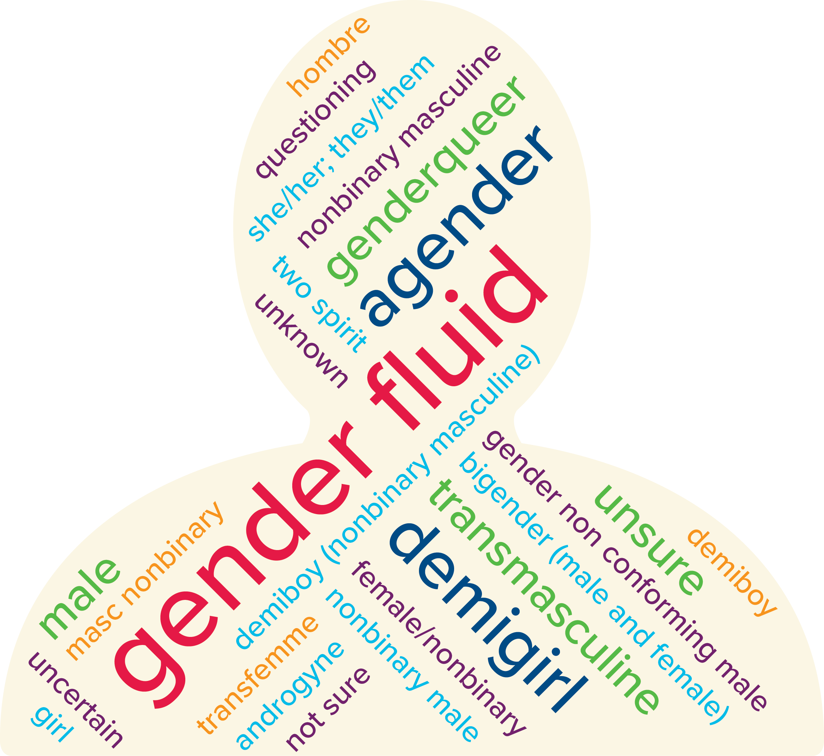
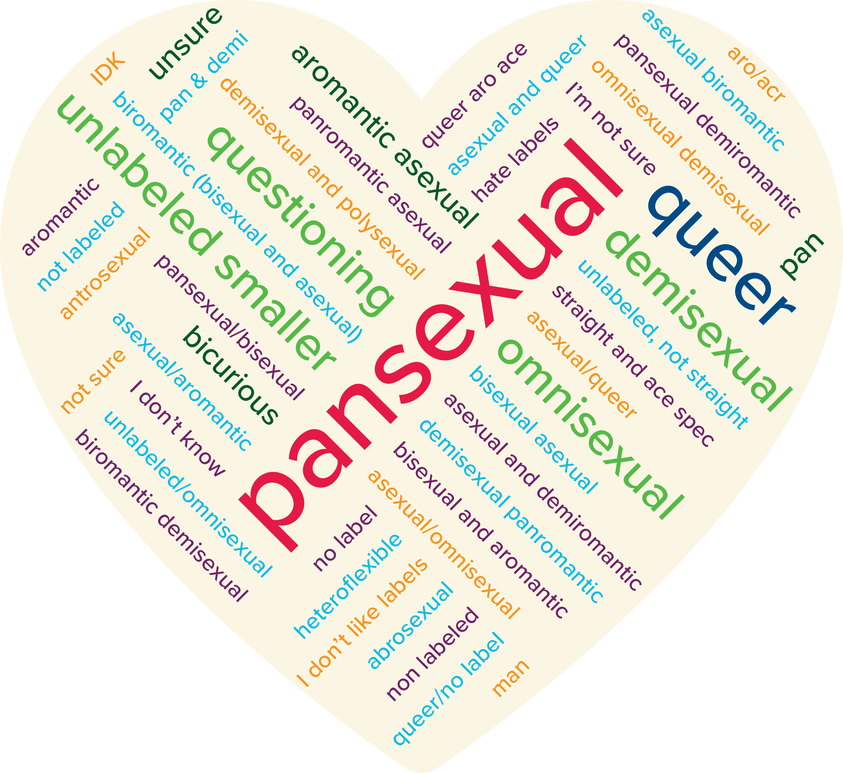
Diversity of Self-Descriptions

Slide 20
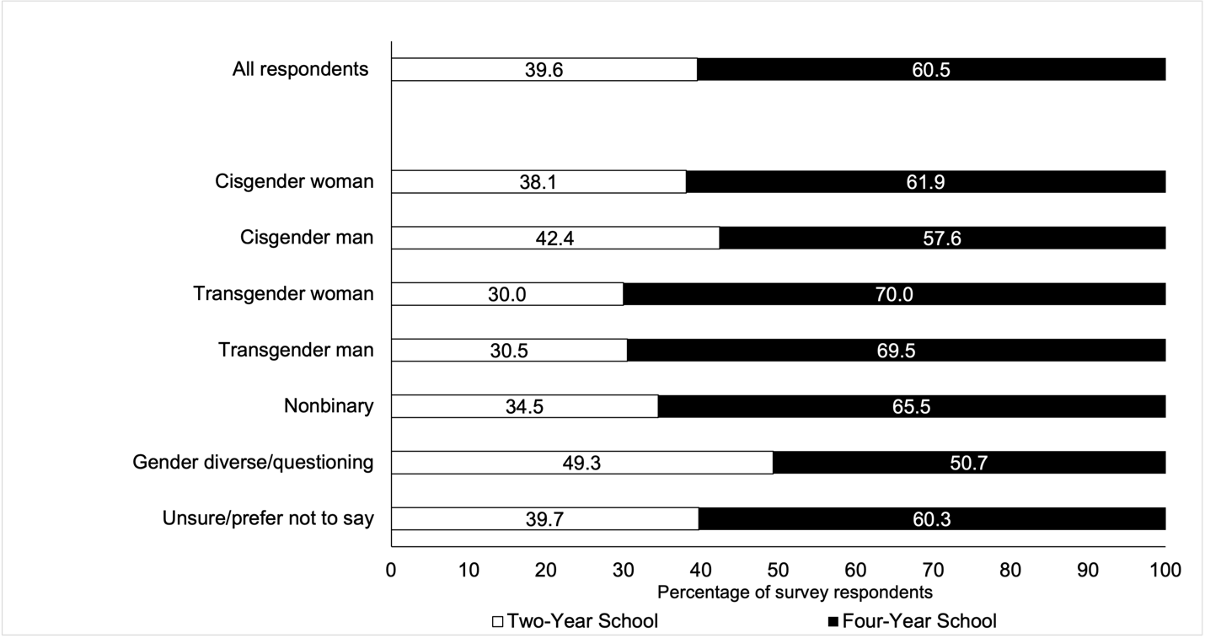
Plans for College Enrollment

Slide 21
Degree Aspirations

Slide 22
College Majors

Slide 23
High School Experience Index
Construct an index from survey questions
HS social & academic experience
Interaction with teacher/staff
Preparation for college
Index Range: -12 to 12
Index < 0: negative experience
Index = 0: neutral
Index > 0: positive experience

Slide 24
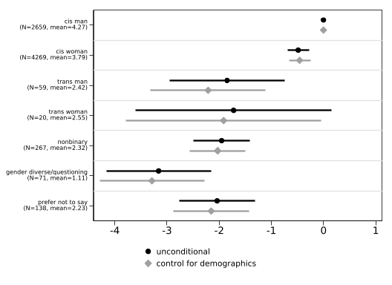
High School Experience by Gender
Note: For the unconditional model, n = 7,483. For the model controlling for demographics (race/ethnicity and parental level of education), n = 7,464. The lines indicate 95 percent confidence intervals while the sample frequency and mean index of each gender identity are reported in parentheses.

Slide 25
College Worries Index
PCA of questions on worries about college
Academic and social
Personal, family, financial
Discrimination
3 indices for worries (56% of variance)
General worries
Worries about discrimination
Worries about financial burdens

Slide 26
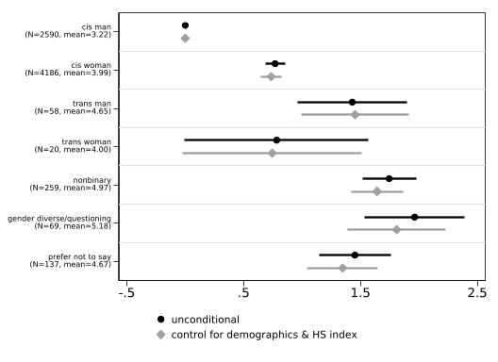
General Worries

Slide 27
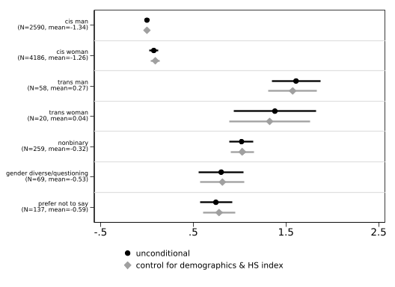
Worries about Discrimination

Slide 28
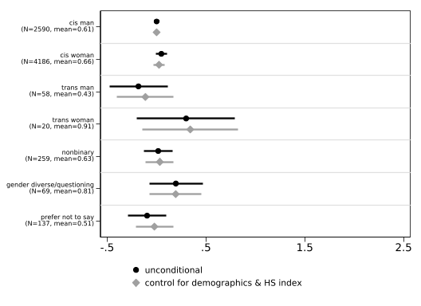
Worries about Financial Burdens

Slide 29
Student Voices
Independence and New Experiences
“I’m excited to be myself. I live in a house of five. I’m the youngest of my three siblings, meaning I’ve had to share a room with my 23-year-old sister since I was born. I’ve never had privacy and I never felt like I could be myself. To use broad terms, I could never properly express myself as a gay, trans teen. I can’t wait to make new friends and enjoy my newfound independence.”
Friends and Community
“I’m most excited to connect with like-minded people. I’m also looking forward to receiving certain medical treatment at my college’s health center that I currently don’t have access to.”
Academic and Learning
“I am excited to expand my knowledge and be the first of my sisters to get a degree. I am aiming to meet my career goal by transferring to a four-year university after completing my associate’s at a CCC [California Community College].”

Slide 30
Discussions
Students hold diverse identities
Different patterns of educational aspirations
Significant differences in HS experience and worries about college
Students also hold much excitement for college
Learning
Community
Independence

Slide 31
Thank You!
ucsun@ucdavis.edu

Slide 32
Appendix

Slide 33
High School Experience Questions
How would you rate your academic performance in high school? (Poor, Fair, Good, Very Good, Excellent)
How would you rate your social experience in high school? (Very negative, Somewhat negative, Neutral, Somewhat positive, Very positive)
Please indicate your agreement with the following statements (Strongly disagree, Somewhat disagree, Neither agree nor disagree, Somewhat agree, Strongly agree)
I feel that I belong in my high school community
Teachers and staff at my high school care about my future
I received good advising from my high school about my college plans
I feel prepared for college

Slide 34
College Worries Items
 | N | Mean
Items:
How worried are you about affording tuition fees | 7957 | 1.827
How worried are you about living expenses | 7956 | 1.676
How worried are you about performing well academically | 7958 | 1.502
How worried are you about balancing work obligations | 7943 | 1.557
How worried are you about balancing family obligations | 7941 | 1.055
How worried are you about finding community | 7934 | 1.316
How worried are you about living away from home | 7948 | .908
How worried are you about having adequate support for emotional and mental health needs | 7944 | 1.127
How worried are you about discrimination based on gender | 7886 | .436
How worried are you about discrimination based on sexual orientation | 7876 | .333
How worried are you about discrimination based on race | 7895 | .514
How worried are you about discrimination based on religion | 7891 | .232
Note. The first twelve rows are items related to college worries included in the survey. Each item ranges from 0 to 3, where 0 represents not worried at all and 3 represents very worried.

Slide 35
Two-Way Tabulation of Gender and Sexual Orientation
Sexual Orientation Gender Identity | Straight/heterosexual | Gay or lesbian | Bisexual/pansexual/omnisexual | Asexual/aromantic/demisexual | Other/queer/ questioning | Prefer not to say | Total
Cisgender man | 85.03 | 4.03 | 5.09 | 0.75 | 0.57 | 4.52 | 100.00
Cisgender woman | 68.05 | 3.03 | 17.85 | 2.25 | 1.50 | 7.32 | 100.00
Transgender man | 6.90 | 32.76 | 32.76 | 6.90 | 12.07 | 8.62 | 100.00
Transgender woman | 20.00 | 40.00 | 25.00 | 10.00 | 0.00 | 5.00 | 100.00
Nonbinary | 1.92 | 18.77 | 50.19 | 13.41 | 9.58 | 6.13 | 100.00
Gender diverse/questioning | 2.90 | 13.04 | 50.72 | 14.49 | 18.84 | 0.00 | 100.00
Prefer not to say | 7.91 | 6.47 | 33.09 | 10.07 | 4.32 | 38.13 | 100.00
Total | 69.45 | 4.42 | 15.17 | 2.43 | 1.74 | 6.79 | 100.00

