Slide 1
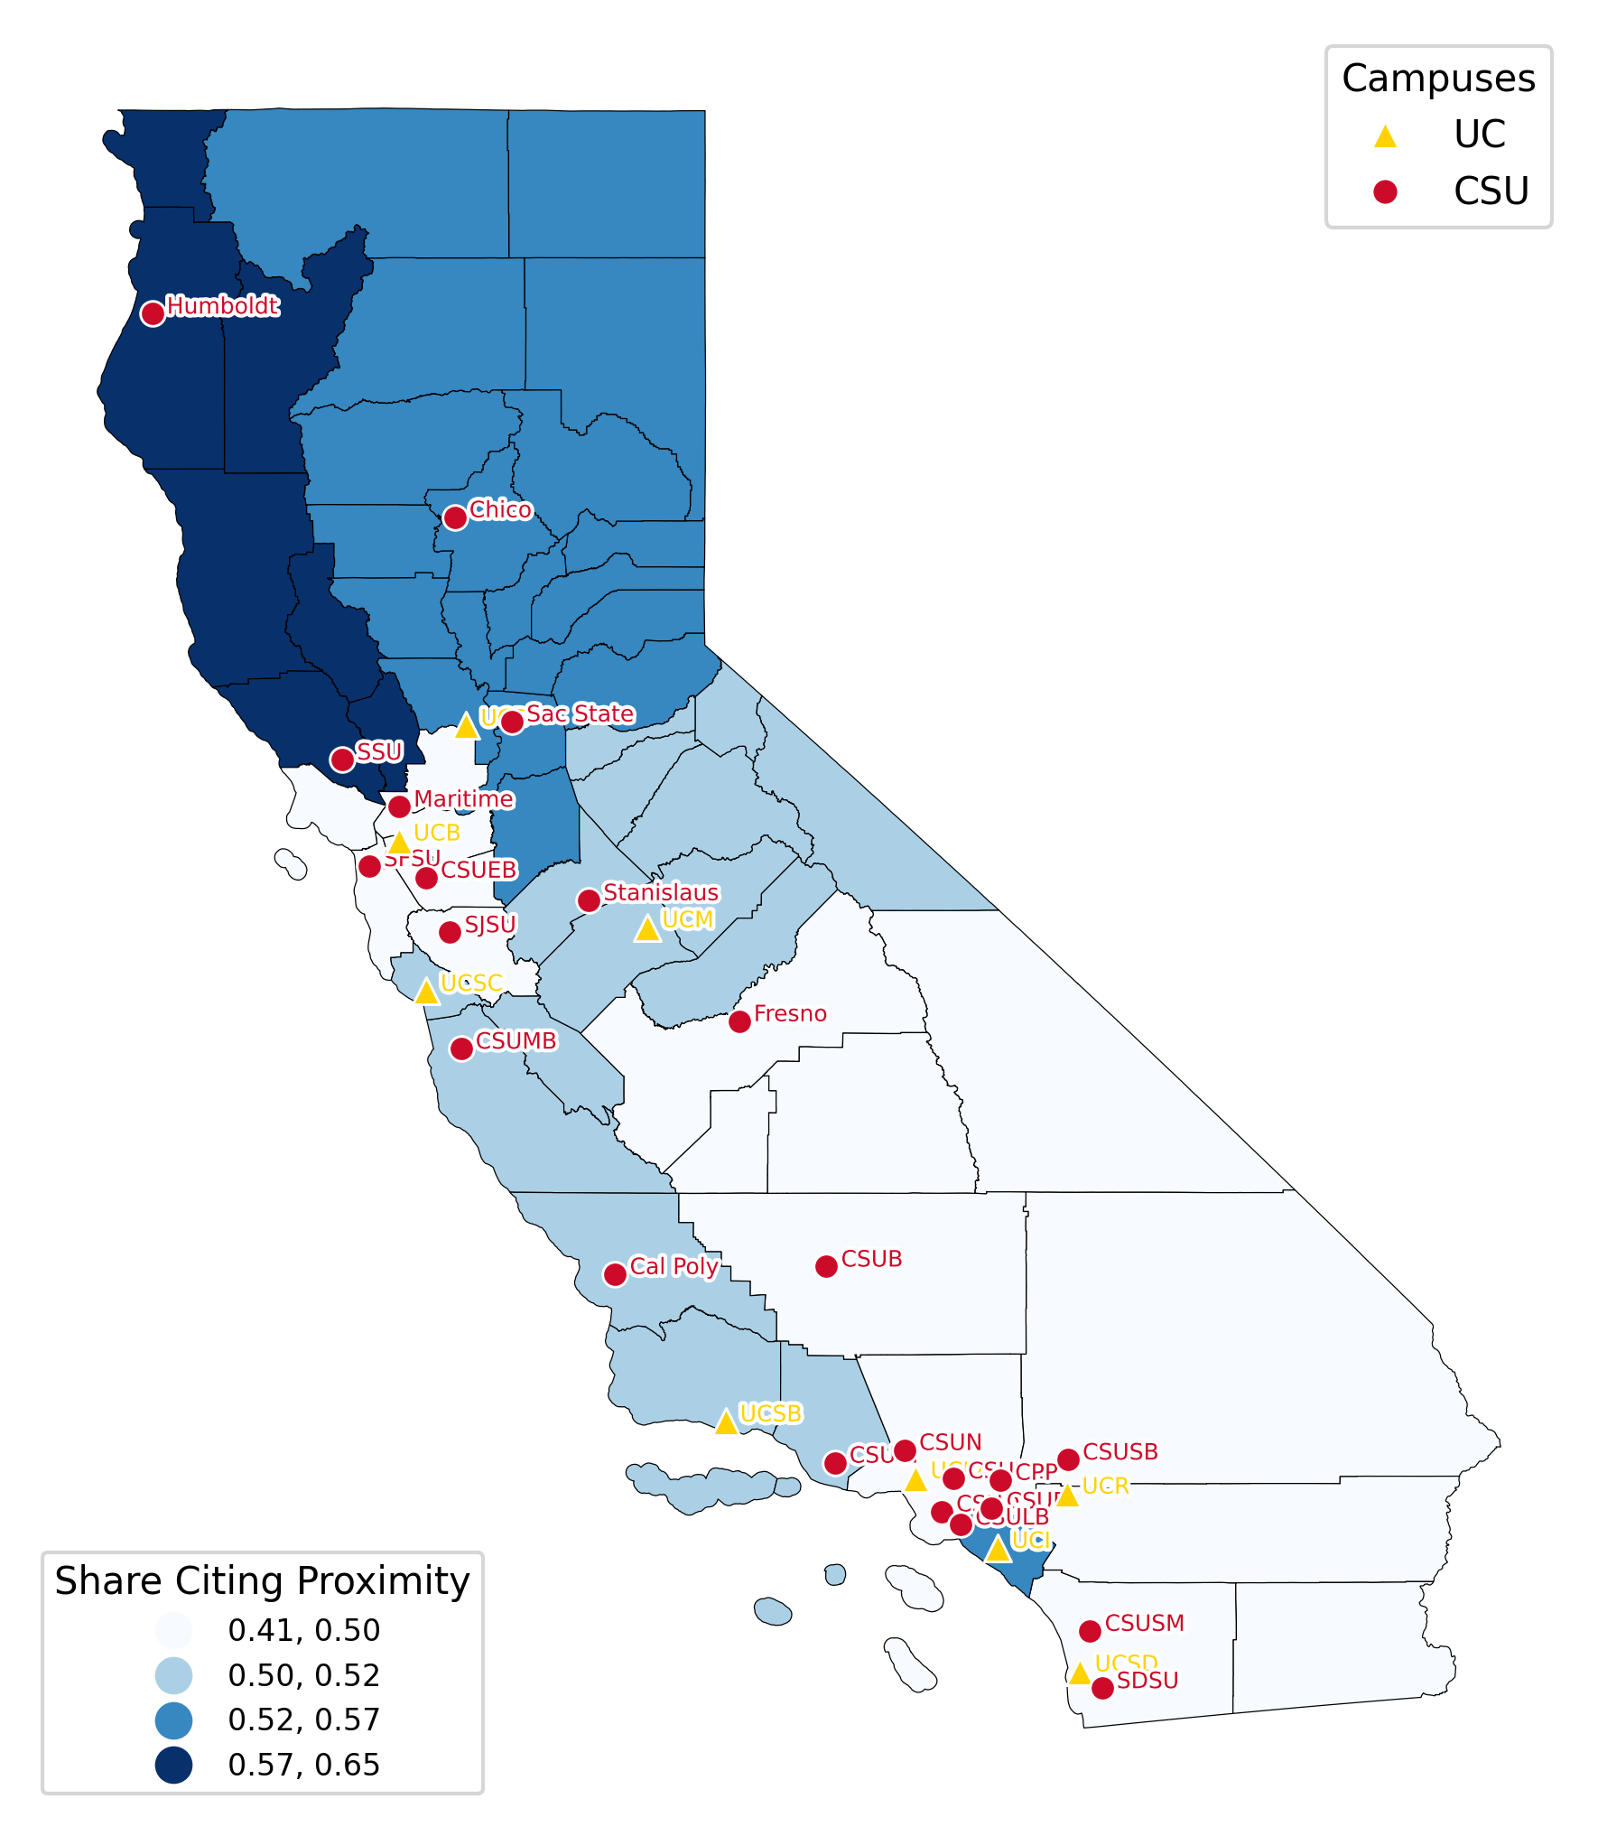
Share of students citing proximity for choosing transfer pathway (by region)
What factors influenced your decision to start at a community college and transfer?

