Slide 1
Infrastructure for a Web Application
Building a Robust and Scalable Web Application
Presented by: Chetan Agrawal
Date: 29/07/24

Slide 2
Agenda
Web Application Architecture
Infrastructure Components
Scalability
Security Measures

Slide 3
Web Application Architecture

Slide 4
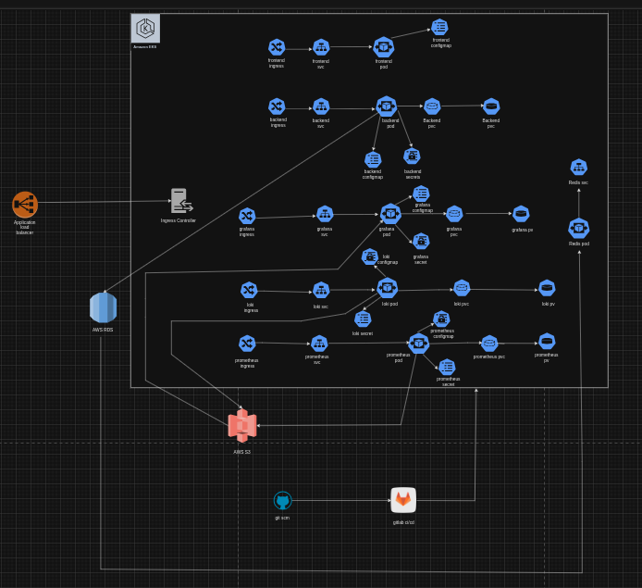

Slide 5
Infrastructure components
1. Application Load Balancer:
Purpose: Distributes incoming traffic across multiple services within the Kubernetes cluster to ensure high availability and reliability.
Example: AWS Application Load Balancer.
Features: HTTP/HTTPS traffic management, SSL termination, advanced routing.
2. Ingress Controller:
Purpose: Manages external access to services within the Kubernetes cluster.
Examples: NGINX, Traefik.
Features: Load balancing, SSL termination, name-based virtual hosting.
3. Amazon EKS (Elastic Kubernetes Service):
Purpose: Managed Kubernetes service that simplifies running Kubernetes on AWS without needing to install and operate your own Kubernetes control plane or nodes.
Features: Scalability, high availability, security integration with AWS services.

Slide 6
4. Front-End Components:
Ingress: Entry point for front-end services.
Service (svc): Kubernetes service to expose front-end pods.
Pod: Containerized application instances running the front-end code.
ConfigMap: Stores configuration data for front-end services.
5. Back-End Components:
Ingress: Entry point for back-end services.
Service (svc): Kubernetes service to expose back-end pods.
Pod: Containerized application instances running the back-end code.
ConfigMap: Stores configuration data for back-end services.
Secrets: Stores sensitive information like passwords and API keys.
PVC (Persistent Volume Claim): Storage resource requests for back-end pods.
6. Monitoring and Logging Components:
Grafana:
Ingress: Entry point for Grafana service.
Service (svc): Exposes Grafana pods.
Pod: Runs the Grafana application.
ConfigMap: Stores configuration data for Grafana.
PVC (Persistent Volume Claim) and PV (Persistent Volume): Storage for Grafana data.

Slide 7
Loki:
Ingress: Entry point for Loki service.
Service (svc): Exposes Loki pods.
Pod: Runs the Loki application, which is used for log aggregation.
ConfigMap: Stores configuration data for Loki.
Secret: Stores sensitive information needed by Loki.
PVC (Persistent Volume Claim) and PV (Persistent Volume): Storage for Loki logs.
Prometheus:
Ingress: Entry point for Prometheus service.
Service (svc): Exposes Prometheus pods.
Pod: Runs the Prometheus application for metrics collection.
ConfigMap: Stores configuration data for Prometheus.
Secret: Stores sensitive information needed by Prometheus.
PVC (Persistent Volume Claim) and PV (Persistent Volume): Storage for Prometheus data.
7. Database:
AWS RDS (Relational Database Service):
Purpose: Managed relational database service for storing structured data.
Features: Automated backups, software patching, automatic scaling, and high availability.

Slide 8
8. Object Storage:
AWS S3 (Simple Storage Service):
Purpose: Scalable object storage for storing and retrieving any amount of data at any time.
Features: High durability, scalability, and security for backup and archival storage.
9. CI/CD Pipeline:
Git SCM (Source Code Management):
Purpose: Version control for source code.
Example: GitHub.
Features: Code repository hosting, version control, collaboration tools.
GitLab CI/CD:
Purpose: Continuous integration and continuous deployment pipeline.
Features: Automated build, test, and deployment processes to streamline code releases.
10. Caching:
Prometheus:
Service (svc): Exposes redis pods.
Pod: Runs the Redis Application.

Slide 9
Steps of CI/CD Pipeline
1. SonarQube Stage:
Purpose: Check the code quality of the source code.
Actions:
Analyze code for bugs, vulnerabilities, and code smells.
Generate a report on code quality.
2. Build Stage:
Purpose: Build the Docker image of the source code with its dependencies and push the image to AWS ECR (Elastic Container Registry).
Actions:
Compile and build the source code.
Create a Docker image.
Push the Docker image to AWS ECR.
Perform a Trivy scan to check the Docker image for vulnerabilities.

Slide 10
3. Deploy Stage:
Purpose: Pull the Docker image from AWS ECR and update the deployment in the Kubernetes cluster using Helm charts.
Actions:
Pull the Docker image from AWS ECR.
Use Helm charts to update the Kubernetes deployment.
Ensure the new version of the application is running correctly in the Kubernetes cluster.

Slide 11
Scalability
1. Horizontal Scalability (Scaling Out):
Definition: Adding more instances of a service or application to distribute the load.
Approach:
Load Balancers: Distribute incoming traffic across multiple instances.
Kubernetes Auto-scaling: Automatically adjusts the number of pods based on traffic or resource usage.
Horizontal Pod Autoscaler (HPA): Scales the number of pods based on CPU/memory usage or custom metrics.
Cluster Autoscaler: Adjusts the number of nodes in the Kubernetes cluster based on resource requests and usage.
Benefits:
Improved fault tolerance.
Enhanced performance under increased load.
Flexibility to scale resources up or down based on demand.

Slide 12
2. Vertical Scalability (Scaling Up):
Definition: Increasing the resources (CPU, memory) allocated to an existing instance.
Approach:
Resource Requests and Limits in Kubernetes: Define the minimum and maximum resources a pod can use.
Upgrading Instance Types: Using more powerful virtual machine types in cloud environments (e.g., AWS EC2 instance types).
Benefits:
Enhanced performance for resource-intensive applications.
Simplified management compared to managing multiple instances.
3. Database Scalability:
Horizontal Scaling:
Sharding: Splitting a database into smaller, more manageable pieces called shards.
Read Replicas: Creating read-only copies of the database to distribute read operations.
Vertical Scaling:
Upgrading Database Instances: Increasing the resources allocated to the database server.
Cloud Services:
Amazon RDS: Supports automatic scaling with features like Aurora Auto Scaling and read replicas.

Slide 13
4. Caching:
Purpose: Reduce load on databases and improve response times by storing frequently accessed data in-memory.
Approach:
In-Memory Caching: Using solutions like Redis to cache database query results, session data, etc.
Benefits:
Faster data retrieval.
Reduced load on backend services and databases.
5. Microservices Architecture:
Definition: Breaking down a monolithic application into smaller, independent services.
Approach:
Service Isolation: Each microservice can be scaled independently.
API Gateway: Manages and routes traffic to the appropriate microservices.
Benefits:
Improved fault isolation.
Independent deployment and scaling of services.
Enhanced flexibility and maintainability.

Slide 14
6. Container Orchestration with Kubernetes:
Purpose: Automate deployment, scaling, and management of containerized applications.
Features:
Auto-scaling: Automatically adjusts the number of running containers based on demand.
Self-healing: Restarts failed containers, replaces and reschedules containers when nodes die, and kills containers that don’t respond to user-defined health checks.
Rolling Updates: Deploy application updates without downtime.
Benefits:
Efficient resource utilization.
High availability and resilience.
Simplified management of complex applications.

Slide 15
Security Measures
1. Network Security:
Application Load Balancer (AWS ALB):
Purpose: Distributes traffic securely across services.
Features: SSL termination to ensure encrypted traffic from clients.
Ingress Controller:
Purpose: Manages external access securely.
Features: TLS/SSL termination, secure routing, and access control policies.
2. Data Security:
AWS RDS (Relational Database Service):
Encryption: Data is encrypted at rest and in transit using AWS KMS (Key Management Service).
Backup: Automated backups and snapshots ensure data integrity and availability.
AWS S3 (Simple Storage Service):
Encryption: Data is encrypted at rest using server-side encryption (SSE-S3, SSE-KMS).
Access Control: Fine-grained access control using IAM policies, bucket policies, and access control lists (ACLs).
3.

Slide 16
3. Identity and Access Management (IAM):
Kubernetes RBAC (Role-Based Access Control):
Purpose: Restricts access to Kubernetes resources based on roles.
Features: Defines roles and role bindings to control who can perform actions on specific resources.
AWS IAM:
Purpose: Manages access to AWS resources.
Features: Policies and roles to grant least-privilege access to users, applications, and services.
4. Secrets Management:
Kubernetes Secrets:
Purpose: Stores sensitive information like passwords, tokens, and keys securely.
Features: Encrypted at rest within the cluster and mounted as environment variables or files in pods.
5. Logging and Monitoring:
Loki:
Purpose: Centralized logging solution for aggregating logs from different services.
Features: Securely stores and manages log data, supports query and analysis of logs.
Prometheus:
Purpose: Monitoring system for collecting and querying metrics.
Features: Securely collects metrics, supports alerting based on defined thresholds.

Slide 17
Grafana:
Purpose: Visualization tool for metrics and logs.
Features: Provides secure dashboards and supports access control for viewing data.
6. Container Security:
Docker Image Scanning:
Tool: Trivy.
Purpose: Scans Docker images for vulnerabilities.
Features: Detects vulnerabilities in OS packages and application dependencies, integrated into the CI/CD pipeline.
7. Secure CI/CD Pipeline:
GitLab CI/CD:
Purpose: Ensures secure code integration and deployment.
Features:
Code Quality Checks: SonarQube stage to ensure code quality and identify vulnerabilities.
Image Scanning: Trivy scan during the build stage to detect vulnerabilities in Docker images.
Deployment Security: Uses Helm charts for secure and consistent deployments.

