Slide 1
Tourist Guide Webpage
B.Tech F.Y.
Name: Chetan Bhupendra Lohkare
Div : K Roll No. : 20 Gr. No :11910486
Software Development Project
Department of Engineering, Sciences and Humanities (DESH)
Vishwakarma Institute of Technology, Pune
A.Y.(2019-2020) Term II

Slide 2
OUTLINE
Introduction
problem statement
Objective of project
Implementation
Module Description
Structure of Project
Working Images of Project
Conclusion and Future Scope
References
2

Slide 3
Introduction
Everyone goes on a vacation and a Tourism management system would play a vital role in planning the perfect trip.
The tourism management system allows the user of the system access all the details such as weather, location, events, etc.
The main purpose is to help tourism companies to manage customer and hotels etc.
The system can also be used for both professional and business trips.
The proposed system maintains centralized repository to make necessary travel arrangements and to retrieve information easily.
3

Slide 4
problem statement
To give the appropriate information about the Tourist places
4

Slide 5
Objective
To help Tourist ,when they visit at any place.
Give some information about that place.
Give Information about visit rout.
Awareness about that place and surrounding area.
5

Slide 6
Implementation
Category of the project
Website (Static website). i.e. Informative Website.
Tools / Platform
Visual Studio Code (Text Editor) , Bootstrap (Online Platform).
Front end Software Requirement
HTML(Hyper Text Markup language) , CSS(Cascading Style Sheets) , Bootstrap.
6

Slide 7
Module Description
HTML
HTML is used to design web pages using markup language.
Hypertext defines the link between the web pages.
Markup language is used to define the text document within tag which defines the structure of web pages.
This language is used to annotate text so that a machine can understand it and manipulate text accordingly.
CSS
CSS describes how HTML elements are to be displayed on screen, paper, or in other media
CSS saves a lot of work. It can control the layout of multiple web pages all at once
External stylesheets are stored in CSS files.
7

Slide 8
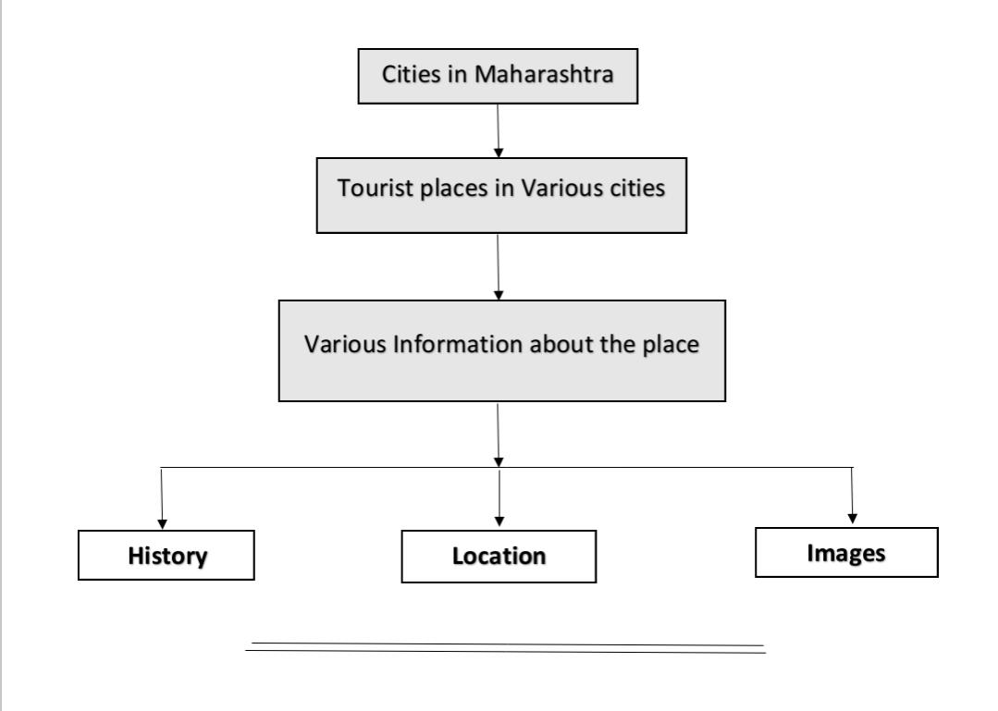
Structure of Project
8

Slide 9
Working Images of Website
9

Slide 10
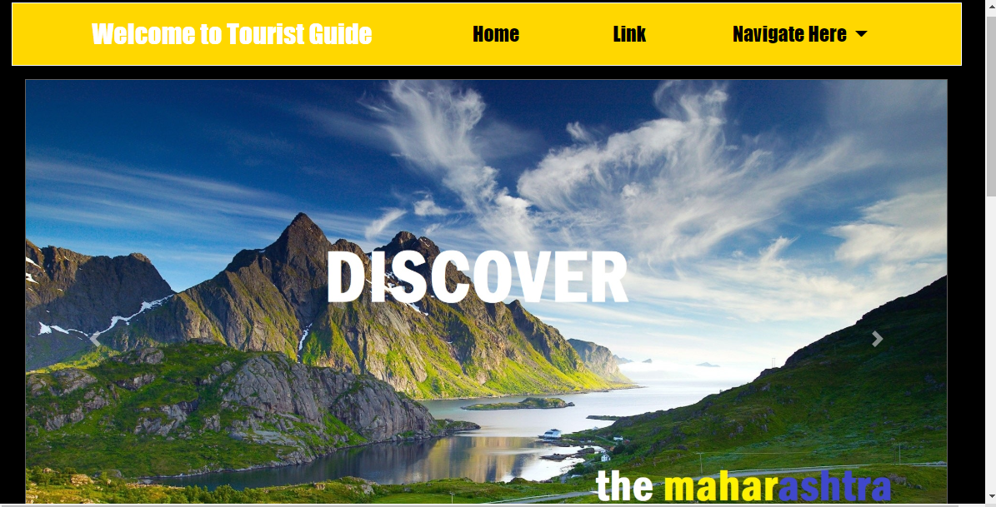
10

Slide 11
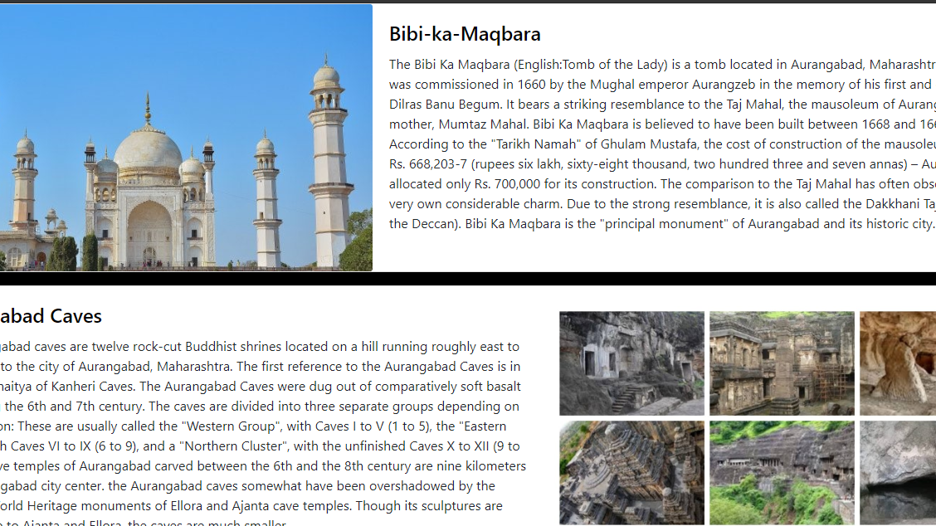
11

Slide 12
Conclusion and Future Scope
Conclusion
Tourism industry is important for the benefits it brings in country.
Due to its role as a commercial activity that creates demand and growth for many more industries.
Tourism not only contributes towards more economic activities but also generates a peace of mind.
Future Scope
We can add the 360-degree view of the tourist place with module and tags in HTML.
Highlighting the main information of the place the tourist will get to know how much that place is likely to be visited.
Further we can add the accommodation for the tourist according to their budgets.
12

Slide 13
Reference
https://en.wikipedia.org/
https://www.docsity.com/en/tours-and-travel-website/4233043/
www.youtbe.com
www.getbootstrap.com
13

Slide 14
°°Thank you°°

