Slide 1
Tourist Guide Webpage
( Software Development Project )

Slide 2
Profile
Name: Chetan Bhupendra Lohkare Div : K Roll No. : 20 Gr. No :11910486
• Guide name : Mugdha Gokhale Mam

Slide 3
Objective
To help Tourist ,when they visit at any place.
Give some information about that place.
Give Information about visit rout.
Awareness about that place and surrounding area.

Slide 4
About Project
First the customer visit our wewebsite. There are two options one is Search engine and another one like there are some pages below the search engine if they are click on the this page then they go directly at that information page which they need.
In this page we put some images of that tourist places which is useful for customer.
In information of that tourist places we give near about all information like open and close time, history, geography etc.

Slide 5
Technical requirements
HTML & CSS & Bootstrap
OPERATING SYSTEM: WINDOWS 10
Visual Studio Code(text editor).

Slide 6
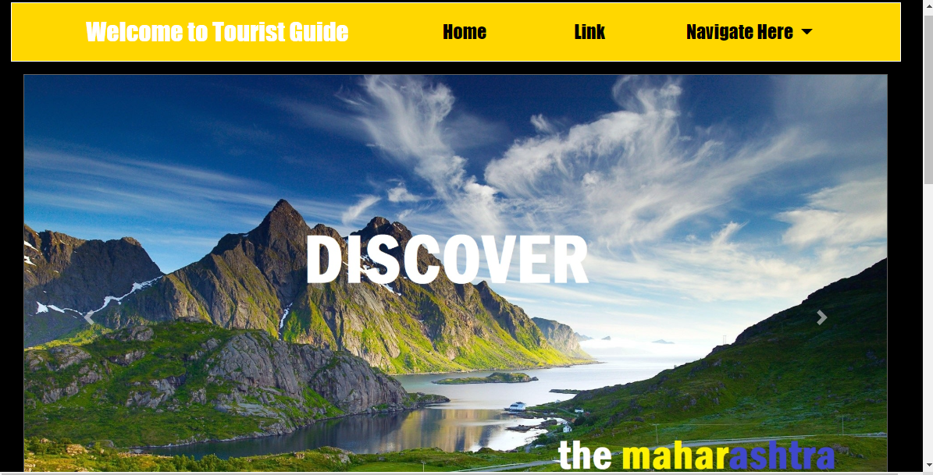

Slide 7
Abstract
Nearly everyone goes on a vacation and a Tourism management system would play a vital role in planning the perfect trip. The tourism management system allows the user of the system access all the details such as weather, location, events, etc. The main purpose is to help tourism companies to manage customer and hotels etc. The system can also be used for both professional and business trips. The proposed system maintains centralized repository to make necessary travel arrangements and to retrieve information easily.

Slide 8
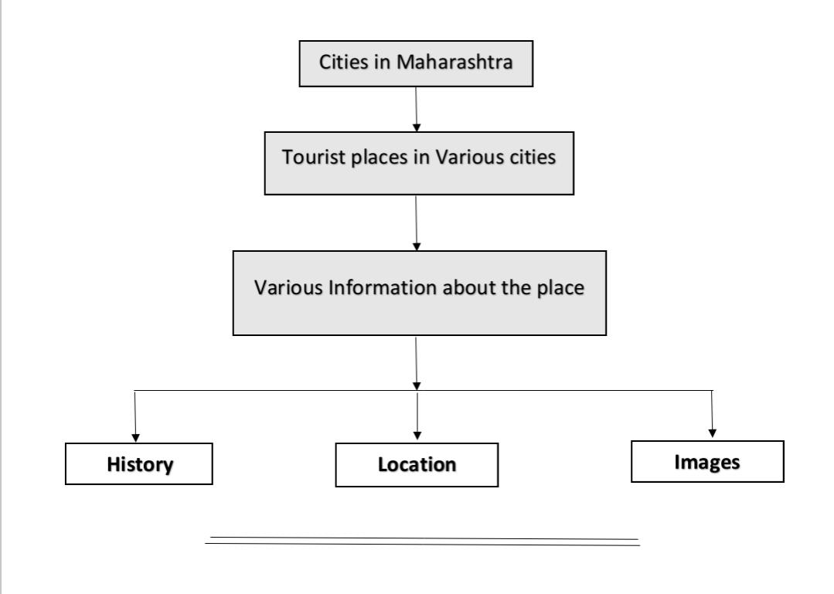
Structure

Slide 9
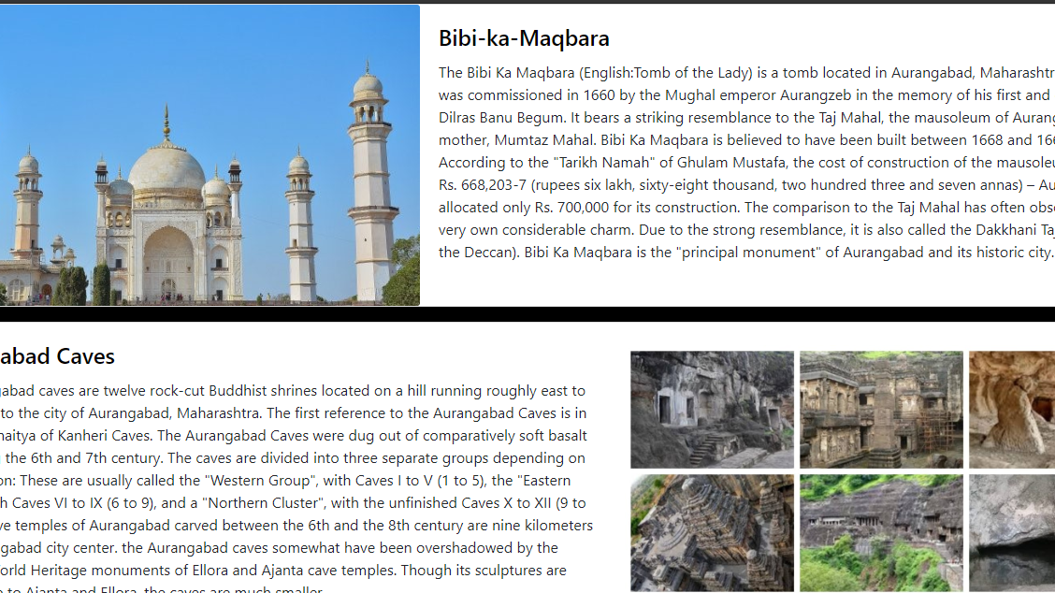

Slide 10
Literature review
The word cloud for the subtheme 'vision' is shown in the diagram in Figure -1, as an example of a word cloud. Mayring's (2003) approach for content analysis has been adopted that consists of four basic stages: data collection, descriptive analysis, category selection and material evaluation (Chang & Katrichis, 2016). In this vein, it has been observed that the strategies that have been developed to promote gastronomy tourism are comprised of four main components: the national, regional, local and sectoral. ...

Slide 11
Future scope
Tourism is considered to be an important aspect of economic growth and the development of a nation. According to the United Nations World Tourism Organization (UNWTO), global tourism is expected to reach 1.6 billion (in terms of international arrivals) by the year 2020. Tourism management is generally considered a bright and potential employment sector as it offers a wide variety of career opportunities in both the private and public sector. This article covers the details of tourism management courses and the prospective job opportunities that it can offer you.

Slide 12
Reference
https://en.wikipedia.org/
https://www.docsity.com/en/tours-and-travel-website/4233043/
www.youtbe.com
www.getbootstrap.com

Slide 13
°°Thank you°°

