Slide 1

A Study and Analysis of Air Quality Index In LockDown

Slide 2
The team
Chetan
Abhijnya
Snehith
S20190010129
chetanreddy.o19@iiits.in
S20190010172
abhijnya.t19@iiits.in
S20190010085
snehith.k19@iiits.in

Slide 3
The problem
The nationwide Janta Curfew on March 22, 2020 and lockdown since March 24, 2020, have resulted in significant improvement in air quality in the country, as revealed by data analysis and comparison of data for time before enforcement of restrictions. An analysis of data generated from continuous ambient air quality monitoring network and findings are summarized in this project.
20XX | 20XX | 20XX | 20XX

Slide 4

What is AQI ?

Slide 5
How to measure air Pollution levels in a City or Country?
Air quality monitors measure PM2.5 and PM10 concentrations in g/m3 • Local, regional, and national governments decide how to disseminate monitor measurements to the public. Preferred way to communicate is via a color-coded Air Quality Index (AQI) that is easy for the public to understand.

Slide 6
What is the Air Quality Index (AQI)?
Index for reporting air quality.
Color is key for communication.
Ranges from 0 to 500(Usually).
Provides indicator of the quality of the air and its health effects.

Slide 7
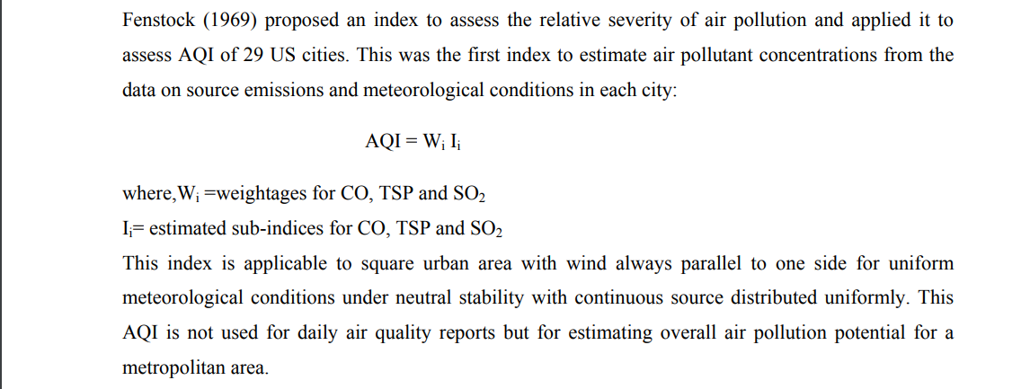
Fenstock Air Quality Index (AQI)

Slide 8
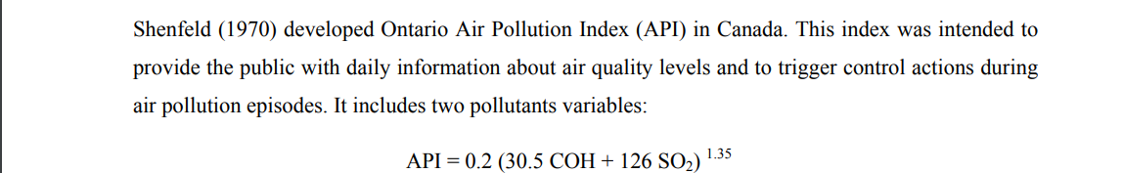
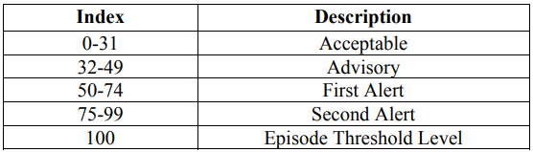
Ontario Air Pollution Index
Descriptor categories for Ontario API

Slide 9
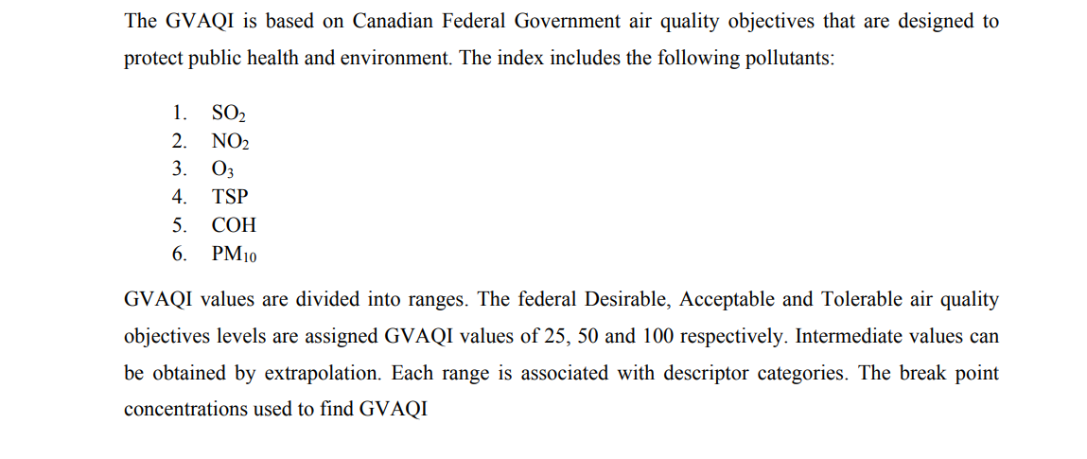
Greater Vancouver Air Quality Index (GVAQI)

Slide 10
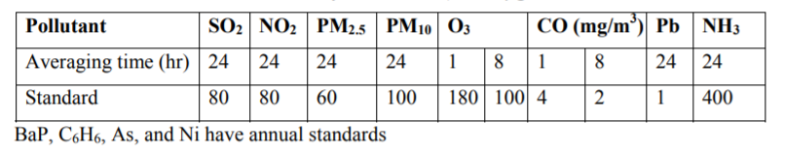
Indian Air Quality Index (IND-AQI)
Indian National Air Quality Standards (INAQS) for 12 parameters carbon monoxide (CO) nitrogen dioxide (NO2), sulphur dioxide (SO2), particulate matter (PM) of less than 2.5 microns size (PM2.5), PM of less than 10 microns size (PM10), Ozone (O3), Lead (Pb), Ammonia (NH3), Benzo(a)Pyrene (BaP), Benzene (C6H6), Arsenic (As), and Nickel (Ni). The first eight parameters have short-term (1/8/24 hrs) and annual standards (except for CO and O3) and rest four parameters have only annual standards.

Slide 11
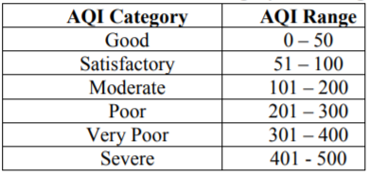
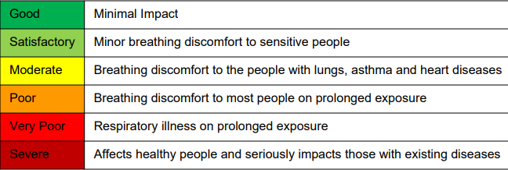
IND-AQI Category and Range

Slide 12
Possible Sources for NH₃
About 67% of ammonia sources is from Volcanic eruptions.
Other sources include combustion of fossil fuel (coal, heavy fuel oil in thermal power plants, office, factories).
Smelting of metals (sulfide ores to produce copper, lead and zinc).
Petroleum refining.
Combustion process in diesel, petrol, natural gas driven vehicles.

Slide 13
Effects of NH₃(Ammonia)
Inhalation of high levels of NH3 causes irritation to the nose, throat and respiratory tract.
Increased inhalation may result in cough and an increased respiratory rate as well as respiratory distress.
An association has been reported between exposure to ammonia and cough, phlegm, wheezing, and asthma at high concentration.

Slide 14
Breakpoint for NH₃
The study [link] has reported that for NH3 levels at 18 mg/m3 , reduction in FEV1 and FVC% were significant in symptomatic than asymptomatic individuals.
For a factor of safety as 10, concentration of 1800 µg/m3 should be considered to be severe in ambient air.
The other breakpoints for ammonia have been evolved on a linear scale from the level of 1800 µg/m3 to the standard concentration of 400 µg/m3 .

Slide 15
Effects of Pb(Lead)
Pb is a toxic metal and its exposure through all routes results in increased blood lead level. At lower concentrations, the blood lead level is proportional to air concentration.
The effect of blood level above 10µg/dL is seen in hematological changes in sensitive population

Slide 16
Breakpoint for Pb
For example, 1μg/m3 of annual lead level will result in 5µg/dL (on an average) of blood lead level (WHO 2000).
At moderate pollution level the break point is at 2µg/m3.
At 20µg/dL blood lead level the effects become more prominent and this corresponds to break point of 4 µg/m3 but to account for factor of safety, next break point is kept at 3.0 µg/m3.
If the lead concentration in air is more than 3.5 µg/m3 the AQI category will be severe..

Slide 17
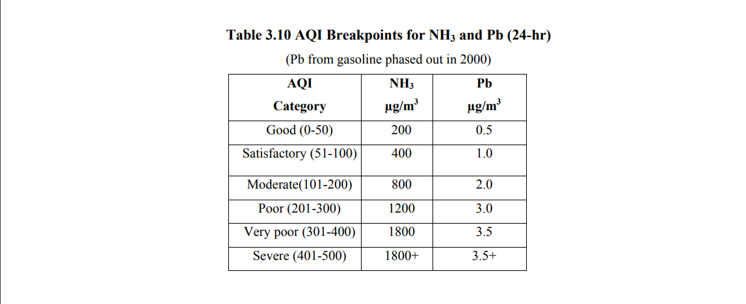
Breakpoints for NH₃ and Pb

Slide 18
Possible sources of Particulate matter(PM10 and PM2.5)
PM- extremely small solid particles and liquid droplets suspended in air.
Made up of variety components including nitrates,sulphates,organic,chemical metals, soil or dust particles.
Motor vehicles, wood burning heaters and industry.
During bush fires or dust storms, particle pollution can reach extremely high concentrations.

Slide 19
Effects of Particulate Matter
Short term exposure can lead to:
Irritated eyes,nose and throat
Worsening asthma and lung disease such as chronic bronchitis.
Heart attacks and arrhythmias
Long term exposure can lead to:
Reduced lung function
Development of cardiovascular and respiratory diseases
Reduction of life expectancy.

Slide 20
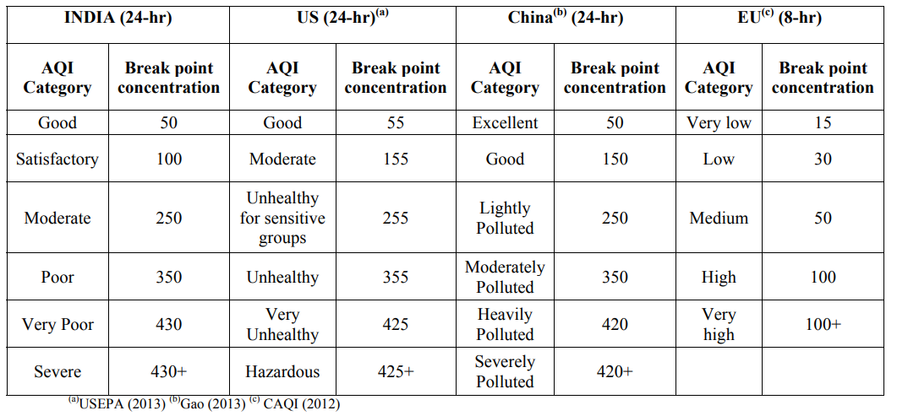
Breakpoints for PM₁₀ (μg/m3 )

Slide 21
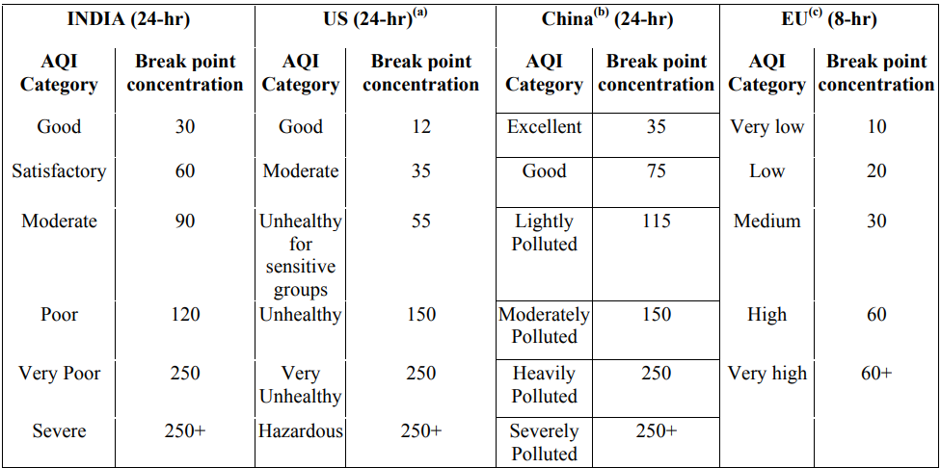
Breakpoints for PM₂.₅ (μg/m3 )

Slide 22
Possible sources of O3
Product of interaction between sunlight and emissions from sources such as motor vehicles and industry.
Formed during summer months and reaches its highest concentrations in the afternoons or early evening.
Majority of ground level ozone is the result of man made VOC and NOx.
Chemical plants,gasoline pumps, oil-based plants, autobody shops and print shops.

Slide 23
Effects of O3
Irritation and inflammation of eyes ,throat, nose and lower airways.
Reduced lung function
COPD
Increased susceptibility to respiratory infections
Can continue to damage lungs when symptoms have disappeared

Slide 24
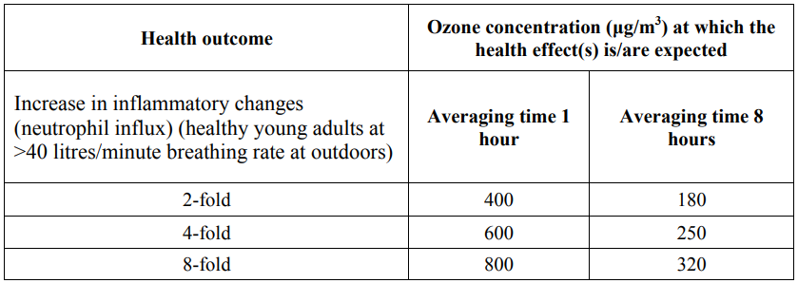
Breakpoint

Slide 25
Possible Sources of NO2
Highly reactive gas
Emissions from motor vehicles, industry, unflued gas-heaters and gas stoves
Found near busy roads and indoors where unflued gas-heaters are in use
Indoor sources - cigarette smoke or cooking with gas
Outdoors, NO2 contributes to the formation of ground level O3 as well as PM.

Slide 26
Effects of NO2
Nitrogen dioxide is respiratory irritant and has variety of adverse health effects on the respiratory system
Increased susceptibility to lung infections in people with asthma
Increased susceptibility to asthma triggers like pollen and exercise
Worsened symptoms of asthma- more frequent asthma attacks
Airway inflammation in healthy people

Slide 27
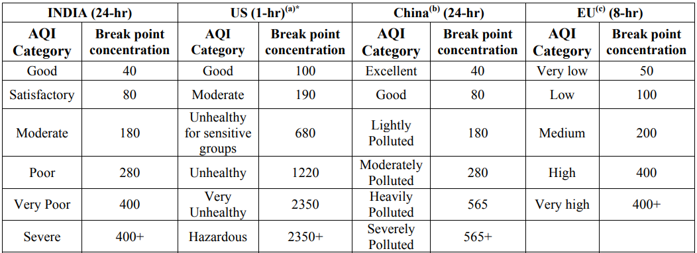
Breakpoint

Slide 28
Possible sources of Carbon Monoxide(CO)
CO forms when the carbon in the fuels doesn’t completely burn
Motor vehicles , industry and bushfires
Indoors:Unflued gas heaters, wood burning heaters, and contained in cigarette smoke.
Levels are high during coldest weather, because cold temepartures make combustion less complete and traps pollutatants close to the ground.

Slide 29
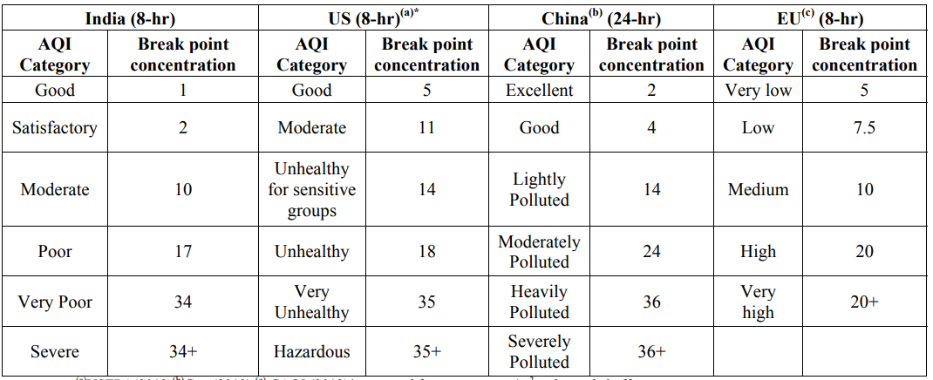
Effects of CO

Slide 30
Other Pollutants
Benzene (C6H6) Benzene is a colorless, sweet smelling liquid. Usual sources are from combustion of fuel, coke oven, glues, paints, furniture wax, and detergents.
Benzene is Hematotoxic, neurotoxic, leukemogenic and even has carcinogenic effects.
Chronic exposure to benzene may cause chromosomal damage, immune suppression.

Slide 31
Other Pollutants
Polyaromatic hydrocarbons (BaP) (particulate phase only) is a five-ring polycyclic aromatic hydrocarbon whose metabolites are mutagenic and highly carcinogenic.
Common sources are combustion of natural gas, Road transport, automobile exhaust fumes.
Mutagenic and highly carcinogenic.
May cause skin, lung, and bladder cancer.

Slide 32
Other Pollutants
Arsenic (As) is a solid layered, a ruffled analogue of graphite, metallic gray in color and is a semiconductor.
Common sources include volcanic ash, weathering of the arsenic containing mineral and ores as well as groundwater.
Causes epigenetic changes, multi-system organ failure.

Slide 33
Other Pollutants
Nickil (Ni) a silvery-white lustrous corrosion resistant metal with a slight golden tinge.
Combustion of fossil fuels, Nickel plating, Metallurgical processes.
Nickel sulfide fume and dust is believed to be carcinogenic.
Causes allergy, dermatitis. Sensitivity to nickel may also be present in patients with pompholyx.

Slide 34
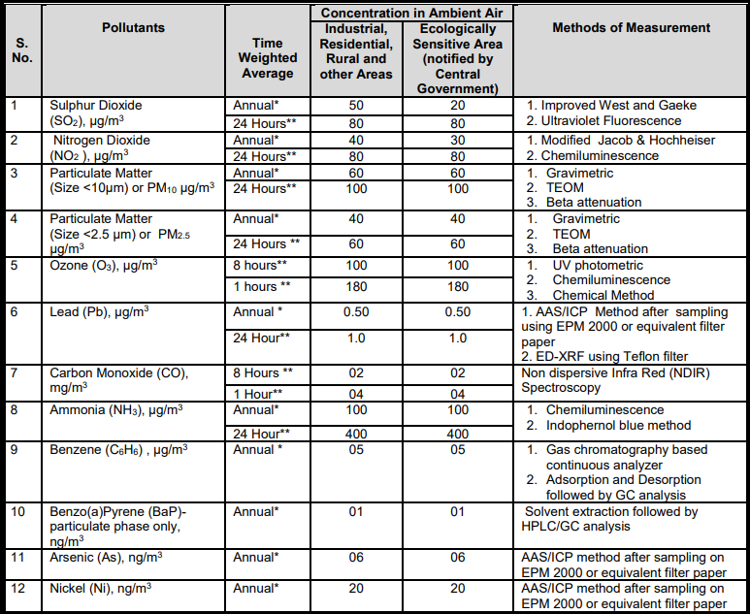

Slide 35
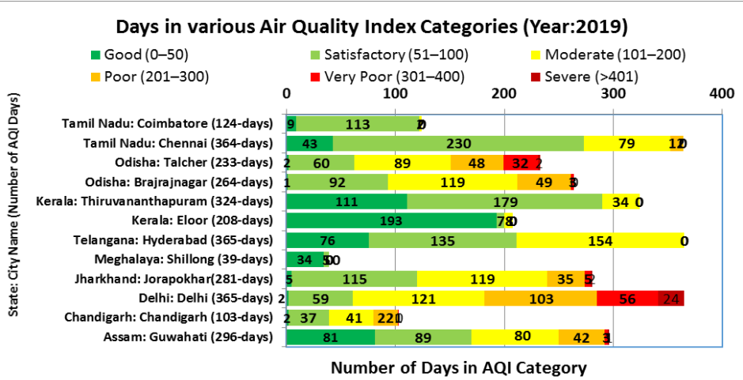

Slide 36

Data Collection
For this project we are using data from Central Pollution Control Board’s (CPCB)
AQI Bulletin data summary.

Slide 37
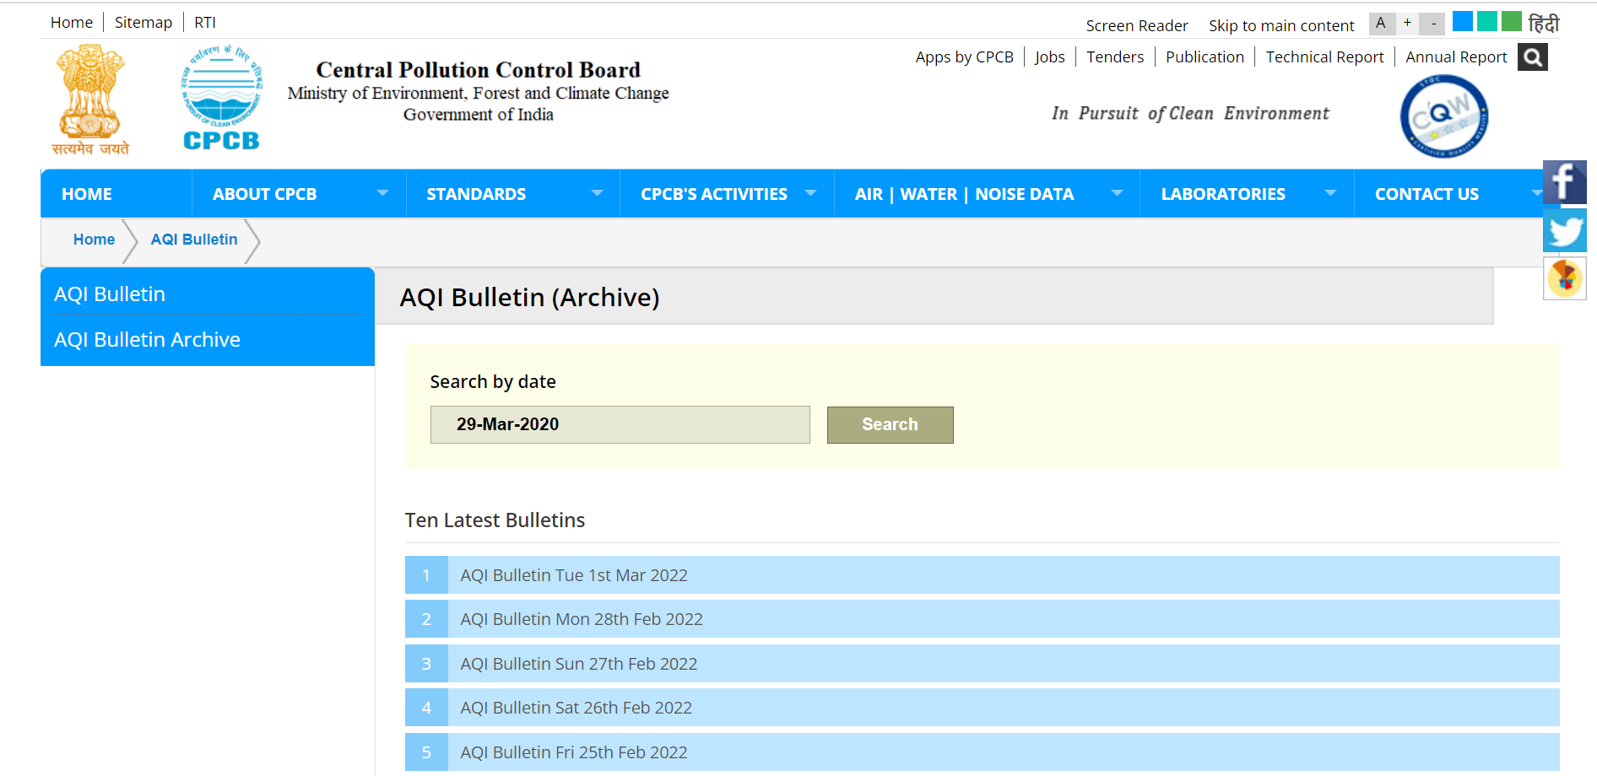

Slide 38
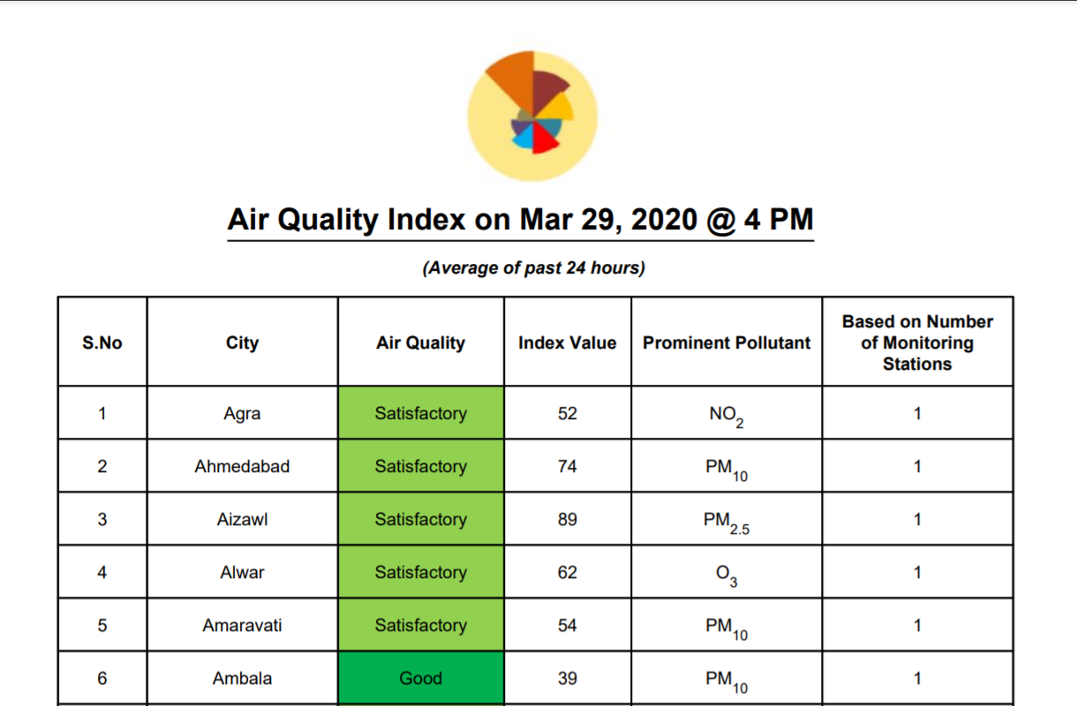

Slide 39
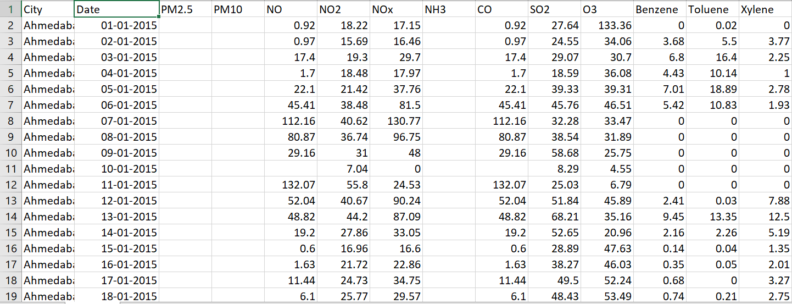
Sample Data

Slide 40
Appendix
https://cpcb.nic.in/AQI_Bulletin.php
https://cpcb.nic.in/upload/Downloads/AQI_Bulletin_20200329.pdf
https://app.cpcbccr.com/ccr_docs/FINAL-REPORT_AQI_.pdf
https://cpcb.nic.in/upload/NAAQS_2019.pdf
https://www.gov.uk/government/publications/ammonia-properties-incident-management-and-toxicology

