Slide 1

Data Visualization: Empowering Business with Effective Insights
Forage Internship
Chetan Chowdhari

Slide 2

Data Visualization: Empowering Business with Effective Insights
Forage Internship
Chetan Chowdhari

Slide 3
Task One
Task 1: Framing the Business Scenario
Create a set of four questions that you anticipate each business leader will ask and want
to know the answers to.
Make sure you differentiate your questions, as both the CEO and CMO view business
decisions through different lenses.

Slide 4
CEO What is our total revenue (Quantity × UnitPrice) and invoice count by Country and by StockCode for the past two quarters? On which InvoiceDate(s) did we experience the largest deviations in revenue or Quantity sold for our top 10 StockCodes, and can those be tied to specific CustomerID cohorts or promotional events? Based on historical daily sales (InvoiceDate + Quantity) and seasonality trends, what revenue and volume do we forecast for our three highest-performing product categories over the next quarter? Which Countries and StockCodes should we prioritize for additional warehouse capacity or supplier agreements—given forecasted demand, current inventory turnover rates, and per-unit profitability? CMO How many unique customers (CustomerID) did we acquire last quarter in each Country, and what was their average order value (Quantity × UnitPrice)? Which customer cohorts (e.g., by acquisition month or region) have the highest and lowest repeat-purchase rates, and are those differences linked to product mix (StockCode) or price sensitivity? Using past purchase frequency and average order value by CustomerID and Description (product), which customer segments are most likely to generate incremental revenue in the next two months? Which high-value customer cohorts and StockCodes should we target with personalized promotions or bundled offers—based on their historical UnitPrice elasticity and forecasted demand—to maximize incremental ROI?

Slide 5
Task Two
Task 2: Choosing the Right Visuals
Task 2: Choosing the Right Visuals
In this task, you will be required to read the questions carefully and understand that business requirement.
Once you have an idea of what is required from the perspective of the CEO and CMO,
you will need to come up with the perfect visual which will illustrate what the senior managers
are looking for in each scenario. Remember, data can be presented in multiple types of charts,
but you are required to select the visual that would best display the information which is being presented.

Slide 6
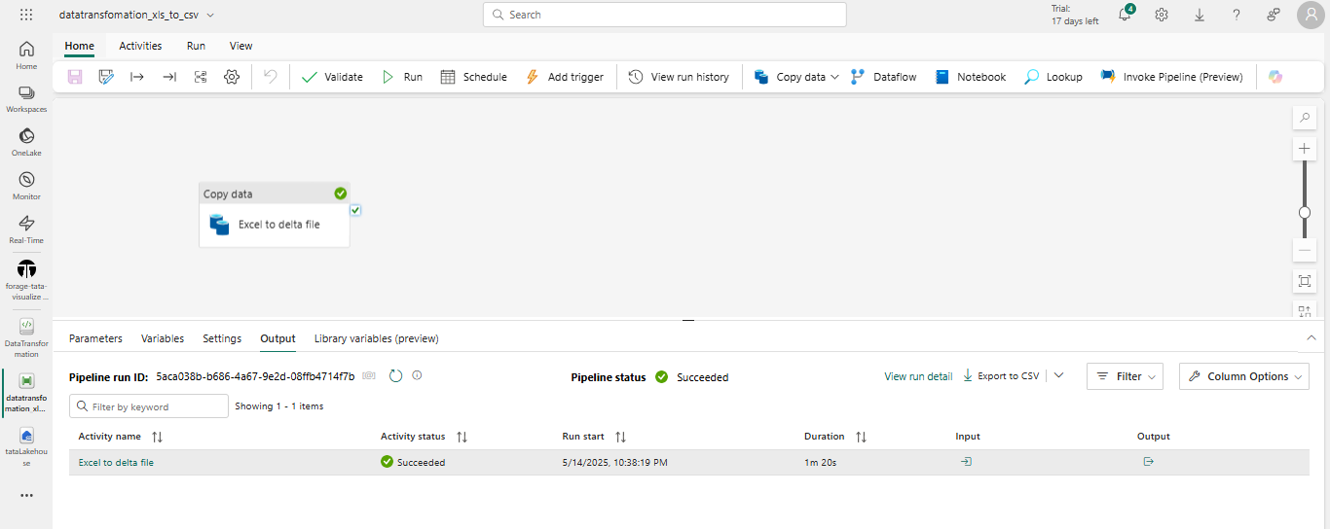
Data Factory – EXCEL TO DELTA FILE

Slide 7
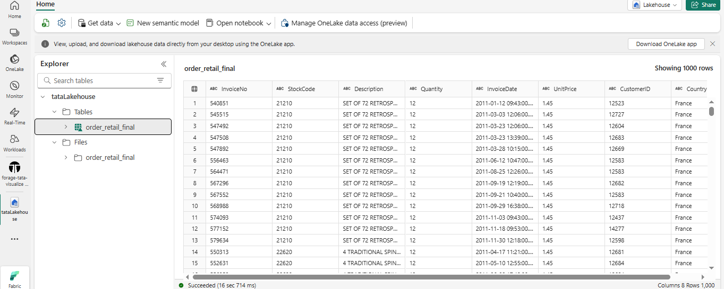
Create a check that the quantity should not be below 1 unit
Data Transformation
Create a check that the Unit price should not be below $0

Slide 8
Task Three
Task 3: Creating Effective Visuals
Task 3: Creating Effective Visuals
Create a set of four questions that you anticipate each business leader will ask and want
to know the answers to.
Make sure you differentiate your questions, as both the CEO and CMO view business
decisions through different lenses.

Slide 9
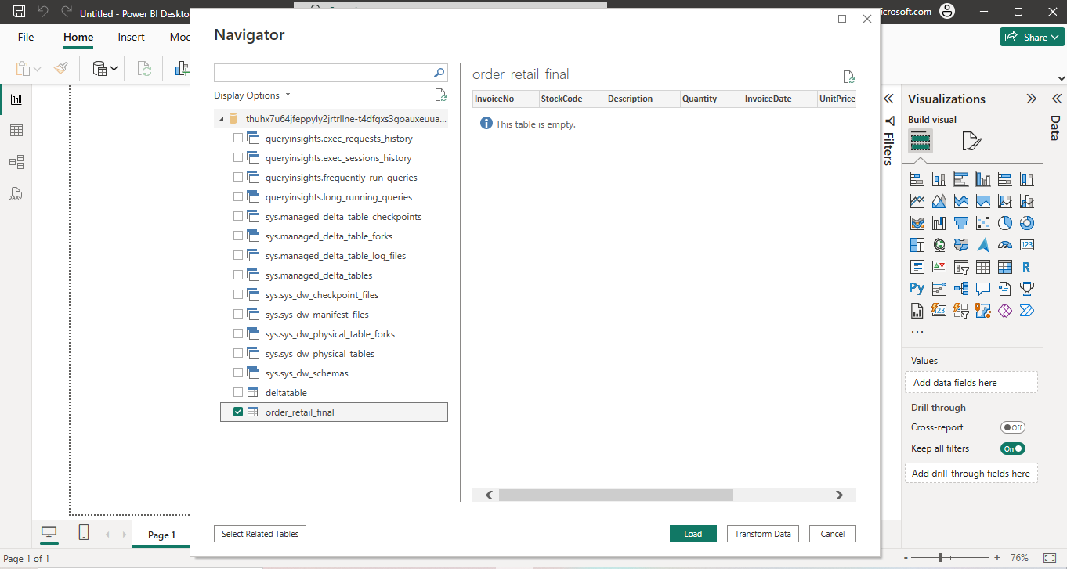
Loading data from Warehouse to Power BI

Slide 10
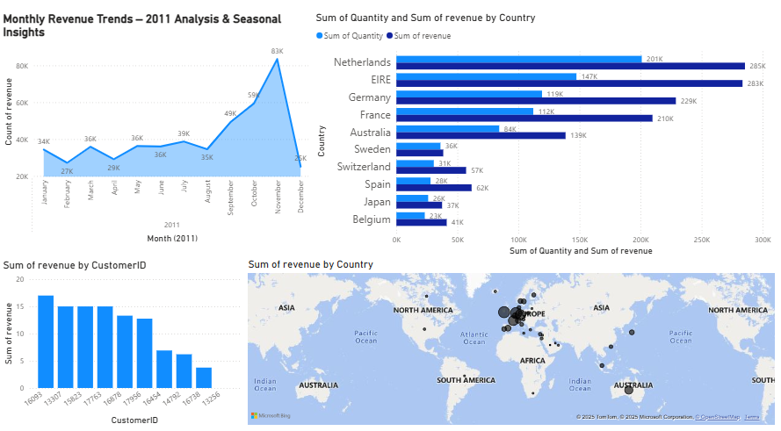

Slide 11
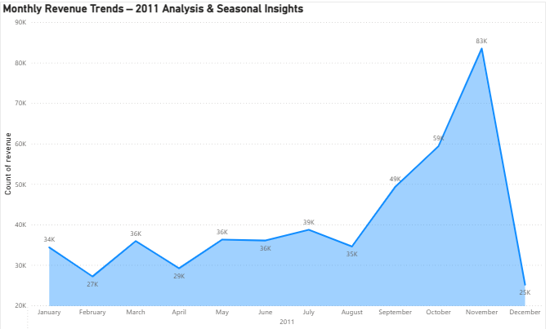
Question 1 The CEO of the retail store is interested to view the time series of the revenue data for the year 2011 only. He would like to view granular data by looking into revenue for each month. The CEO is interested in viewing the seasonal trends and wants to dig deeper into why these trends occur. This analysis will be helpful for the CEO to forecast for the next year. Answer :-

Slide 12
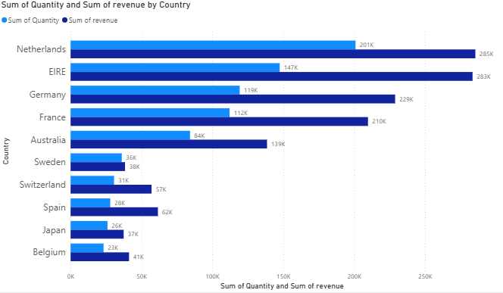
Question 2 The CMO is interested in viewing the top 10 countries which are generating the highest revenue. Additionally, the CMO is also interested in viewing the quantity sold along with the revenue generated. The CMO does not want to have the United Kingdom in this visual. Answer :-

Slide 13
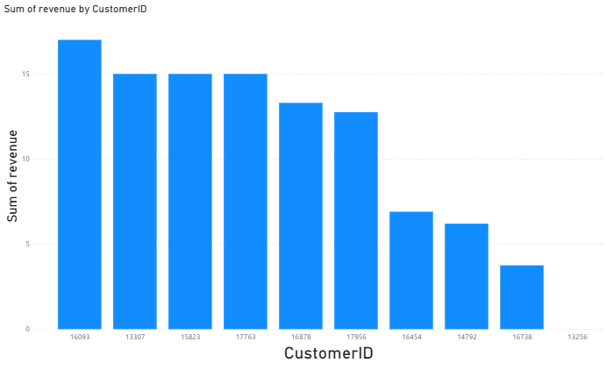
Question 3 The CMO of the online retail store wants to view the information on the top 10 customers by revenue. He is interested in a visual that shows the greatest revenue generating customer at the start and gradually declines to the lower revenue generating customers. The CMO wants to target the higher revenue generating customers and ensure that they remain satisfied with their products. Answer :-

Slide 14
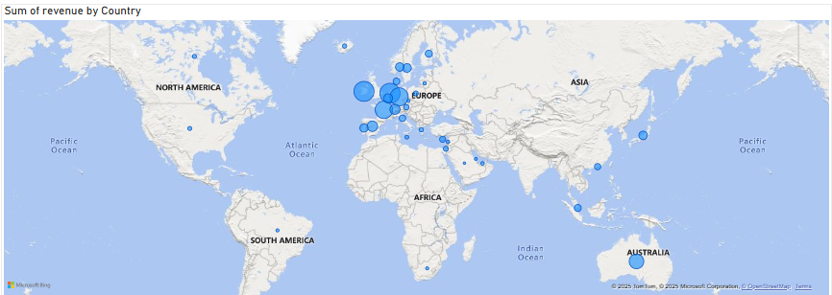
Question 4 The CEO is looking to gain insights on the demand for their products. He wants to look at all countries and see which regions have the greatest demand for their products. Once the CEO gets an idea of the regions that have high demand, he will initiate an expansion strategy which will allow the company to target these areas and generate more business from these regions. He wants to view the entire data on a single view without the need to scroll or hover over the data points to identify the demand. There is no need to show data for the United Kingdom as the CEO is more interested in viewing the countries that have expansion opportunities. Answer :-

Slide 15
Task Three
Task 3: Creating Effective Visuals
Task 4: Communicating Insights and
Analysis

Slide 16
Key Business Recommendations for CEO & CMO
✅ Expand into high-demand regions—Target countries with strong product demand beyond the UK. ✅ Strengthen top customer relationships—Ensure high-revenue customers remain satisfied. ✅ Optimize inventory based on seasonal trends—Adjust supply chain to match peak demand periods. ✅ Leverage insights for regional marketing strategies—Invest in localized campaigns for maximum impact. ✅ Monitor revenue growth and adjust strategy—Use data-driven decision-making for expansion planning.

