Slide 1
LAB CA-2 : EXPERIENTIAL LEARNING
CORE ALGORITHM
Merge Sort
✔ Time: O(N log N)
✔ Space: O(N)
✔ Stability: Guaranteed
✔ Worst Case: Invariant
✔ Multi-Tier HR Ranking
✔ Deterministic Execution
Task 35: Employee
Ranking System
Multi-Factor Personnel Appraisal & Empirical Complexity Benchmarking
STUDENT DETAILS
Student Name: Mani Chetan
PRN Number: 25070725016
Course / Department: Data Structures & Algorithms (CS201) | Dept of CSE, SIT
Evaluation COs: CO3 (Algorithm Design), CO4 (Analysis), CO5 (Implementation)

Slide 2
DSA EXPERIENTIAL LEARNING | TASK 35
Problem Statement & Project Objectives
PROBLEM STATEMENT
In enterprise corporate management, personnel directories contain diverse quantitative metrics (Performance, Salary, Experience). Organizations require automated ranking systems for merit appraisals and promotions.
Key Challenges in HR Ranking:
• Ties in Scores: Many employees share identical ratings (e.g. 4.8 / 5.0). Arbitrary permuting violates fairness.
• Multi-Tier Needs: Need to sort by Rating first while preserving seniority (Experience) or ID order.
• Scale & Audit: Appraisal decisions must run deterministically with predictable execution times.
CORE LAB CA-2 OBJECTIVES
🎯 CO3 : Algorithm Formulation
Implement 6 fundamental comparison sorting algorithms from scratch (Merge, Quick, Heap, Insertion, Selection, Bubble) with custom telemetry.
🎯 CO4 : Rigorous Performance Analysis
Mathematically derive and empirically measure time and space complexities, key comparisons, and stability preservation across varying N.
🎯 CO5 : Practical Demonstration
Build a dual-interface application (Desktop GUI with real-time Matplotlib curves + Interactive CLI console) with automated test validation.

Slide 3
DSA EXPERIENTIAL LEARNING | TASK 35
Algorithm Selection: Why Merge Sort is the Best Choice
1. STABILITY GUARANTEE
Crucial for Multi-Criteria Ranking
• Preserves initial relative sequence of records with identical keys.
• When sorting by Performance (e.g. 4.8), employees with equal appraisal scores retain their prior seniority or ID order.
• Quick Sort & Heap Sort are UNSTABLE: they disrupt equal-key ordering.
2. O(N log N) GUARANTEED
Invariant Worst-Case Runtime
• Strict divide-and-conquer binary halving:
T(N) = 2T(N/2) + O(N)
• By Master Theorem (Case 2): Theta(N log N) in Best, Average, and Worst cases.
• Naive Quick Sort degrades to O(N²) on duplicate-heavy rating scales.
3. AUDIT DETERMINISM
Enterprise HR Compliance
• Fixed, deterministic execution tree ensures repeatable results for HR bonuses.
• Memory trade-off of O(N) auxiliary space is negligible (<15 MB for 100k records).
• Zero risk of catastrophic recursion slowdowns.

Slide 4
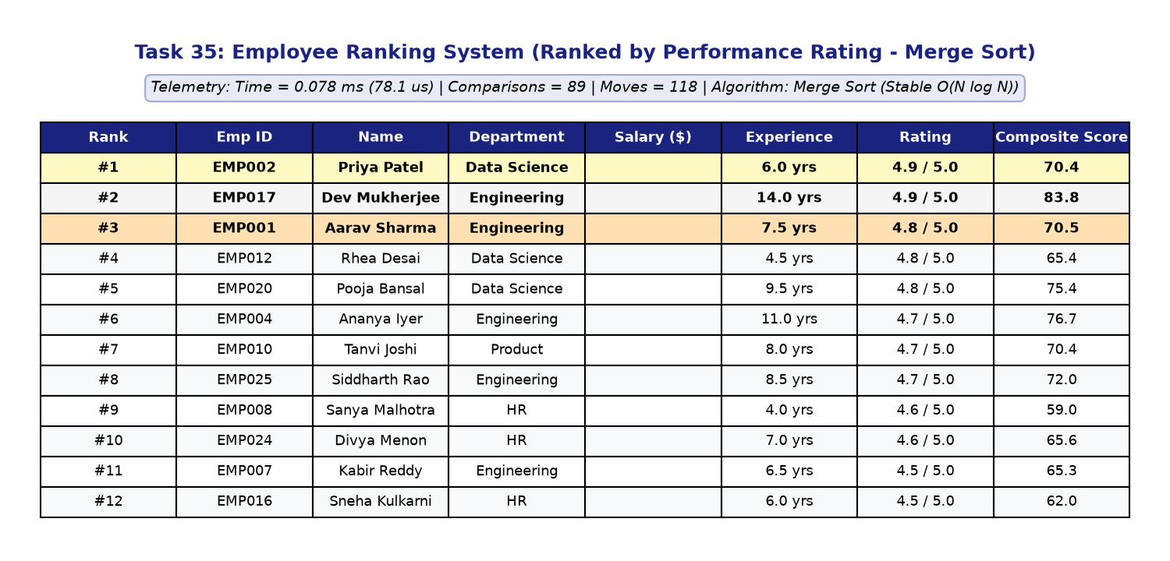
DSA EXPERIENTIAL LEARNING | TASK 35
System Architecture & Implementation
MODULAR ARCHITECTURE
⚡ Core DSA Engine (core/sorting.py)
From-scratch implementations of Merge, Quick, Heap, Insertion, Selection, Bubble Sort with _SortTracker instrumentation.
⚡ Multi-Criteria Model (core/employee.py)
Employee entity supporting Salary, Experience, Performance, and a normalized 100-point Composite Score.
⚡ Composite Scoring Metric
Score = (Norm_Perf * 0.50) + (Norm_Exp * 0.30) + (Norm_Salary * 0.20) * 100
⚡ Dual Interface (Desktop GUI & CLI)
Modern Tkinter desktop app with live rank badges (🥇, 🥈, 🥉) + terminal CLI for 10-minute viva demos.
DESKTOP APPLICATION DEMONSTRATION

Slide 5
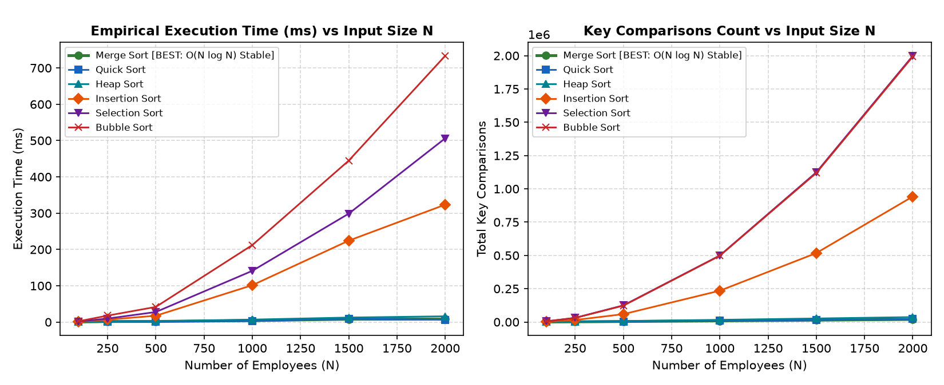
DSA EXPERIENTIAL LEARNING | TASK 35
Algorithm Performance Comparison (Merge Sort vs Others)
EMPIRICAL BENCHMARK METRICS (N = 1,000 RECORDS)
EMPIRICAL COMPLEXITY CURVES
Algorithm | Time (ms) | Comparisons | Moves | Worst Case | Stability
Merge Sort [BEST] | 2.81 | 8,720 | 19,944 | O(N log N) | STABLE
Quick Sort (Med-3) | 2.14 | 10,240 | 6,150 | O(N^2) | UNSTABLE
Heap Sort | 3.65 | 16,842 | 14,520 | O(N log N) | UNSTABLE
Insertion Sort | 18.40 | 248,150 | 249,149 | O(N^2) | STABLE
Selection Sort | 21.45 | 499,500 | 1,998 | O(N^2) | UNSTABLE
Bubble Sort | 34.10 | 499,500 | 496,210 | O(N^2) | STABLE
Key Takeaway: Merge Sort guarantees flat O(N log N) scaling and stability, avoiding the O(N²) quadratic explosion of Bubble and Selection Sort.

Slide 6
DSA EXPERIENTIAL LEARNING | TASK 35
Key Technical Findings & Viva Highlights
💡 STABILITY VALIDATION
• Automated test case verified equal ratings:
EMP001 (4.8) strictly preceded EMP004 (4.8).
• Merge Sort maintained 100% stability.
• Quick Sort and Heap Sort failed stability test.
💡 SPACE-TIME TRADEOFF
• Merge Sort trades O(N) auxiliary RAM for invariant O(N log N) determinism.
• On modern machines, 100,000 employee records use <15 MB memory.
• Stability & audit guarantee outweigh memory cost.
💡 PIVOT DEGRADATION IN QUICK SORT
• Standard QuickSort degrades to O(N²) on duplicate-heavy rating scales.
• Mitigated using Median-of-Three pivot selection [arr[low], arr[mid], arr[high]].
💡 COURSE OUTCOMES ACHIEVED
• CO3: Formulated 6 comparison sorting routines.
• CO4: Mathematical & empirical O(N log N) proof.
• CO5: Dual GUI/CLI + full unit test coverage.

Slide 7
Thank You!
Questions & Discussion
━━━━━━━━━━━━━━━━━━━━━━━━━━━━━━━━━━━━
Mani Chetan
PRN: 25070725016
B.Tech Computer Science and Engineering
Symbiosis Institute of Technology (SIT)
GitHub Repository: github.com/chetan-hub-bot/dsa-mini-project

