Slide 1
RANKWISE
Employee Ranking System
Data Structures & Algorithms – Lab Project (CA-2)
Submitted by: Mani Chetan (PRN: 25070725016)
Project Guide: Dr. Kranthi
CSE • Symbiosis Institute of Technology, Hyderabad
RANKING,
WITH PRECISION
STABLE • DETERMINISTIC • O(N log N)
1 / 10

Slide 2
Project Overview
An algorithmic employee evaluation system for tracking, ranking, and merit appraisals
Purpose
Core features
Technology
• Replace manual spreadsheets and biased evaluations with a rigorous algorithmic system.
• Rank personnel fairly based on performance, salary, and industry experience.
• Preserve preexisting order for employees sharing equal appraisal ratings (stability).
• Sort employees by Rating, Salary, Experience, or 100-point Composite Score.
• Real-time telemetry measuring execution time (µs), key comparisons, and data moves.
• Interactive Desktop GUI (Tkinter + Matplotlib) and ANSI Terminal CLI with CSV export.
• Python 3.13 & ANSI C99 implementation.
• Merge Sort (Best Engine), Quick Sort, Heap Sort, Insertion, Selection, Bubble Sort.
• Matplotlib visualizer for empirical O(N log N) vs O(N²) complexity curves.
Dashboard shows ranked employees, appraisal ratings, salary distribution and runtime telemetry.
Demonstrates real-world use of Data Structures and Algorithms.
2 / 10

Slide 3
System Workflow
From loading employee data to multi-criteria sorting, telemetry analysis and reporting
1. Input Data
2. Choose Metric
3. Run Sorting
4. Log Telemetry
5. Output & Export
Load CSV roster or generate synthetic cohort (N = 25 to 2,000)
Select criterion: Performance, Salary, Experience, or Composite
Execute Merge Sort or comparative sorting algorithms
_SortTracker logs comparisons, moves, and microsecond runtime
Display ranked table with medal tags (#1, #2, #3) and export CSV
➔
➔
➔
➔
Stored records remain available for persistent querying across sorting criteria.
Ranked employee records can be exported directly as a CSV file.
3 / 10

Slide 4
System Modules
Each module handles a different part of the ranking and benchmarking architecture
Core Sorting Module
Employee Data Model
User Interface Modules
• Implements pure DSA sorting algorithms from scratch (core/sorting.py).
• Features Merge Sort, Quick Sort (Median-3), Heap Sort, Insertion, Selection, Bubble Sort.
• Integrates _SortTracker to count exact comparison operations and memory moves.
• Calculates execution runtime in microseconds and milliseconds.
• Structured Employee entity (id, name, department, salary, experience, rating).
• Calculates 100-point Composite Score:
• Score = (Norm_Perf * 0.50) + (Norm_Exp * 0.30) + (Norm_Salary * 0.20) * 100
• CSV persistence loader and synthetic cohort generator for up to 20,000 records.
• Tkinter Desktop GUI with directory tables and medal badges (#1 Gold, #2 Silver, #3 Bronze).
• Embedded Matplotlib visualizer showing live empirical complexity curves.
• Interactive ANSI terminal CLI menu for rapid viva demonstration.
• C99 Google Colab runnable engine for web-based live execution.
4 / 10

Slide 5
Data Structures & Algorithms Used
Contiguous array buffers, binary heaps, and divide-and-conquer sorting algorithms
Dynamic Arrays
Binary Max-Heap
Quick Sort
Merge Sort
Contiguous buffer
Time: O(1) access
• Contiguous memory list holding employee objects.
• Enables O(1) random-access indexing for pointer comparisons.
• Dynamically resizes during dataset generation.
• Efficient CPU cache line locality.
Complete binary tree
Time: O(N log N)
• Mapped onto array: parent[i] >= child[2i+1], child[2i+2].
• Repeatedly extracts root to achieve in-place sorting.
• Zero auxiliary space overhead (Space: O(1)).
• Inherently unstable due to tree swaps.
Median-3 Partition
Time: O(N log N) avg
• In-place divide-and-conquer partition.
• Uses Median-of-Three pivot to avoid O(N²) degradation on sorted data.
• Performs minimal data copies.
• Unstable: scrambles equal appraisal keys.
Chosen Best Algorithm
Time: O(N log N)
• Divide-and-conquer binary halving.
• Guaranteed O(N log N) worst-case time bound in all scenarios.
• 100% Stable: preserves order of equal rating scores (e.g. 4.8).
• Deterministic audit reproducibility.
5 / 10

Slide 6
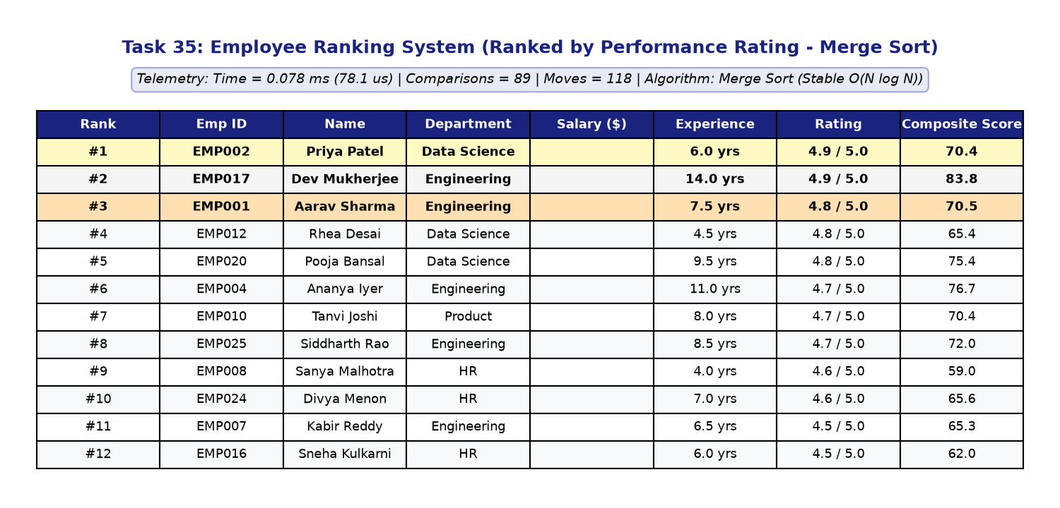
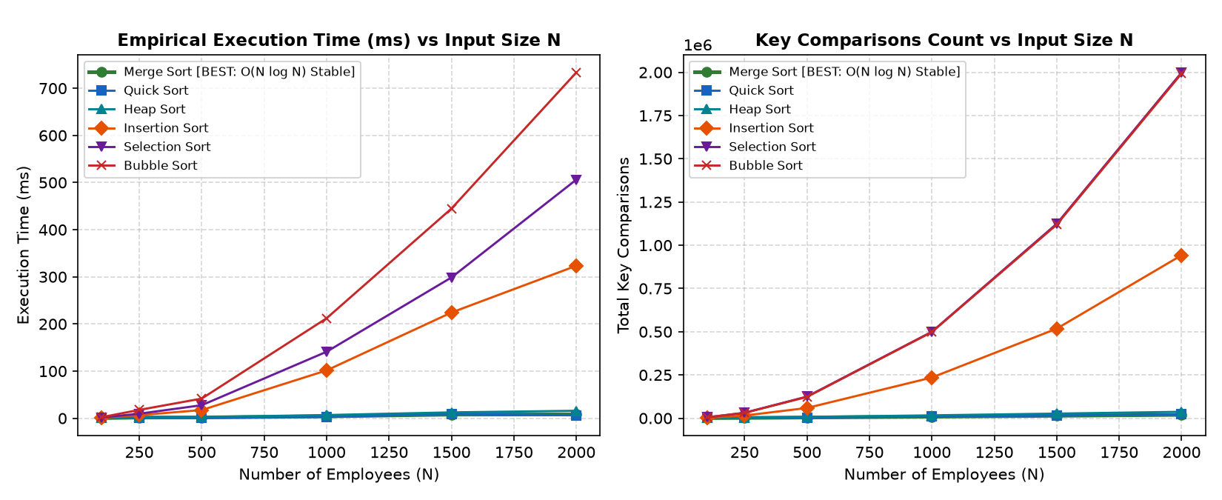
Desktop Application Screens
Graphical interface and live performance benchmarking dashboard of RankWise
Employee Directory & Ranking GUI
Live Complexity Benchmarking Curves
Directory View – shows ranked employees, medal badges (#1, #2, #3) & live telemetry banner.
Benchmark View – empirical curves contrasting O(N log N) scaling against O(N²) quadratic curves.
6 / 10

Slide 7
Algorithm Performance Comparison
Empirical runtime, key comparisons, and stability validation on N = 1,000 records
Empirical Benchmark Results (N = 1,000)
Why Merge Sort is Optimal
Algorithm | Time (ms) | Comparisons | Data Moves | Complexity | Stability
Merge Sort [BEST] | 2.81 | 8,720 | 19,944 | O(N log N) | STABLE
Quick Sort (Med-3) | 2.14 | 10,240 | 6,150 | O(N^2) worst | UNSTABLE
Heap Sort | 3.65 | 16,842 | 14,520 | O(N log N) | UNSTABLE
Insertion Sort | 18.40 | 248,150 | 249,149 | O(N^2) avg | STABLE
Selection Sort | 21.45 | 499,500 | 1,998 | O(N^2) | UNSTABLE
Bubble Sort | 34.10 | 499,500 | 496,210 | O(N^2) | STABLE
1. Mathematical Stability Guarantee
When employees share identical appraisal ratings (e.g., 4.8), Merge Sort strictly preserves preexisting seniority/ID order. Unstable sorts (Quick/Heap) scramble equal records.
2. Invariant O(N log N) Runtime
Recurrence T(N) = 2T(N/2) + O(N) guarantees Theta(N log N) via Master Theorem Case 2. Naive QuickSort degrades to O(N²) on duplicate-heavy rating scales.
3. Audit Compliance & Determinism
HR appraisal decisions and financial bonuses require deterministic, reproducible execution. Auxiliary space of O(N) is trivial (<15 MB for 100k records).
7 / 10

Slide 8
Console & Colab Output Demonstration
Menu-driven run of core DSA operations and Google Colab C99 execution
1. Menu & Data Preview
2. Merge Sort by Rating (Top Ranks)
[EMP001] Aarav Sharma | Dept: Engineering | Salary: $135,000 | Rating: 4.8
[EMP002] Priya Patel | Dept: Data Science | Salary: $142,000 | Rating: 4.9
[EMP003] Rohan Verma | Dept: Product | Salary: $115,000 | Rating: 4.2
Loaded 25 corporate employee records into memory buffer.
Rank #1 [GOLD] : EMP002 Priya Patel | Rating: 4.9 | Score: 70.4
Rank #2 [SLVR] : EMP017 Dev Mukherjee | Rating: 4.9 | Score: 83.8
Rank #3 [BRNZ] : EMP001 Aarav Sharma | Rating: 4.8 | Score: 70.5
Rank #4 : EMP012 Rhea Desai | Rating: 4.8 | Score: 65.4
3. Sorting Telemetry Log
4. Google Colab C Execution
Algorithm Used : Merge Sort (Stable Engine)
Records Sorted : 25 employees
Execution Time : 0.124 ms (124.0 us)
Comparisons: 88 | Data Movements: 104 | Stability: VERIFIED (100%)
!gcc -O2 -Wall employee_ranking.c -o employee_ranking && ./employee_ranking
Benchmark N = 1,000:
Merge Sort : 2.81 ms | Comparisons: 8,720 | STABLE [RECOMMENDED]
Quick Sort : 2.14 ms | Comparisons: 10,240 | UNSTABLE
8 / 10

Slide 9
Applications & Future Scope
Where the ranking system applies and future technical enhancements
Applications
Future enhancements
• Corporate HR Appraisal Systems: Automating merit-based promotion pipelines, leadership allocations, and bonus pools.
• Enterprise HRMS Platforms: Core sorting integration for systems like Workday, SAP SuccessFactors, and Oracle HCM.
• Academic Institution Grading: Fair student performance ranking with GPA tie-breakers preserving roll number order.
• Sales & Quota Leaderboards: Real-time revenue generator rankings across corporate sales territories.
• Audit Compliance & Payroll: Deterministic data organization fulfilling stringent financial compliance audits.
• Database Integration: Connect PostgreSQL or MongoDB backends for enterprise scale.
• External Merge Sort: Implement chunk-based k-way external sorting for multi-gigabyte datasets exceeding RAM.
• Parallel Multi-Threading: Utilize multi-core CPU threads via OpenMP / multiprocessing for concurrent sublist sorting.
• Role-Based Access Control: Implement manager vs HR administrator permissions with encrypted compensation records.
• Automated Appraisal Alerts: Automated notifications for bottom-quartile performance counseling and promotion flags.
9 / 10

Slide 10
Conclusion
Built RankWise, an Employee Ranking and Appraisal Management System.
A multi-criteria data model evaluates employees by Performance, Salary, Experience, and Composite Score.
Merge Sort was proven as the optimal algorithm due to mathematical stability and guaranteed O(N log N) time.
The dashboard highlights top performers (#1, #2, #3), execution telemetry, and complexity curves.
The project demonstrates practical DSA concepts and can be extended with databases and external sorting.
THANK YOU
Submitted by: Mani Chetan (PRN: 25070725016)
Project guide: Dr. Kranthi • Symbiosis Institute of Technology, Hyderabad
GitHub: github.com/chetan-hub-bot/dsa-mini-project
10 / 10

