Slide 1
IGT
INFORMATION GATHERING TOOL

Slide 2
INTRODUCTION
Reconnaissance is a systematic attempt to locate, gather, identify and record information about the target.
Attackers extract information such as live machines, port, port status, OS details, device type, system uptime to launch attack.
IGT is a tool developed using Python to perform some basic information gathering and hacking methodologies like pinging, footprinting of information like operating system details, port scanning, performing flooding attacks, etc. using the utilities and commands provided by KALI LINUX.
It provides its users with an easy GUI to execute the same.

Slide 3
ILLUSTRATIONS →

Slide 4
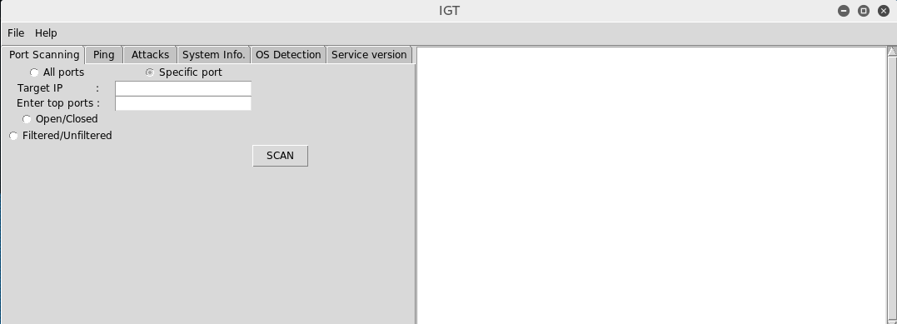
HOME SCREEN
TABS
OUTPUT PANEL

Slide 5
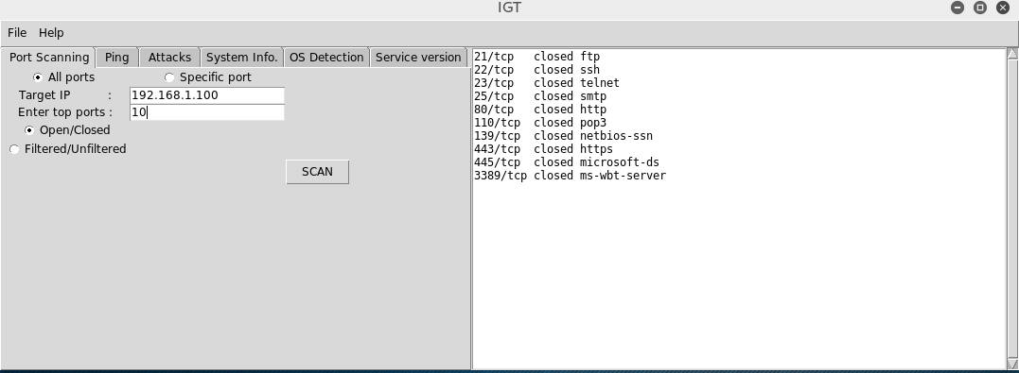
PORT SCANNING

Slide 6
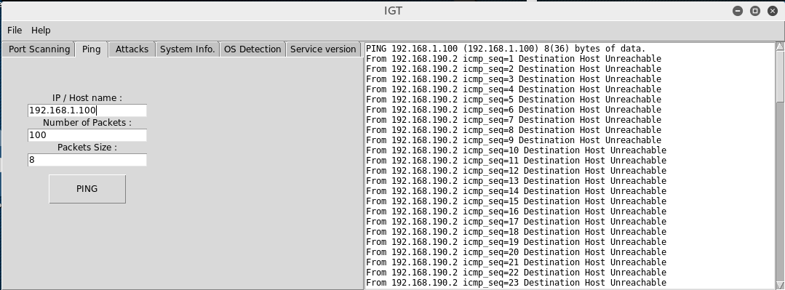
PING

Slide 7
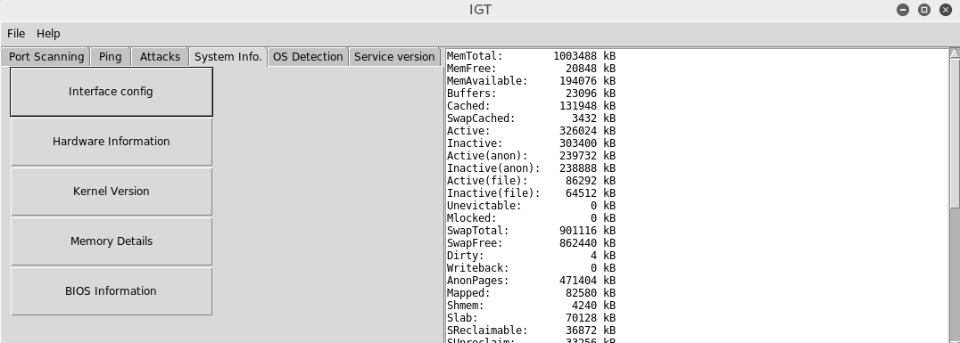
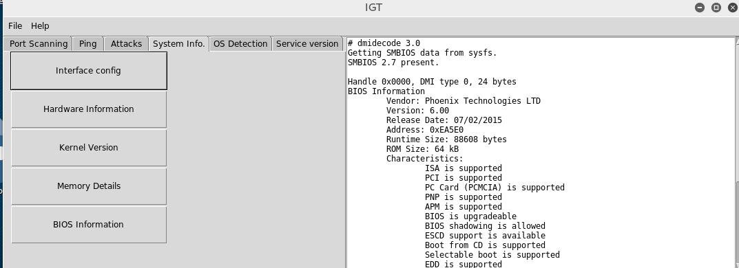
SYSTEM INFO

Slide 8
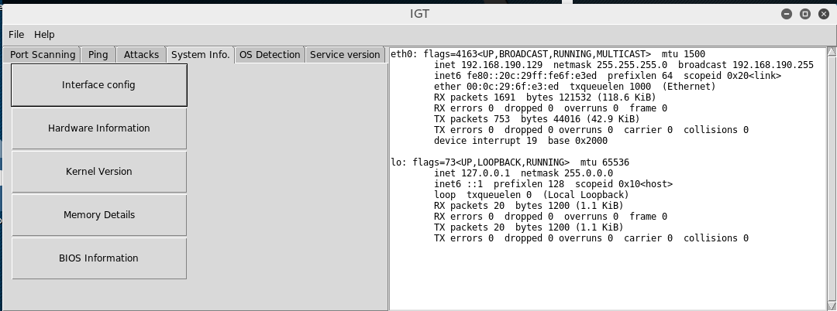
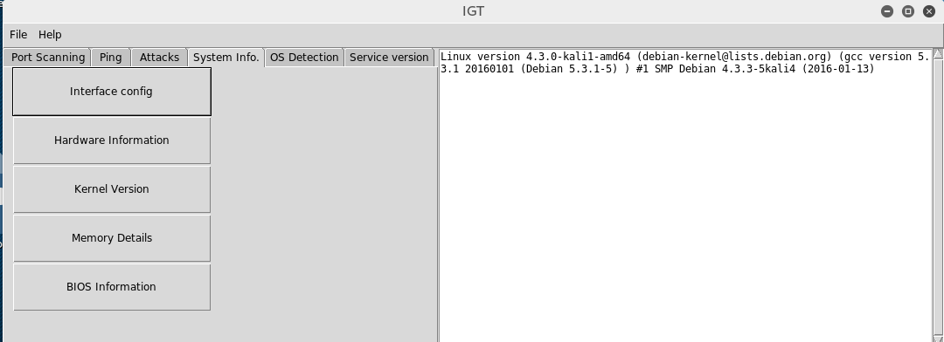
SYSTEM INFO

Slide 9
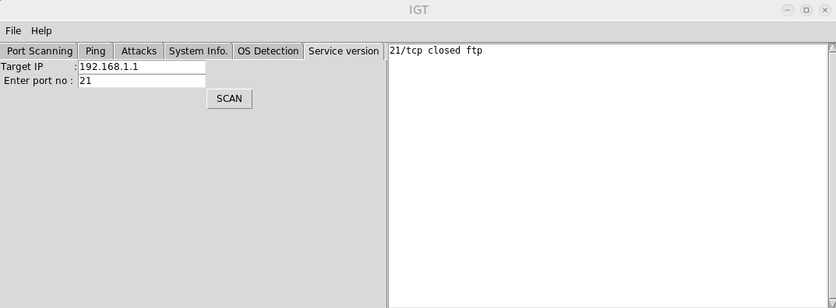
SERVICE VERSION

Slide 10
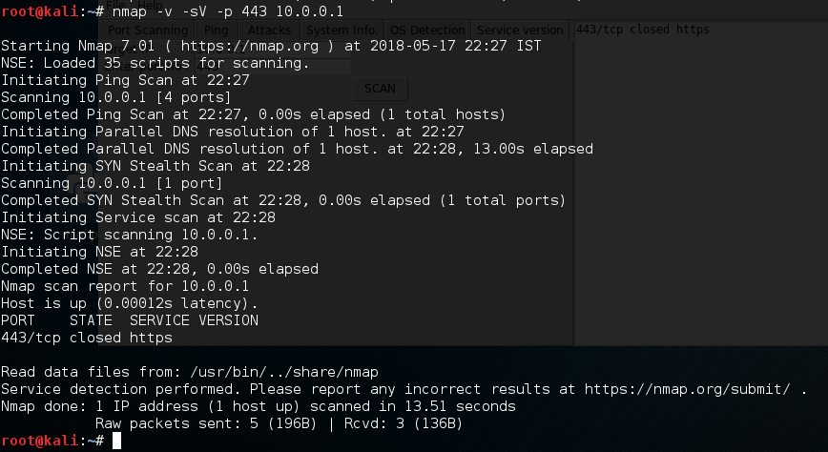
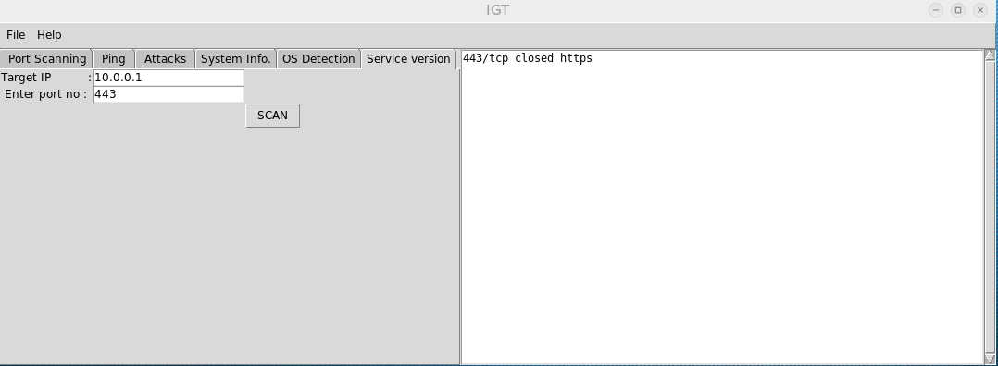
FILTERED OUTPUTS

Slide 11
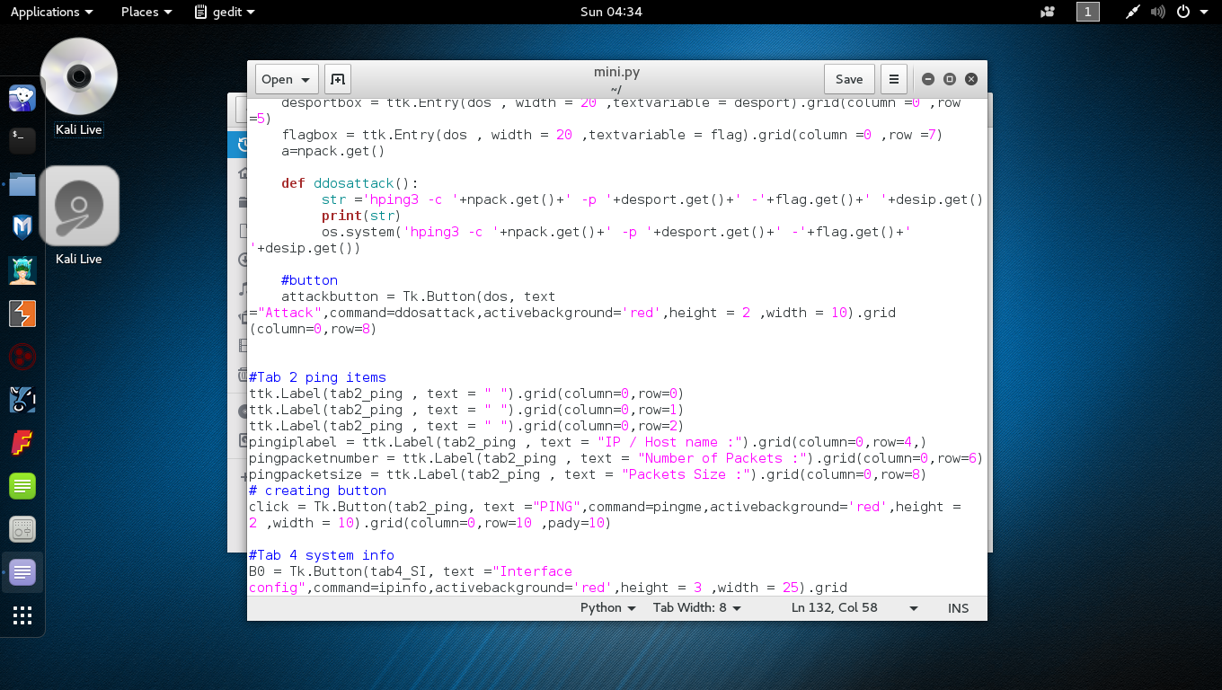
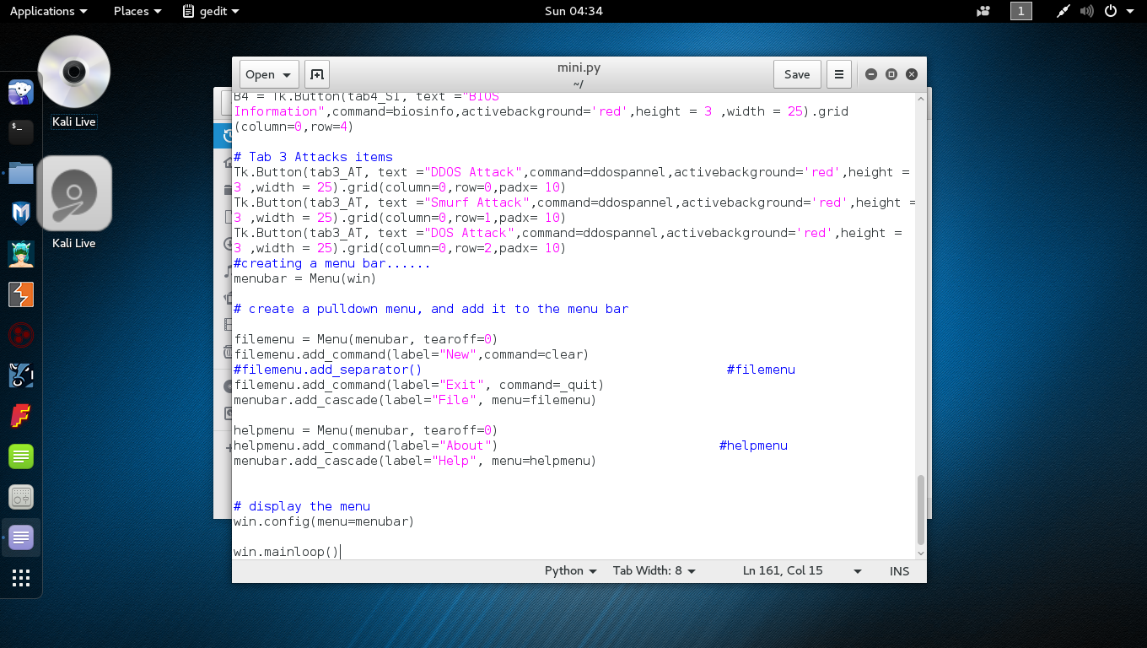
CODE EXTRACTS

Slide 12
FUTURE SCOPE
Learning and typing commands along with their different attributes repetitively is a hectic task now-a-days.
With IGT ,these things have been made easy as most users find a GUI much more friendly than a Command Prompt.Even the output is filtered limited only to the relevant things so that the user does not have to go looking for them as in a CLI.
As students of Ethical Hacking, the tool proves to be immense use of our own too.

Slide 13
THANK YOU

