Slide 1



FIND APP
Prepared by:- 16IT099
chetan m punani

Slide 2
OUTLINE
Project Definition
Objective
Data Flow
Screen Shot
Advantage
Futur enhancement
Reference

Slide 3
Need of this application...?
The purpose of this app is find something item easily.
Some time we lost some item and we can not find item so at that time this app will helpfull.

Slide 4
OBJECTIVE
Login Page
Home Page
Find Something Page
Lost Something Page
Add Details
Submit

Slide 5
Data flow to login page
Detail
Login
Page
DataBase
User
ACK
No
Yes
Home
Page

Slide 6
Data flow of home Page
Find Something
Add required
detail
After Login
Home Page
Add required
detail
Lost Something

Slide 7
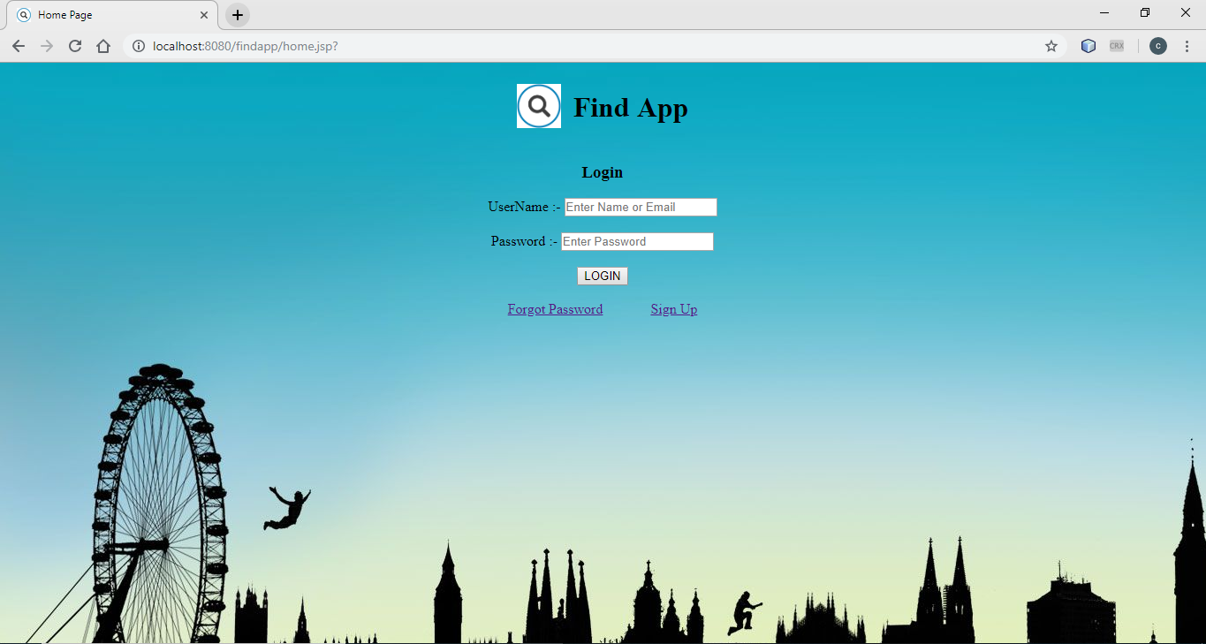
screen shot

Slide 8
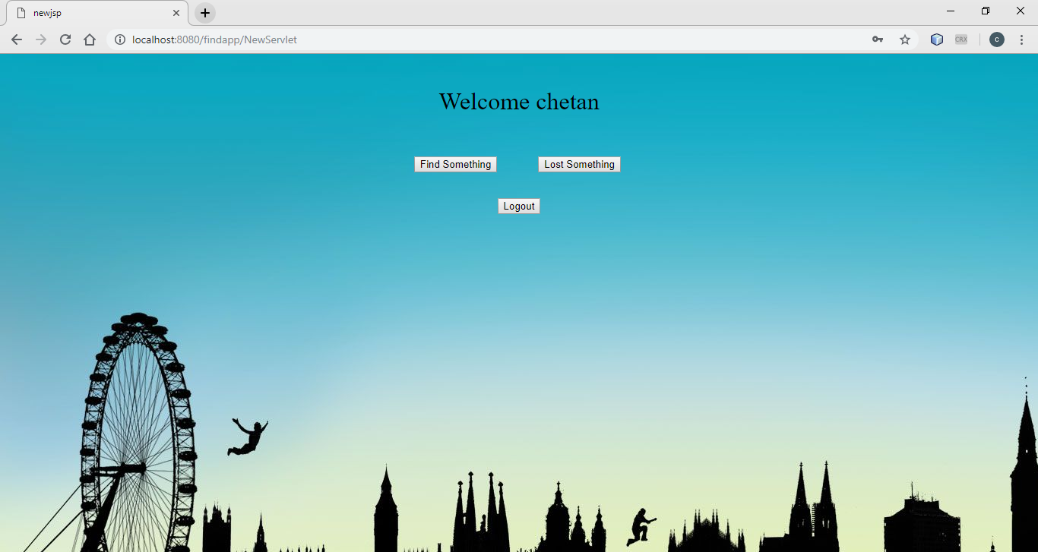

Slide 9
ADVANTAGE
Easy to find out any lost item.
Chance of another item or miss item find such type of problem is solve.
Provide security to your information is not leaked.

Slide 10
Futuer enhancement
Modify the project with batter approch with more graphics
One can also made android or iso application.
It can applicable for all user .
We will also store the data of which item is find or which is lost.

Slide 11
Reference
https://www.javatpoint.com/java-jdbc
https://www.tutorialspoint.com/servlets/servlets-database-access.htm
https://www.javatpoint.com/jsp-tutorial

Slide 12
Thank You...!

