Slide 1
SURVIVAL RATE PREDICTION AND ALERT SYSTEM

Slide 2
APPROACH
Doctors face difficulty in determine the survival rate of patient instantly depending on multiple parameters
Late detection leads to delay in patients treatment
External enterprise will do the analysis for doctor and provide him with percentage of survival

Slide 3
USE CASES
Nurse will add patients data, which will be forwarded to doctor, further doctor will forward the data to analysis team which will determine the survival rate
Reception can contact medical inventory for medical supplies
Reception can contact police department if the patient brought in is attacked or seems suspicious

Slide 4
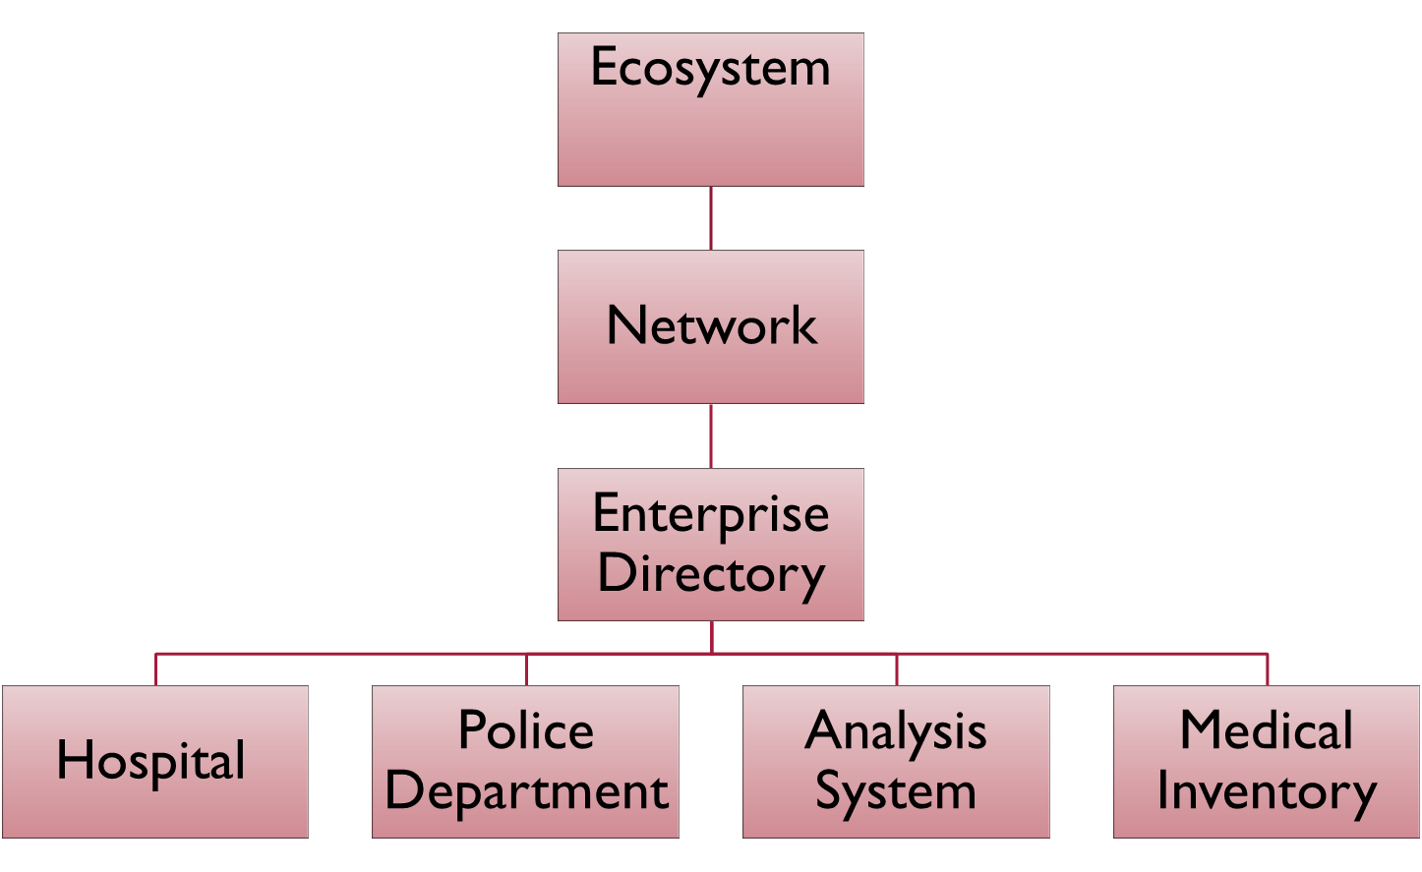

Slide 5
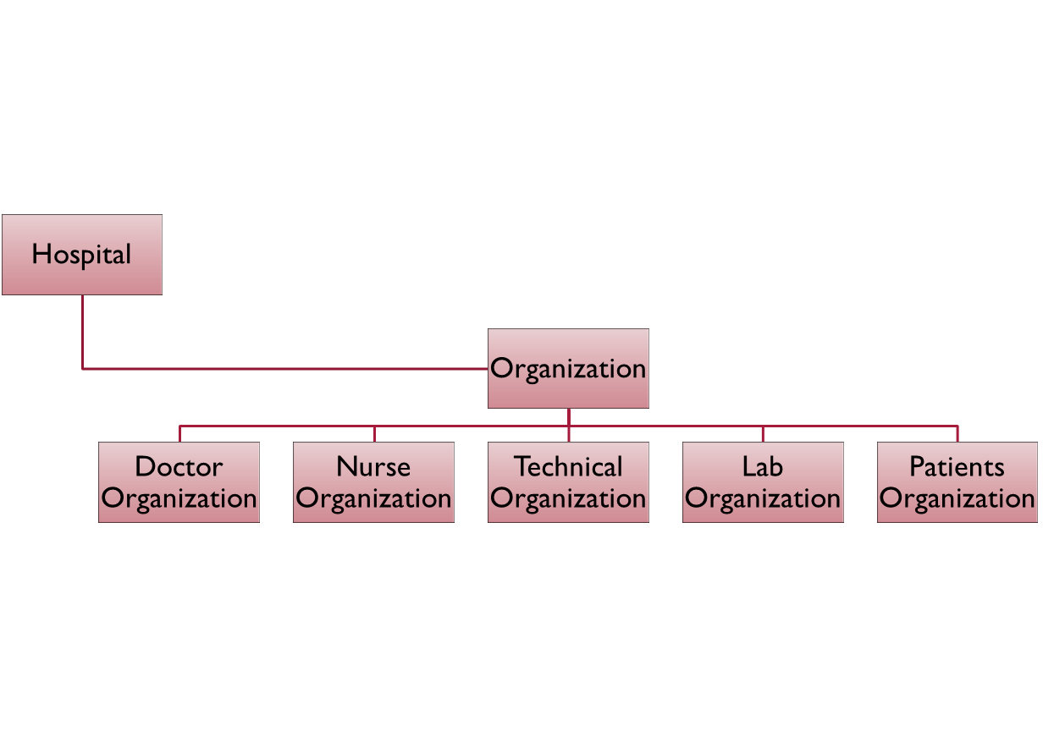

Doctor Role
Nurse Role
Technician Role
Lab Assistant Role

Slide 6
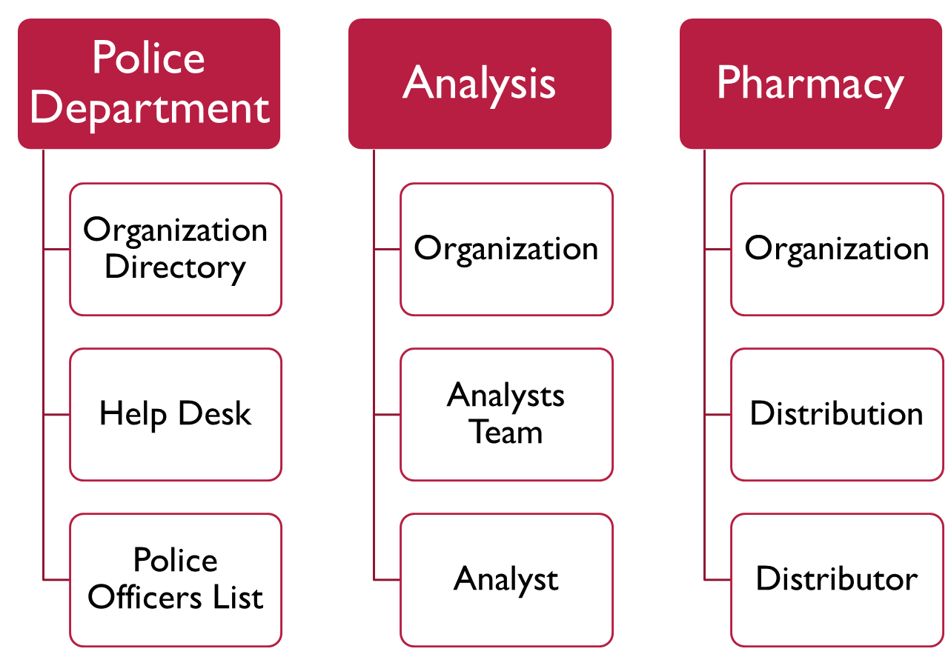

Slide 7
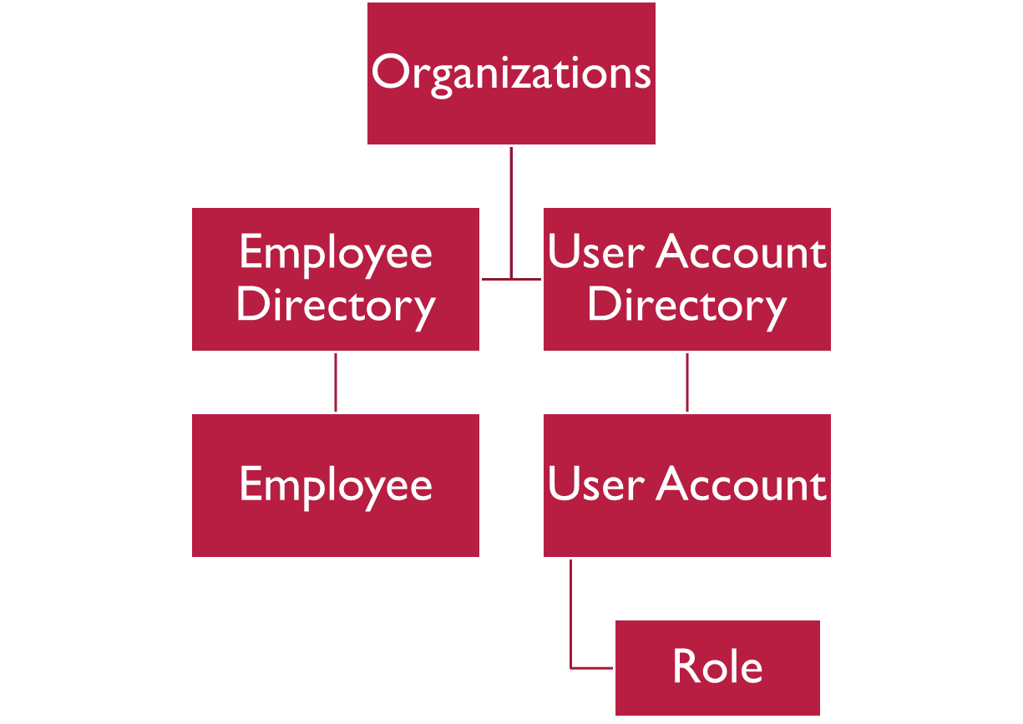

Slide 8
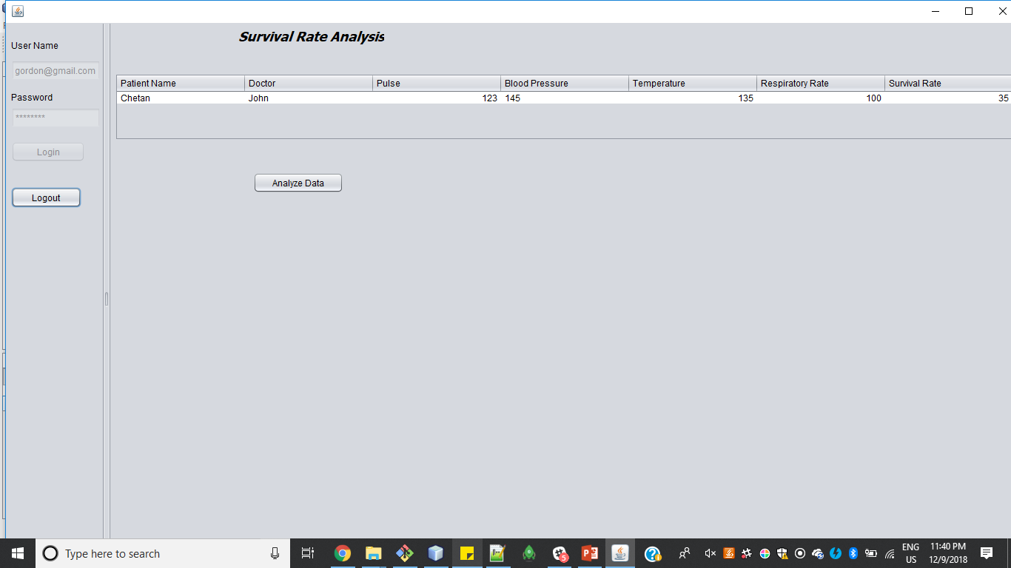

Slide 9
