Slide 1

Airline Chatbot
Use Case

Slide 2
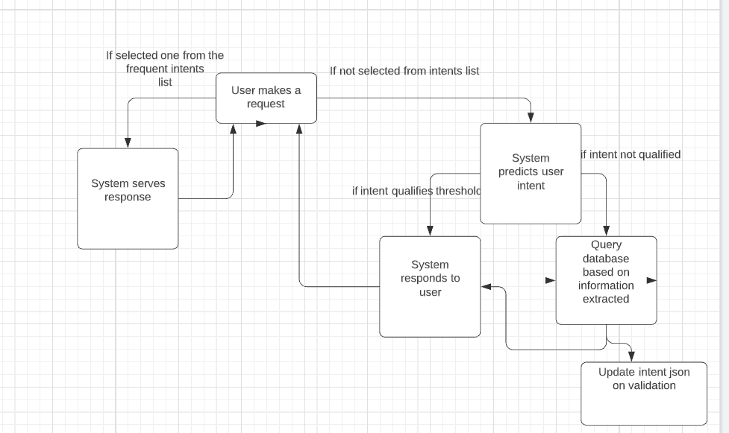
Customer service - Chatbot
Objective is to deal with queries from customers and travel booking companies regarding cancellations, date change, information request, upgrades, seat booking etc.
Below is the system flow

Slide 3
Customer service - Chatbot
This will be rule-based plus NLP base chatbot.
Following files will be involved in this process:
1) A json file which contains intents along with high level actions for which users can interact with chatbot
Eg: {“tag”: ’ticket booking’, “pattern”:{'i want to book flights','i want to do reservation’},
“response”:{'enter source and destination along with required details’}}
2) A Deep Learning or ML model to predict the user intent from message
3) A python script to understand user language, interact with DB and json file to give required response
We will create the list of all possible user intents and list of patterns and train a deep learning model to predict user intent give a certain pattern.
When user drops a message, first things we will display is the list of most frequent intents to guide user. If none selected, we will predict user intent using deep learning model.
We will set a certain confidence threshold to get the predicted intent to qualify for response.
If intent is qualified, send response from the response list.
If no intent is qualified, then will use NER to extract the information from text, using the extracted information, form a dynamic query, query the database, fetch response and display it to users.
We can dump those user messages which are not qualified by deep learning model or if no information extracted using NER or if bot didn’t understand the user message, so that those can be reviewed and added to our intent json file which can help us to retrain the deep learning model.
This can help our bot in continuous learning from users.
We can also give a try for various python packages like Chatterbot, RASA

Slide 4


