Slide 1

Predictive Maintenance & Diagnostic Report Generation using LLM
Pimpri Chinchwad Education Trust (PCET) Pimpri Chinchwad College of Engineering An ISO 9001:2015 Certified Institute, NBA Accredited, Accredited by NAAC with ‘A’ grade
Project Guide: Mrs. Babita R. Jane
121B1F069: Chetan Mahale
121B1F072: Sanchalee Meshram
121B1F080: Pranav Narkhede

Slide 2
Contents
Problem statement
Introduction
Motivation
Literature survey
Objectives
Scope
Software
Proposed workflow
Advantages
Applications
Conclusion
References

Slide 3
Problem Statement

Slide 4
Problem Statement
Failure Prediction: Develop a system to accurately predict if a machine will fail based on operational data and performance metrics.
Failure Type Identification: Classify the type of machine failure to enable targeted troubleshooting and maintenance.
Result Explanation & Report Generation: Provide understandable explanations for predictions and generate comprehensive diagnostic reports automatically for technicians and decision-makers.

Slide 5
Introduction

Slide 6
Introduction
Definition: Leveraging data analysis and machine learning to anticipate equipment failures before they occur, optimizing maintenance schedules and boosting operational efficiency.
Role of LLMs: Automate diagnostic report generation, analyze vast data, and provide actionable insights to drive informed decisions.
Significance: Reducing unexpected breakdowns, minimizing maintenance costs, and enhancing reporting accuracy and speed. Optimizing resource allocation and elevating equipment reliability across industries.

Slide 7
Motivation

Slide 8
Motivation
Cost Efficiency: Reduces downtime and maintenance costs, with studies showing up to 50% of maintenance budgets wasted on unnecessary tasks. Predictive strategies ensure resources are allocated effectively.
Data-Driven Decisions: Employs analytics to forecast potential failures, facilitating informed maintenance scheduling and improving equipment reliability.
Sustainable Manufacturing: Aligns with sustainable production goals by minimizing downtime and extending equipment life, optimizing maintenance processes for a greener operational footprint.

Slide 9
Literature Survey

Slide 10
SrNo | Title and Link | Methodology | Results
1. | Review On Predictive Maintenance in Industry 4.0: Overview, Models, and Challenges[1] | Reviewed literature on smart industrial maintenance. Covered predictive maintenance - evaluation, tools and materials, challenges, workflow, various PdM models like CBM, and models for RUL prediction. | Possible to notice intelligent maintenance is a new tool to handle maintenance events. Proposed a novel multifunctional platform of industrial predictive maintenance based on asset management and smart maintenance planning.
2. | Machine Learning approach for Predictive Maintenance in Industry 4.0 | Collected datasets from sensors for the cutting machine. Random Forest for multi-label classification. | Overall Accuracy: 0.95 Average Accuracy: 0.92 Precision: 0.94 Recall: 0.95

Slide 11
SrNo | Title and Link | Methodology | Results
3. | Machine Learning for Predictive Maintenance: a Multiple Classifier Approach | Proposed two multi-class PdM training algorithms that use Monte Carlo simulations and can be adapted to any classification algorithm. In this article, SVM and KNN are used. | SVM: No of simulations = 10 Accuracy: 98.47 Precision: 63.14 Recall: 70.84 No of simulations = 20 Accuracy: 98.37 Precision: 56.61 Recall: 77.77 KNN: No of simulations = 10 Accuracy: 98.47 Precision: 64.09 Recall: 67.85 No of simulations = 20 Accuracy: 98.39 Precision: 58.00 Recall: 75.42

Slide 12
SrNo | Title and Link | Methodology | Results
4. | DefectTwin: When LLM Meets Digital Twin for Railway Defect Inspection | Addressed the challenge of limited samples by integrating pre-trained LLM into Digital Twin. Utilizes multimodal and multi-model (M²) LLM-based AI pipeline to analyze seen and unseen visual defects in railways. | Image: Precision: 0.92 Recall: 0.93 F1- Score: 0.92 AUC: 0.93 Video: Precision: 0.76 Recall: 0.74 F1- Score: 0.77 AUC: 0.77
5. | A real-time predictive maintenance system for machine systems | Introduced effective real-time predictive maintenance based on motion current which can detect abnormal electric conditions. MLP with softmax activation function was used and was trained using scaled conjugate gradient (SCG) optimization. | Precision: 97.59%. Classification is not affected by parameters and hence it is observed that the motion current signature is independent of tuning parameters

Slide 13
SrNo | Title and Link | Methodology | Results
6. | Self-supervised LLM customizer (SSLC): Customizing LLMs on unlabeled data to enhance contextual question answering | Proposed a framework (SSLC) for customizing LLMs using unlabeled text to enhance contextual question answering on custom data. Text Segmentation → Sentence Extraction → Synthesis → Curation → Fine Tuning | Excels baseline models in 75% of the experiments by both qualitative and quantitative metrics. Dataset: AdversarialQA Model: Mistral (7B) ROUGE-2: 0.21 ROUGE-L: 0.41 METEOR: 0.36 BERT-F1: 0.91 Human Eval(proxy): 0.46
7. | Log-based Predictive Maintenance | Used Multi-Instance Learning[MIL] which includes creating bags of instances. The combined approach of instance-to-example, meta-examples, and instance-based supervised learning is used. | Features: 389 Precision: 0.9 Recall: 0.86 Features: 297 Precision: 0.84 Recall: 0.73

Slide 14
SrNo | Title and Link | Methodology | Results
8. | Advanced Machine Learning Techniques for Predictive Maintenance in Industrial IoT: Integrating Generative AI and Deep Learning for Real-Time Monitoring (Hypothesis) | Uses Gen-AI for PdM on Industrial IoT sensors Big Data. Data Augmentation Hybrid CNN-RNN model development Real Time anomaly detection and failure prediction | Metrics will be: Precision, Recall, F1-Score The effectiveness of the model will be assessed by comparing its performance with a baseline model trained solely on real-world sensor data collected from the testbed.
9. | A Text-Based Predictive Maintenance Approach for Facility Management Requests Utilizing Association Rule Mining and Large Language Models | Used temporal association mining, predictive maintenance, temporal filter, semantic similarity on textual data. The goal is to identify and predict maintenance needs based on historical facility management requests. It compares 4 LLM models. | The English RoBERTa model has highest acceptance rates for the minimum similarity thresholds of 0.65 and 0.7.
10. | Scalable Development and Deployment of LLMs in Manufacturing: Leveraging AI to Enhance Predictive Maintenance, Quality Control, and Process Automation | Transfer learning, Federated learning, model compression, edge computing, cloud and edge deployment. | The study demonstrates that using LLMs in manufacturing leads to more accurate predictions for maintenance, reducing machine downtime and repair costs. It also enhances quality control by automating inspections, resulting in fewer defects.

Slide 15
SrNo | Title and Link | Methodology | Results
11. | Towards Automated Solution Recipe Generation for Industrial Asset Management with LLM | Data collection, LLM integration, solution recipe generation, automation framework, evaluation. | The results of the paper show that using LLMs to automatically generate maintenance solutions significantly improves the efficiency of asset management. The model successfully provides clear, step-by-step instructions that reduce equipment downtime and optimize performance.
12. | Robot fault detection and remaining life estimation for predictive maintenance | Survival analysis, extremely randomized trees, K-nearest neighbors, convolutional neural networks. | Without PCA, extremely randomized trees: Survival analysis = 0.76 Accuracy = 0.95 Precision = 0.98 Recall = 0.96 With PCA, extremely randomized trees: Survival analysis = 0.80 Accuracy = 0.98 Precision = 0.98 Recall = 0.96

Slide 16
SrNo | Title and Link | Methodology | Results
13. | Predictive maintenance for aircraft components using proportional hazard models | Data collection, proportional hazard models, extreme value analysis, reliability modeling. | Proportional hazard models significantly improved predictive maintenance for aircraft components. Model reduced unscheduled failures by up to 90% without increasing costs.
14. | Predictive Maintenance Optimization for Aircraft Redundant Systems Subjected to Multiple Wear Profiles | Data collection, wear profile analysis, predictive modeling, optimization, simulation. | The optimal predictive maintenance strategy reduced overall maintenance costs of aircraft components. In one case, the cost was reduced from 1.7 to 0.56 compared to a reactive approach.
15. | A research study on unsupervised machine learning algorithms for early fault detection in predictive maintenance | Exhaust fan vibration data was collected every 240 minutes over 12 days. Features like peak acceleration and velocity were extracted, PCA to reduce dataset, algorithms such as hierarchical clustering, model based clustering. | Results show that unsupervised machine learning algorithms, particularly clustering and PCA were effective in early fault detection.

Slide 17
SrNo | Title and Link | Methodology | Results
16. | A Digital Twin predictive maintenance framework of air handling units based on automatic fault detection and diagnostics | Data collection, digital twin creation, fault detection, condition precondition, maintenance planning and framework validation. | When the cooling valve is closed during the cooling phase: Accuracy = 87.5% error = 12.5%. When dampers are closed: Accuracy = 80%, error = 20%. No faults: Accuracy = 99.8%, error = 0.2%
17. | Predictive Maintenance using Machine Learning | Continuously monitoring and collecting sensor data from the tubing machine, followed by cleaning and preparing the gathered information to extract relevant features and identify potential patterns. Finally, machine learning algorithms, such as LSTM, are applied to effectively forecast machine downtime. | Enhanced prediction of machine failures. Improved maintenance scheduling leads to reduced downtime. Increased overall productivity and efficiency in operations.
18. | State-of-the-Art Predictive Maintenance Techniques | Proposed multiple methodologies As calibration Verification, Empirical and Physical Modeling, Time-Domain Reflectometry (TDR), Neural Network Modeling, Predictive Maintenance Data Analysis, etc | Reduced calibration issues to 10% Sensor reliability by 90% Improved decision making

Slide 18
SrNo | Title and Link | Methodology | Results
19. | A deep attention based approach for predictive maintenance applications in IoT scenarios | Positional encoding was used to capture the order of time steps, and an attention module focused on relevant data points by computing weighted sums based on their importance. A feed-forward network further processes and effectively combines regression modeling and advanced neural network techniques to enhance predictive accuracy. | RMSE scores for the proposed model are: 18.92 ± 0.26 at 10 cycles 14.40 ± 0.21 at 20 cycles 13.50 ± 0.30 at 30 cycles Epochs-300 The model is 20% faster to train than the LSTM model
20. | Data-driven and Knowledge-based predictive maintenance method for industrial robots for the production stability of intelligent manufacturing | Involves the integration of a fault prediction module, a knowledge graph (KG) construction module, and a maintenance scheme assistance decision support module. The fault prediction module utilizes KNN-LSTM to handle high-dimensional non-linear time series data.The KG construction module stores and reasons knowledge related to IR maintenance. The maintenance scheme assistance module provides accurate maintenance recommendations based on the KG | The best result achieved through LSTM+KNN F1 Score-0.9109 Recall-0.9388 Precision-0.8846 Accuracy- 0.9091 They have also tried Resnet18, SVM, Xgboost, LSTM and Neural Network.

Slide 19
SrNo | Title and Link | Methodology | Results
21. | Machine Learning for Predictive Maintenance in Solar Farms | Operational data from a solar farm is collected using sensors. techniques like Random Forests and Support Vector Machines develop predictive maintenance models. A financial analysis compares maintenance costs and downtime before and after implementation | Logistic Regression Accuracy (%)-94.2 Precision (%)-92.5 Recall (%)-95.8 F1-Score (%)-94.1 Decision Trees Accuracy (%)-91.7 Precision (%)-90.2 Recall (%)-92.5 F1-Score (%)-91.3 Random Forest Accuracy (%)-96.5 Precision (%)-95.8 Recall (%)-97.2 F1-Score (%)-96.5 Cost-40% saving

Slide 20
SrNo | Title and Link | Methodology | Results
22. | A predictive maintenance model for optimizing production schedule using deep neural networks | Analyzing time series data to model the Remaining Useful Life (RUL) of machines Used (DNN) and (RNN) models to predict maintenance needs, which are then integrated with production schedules for overall operational optimization. | Model with their Accuracy RRF -95.01 CNN-92.2 LSTM-91.08 CNN LSTM-89.74 GRU-88.8 RNN-83.32 DFF-83.81
23. | Predictive Maintenance of Machine Tool Systems Using Artificial Intelligence Techniques Applied to Machine Condition Data | SVM and ANN(RNN & CNN) are USED for predictive maintenance by extracting meaningful features from datasets collected during machining and bearing experiments. | Accuracy of 87%
24. | Anomaly Detection in Sensor Data with Machine Learning: Predictive Maintenance for Industrial Systems | LSTM-based encoder-decoder models for detecting anomalies in multi-sensor data Density-based clustering algorithms like DBSCAN used for identifying clusters in large datasets with noise. Active learning techniques for improving model performance | Algo with AUROC AUPRC F1-Score LSTM 0.98 0.87 0.93 Autoencoder 0.96 0.82 0.90 One-Class SVM 0.94 0.78 0.88

Slide 21
Literature Gap
All the articles focused on a single type of machine for eg, railway, shop floor machines etc. No generalized approach available.
None of the approach tells about giving instructions are given to machine operator.
Lack of explanation to why machine failed.

Slide 22
Objectives

Slide 23
Objectives
Develop a Predictive Maintenance Model: Build a robust machine learning model to accurately classify machine parts based on operational data, predicting whether a failure will occur and identifying the type of failure.
Enhance Maintenance Efficiency: Reduce unplanned downtime by predicting machine failures in advance, allowing for timely maintenance interventions.

Slide 24
Objectives
Integrate LLM for Diagnostic Reports: Utilize a Large Language Model (LLM) to automatically generate detailed diagnostic reports based on the classification results, providing actionable insights for maintenance teams.
Improve Interpretability of Predictions: Leverage the LLM to provide natural language explanations of the machine learning model's predictions, helping users understand the rationale behind each classification and recommended action.

Slide 25
Scope

Slide 26
Deliverables
A machine learning model capable of predicting machine failures and classifying the type of failure.
A Large Language Model (LLM) integrated system that generates customized diagnostic reports based on model predictions.
A user-friendly interface for accessing predictions and reports.

Slide 27
Future Scope
Train RAG Architecture for customized user queries.
Real Time monitoring, predicting and reporting with integration of IoT Devices.
Tailor the predictive maintenance system for specific industries

Slide 28
Software

Slide 29










Slide 30
Proposed Workflow

Slide 31
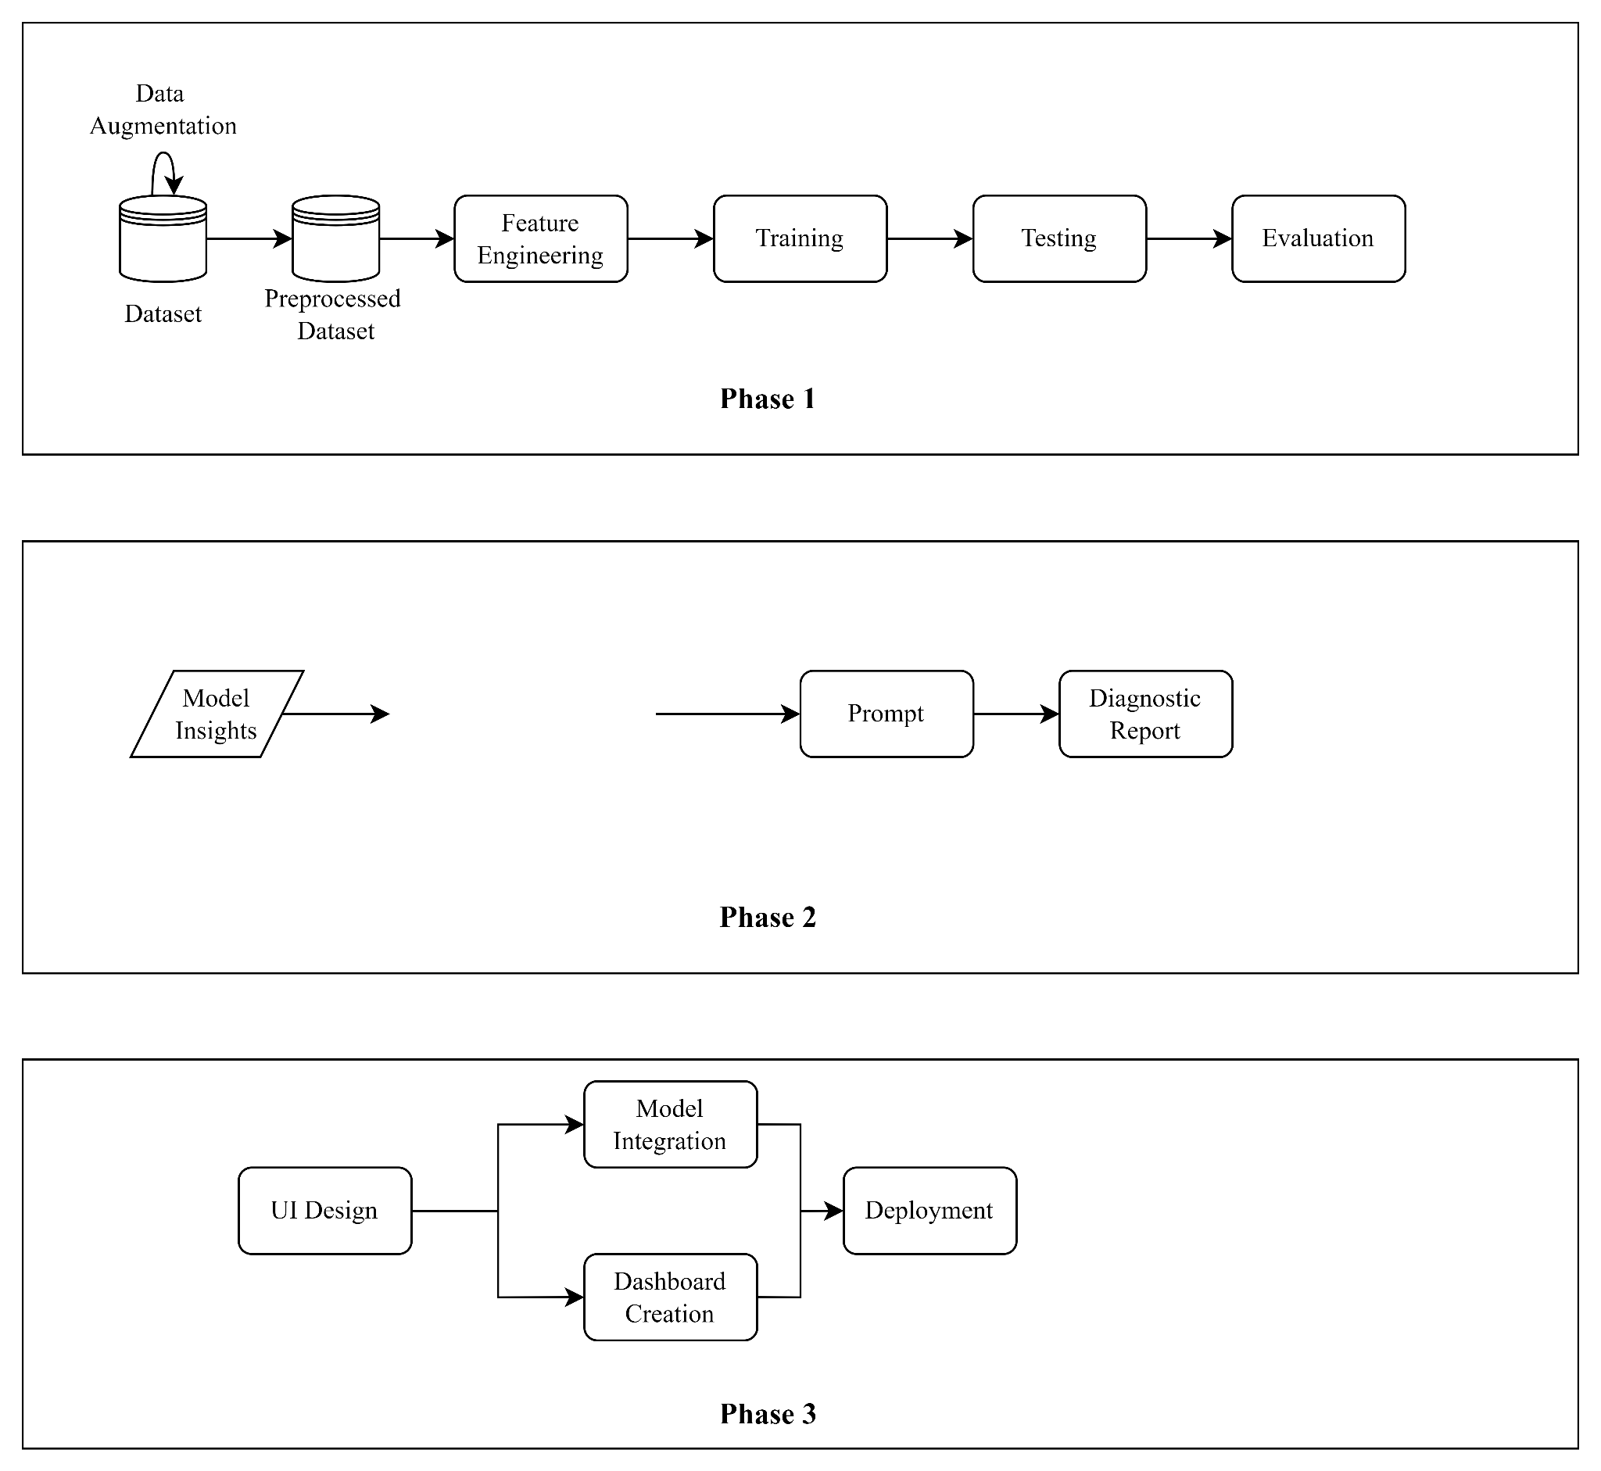


Slide 32
Advantages

Slide 33
1. Early Fault Detection and Prevention
ML identifies failure patterns early, allowing timely maintenance and reducing downtime.
2. Cost Savings
PdM avoids unnecessary repairs, and LLMs reduce labor costs through automated report generation.
3. Improved Accuracy and Efficiency
ML models enhance prediction accuracy, while LLMs generate consistent and precise reports.
4. Enhanced Decision-Making
PdM provides real-time insights, and LLMs offer actionable, easy-to-understand recommendations.

Slide 34
Applications

Slide 35
Data Centre
Server Maintenance: Monitor and predict failures in servers, storage systems, and networking equipment to ensure high availability and reliability of data center operations.
Cooling Systems: Predict maintenance needs for cooling systems and HVAC units critical for maintaining optimal operating conditions in data center

Slide 36
Robotics and Automation
Industrial Robots: Monitor and predict failures in robots used in manufacturing and automation processes to reduce downtime and improve efficiency.
Service Robots: Apply predictive maintenance to service robots used in various applications, such as healthcare, hospitality, and logistics, to ensure reliable operation.

Slide 37
Smart Devices and IoT
Device Management: Apply predictive maintenance to manage and maintain smart devices and IoT sensors deployed in various environments, ensuring continuous operation and data accuracy.
Network of IoT Devices: Predict and address potential issues in networks of connected devices to ensure reliable data transmission and device performance.

Slide 38
Conclusion

Slide 39
Integrating Predictive Maintenance with LLMs and ML enhances early fault detection, reduces costs, and improves decision-making with real-time insights. It automates report generation, minimizing human error and ensuring compliance. This combination boosts efficiency, extends equipment life, and supports continuous operational improvement.

Slide 40
References

Slide 41
References
[1] Achouch, Mounia, et al. "On predictive maintenance in industry 4.0: Overview, models, and challenges." Applied Sciences 12.16 (2022): 8081.
[2] Paolanti, Marina, et al. "Machine learning approach for predictive maintenance in industry 4.0." 2018 14th IEEE/ASME International Conference on Mechatronic and Embedded Systems and Applications (MESA). IEEE, 2018.
[3] Susto, Gian Antonio, et al. "Machine learning for predictive maintenance: A multiple classifier approach." IEEE transactions on industrial informatics 11.3 (2014): 812-820.

Slide 42
References
[4] Ferdousi, Rahatara, et al. "DefectTwin: When LLM Meets Digital Twin for Railway Defect Inspection." arXiv preprint arXiv:2409.06725 (2024).
[5] Bansal, Dheeraj, David J. Evans, and Barrie Jones. "A real-time predictive maintenance system for machine systems." International Journal of Machine tools and manufacture 44.7-8 (2004): 759-766.
[6] Hegde, Raveendra, and Saurabh Sharma. "Self supervised LLM customizer (SSLC): Customizing LLMs on unlabeled data to enhance contextual question answering." (2024).

Slide 43
References
[7] Sipos, Ruben, et al. "Log-based predictive maintenance." Proceedings of the 20th ACM SIGKDD international conference on knowledge discovery and data mining. 2014.
[8] Prabhod, Kummaragunta Joel. "Advanced Machine Learning Techniques for Predictive Maintenance in Industrial IoT: Integrating Generative AI and Deep Learning for Real-Time Monitoring." Journal of AI-Assisted Scientific Discovery 1.1 (2021): 1-29.

Slide 44
[9] Lowin, Maximilian. "A Text-Based Predictive Maintenance Approach for Facility Management Requests Utilizing Association Rule Mining and Large Language Models." Machine Learning and Knowledge Extraction 6.1 (2024): 233-258.
[10] Kurkute, Mahadu Vinayak, Gunaseelan Namperumal, and Akila Selvaraj. "Scalable Development and Deployment of LLMs in Manufacturing: Leveraging AI to Enhance Predictive Maintenance, Quality Control, and Process Automation." Australian Journal of Machine Learning Research & Applications 3.2 (2023): 381-430.
[11] Zhou, Nianjun, et al. "Towards Automated Solution Recipe Generation for Industrial Asset Management with LLM." arXiv preprint arXiv:2407.18992 (2024).

Slide 45
[12] Pinto, Riccardo, and Tania Cerquitelli. "Robot fault detection and remaining life estimation for predictive maintenance." Procedia Computer Science 151 (2019): 709-716.
[13] Verhagen, Wim JC, and Lennaert WM De Boer. "Predictive maintenance for aircraft components using proportional hazard models." Journal of Industrial Information Integration 12 (2018): 23-30.
[14] Vianna, Wlamir Olivares Loesch, and Takashi Yoneyama. "Predictive maintenance optimization for aircraft redundant systems subjected to multiple wear profiles." IEEE Systems Journal 12.2 (2017): 1170-1181.

Slide 46
[15] Amruthnath, Nagdev, and Tarun Gupta. "A research study on unsupervised machine learning algorithms for early fault detection in predictive maintenance." 2018 5th international conference on industrial engineering and applications (ICIEA). IEEE, 2018.
[16] Hosamo, Haidar Hosamo, et al. "A Digital Twin predictive maintenance framework of air handling units based on automatic fault detection and diagnostics." Energy and Buildings 261 (2022): 111988.
[17]

Slide 47
Thank You!

