Slide 1

Predictive Maintenance & Diagnostic Report Generation using LLM
Pimpri Chinchwad Education Trust (PCET) Pimpri Chinchwad College of Engineering An ISO 9001:2015 Certified Institute, NBA Accredited, Accredited by NAAC with ‘A’ grade
Project Guide: Mrs. Babita R. Jane
121B1F069: Chetan Mahale
121B1F072: Sanchalee Meshram
121B1F080: Pranav Narkhede

Slide 2
Problem Statement
Failure Prediction: Develop a system to accurately predict if a machine will fail based on operational data and performance metrics.
Failure Type Identification: Classify the type of machine failure to enable targeted troubleshooting and maintenance.
Result Explanation & Report Generation: Provide understandable explanations for predictions and generate comprehensive diagnostic reports automatically for technicians and decision-makers.

Slide 3
Literature Gap
All the articles focused on a single type of machine for eg, railway, shop floor machines etc. No generalized approach available.
None of the approach tells about giving instructions to machine operator.
Lack of explanation to why machine failed.

Slide 4
Objectives
Develop a Predictive Maintenance Model: Build a robust machine learning model to accurately classify machine parts based on operational data, predicting whether a failure will occur and identifying the type of failure.
Enhance Maintenance Efficiency: Reduce unplanned downtime by predicting machine failures in advance, allowing for timely maintenance interventions.

Slide 5
Objectives
Integrate LLM for Diagnostic Reports: Utilize a Large Language Model (LLM) to automatically generate detailed diagnostic reports based on the classification results, providing actionable insights for maintenance teams.
Improve Interpretability of Predictions: Leverage the LLM to provide natural language explanations of the machine learning model's predictions, helping users understand the rationale behind each classification and recommended action.

Slide 6
Methodology
Data Augmentation with CTGAN
Add new class “About to fail” to existing classes i.e “Failed” and “Not Failed”
Training: Will be experimenting on various SML algorithms
Evaluation Metrics: Precision, Recall, Accuracy, F1 score and support
Use Llama 3.2 to generate report
Integrate the ML model and LLM into our system
Documentation

Slide 7
System Architecture

Slide 8
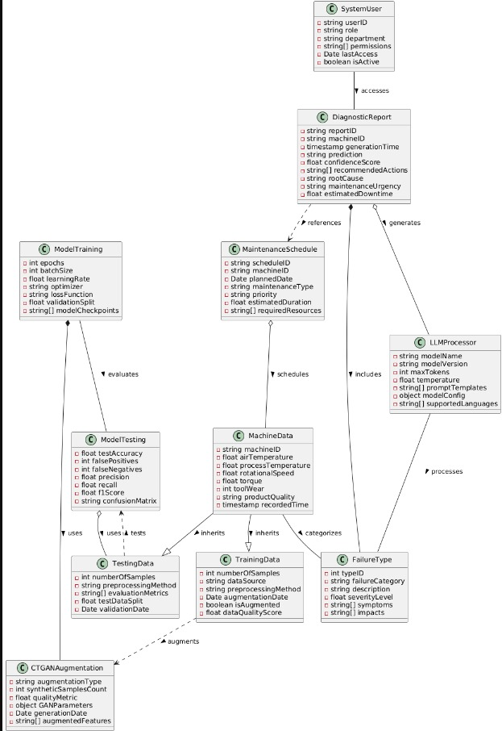
Analysis Level Class Diagram

Slide 9
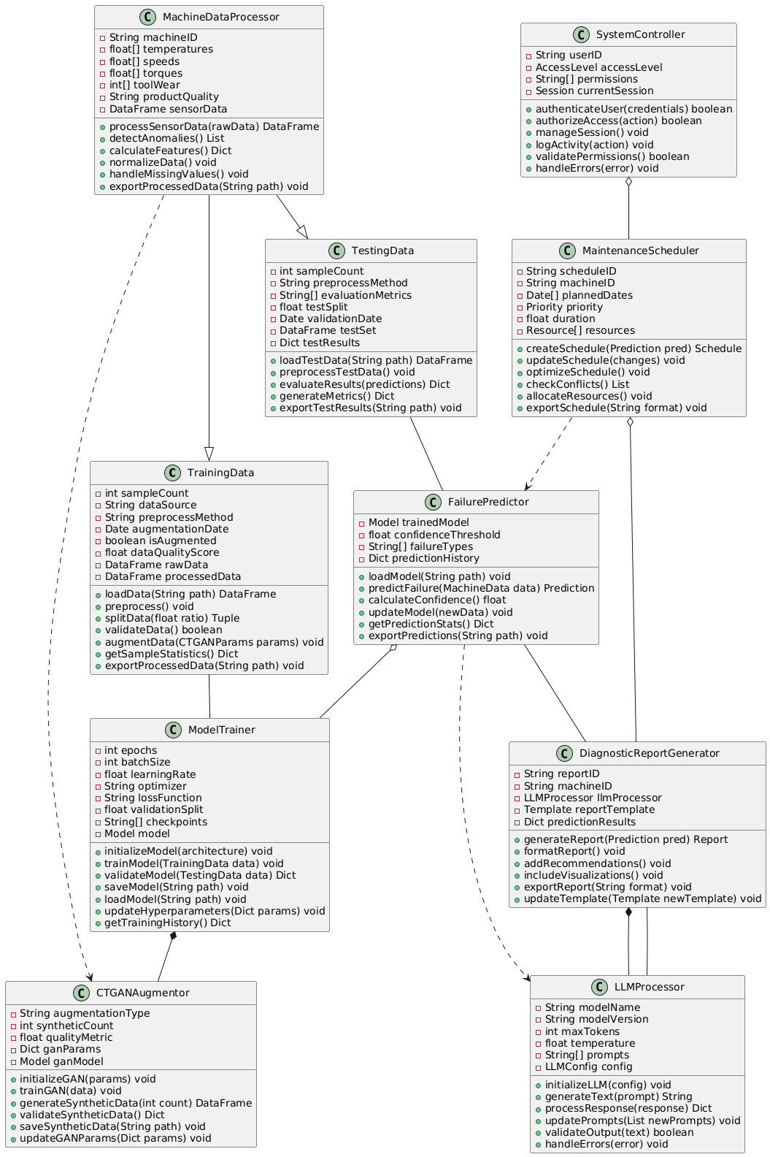
Implementation Level Class Diagram

Slide 10
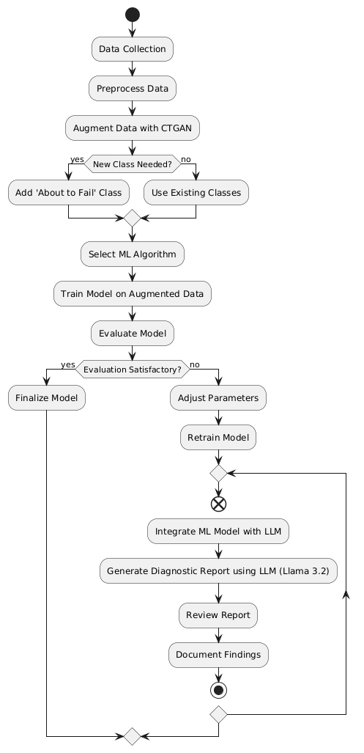
Activity Diagram

Slide 11
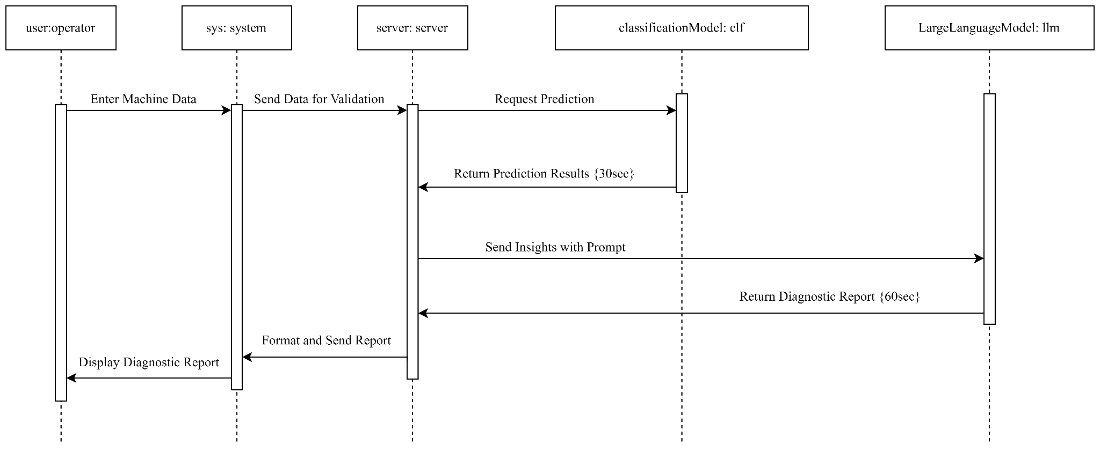
Sequence Diagram

Slide 12
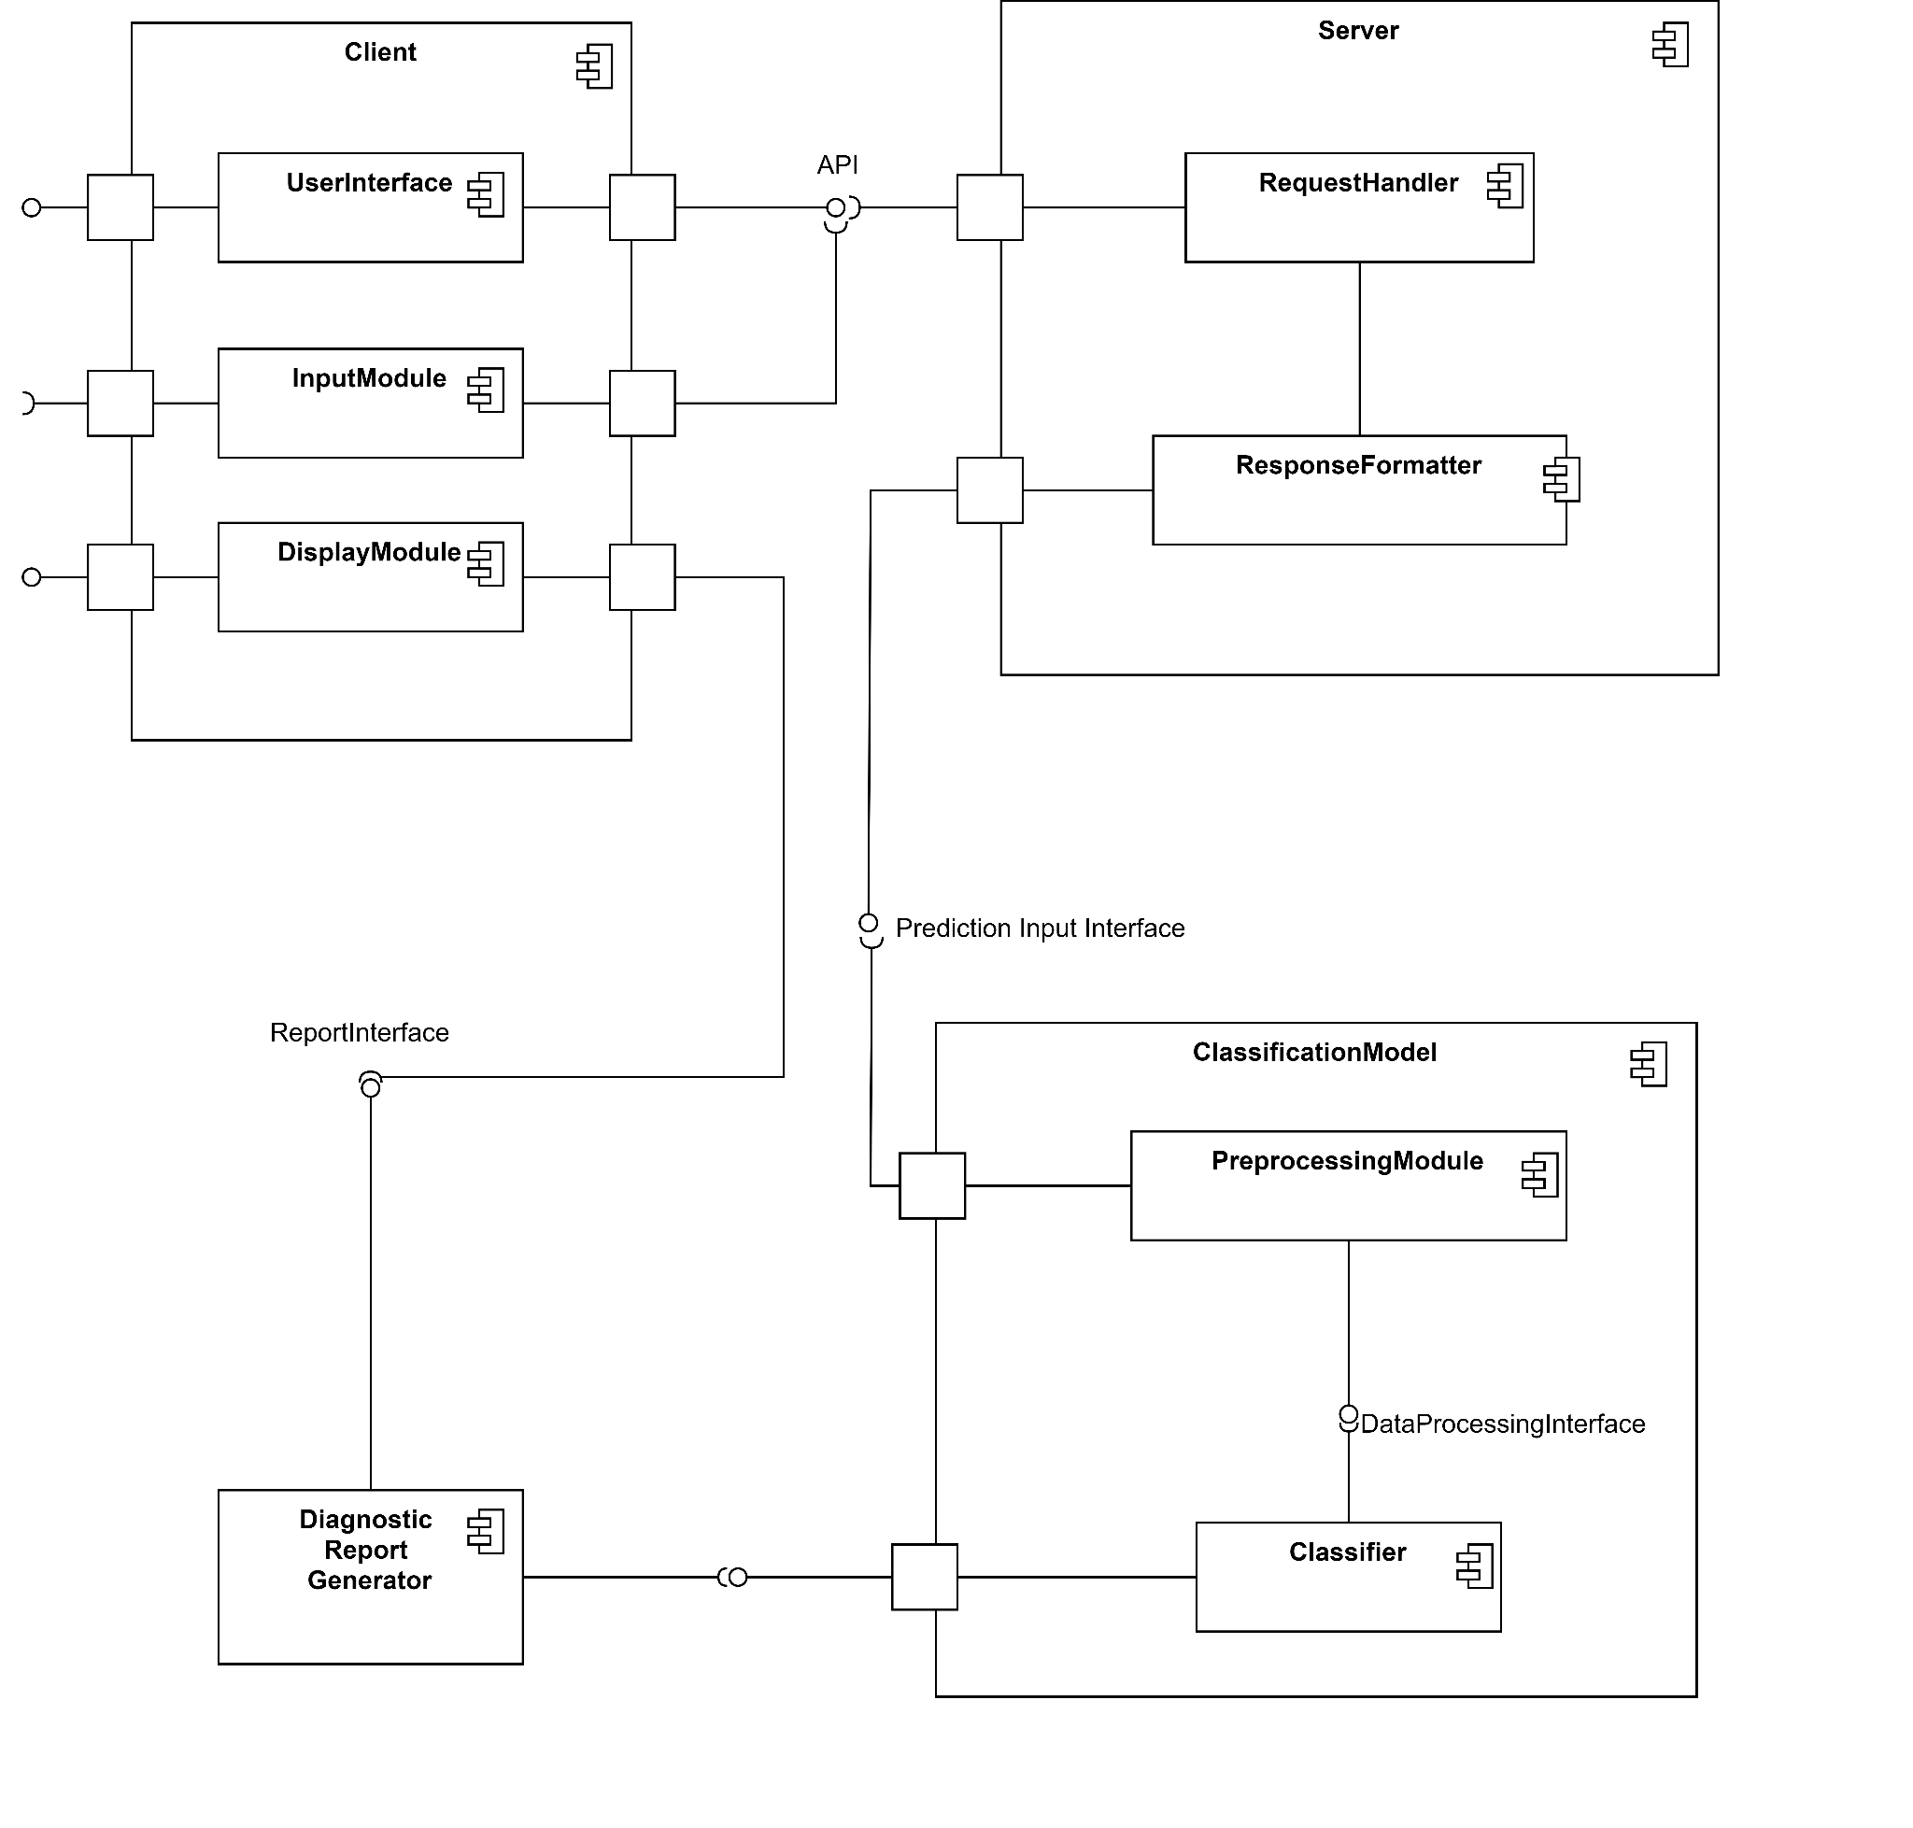
Component Diagram

Slide 13
Tools and Technologies

Slide 14










Slide 15
Thank You

