Slide 1

Pimpri Chinchwad Education Trust (PCET) Pimpri Chinchwad College of Engineering An ISO 9001:2015 Certified Institute, NBA Accredited, Accredited by NAAC with ‘A’ grade
Predictive Maintenance & Diagnostic Report Generation using LLM
Project Guide: Mrs. Babita R. Jane
121B1F069: Chetan Mahale
121B1F072: Sanchalee Meshram
121B1F080: Pranav Narkhede

Slide 2
Problem Statement
Failure Prediction: Develop a system to accurately predict if a machine will fail based on operational data and performance metrics.
Failure Type Identification: Classify the type of machine failure to enable targeted troubleshooting and maintenance.
Report Generation: Generate comprehensive diagnostic report with LLM automatically for machine operators and decision-makers.

Slide 3
Dataset
AI4I 2020 Predictive Maintenance Dataset
From UC Irvine Machine Learning Repository
6 target features
The dataset consists of 10,000 data points stored as rows with 14 features in columns

Slide 4
Dataset
Feature | Type | Feature | Type
UID | Integer | Tool wear | Integer
Product ID | Categorical | Machine failure | Integer
Type | Categorical | TWF | Integer
Air temperature | Continuous | HDF | Integer
Process temperature | Continuous | PWF | Integer
Rotational speed | Integer | OSF | Integer
Torque | Continuous | RNF | Integer

Slide 5
Feature Description
UID: unique identifier ranging from 1 to 10000
product ID: consisting of a letter L, M, or H for low (50% of all products), medium (30%) and high (20%) as product quality variants and a variant-specific serial number
air temperature [K]: generated using a random walk process later normalized to a standard deviation of 2 K around 300 K
process temperature [K]: generated using a random walk process normalized to a standard deviation of 1 K, added to the air temperature plus 10 K.
rotational speed [rpm]: calculated from a power of 2860 W, overlaid with a normally distributed noise
torque [Nm]: torque values are normally distributed around 40 Nm with a Ïƒ = 10 Nm and no negative values.
tool wear [min]: The quality variants H/M/L add 5/3/2 minutes of tool wear to the used tool in the process. and a
machine failure: label that indicates, whether the machine has failed in this particular datapoint for any of the following failure modes are true.

Slide 6
Feature Description
The machine failure consists of five independent failure modes
tool wear failure (TWF): the tool will be replaced of fail at a randomly selected tool wear time between 200 â€“ 240 mins (120 times in our dataset). At this point in time, the tool is replaced 69 times, and fails 51 times (randomly assigned).
heat dissipation failure (HDF): heat dissipation causes a process failure, if the difference between air- and process temperature is below 8.6 K and the tool rotational speed is below 1380 rpm. This is the case for 115 data points.
power failure (PWF): the product of torque and rotational speed (in rad/s) equals the power required for the process. If this power is below 3500 W or above 9000 W, the process fails, which is the case 95 times in our dataset.
overstrain failure (OSF): if the product of tool wear and torque exceeds 11,000 minNm for the L product variant (12,000 M, 13,000 H), the process fails due to overstrain. This is true for 98 data points.
random failures (RNF): each process has a chance of 0,1 % to fail regardless of its process parameters. This is the case for only 5 data points, less than could be expected for 10,000 data points in our dataset.

Slide 7
Data Preprocessing
Tasks carried out:
Dropping Irrelevant Features
Feature Engineering
Standardization
Label Encoding
Train - Test Splitting
Saving Files

Slide 8
Dropping Irrelevant Features
UID is an identifier which does not add value to the model hence it can be dropped.
Similarly Product ID can be dropped too.
Machine failure is a redundant feature since if any one of the failure mode is 1 (yes), it will be set to 1

Slide 9
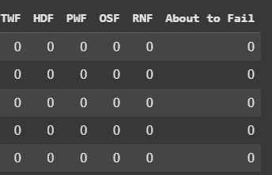
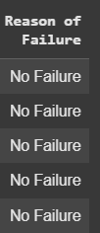
Feature Engineering
Adding New Class:
“About To Fail”
Based on threshold
(275 <= row['Air temperature [K]'] <= 295) or
(275 <= row['Process temperature [K]'] <= 305) or
(900 <= row['Rotational speed [rpm]'] <= 1200) or
(2 <= row['Torque [Nm]'] <= 3) or
(row['Tool wear [min]'] > 250)
2. Instead of having 6 sparse features construct, one dense feature:

Slide 10
Standardization and Label Encoding
Standard Scaling to bring features on same scale
Label Encoding all the categorical features
Train - Test Split: 70% - 30%

Slide 11
Data Visualization

Slide 12
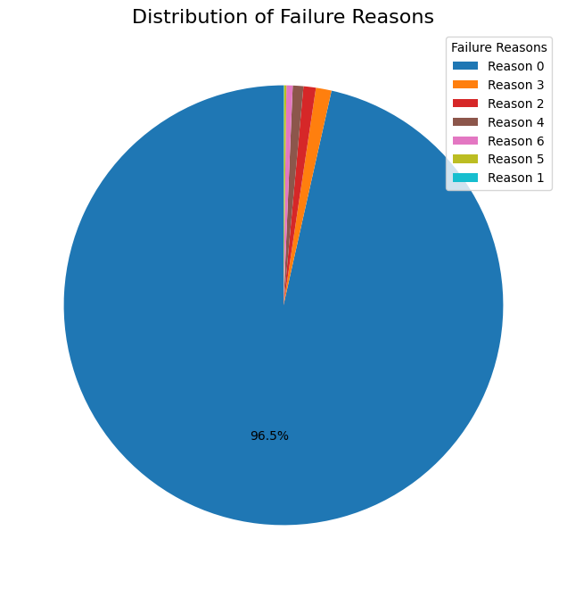
Highly Imbalanced Data

Slide 13
Methodology

Slide 14
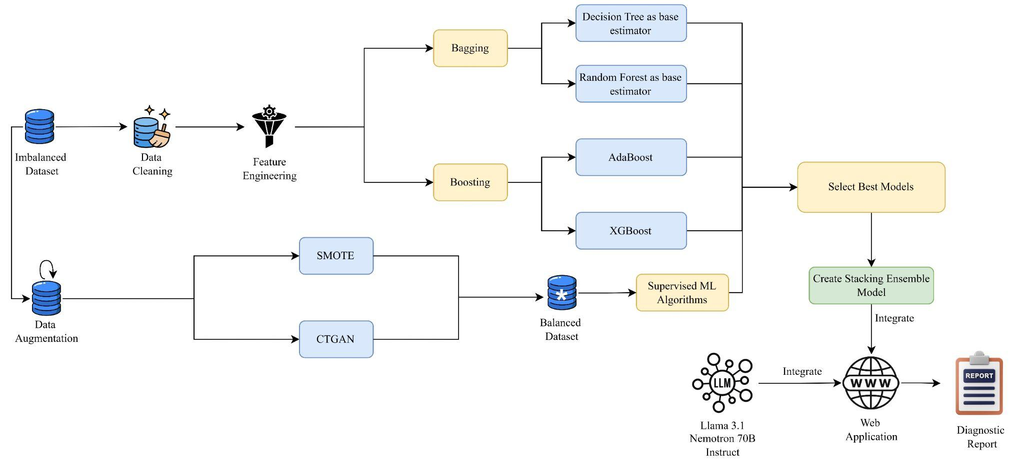
Methodology Block Diagram

Slide 15
Deciding Metrics for Evaluation
Any dataset of Predictive Maintenance will have a Natural Imbalance because the occurrence of failure is very low rather than success.
Hence Accuracy cannot be a metric for evaluation because it will be biased towards success class.
Instead of Accuracy, we have considered metrics like Precision and Recall.
Precision minimizes false positives (unnecessary maintenance), while recall ensures minimal false negatives (missed failures), optimizing maintenance strategies.

Slide 16
Bagging on Imbalanced Data

Slide 17
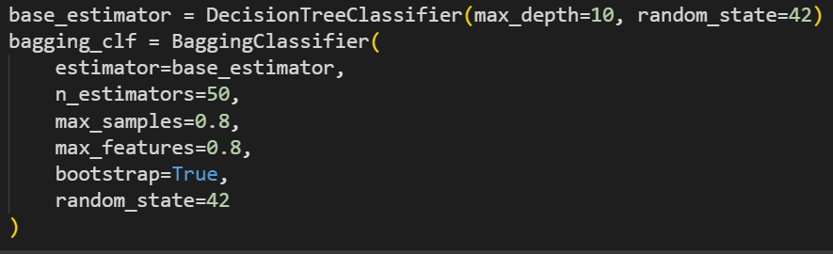
Bagging Classifier with Decision Tree Base Estimator

Slide 18
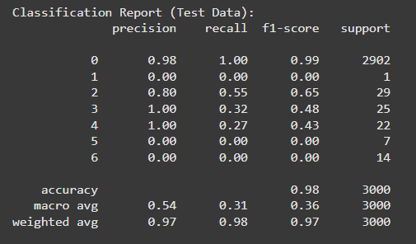
Results

Slide 19
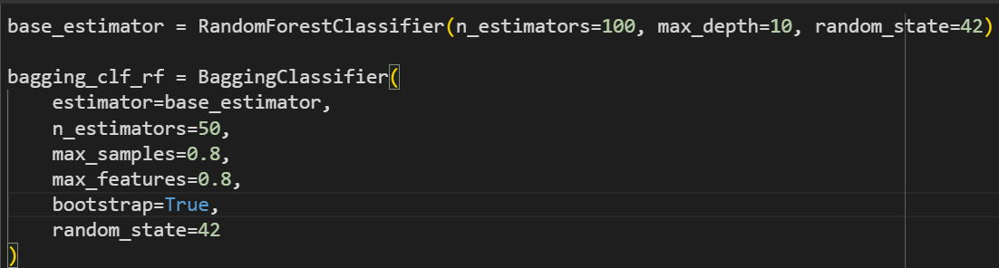
Bagging Classifier with Random Forest Base Estimator

Slide 20
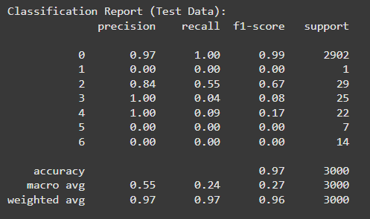
Results

Slide 21
Boosting on Imbalanced Data

Slide 22
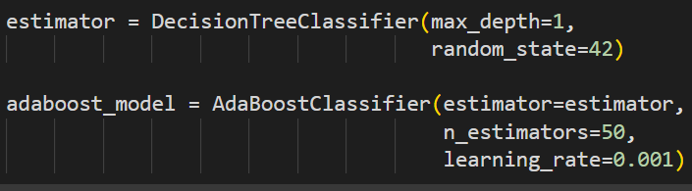
Adaboost

Slide 23
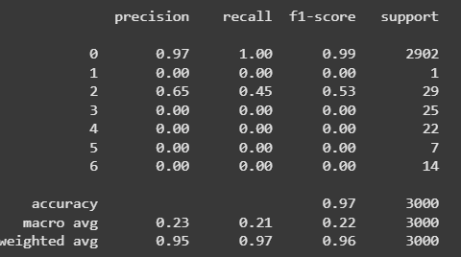
Results

Slide 24
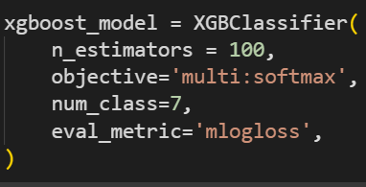
XGBoost

Slide 25
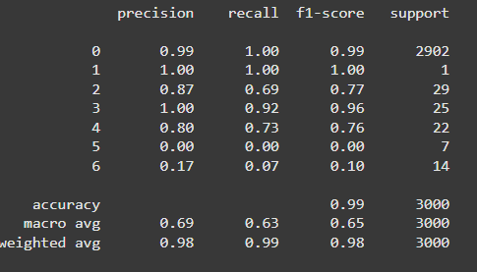
Results

Slide 26
Overview of Results
Algorithm | Average Precision | Average Recall | Average F1 Score
Bagging with Decision Tree | 0.54 | 0.31 | 0.36
Bagging with Random Forest | 0.55 | 0.24 | 0.27
AdaBoost | 0.23 | 0.21 | 0.22
XGBoost | 0.69 | 0.63 | 0.65

Slide 27
Data Augmentation using SMOTE

Slide 28
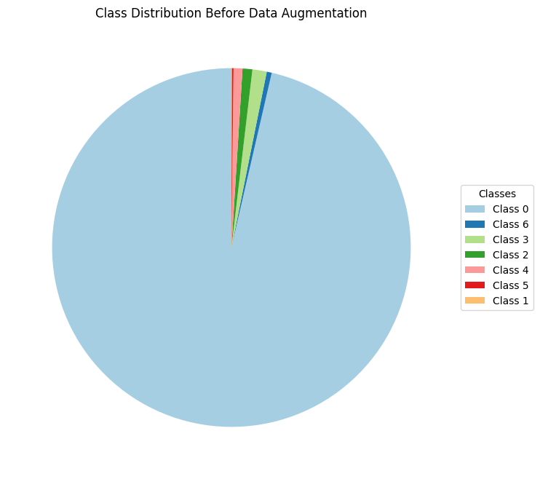
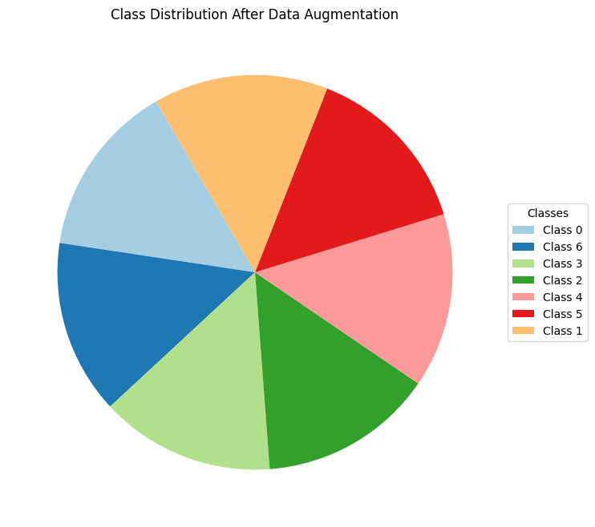
Data Distribution Before and After Augmentation

Slide 29
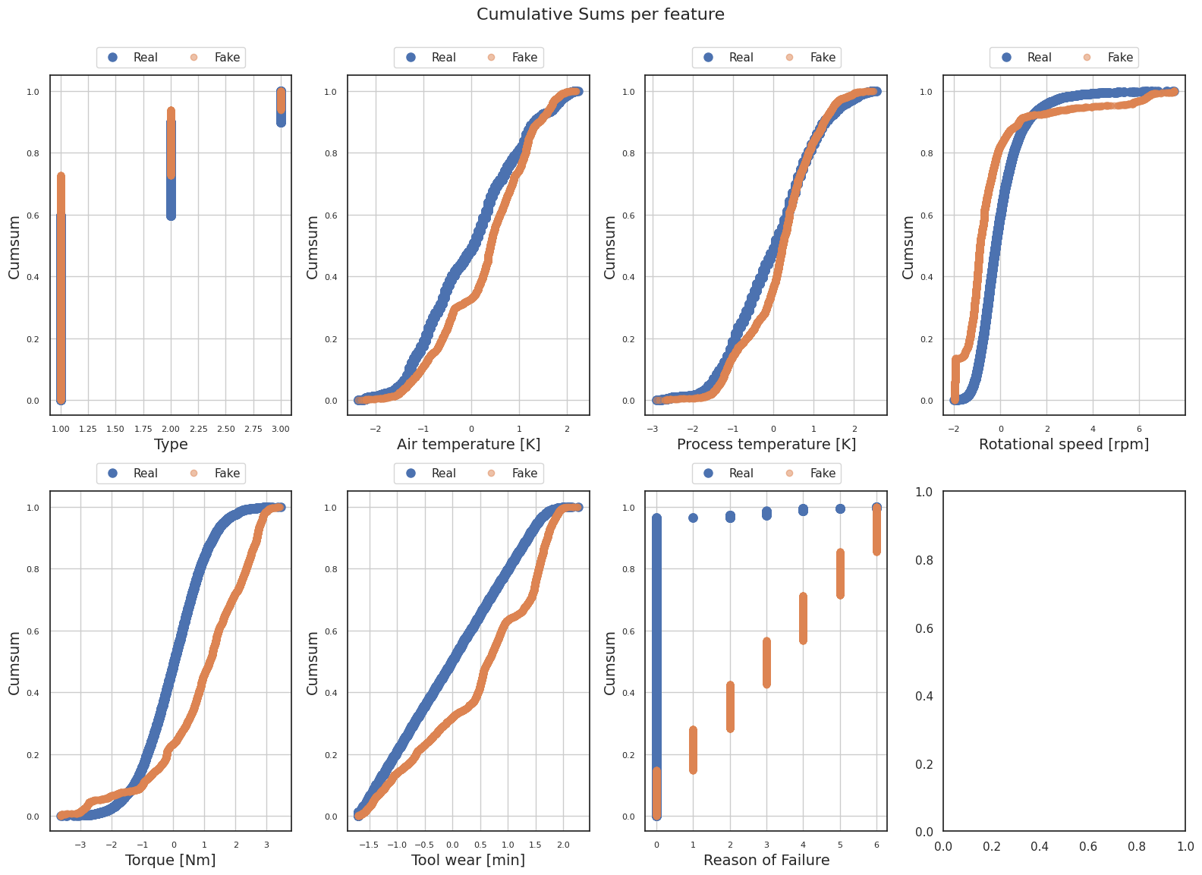
Quality of Data Generated

Slide 30
Data Augmentation using CTGAN

Slide 31
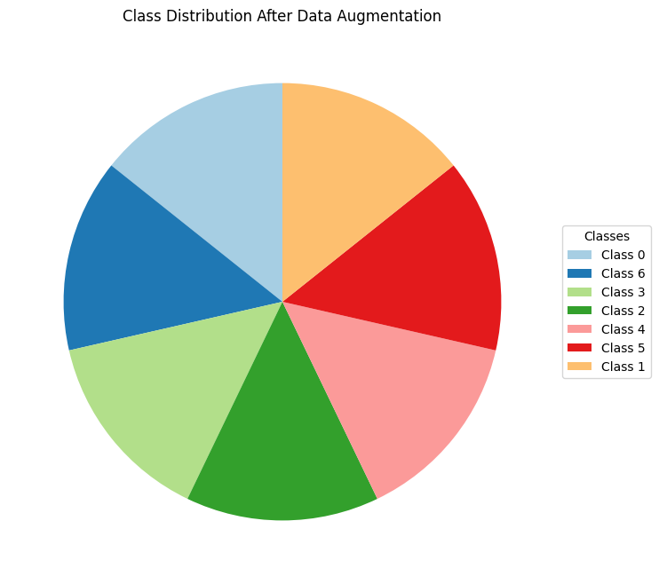
Data Distribution Before and After Augmentation

Slide 32
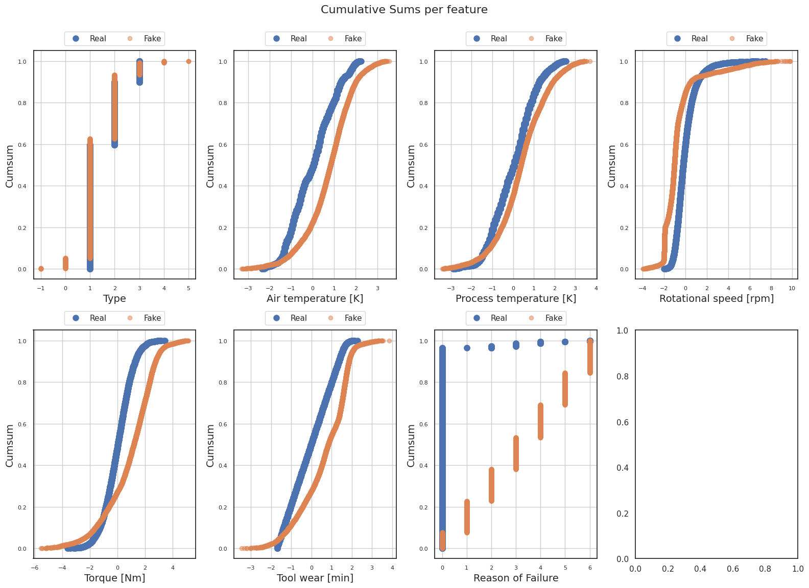
Quality of Data Generated

Slide 33
Deciding Metrics for Evaluation against Augmented Dataset
Now as the dataset is balanced, we can use Accuracy also as a metric
So now the metrics are Precision, Recall and Accuracy

Slide 34
SML
Algorithms on SMOTE Augmented Dataset

Slide 35
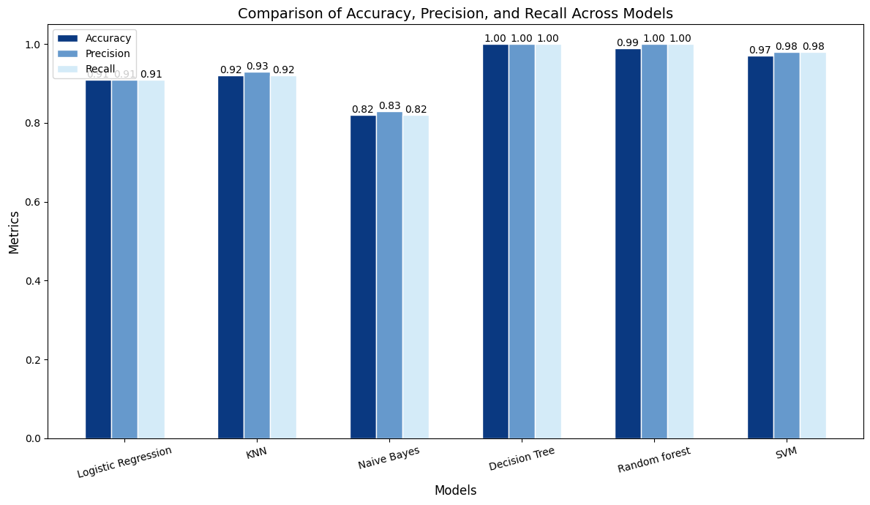
Comparative Analysis

Slide 36
SML
Algorithms on CTGAN
Augmented Dataset

Slide 37
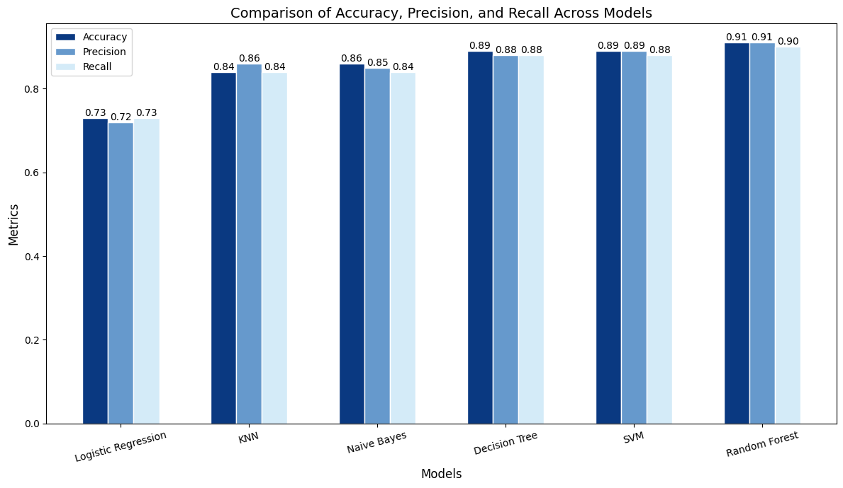
Comparative Analysis

Slide 38
Stacking Ensemble Model

Slide 39
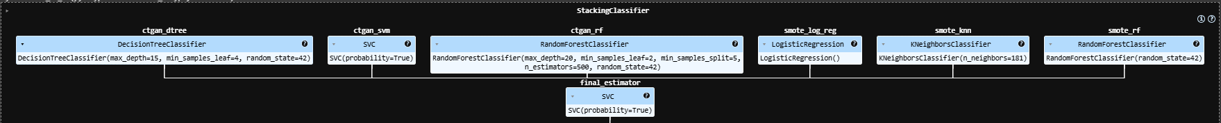
Stacking Ensemble Model

Slide 40
Training and Testing
SMOTE augmented dataset and CTGAN augmented dataset were aggregated to make a balanced training data.
The test dataset was also aggregated in the same way

Slide 41
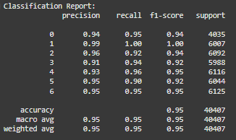
Results on Stacking Model

Slide 42
Next Steps
Select best LLM according to our use case
Create Web application
Integrate Stacking Classifier
Create LLM Pipeline
Integrate LLM

Slide 43
About
LLM

Slide 44
Selection of Large Language Model
LLM: Llama-3.1-Nemotron-70B-Instruct by Nvidia
Nvidia improved the Meta's Llama 3.1 to generate helpful and human like responses, which best fits our use case.
Arena-Hard Score:
Llama-3.1 - 51.6
Llama-3.1-Nemotron-70B-Instruct - 70.9
Model Architecture:
Architecture Type: Transformer
Network Architecture: Llama 3.1

Slide 45
What is Arena-Hard Score:
It is an automatic evaluation tool for instruction-tuned LLMs.
Key features of the Arena-Hard benchmark include:
Reflects human preference in real-world use cases: The benchmark score has a high agreement with human preference.
Frequently updates to avoid over-fitting or test set leakage: It uses new, unseen prompts to ensure the benchmark remains challenging and relevant.

Slide 46
Why Llama-3.1-Nemotron-70B-Instruct
Reflects human preference in real-world use cases: The benchmark score has a high agreement with human preference.
Best acc to following comparisons

Slide 47
Overview of the Llama-3.1-Nemotron accuracy and efficiency.
Name of LLM | MT Bench* | MMLU*
Llama-3.1- Nemotron-51B- Instruct | 8.99 | 80.2 %
Llama 3.1-70B- Instruct | 8.93 | 81.66 %
Llama 3-70B | 8.94 | 80.17 %
*MT - Bench - Designed to test Multi-Turn conversation and instruction-following ability, covering common use cases and focusing on challenging questions to differentiate models.
*MMLU - Massive Multitask Language Understanding: Aims to enhance how machines interpret and process human language significantly.
Source: Nvidia Blog

Slide 48
Prompt Used
Generate a diagnostic report based on the following machine parameters:
Type: {Type}
Air Temperature [K]: {Air_temp}
Process Temperature [K]: {Process_temp}
Rotational Speed [rpm]: {Rot_speed}
Torque [Nm]: {Torque}
Tool Wear [min]: {Tool_wear}
and the predicted failure class: {predicted_class} (one of the following: TWF - Tool Wear Failure, HDF - Heat Dissipation Failure, OSF - Overstrain Failure, PWF - Power Failure, RNF - Random Failure, About to Fail, or No Failure).
Include in the report:
A brief summary of the operational parameters.
Actionable recommendations tailored only to the specific failure class {predicted_class} provided. Avoid listing or referring to other failure classes.
If the failure class is "No Failure," confirm that the machine is operating normally and requires no immediate maintenance, while suggesting continued monitoring and scheduled maintenance.
Ensure the output is concise, actionable, and relevant to the provided parameters.

Slide 49
Web
Application

Slide 50
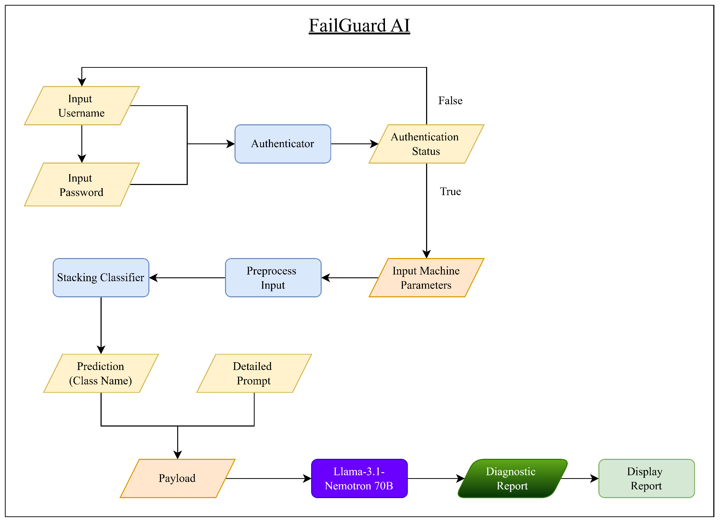
Web Flow Diagram

Slide 51
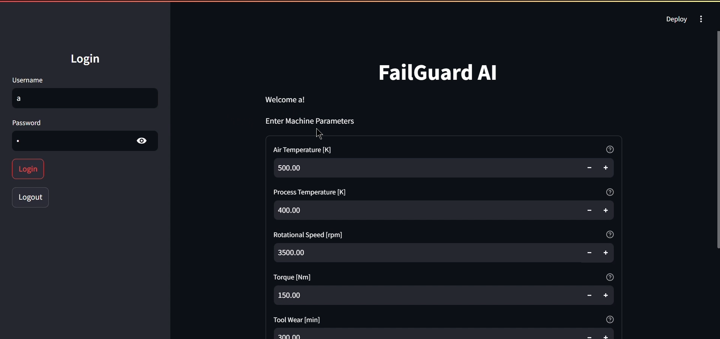
Web App

Slide 52
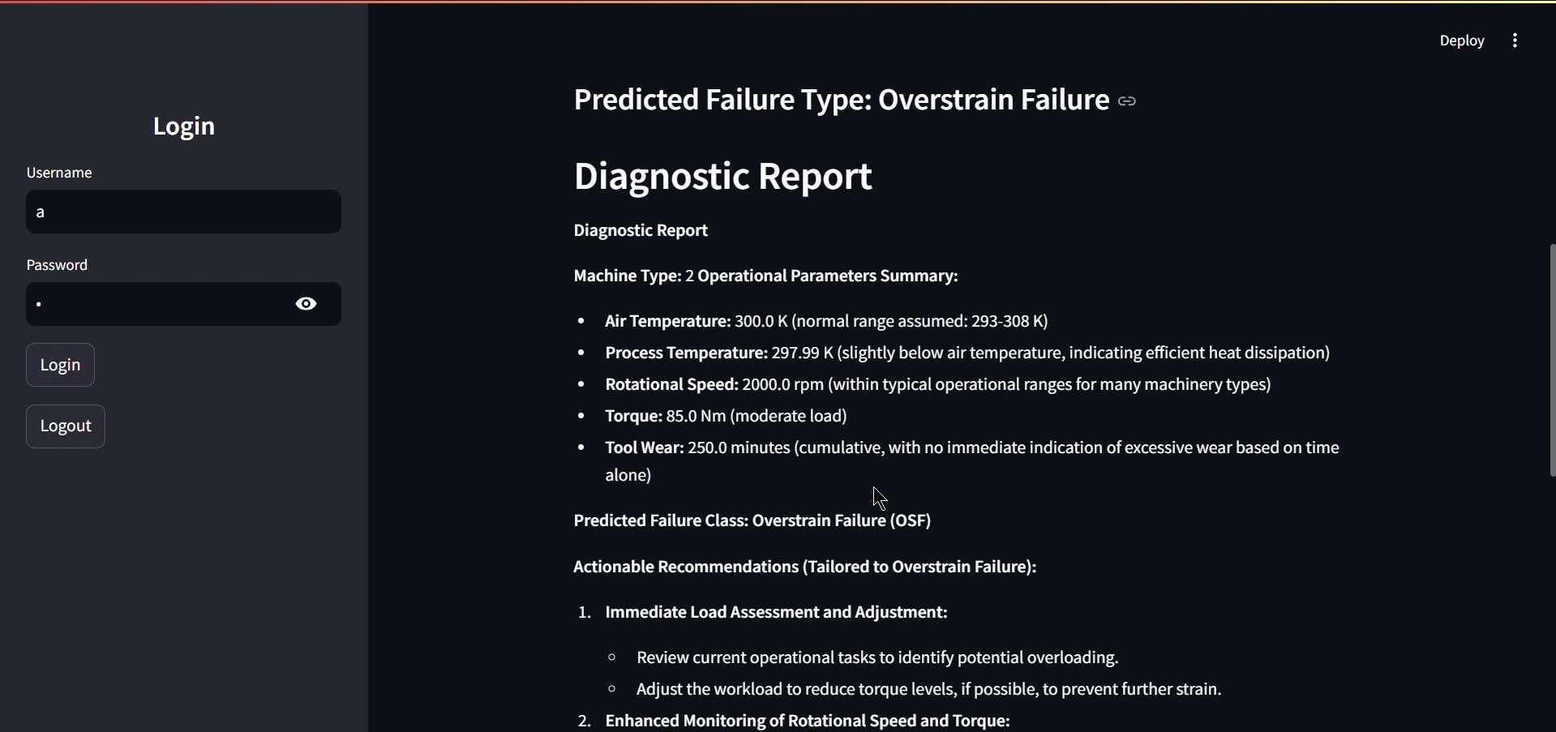
Web App

Slide 53
Advantages
The system is able to fulfill all the objectives i.e. Failure Prediction, Type of Failure and Diagnostic Report
Besides objectives, the system also delivers the identified literature gaps
Building a robust generalized System
Identifying the reason why machine failed
Giving instructions to operators through report

Slide 54
Disadvantages
Every dataset is naturally imbalanced, which makes predictions difficult.
The diagnostic report generated by the LLM depends heavily on its prompt and fine-tuning. It may produce inaccurate or irrelevant information if the input is misinterpreted or incomplete.
The system requires a constant internet connection.

Slide 55
Future Scope
Fine Tune LLM for the specific use case.
Implement a RAG (Retrieval Augmented Generation) architecture for more relevant results.
Enhance explainability of results with the help of XAI architectures like SHAP (SHapley Additive exPlanations) or LIME (Local Interpretable Model-agnostic Explanation)
Validate the responses with the help of SMEs
Experiment on various LLMs using various fine-tuned prompts for better results.

Slide 56
Conclusion
Handled the Data challenges using Statistical and GenAI techniques.
The project offers comprehensive solution to the problem of predictive maintenance.
The project aligns closely with real-world industrial scenarios providing actionable insights to machine operators.
The modular design of the system allows for scalability and adaptation to other predictive maintenance datasets, though further testing is needed to generalize the solution.

Slide 57
Thank You!

