Slide 1

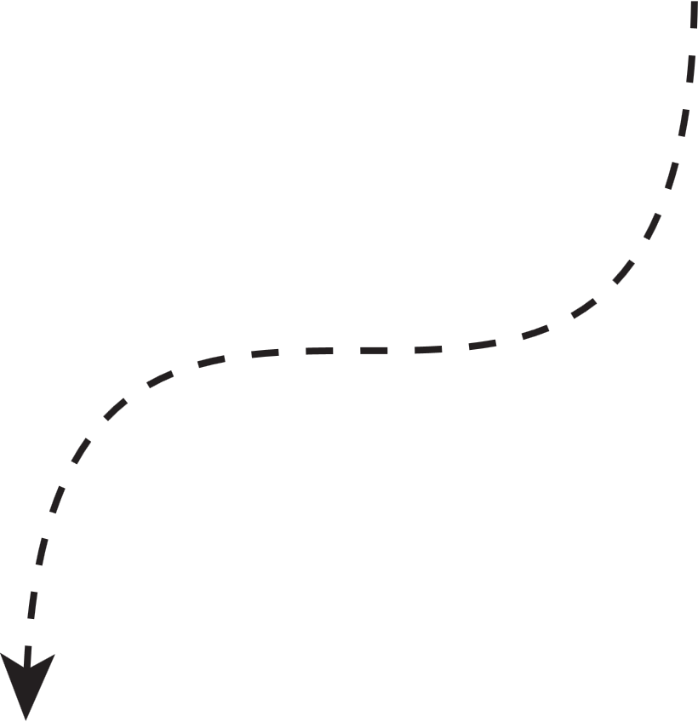




By Dataviz

Slide 2
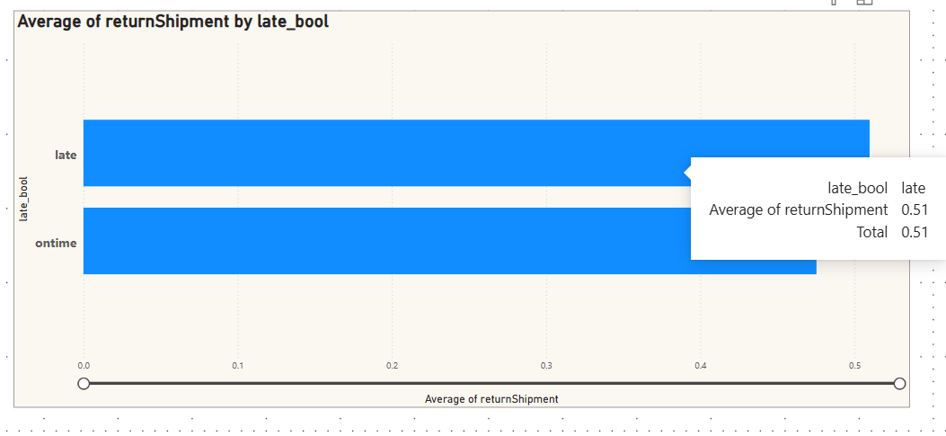
Impact of Late deliveries on returns
Your paragraph text
Customers experiencing longer waits are more likely to be dissatisfied, which increases return likelihood and associated costs.

Slide 3
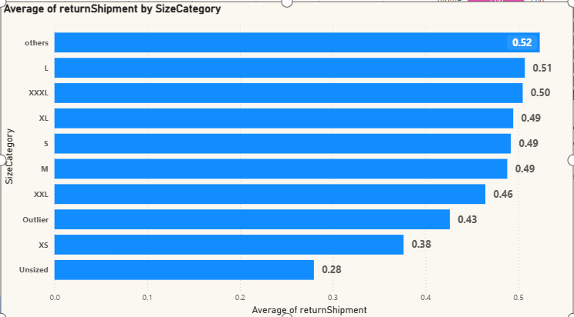
Impact of Size on returns
size less than 34, L, and XXXL items show notably higher returns, pointing to potential sizing inaccuracies.

Slide 4
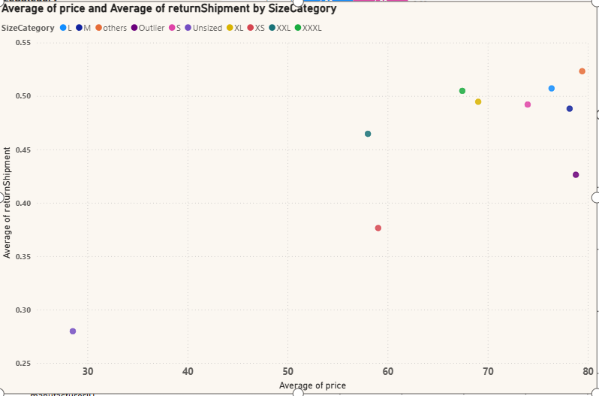
Impact of Price on returns
Items with higher average prices also tend to show higher return rates. This may reflect heightened customer expectations for expensive items, leading to more returns if they do not meet quality or fit expectations

Slide 5
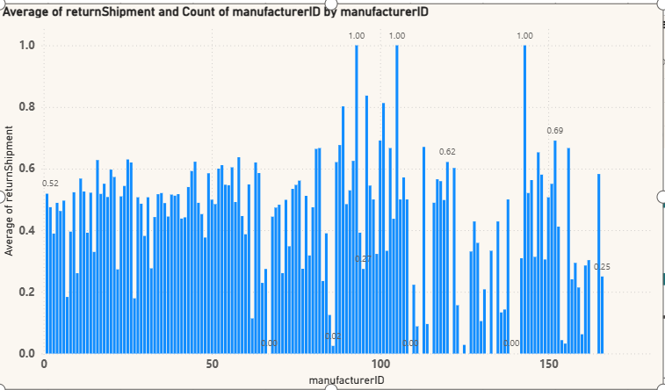
Impact of manufacturers on returns
The return rates vary considerably by manufacturer, with some IDs showing average returnShipment values near 0.2–0.3(a more stable performance in terms of product acceptance) and others approaching 1.0 (i.e., almost every order is returned). This suggests that product quality or design consistency differs significantly among manufacturers.

Slide 6
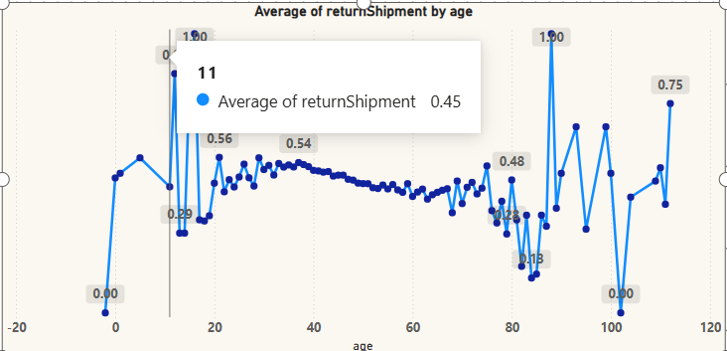
Impact of customer age on returns
From roughly ages 30 to 60, the average returnShipment appears more consistent and somewhat lower compared to the extremes, suggesting that these middle-aged customers may have clearer product expectations and less likelihood of returning items

Slide 7
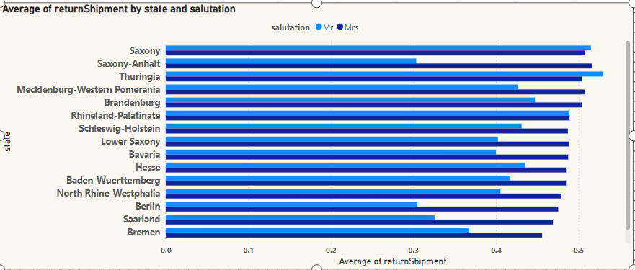
Impact of customer location and gender on returns
Saxony, and Thuringia show some of the highest return rates (above ~0.50). This suggests that products delivered to these states—regardless of gender—are more frequently returned.In states like Saxony-Anhalt, the Mrs segment appears slightly higher in returnShipment compared to the Mr segment. This could mean female customers in these areas have more stringent expectations or are purchasing items that are prone to fit issues.

Slide 8
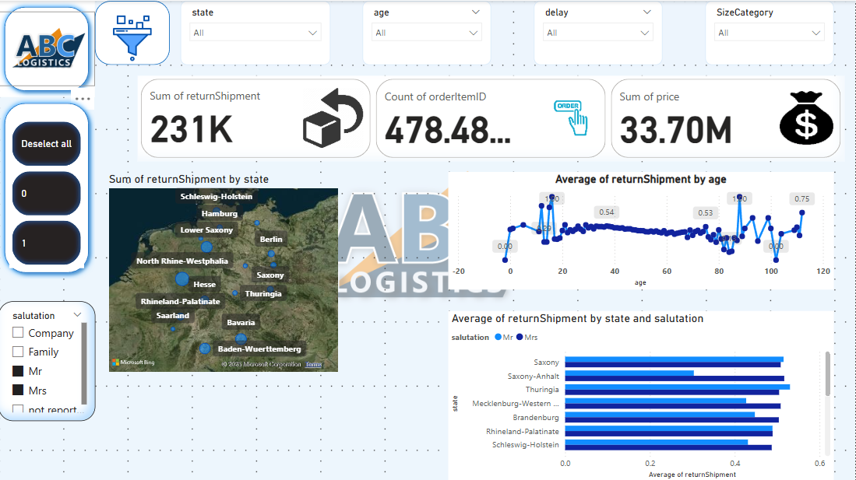
DASHBOARD

