Slide 1


Classification of Myocardial Infarction
Mentor – Mr. Parth
Team –
Akshay K S Chetangouda Patil Karan R Kishore Kumar H B
26-08-2021

Slide 2
Business Objective
Myocardial Infarction(Commonly known as “Heart attack”) is one of the most challenging problems of modern medicine. Acute myocardial infarction is associated with high mortality in the first year after it. The incidence of MI remains high in all countries. This is especially true for the urban population of highly developed countries, which are exposed to chronic stress factors, irregular and not always balanced nutrition.

Slide 3
Architecture - Flow
Data Set Details
EDA
Model Building
Model Evaluation
Deployment
Output
Challenges Faced

Slide 4
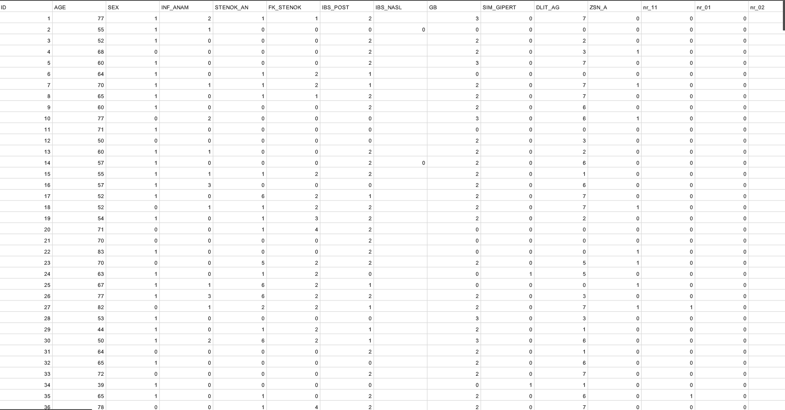
Data Set Details
No of Rows – 1701
No of Columns - 124

Slide 5
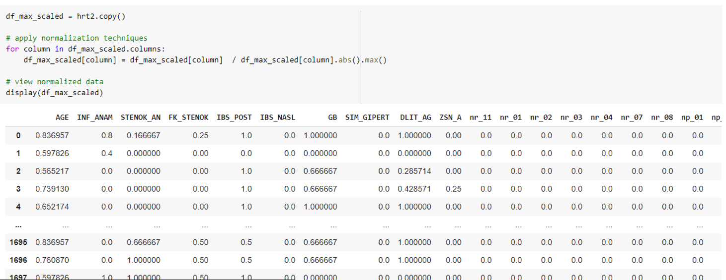
E.D.A
Normalization:

Slide 6
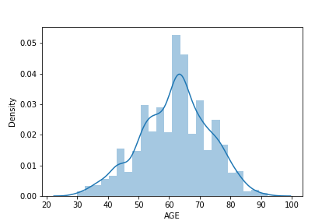
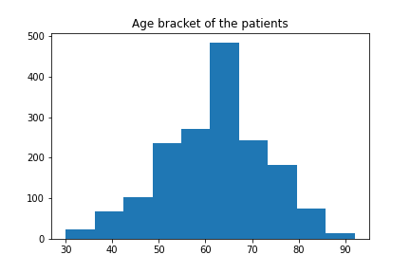
E.D.A
Some Visualizations :

Slide 7
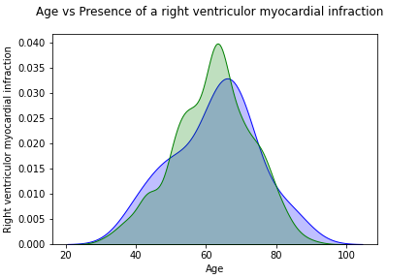
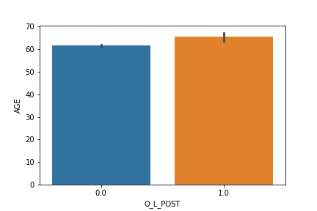
E.D.A

Slide 8
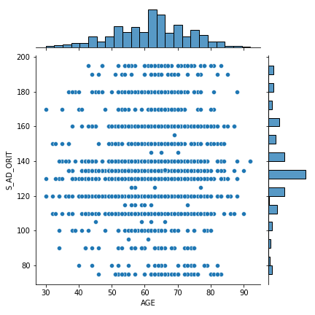
E.D.A

Slide 9
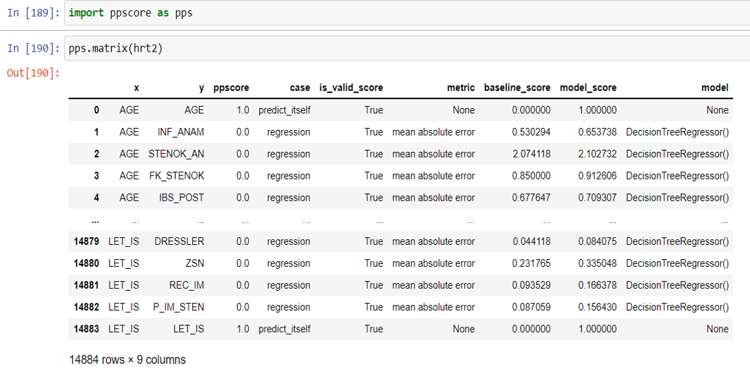
E.D.A
PPS:

Slide 10
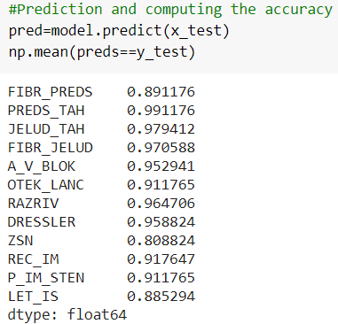
Model Building
Decision Tree Classifier using Gini Criteria:

Slide 11
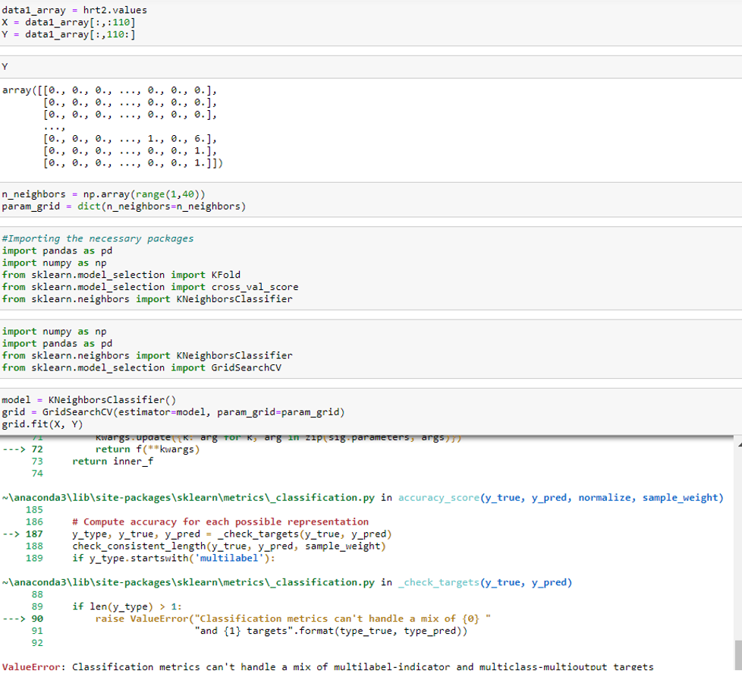
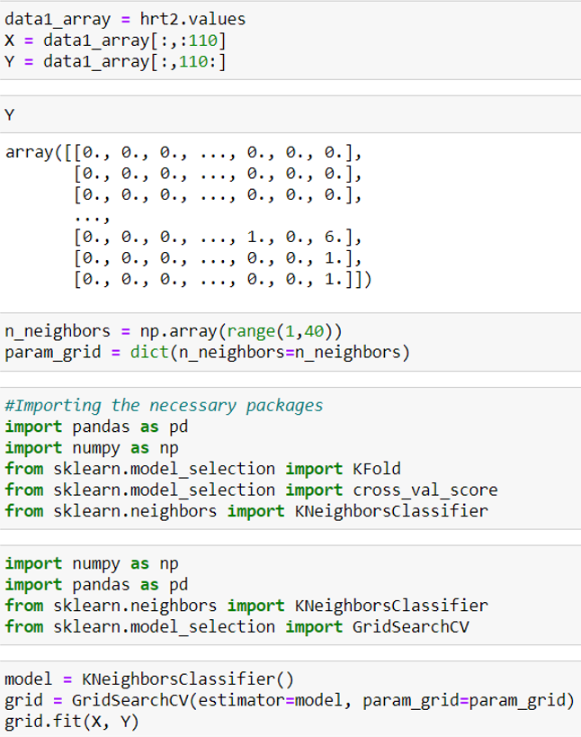
Model Building
KNN:

Slide 12
THANK YOU

