Slide 1
RETINA SEGMENTATION USING U-NET ALGORITHMS
Group Members
Chetan.J (R19EC100)
Naveen.M (R19EC133)
Kushwan.M (R19EC132)
Chandra Kiran.K (R19EC122)
Group No: 29
Group Name: Developers
Project Guide: Prof. Eswar Reddy M

Slide 2
Contents
Abstract
Introduction
Literature Survey
Problem Definition/ Objective
Methodology
Implementation
Results and discussion
Paper progress
Applications
References

Slide 3
Abstract
Retina segmentation refers to the process of separating a picture of the retina into its numerous parts, including the optic disc, blood vessels, and retinal layers. This is carried out to help detection and monitoring of various eye conditions such as glaucoma, diabetic retinopathy, and age-related macular degeneration. Retina segmentation is performed using computer algorithms and image processing techniques, and it is a key phase in retinal image analysis. The segmentation procedure is difficult because retinal structures have subtle variations in their intensity, colour, form, as well as due to variety of artifacts present such as blood, exudates, and haemorrhages. For medical picture segmentation tasks like retinal segmentation, U-Net is a popular deep learning method, which consists of a encoder-decoder architecture with skip connections between them, that enables exact localization and precise transfer of information. In the proposed model, the outcome of segmentation is a binary image with distinct and labelled pixels for each of the various structures. The advantage of our model is that, we can train it with a small dataset and segment them accurately.

Slide 4
Introduction
The retinal image analysis is completed by detecting and segmenting the optic disc, blood vessels, and other important features. The retina's central section, the optic disc, houses the optic nerve and the blood vessels that nourish the retina. Fundus images may be divided into segments using several methods, such as thresholding, edge detection, and machine learning algorithms. Analysis can be performed following segmentation to check for any retinal diseases. For instance, it is possible to recognize Experiencing age- related macular degeneration and diabetic retinopathy by looking for drusen, which are yellow deposits in the retina.[7] The analysis of fundus pictures is a crucial method for locating retinal diseases. Diseases that impact the retina and alter the retinal blood vessels include diabetes, hypertension, and arteriosclerosis. Segmenting the retinal vessels first will help identify the alterations in the blood vessels. The following are the segmentation's primary challenges, Disparate backdrop lighting, False vessels are frequently found close to the margin of the optic disc, etc

Slide 5
The purpose of this study is to look at how pre-processing techniques affect the ability to correctly segment retinal blood vessels. Using these pre-processing phases from existing methodologies and post-processing stages from our suggested module, we evaluate studies on the exact segmentation of retinal vessels. To produce a well-segmented picture, many filters and double- threshold methods are utilized in the post-processing phases. The second phase is built using a grayscale picture with high contrast and noise reduction due to the existence of small vessels. When necessary, we produce well-segmented photos using our post-processing module. Automated segmentation approaches for retinal blood vessels have been employed in several studies, however additional research is needed to increase the accuracy of accurately identifying microscopic veins. We offer and illustrate a remedy for these problems. It features pre- and post-processing modules for getting an improved picture and a well-segmented image during post-processing.

Slide 6
Literature Survey
A thorough examination of the deep learning-based segmentation of the retinal blood vessels. It is possible to diagnose several disorders, including diabetes and hypertension, by looking at the geometrical properties of retinal arteries, which also represent the patients' overall health. Deep learning algorithms have lately been employed to segment retinal vessels fast due to their greater efficiency and accuracy when compared to manual segmentation and other computer-aided diagnostic processes [1]. Looked at recent works that used deep learning to segment retinal vessels. Investigated these suggested methodologies, particularly the network designs, and identified the general direction of the models. We outlined challenges and important factors for using deep learning to segment retinal vessels, also potential directions for further investigation [2]. The main anatomical feature that may be seen in retinal imaging are the blood vessels. The segmentation of retinal blood vessels is now widely used for the diagnosis of cardiovascular (CVD) and retinal illnesses. In order to automatically detect retinal diseases like cataract and diabetic retinopathy, a suitable vascular segmentation algorithm is needed [3].

Slide 7
By adopting computer-aided diagnosis (CAD) to identify retinal illnesses, patients can lower their chance of losing their vision and medical expenses. In this study, multiple machine learning and deep learning-based techniques for automatically segmenting blood vessels in retinal pictures are examined and compared. This paper provides concise explanations of fundus photography, easily available retinal databases. and pre- and post-processing techniques for retinal vascular segmentation [4]. The vessels, blood segmentation techniques make it simple to identify and treat a variety of eye conditions. Retinal imaging technologies are employed in a variety of settings, including ophthalmology, identifying diabetic retinopathy in its early stages, and ocular fundus procedures. There are many illnesses that affect the retina and the choroid that lies beneath it[5]. Fundus photographs captured by a fundus camera can be used to diagnose and treat various disorders. After then, the photos are processed. Retinal image segmentation is required in order to identify the characteristics that can help with diagnosis and therapy. Diabetic retinopathy (DR) is the most common kind of diabetic eye damage and a significant cause of blindness It occurs from changes in the blood vessels of the retina. Damage to the blood vessels can result in bleeding and the growth of flimsy new blood vessels, while damage to the nerve cells can result in blurred vision and ocular haemorrhage [6].

Slide 8
Damage to the blood vessels can result in bleeding and the growth of flimsy new blood vessels, while damage to the nerve cells can result in blurred vision and ocular haemorrhage [6]. Through quantitative evaluation of the retina's vascular architecture, it is possible to monitor the impact of diabetes, hypertension, and early delivery on the visual system. Therefore, utilizing the best technique, image analysis techniques can be used in ophthalmology to detect the needed properties. For the purpose of identifying blood vessels in the retina, we provide image processing methods [7]. The techniques include creating a bank of Gabor filters that are directionally sensitive for various scale and elongation parameter values. The effectiveness of the techniques was assessed using 40 retinal pictures from the DRIVE database. With an area under the receiver operating characteristic curve of up to 0.96, high blood vessel identification efficiency was attained. Diabetes, high blood pressure, arteriosclerosis. and retinopathy of prematurity alter the form, breadth, and tortuosity of the blood vessels in the retina [8]. Monitoring disease processes and assessing their effects on the visual system may be aided by quantitative examination of the architecture of the retinal vasculature and alterations as mentioned above.

Slide 9
Problem Definition/ Objective
The objective of this project is to overcome the complexity of existing system, with additional pre-processing steps of converting input image into a grey scale image and noise reduction. It results in Accurate classification, High performance, and Easy Identification.

Slide 10
METHODOLOGY
Proposed System
In the proposed work, the input image is converted to grayscale. and noise reduction is also carried out. This is done to improve image quality and reduce noise, which could impair the accuracy of segmentation. In this step, edge detection, thresholding, and morphological techniques are combined to pinpoint the vessel segments. After the vessel segments have been eliminated, just the background pixels from the original image are kept in this stage. This step is crucial because it helps isolate the vasculature from the surrounding area of the image. improving the accuracy of segmentation. This stage involves creating a binary mask with the background pixels set to 0), the vessel-related pixels set to 1, and the actual vessel pixels set to 0. In this step, the binary masks developed in the phase before are used to train the U Net model. These models then quickly segment the vessels in the input image. The vasculature and background pixels may be easily distinguished and separated in the final segmented image. This is applicable to more research and medical diagnosis.

Slide 11
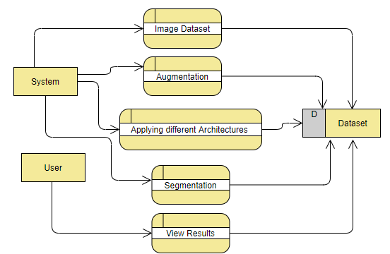
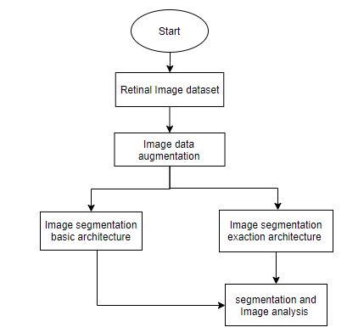
FLOW CHART :

Slide 12
The project has implemented by using below listed algorithm.
U-Net algorithm
Convolutional neural networks with the U-Net architecture are used to segment images. Since it was created for biological image segmentation, a few other disciplines have adopted it. The "U" in U-Net refers to the shape of the architecture which is symmetrical with a "contracting path" encoding context in the early layers and a "symmetric expanding path" decoding the context in the later layers. The U-Net architecture is well suited for tasks where the amount of context needed for making a prediction varies greatly across the image and where fine details need to be preserved. A convolutional network design called the u-net is used to quickly and precisely segment images. For the ISBI challenge, it has so far outperformed the previous top method (a sliding window convolutional network) for segmenting brain structures in electron microscopic stacks.

Slide 13
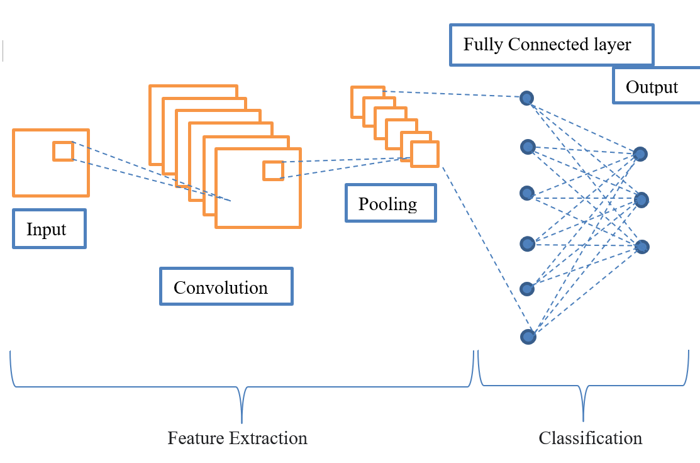
CNN ARCHITECTURE

Slide 14
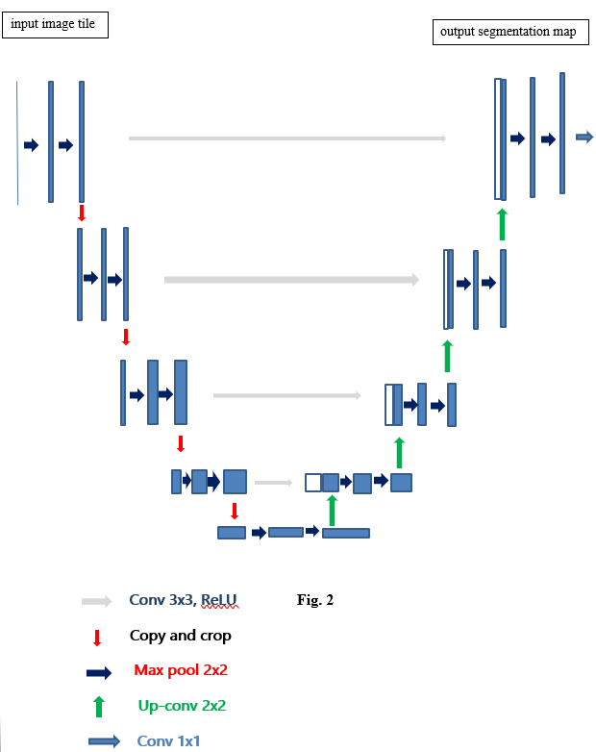
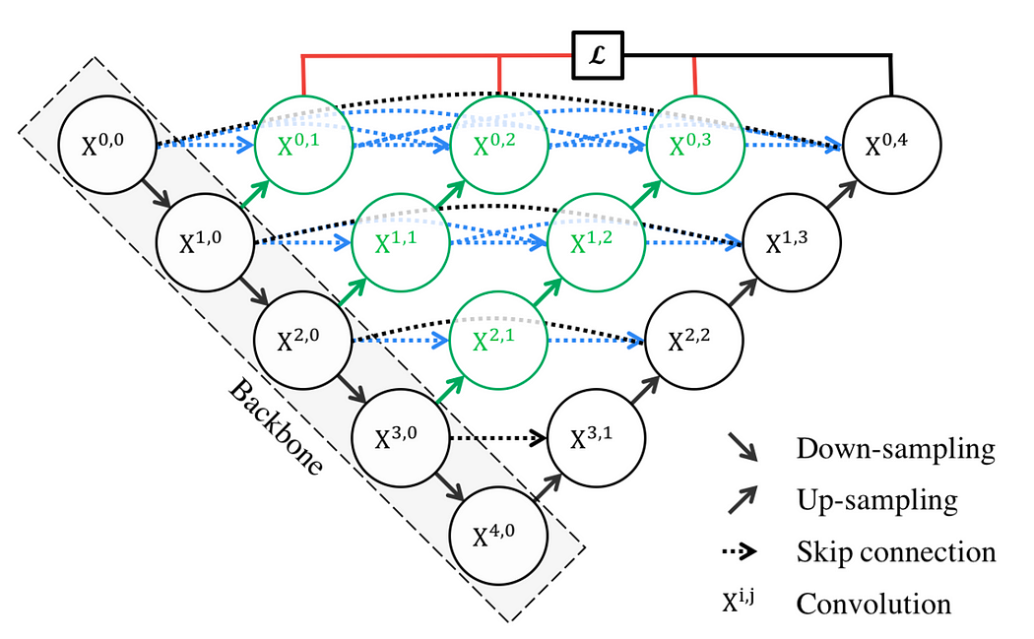
UNET++ ARCHITECTURE
U-NET ARchitecture

Slide 15
In U-net, each level of encoder path consists of a convolution layer, a ReLU layer and a max-pooling layer, which are responsible for feature extraction. Correspondingly, each level of decoder path consists of a transpose-convolution layer with skip connections connenting to respective encoding layer. CNNs refer to Convolutional neural networks, that are used to process multi-dimensional data including images, real-time video streaming, etc., It uses filters to extract the vital features of an input image, to carry out classification, segmentation, or object detection. In the proposed model ReLu activation function and max-pooling are followed by CNN layer in the extracting path.
The UNet++ architecture is an extension of the popular UNet for image segmentation. It consists of multiple nested U-shaped paths, each with a different resolution level, and skip connections that connect the paths. The skip connections allow for the fusion of multi-scale features from different levels of the network, improving segmentation performance. Additionally, UNet++ uses a modified attention gate mechanism to selectively highlight informative features in each resolution level, improving the network's ability to focus on relevant features. This architecture enables UNet++ to capture multi-scale contextual information efficiently, making it a powerful tool for image segmentation tasks.

Slide 16
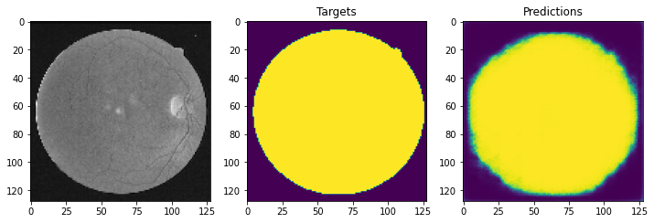
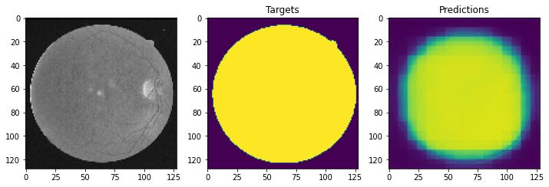
Results and Discussions
Below figures shows the predictions of segmented images using U-net and U-net++ architectures i.e., prediction with its associated input and target image. Total number of parameters that have been trained with U-net and U-net++ architectures are 1,941,105 and 4,715,761 respectively.
Prediction using U-net architecture
Prediction using U-net++ architecture

Slide 17
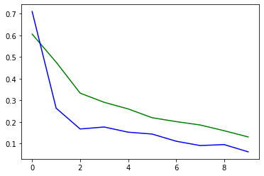
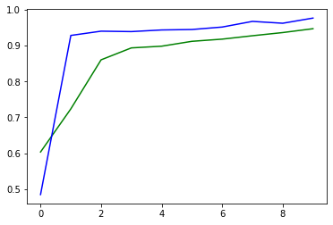
Plot of Loss and Accuracy of Training (green, loss = 0.1310, accuracy = 0.9472, epochs = 10) and Validation (blue, loss = 0.0622, accuracy = 0.9768, epochs = 10) datasets using U-Net architecture.

Slide 18
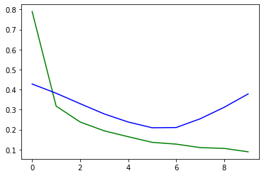
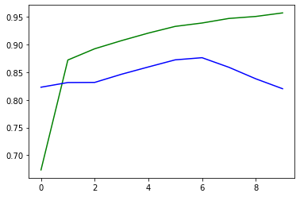
Plot of Loss and Accuracy of Training (green, loss = 0.0891, accuracy = 0.9575, epochs = 10) and Validation (blue, loss = 0.3781, accuracy = 0.8204, epochs = 10) datasets using U-Net++ architecture.

Slide 19
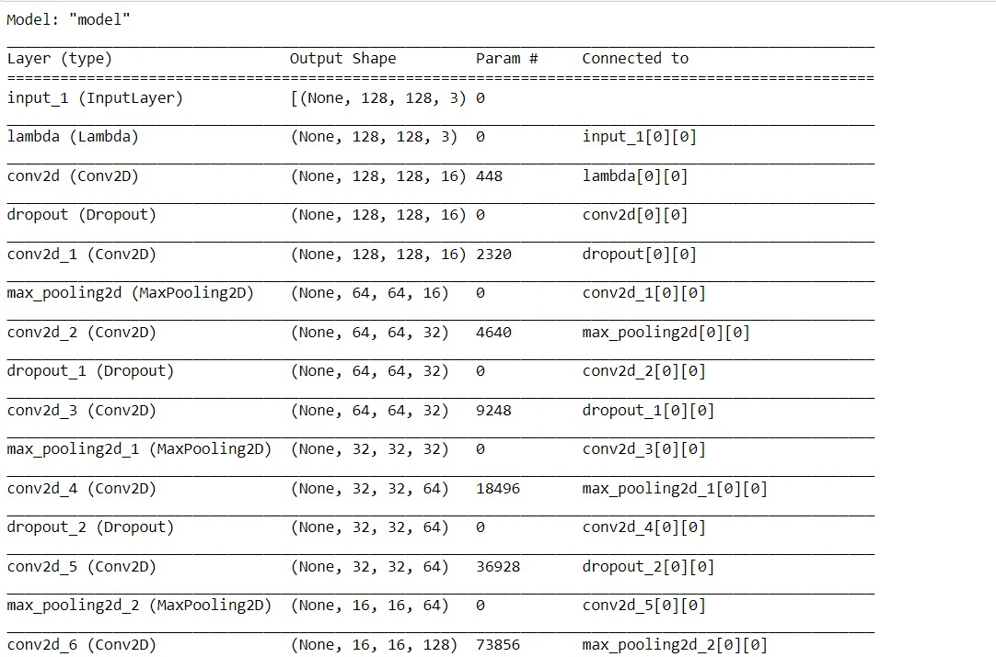

Slide 20
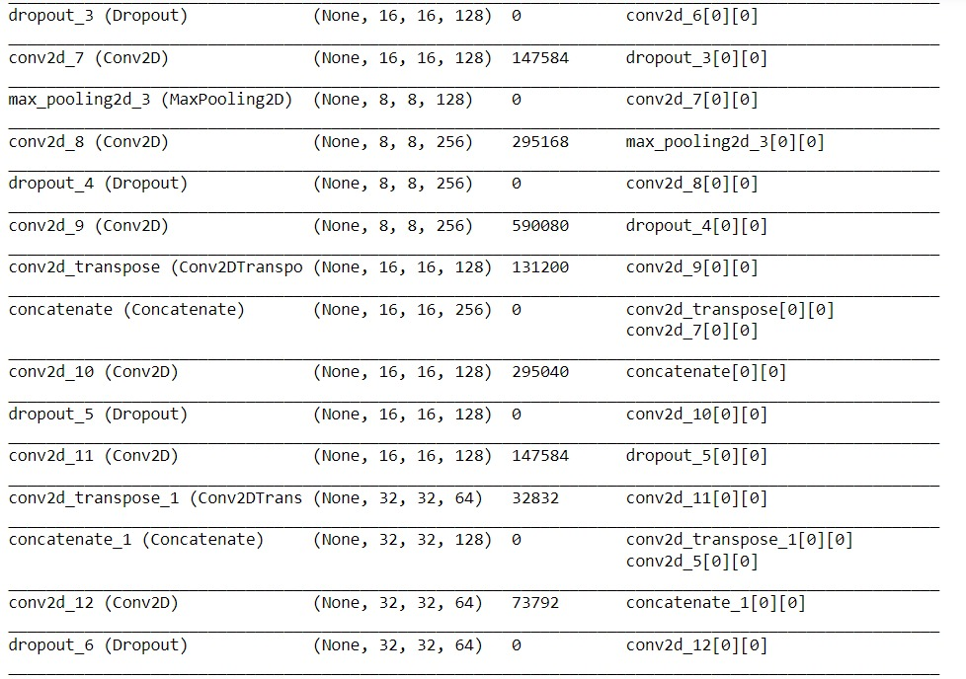

Slide 21
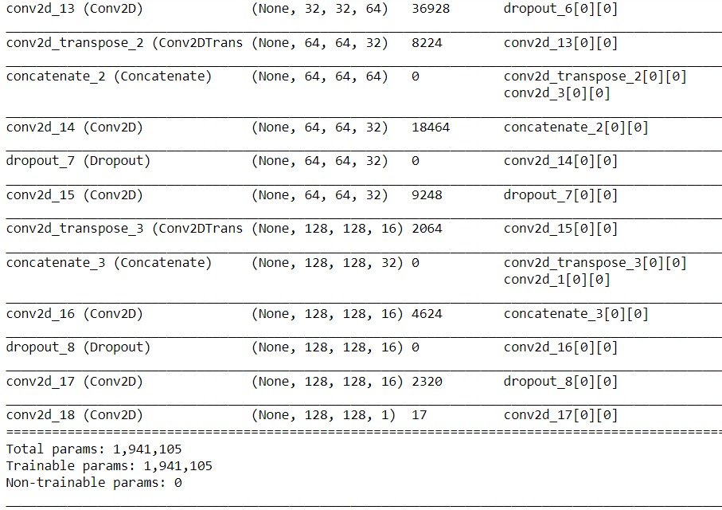

Slide 22
CONCLUSION & FUTURE SCOPE
The proposed model overcame the complexity of existing system, with additional pre-processing steps of converting input image into a grey scale image and carrying noise reduction. It results in Accurate classification, High performance, and Easy Identification. From above results, we observed that U-net architecture increased its accuracy from Training to Validation dataset, where as U-net++ architecture is slightly experiencing variance, since its accuracy dropped a little from Training to Validation dataset.
The future scope of U-Net and U-Net++ architectures includes 3D image segmentation, multi-modal image segmentation, video segmentation, and real-time segmentation. These architectures have great potential for further research and development in image segmentation and related fields.

Slide 23
Applications
Medical image analysis
Object detection
Recognition Tasks
Traffic control systems
Video surveillance

Slide 24
References
[1] Toufique A. Soomro, Ahmed Ali, Nisar Ahmed Jandan, Ahmed J. Afifi et al. "Impact of Novel Image Pre-processing Techniques on Retinal Vessel Segmentation", Electronics, 2022.
[2] N. Tajbakhsh, L. Jeyaseelan, Q. Li, J. Chiang, Z. Wu, and X. Ding, “Embracing imperfect datasets: A review of deep learning solutions for medical image segmentation,” arXiv preprint arXiv:1908.10454, 2021.
[3] Chen Ding, Runze Li, Zhouyi Zheng, Youfa Chen, Dushi Wen, Lei Zhang, Wei Wei, Yanning Zhang. "Multiple Multi-Scale Neural Network Knowledge Transfer and Integration for Accurate Pixel-Level Retinal Blood Vessel Segmentation", Applied Sciences, 2022.
[4] C. Liu, L.-C. Chen, F. Schroff, H. Adam, W. Hua, A. L. Yuille, and L. Fei-Fei, “Auto-deeplab: Hierarchical neural architecture search for semantic image segmentation,” in Proceedings of the IEEE Conference on Computer Vision and Pattern Recognition, 2021.
[5] T. Jahnavi, DN. Vasundhara. "Segmentation of medical images using U-Net++", 2022 4th International Conference on Advances in Computing, Communication Control and Networking (ICAC3N), 2022.

Slide 25
[6] Bifang Ma, Chih-Yung Chang. "Semantic Segmentation of High-resolution Remote Sensing Images using Multiscale Skip Connection Network", IEEE Sensors Journal, 2021.
[7] Huimin Huang, Lanfen Lin, Ruofeng Tong. Hongjie Hu, Qiaowei Zhang, Yutaro Iwamoto, Xianhua Han, Yen-Wei Chen, Jian Wu. "UNet 3+: A Full-Scale Connected UNet for Medical Image Segmentation", ICASSP 2020-2020 IEEE International Conference on Acoustics, Speech and Signal Processing (ICASSP), 2020.
[8] Mark J Connolly, Eric R Cole, Faical Isbaine, Coralie de Hemptinne et al. "multi-objective data-driven optimization for improving deep brain stimulation in Parkinson's disease", Journal of Neural Engineering, 2021.
[9] T. Jahnavi, DN. Vasundhara. "Segmentation of medical images using U-Net++" , 2022 4th International Conference on Advances in Computing, Communication Control and Networking (ICAC3N), 2022.

Slide 26
Thank You…..

