Slide 1

National Institute of Technology , Raipur-492001 Licence Plate Detection System by Team : THE ARSENAL Submitted by: Chetan Kumar Das Gagan Badaya Satyam Pandey

Slide 2
Contents
Introduction
Application
Screenshots
Important libraries and Components
How it works?
Future Scope
Conclusion
Demonstration

Slide 3
Introduction
The Automatic number plate recognition is a surveillance method that uses optical character recognition on images to read the license plates on vehicles.
They can use existing closed-circuit television or road-rule enforcement cameras, or ones specifically designed for the task.
They can be used by various police forces and as a method of electronic toll collection on pay-per-use roads and monitoring traffic activity, such as red light adherence in an intersection.

Slide 4
Application :
This system can be used by the any organisation which includes vehicles , like:
Traffic system
Toll bridge
Commercial parking
Cab/taxi services

Slide 5
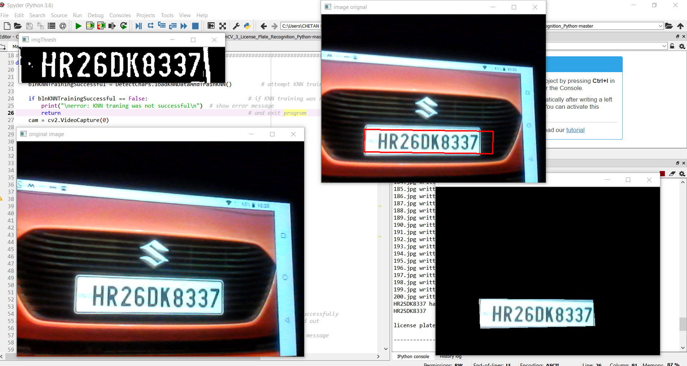
Screenshot

Slide 6
Important Libraries And Components
OpenCV
Detectchars
Imutiles
Numpy
Webcam
Detectplates

Slide 7
Working
The entire process works in three steps find plates: image is scanned and particularly plates are detected
find character within plates : characters within plates are recognised and overlapping characters are decoded if any,
finally list of possible plates : all possible plates are listed and the plate with maximum occurrence is selected.

Slide 8
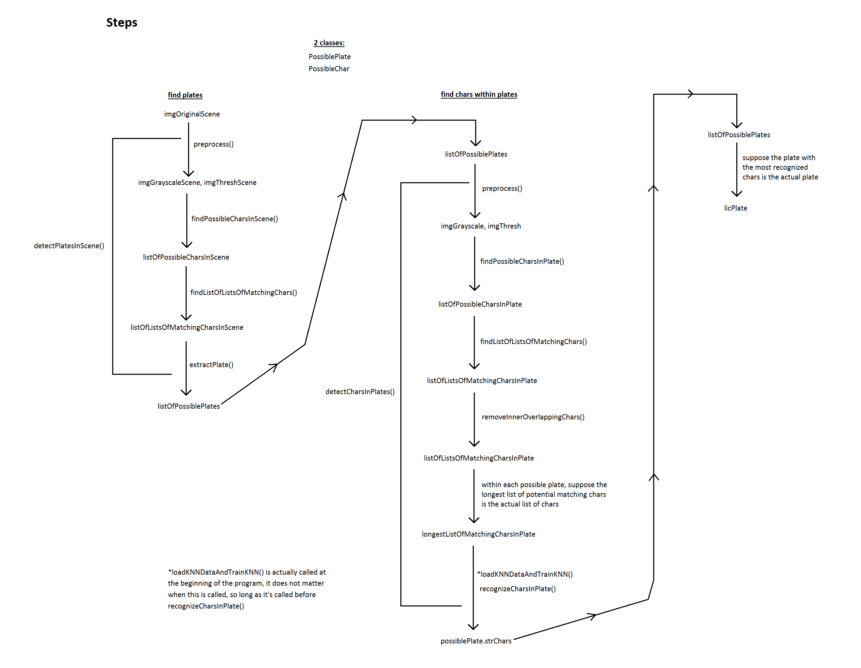

Slide 9
Future Scope
It can be used in the vehicle theft systems by integrating it with the CCTV cameras.
It will prevent the traffic violations happens on the road by extracting information with the help of number plate.
It can also be of great use in commercial parking systems as well as in toll plaza.

Slide 10
Conclusion
The objective of this project is to recognize number plates of the vehicles in a real time environment so that it can be applied in real world problems.
The problematic has been divided into several chapters, according to a logical sequence of the individual recognition steps.

